Slide 1
WEB-BASED DEPARTMENTAL ANNOUNCEMENT SYSTEMS
PREPARED BY: JOEL ELISHA TABJI (CST21HND0112)
SUPERVISED BY: Mrs. SHU'AIBU MAIRO BIO

Slide 2
Table of content
Background of the Study
Statement of the Problem
Aims and Objective of the Study
Significance of the Study
Summary of Literature Review
Research Methodology
System Modeling
Proposed Interface Design
Summary / Conclusion

Slide 3
Background of Study
Online notice boards, also known as virtual notice boards or electronic bulletin boards, are digital platforms (web-based applications) where users can post and view notices and other information. These notice boards can be used for a variety of purposes, such as sharing information about upcoming events, posting job opportunities, or sharing news and updates within a community or organization. Online notice boards are commonly used by schools, universities, businesses, and other organizations as a way to easily share information with a large number of people. Some online notice boards are public and can be accessed by anyone, while others may require a login or other form of authentication to access the information. Salisu (2019).
The concept of an online notice board is a relatively new one. It provides a platform for people to share information quickly and efficiently without the need for physical paper notices. Online notice boards are now used by many organizations and businesses to spread the word about their services, products, and events. Kingsley et al. (2021)

Slide 4
Statement of the Problem
In spite of the importance of information on notice boards, it has come under a severe threat from the manual system of information broadcast. This is very much applicable in most educational institutions. The manual system involves placing letters coming from inside and outside of the departments on notice boards located in the department. In the case of the computer science department at Kaduna polytechnic, there is still the manual method of passing information around as they are pinned on the notice board as they are placed in strategic positions around the department.

Slide 5
Aim and Objectives
aim
objectives
To develop an online notice board for the department of computer science at Kaduna polytechnic
In the front-end development modern technologies such as HTML, CSS, and JavaScript will be employed to create an interactive UI and UX as well as Django which is a Python web framework will be employed in developing the back-end
In storing and retrieval of the collected dataset; SQLite which is an open-source relational database, will be used as the database technology.
Vital testing will be carried out in ensuring the efficacy of the research work

Slide 6
Significance of the Study
This study will have a potential impact on the department as it would create a platform for computerized information dissemination at the departmental level, other importance of this study is discussed below
Effective update of notice/letter intake; once notice/letters arrive, the computer updates it within seconds of notification.
Time management; this method reduces the time spent manually managing notices/letters.
Fraud reduction by making the notice unavailable to all unauthorized users

Slide 7
Summary of literature review
Title | Author & Year | Description | Merit | Demerits
IoT-Based Digital Wireless Notice Board. | Gourav et al. (2022). | This paper aims to present a technology-based online notice board using the Internet of Things (IoT) for the dissemination of information that is cost-effective. | completely capable of sending pertinent information and announcements and keeping users up to date regularly | Components are not easily accessible
Notification information system android-based for spreading school information. | Istiono and Sampurna (2021). | The research created an Android-based information notification application with push messaging services to distribute information from the school to students or parents via push notification, and after tapping the notice, the specifics of this information may be viewed. | Reduction in the cost of distributing information from the school to parents or students. | The system is limited to just android users.
E-Notice Board (ENB) for the Faculty Community. | Kingsley et al. (2021). | This project, aimed at creating an online Electronic Notice Board (ENB) for the faculty community. | Location constraints in the dissemination of information were eliminated. | The system is limited only to the web.

Slide 8
Summary of literature review
Title | Author & Year | Description | Merit | Demerits
College Notification System | Srisha et al. (2019). | This paper implements the E-Notice Board application, which may operate on any computer system through a local area network, a wired network, or a wireless network. | It even reveals the availability of the book before searching, which saves a significant amount of time. | The system has a deficiency in user experience.
Mobile-Based Notice Board & College Management System Using Firebase Implementation. | Sachin et al. (2018). | The article designed an android application to assist the institution's personnel in their advancement and academic growth. | This system simplified the process with an Android application, which sends immediate messages to students or concerned staff. | Some android operating systems are not supported.

Slide 9
Research methodology
Choice of programming language
Method of data collection
This research work will be a web-based application and will be implemented on a relational database system (SQLite). HTML (hypertext markup language), CSS (cascading style sheet), and JavaScript for the frontend development while Django (Python) will be employed for the backend programming.
Before constructing any system, it is necessary to collect data and facts about the existing system to comprehend what is going on. Two approaches were used in this study.
Observation of the Work Environment
Documentation

Slide 10
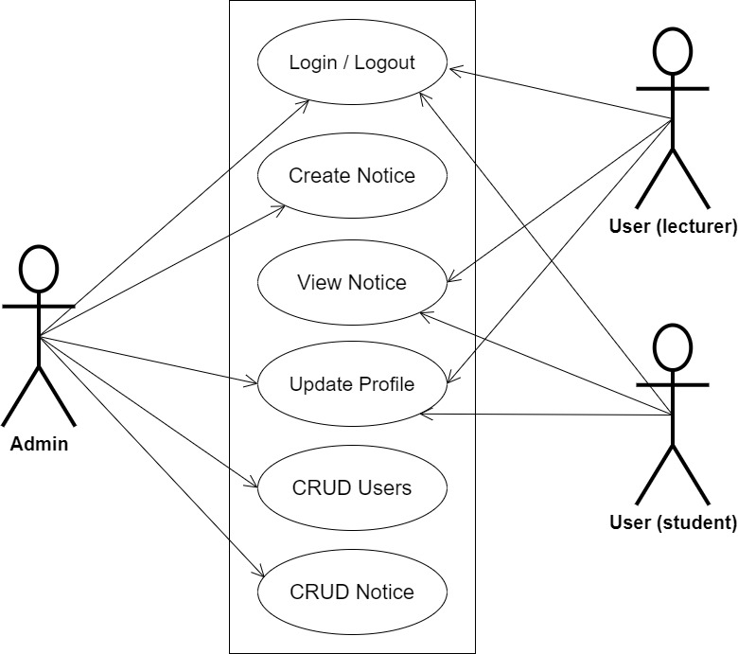
SYSTEM MODELING (USE CASE DIAGRAM)

Slide 11
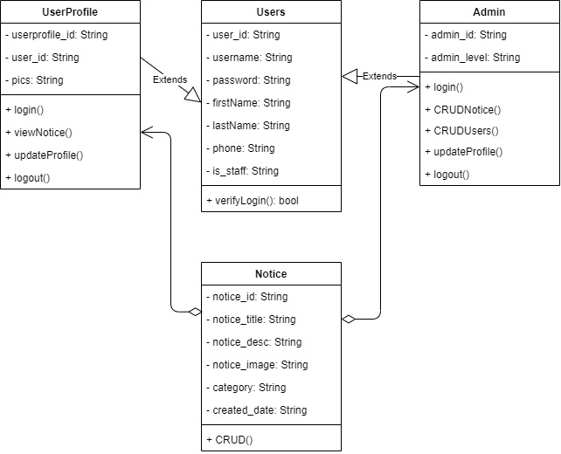
SYSTEM MODELING (CLASS DIAGRAM)

Slide 12
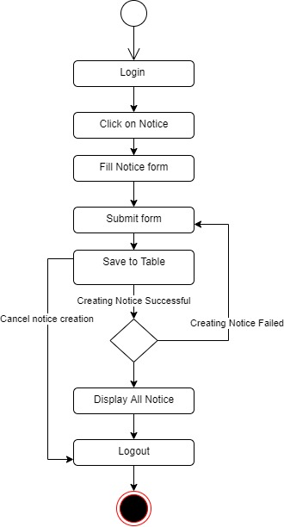
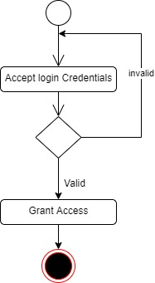
SYSTEM MODELING (ACTIVITY DIAGRAM)
User Login Activity
Create Notice Activity

Slide 13
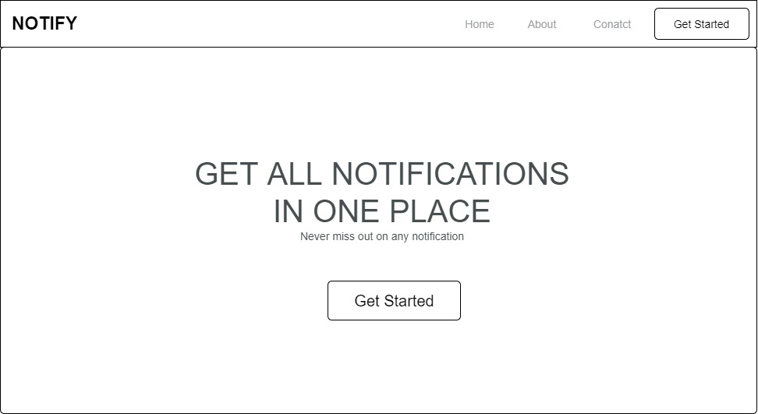
PROPOSED INTERFACE DESIGN
Home Page

Slide 14
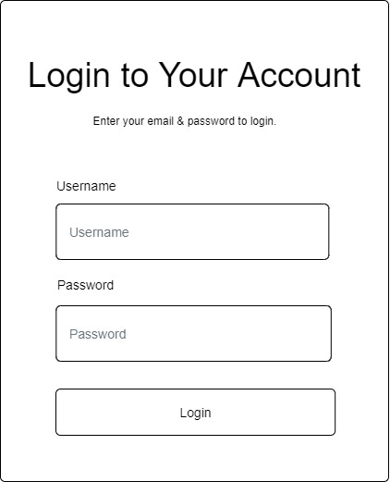
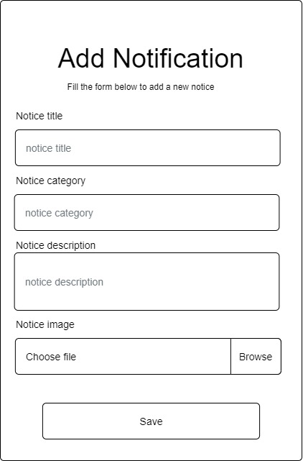
PROPOSED INTERFACE DESIGN
Login Form
Notification Form

Slide 15
SUMMARY
This research work is centered on the development of an online notice board for the department of computer science at Kaduna polytechnic it will cover the dissemination of information within the computer science department and information from departmental administration to staff and to students. It will not cover the dissemination of information across the entire departments in Kaduna polytechnic

Slide 16
THANK YOU

