Slide 1

A WEB-BASED STUDENT MEDICAL TEST SCHEDULER AND RESULT ISSUING SYSTEM FOR KADUNA POLYTECHNIC

Slide 2

Research methodology
Method of data collection
Before constructing any system, collecting data and facts about the existing system is necessary to comprehend what is going on. Two approaches were used in this study.
Observation of the Work Environment
Documentation
Choice of programming language
This study will be a web-based application based on a relational database (SQLite) design. HTML (hypertext markup language), CSS (cascading style sheet), and JavaScript will be utilized for front-end development, while Django (Python) will be used for back-end programming

Slide 3
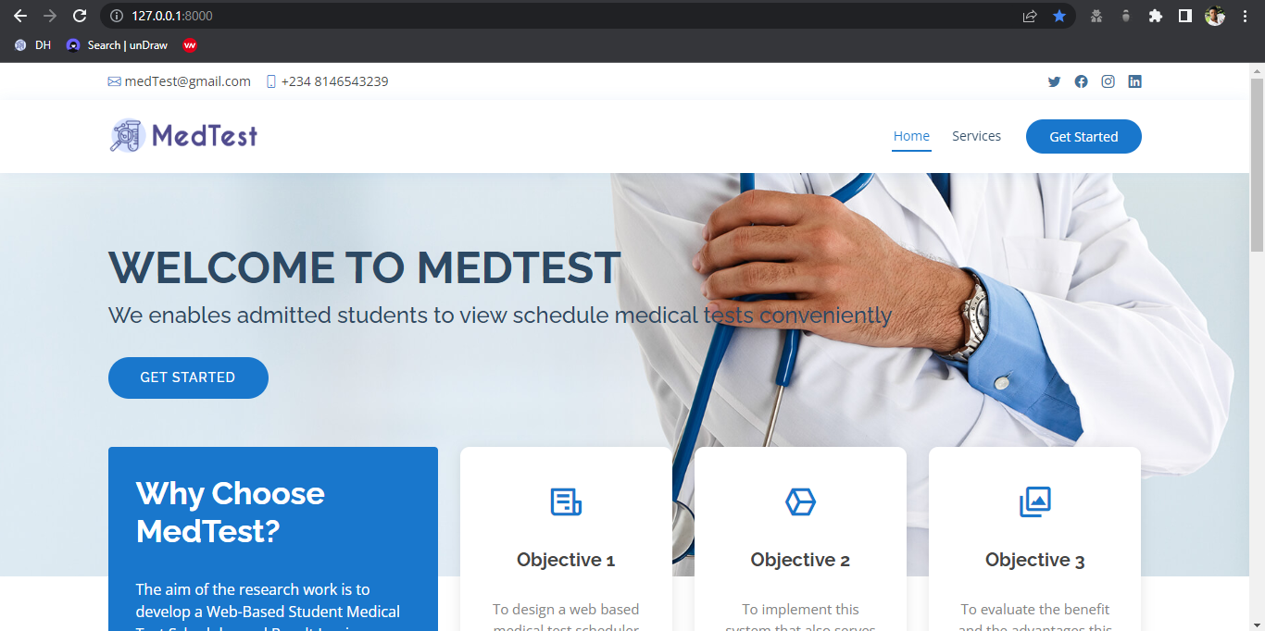
Home page
3
A Web-based Student Medical Test Scheduler And Result Issuing System

Slide 4
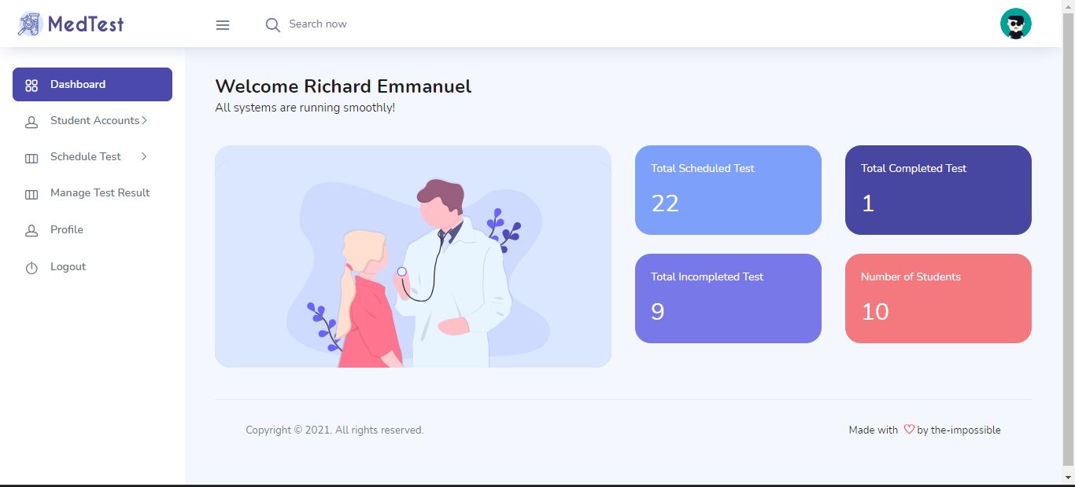
Administrator Dashboard
4
A Web-based Student Medical Test Scheduler And Result Issuing System

Slide 5
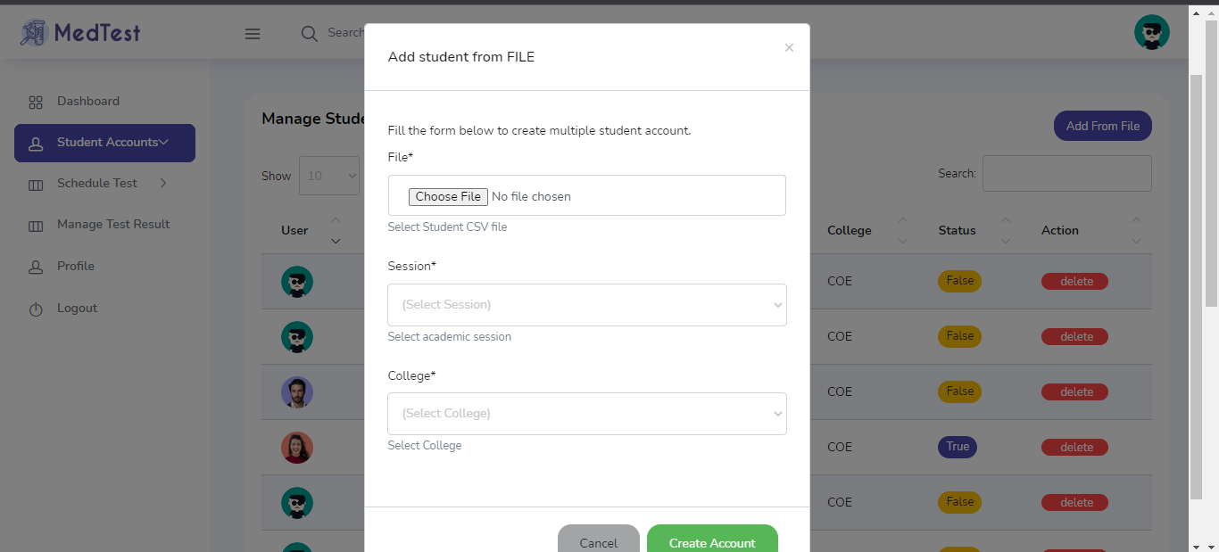
Automated Accounts Creation
A Web-based Student Medical Test Scheduler And Result Issuing System
5

Slide 6
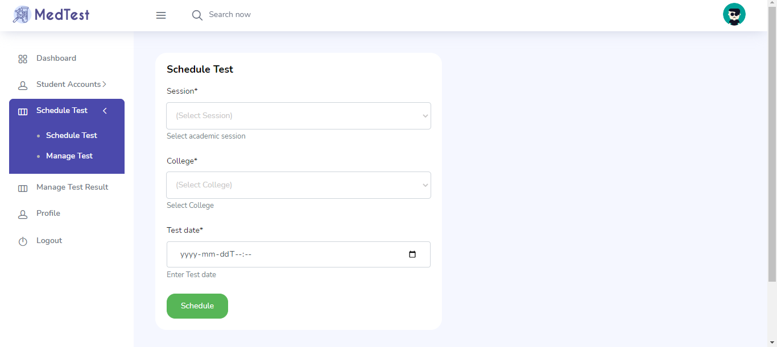
Automated Test Schedule
A Web-based Student Medical Test Scheduler And Result Issuing System
6

Slide 7
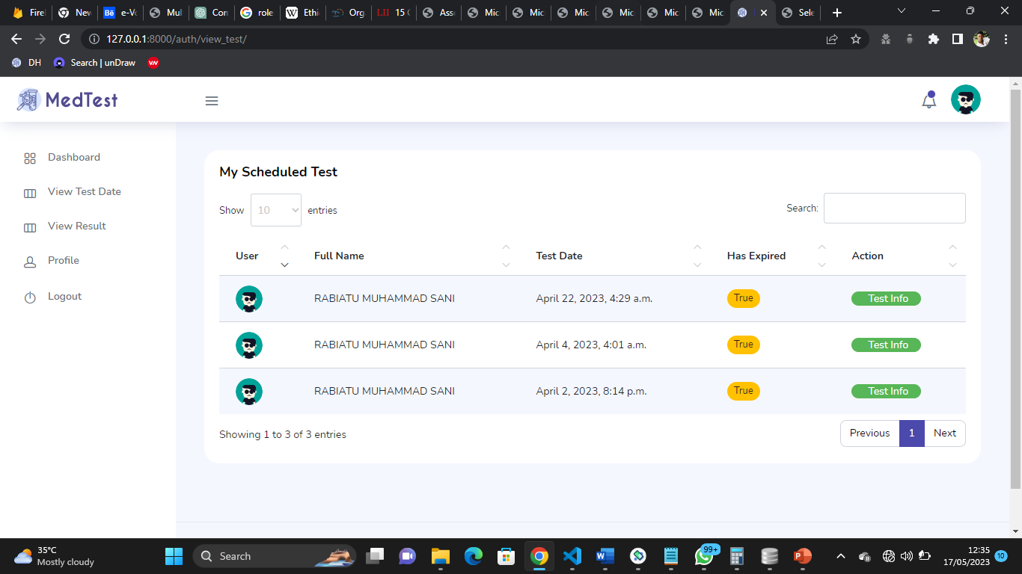
Student Schedule Test Page
A Web-based Student Medical Test Scheduler And Result Issuing System
7

Slide 8
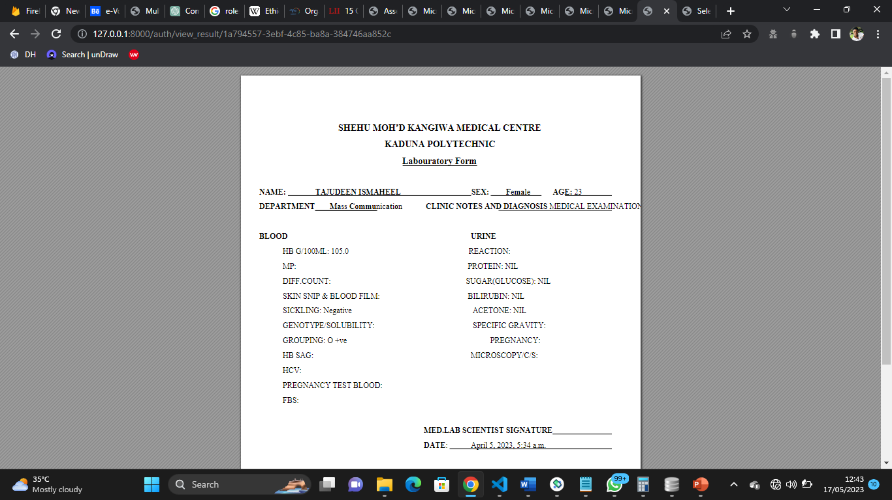
Student Test Result
A Web-based Student Medical Test Scheduler And Result Issuing System
8

Slide 9

Summary
This research work is centered on the development of a favourable algorithm for scheduling medical tests for admitted students while allowing the students to use the system online, to confirm their own appointment by themselves, this system also provides a dependable medical database as well as provide results for the medical tests conducted, printable online, it also focused on the development of a user-friendly, web-based interface to serve its purpose
9
A Web-based Student Medical Test Scheduler And Result Issuing System

