Slide 1

RESULT VALIDATION AND VERIFICATION SYSTEM FOR KADUNA POLYTECHNIC (KADPOLY E-VERIFY)
PREPARED BY: FARUK GBOLAHAN MUHAMMAD (CST20HND0193)
SUPERVISED BY: MR. AHMAD KABIR IBRAHIM
1

Slide 2

Table of content
Background of the Study
Statement of the Problem
Aims and Objective of the Study
Significance of the Study
Summary of Literature Review
Research Methodology
System Modeling
Proposed Interface Design
Summary / Conclusion

Slide 3

BACKGROUND OF STUDY
Information and Communication Technology is one of the diverse industries in the world that is increasing development in a certain country. Verification is the process of establishing the truth, accuracy, or validity of something such as the verification of official documents (Musee, 2017).
Most of the applicants falsify their educational credentials. What's more, industry experts cite academic fraud as the most common lie on resumes. This poses the greatest danger to an organization. This has been accelerated by applicants who falsify the information. The risks involved in not verifying the applicant’s certificate details include, greater recruiting and replacement costs, increased employee turnover, compromised business performance, embarrassment, and a negative impact on Kaduna polytechnic reputation

Slide 4

Statement of the problem
Recently employers have been experiencing has high alarming rate of fake certificates (Taylor, 2017). This is due to the traditional paper-based prototype of verification. The issue of forgery of printed certificates is one that is frequently encountered. Similarly, the low skill level required to counterfeit academic certificates is a major issue. The difficulty of the traditional verification process has resulted in unnecessary delays as well as inconvenient long-distance travel for verification purposes. However, with advancements in information and computer technology, a paradigm shift from traditional based verification to real-time verification is required

Slide 5



Aim and Objectives of the Study
The project is aimed at designing a working platform in Kaduna polytechnic that will be used nationally and perhaps internationally in verifying the records of academic certificates for all graduates from Kaduna polytechnic in Nigeria
Objective 01
Objective 02
Objective 03
To create a system that would verify all Kaduna polytechnic certificates records making sure that they are all valid and original
System should eliminate the problem of using fake certificates which are used in different applications and registration for recruitment
Reduce the cost of parsing information and efficiently manage Results information of the students

Slide 6

Significance of Study
This study will have a potential impact on Kaduna Polytechnic as it would create a platform for registering each student’s result to the database upon when the need for verification of the result. As well as recruiting organizations and employers will have easy and fast opportunities to verify the certificates presented to them thus it would help them in verifying academic certificates held by an individual

Slide 7
Summary of literature review
Title | Author & Year | Description | Merit | Demerits
Academic Certificate Record Verifying Platform. | Clement (2018). | This research work is an effort toward the elimination of fake certificates in learning institutions | The system lowers the danger of certificates being lost accidentally or stolen as a result of transferring them on occasion. | The system is limited to Tanzania only.
An Enhanced Web Base Certificate Verification System. | Emele et al. (2020). | The enhanced web-based certificate verification system will help schools and cooperating organizations validate the authenticity of students' certificates by showing certificate data and format with the owner's image. | The system is able to verify and authenticate students’ certificates with ease | The system may not be scalable due to the choice of programming language used.

Slide 8
Summary of Existing system
Title | Author & Year | Description | Merit | Demerits
A Generic Certificate Verification System for Nigerian Universities. | Patrick et al. (2019). | The study aims to develop an online certificate verification system that easily confirms the authenticity of a certificate by employers or recruiters. | Employers can obtain original certificates from schools easily and quickly. | The study is limited to information gathered from the review of the literature
Educational Certificate Verification System Using Blockchain. | Dinesh et al. (2020). | The system uses blockchain technology to offers a verified distributed ledger with a cryptographic technique to combat academic certificate forgery. | The system ensures transparency and data immutability. | Lot of computing power is required.
Eunicert: Ethereum Based Digital Certificate Verification System. | Thua and Khoa (2019). | The study proposes a solution issuing and verifying digital certificates called EUniCert to solve this problem. | The system improved the latency to validate result digitally. | Smart contracts were not used to generate digital certificates, which would have increased security and transparency.

Slide 9

Research methodology
Method of data collection
In executing any system, one has to have an insight of what is happening, it is important that information and fact about the existing system is gathered. In executing this research, two methods were employed.
Observation of the Work Environment
Interview
Choice of programming language
Various types of programming language exist that could have been used in writing this tutorial application but the choices of programming languages used involve HTML5, CSS3, JavaScript, Python (Django) and SQLite. The reasons for choosing these programming languages is that it is a web-based application and require web programming language

Slide 10
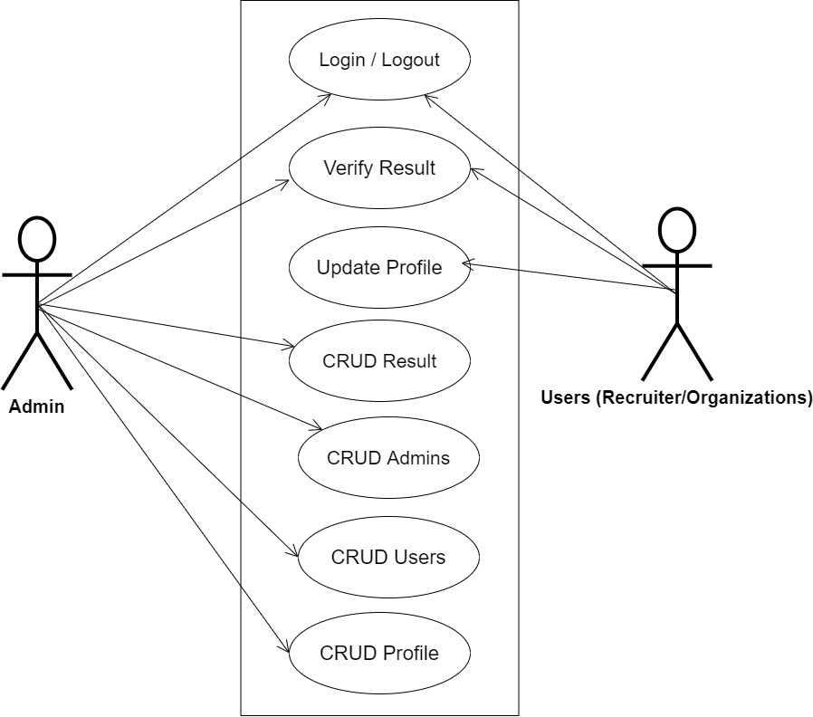
SYSTEM MODELING (USE CASE DIAGRAM)

Slide 11
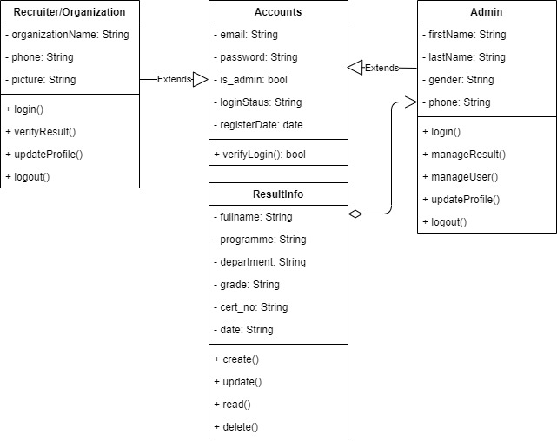
SYSTEM MODELING (CLASS DIAGRAM)

Slide 12
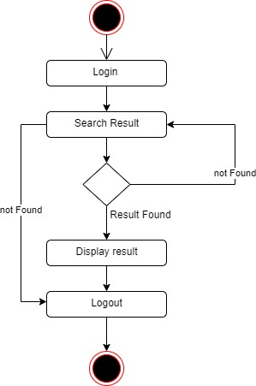
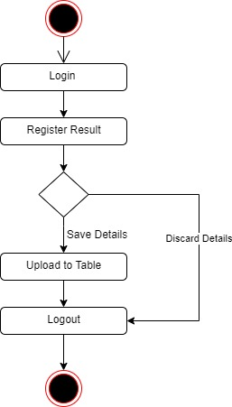
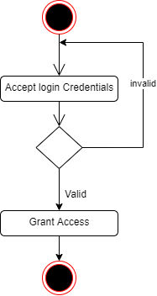
SYSTEM MODELING (ACTIVITY DIAGRAM)
User Login Activity
Verify Result Activity
Register Result Activity

Slide 13
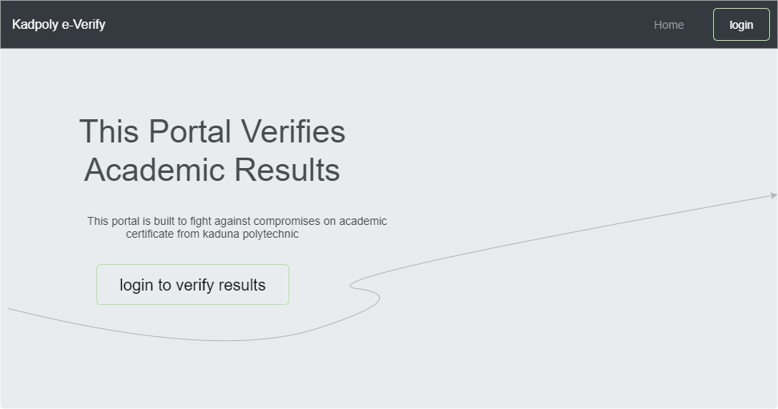
Proposed interface design
Homepage

Slide 14
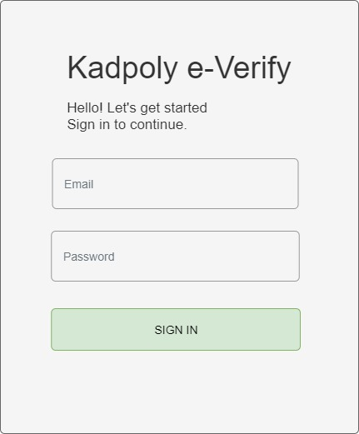
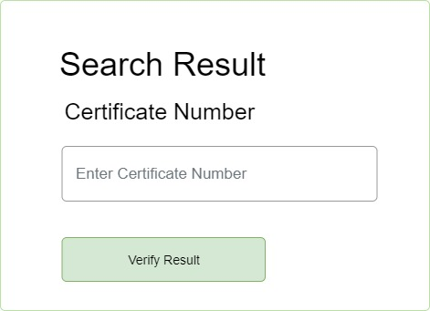
Proposed interface design
Login Form
Search Result Form

Slide 15

Summary
This result verification software reduces instances of academic fraud, also the system reduces the process of sending people to advocates to verify their certificate credentials. The people that are expected to fully utilize this portal are the Student Affairs of Kaduna polytechnic and Recruiting organization. The study will not cover the verification and validation of other school certificates
14

Slide 16

Thank you!
Thank you
Flora@contoso.com
http://www.contoso.com/

