Slide 1

Telegram Bot That Provides Students With Academic-Related Information In Computer Science Department

Slide 2

Research methodology
Choice of programming language
Method of data collection
This research work will be a mobile-based application and will be implemented on a relational database system (SQLite). The student telegram Bot will be developed using the python request library, BotFather API, while Python will serve as the backend these are the modern language used in developing the system
It is crucial to acquire data and facts about the current system before implementing any system since one has to understand what is happening. Three techniques were used to conduct this study.
Observation of the Work Environment
Documentation
Interview

Slide 3
Interface Design
Login Screen

Slide 4


Summary
This research work is centered on the development of a telegram-based application that aids students with academic-related information and requests regarding the department through the use of a telegram bot. The telegram bot will only provide information regarding the courses offered by the department, a list of all the lecturers and their courses, courses credit load, links to lecture materials for download, and the location of all computer lecture halls as the classes are not in one location

Slide 5
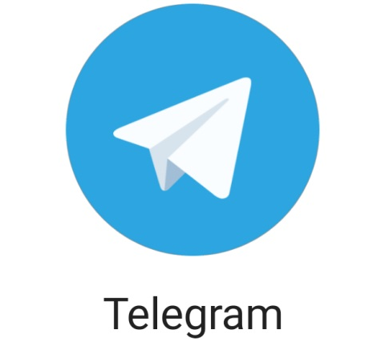

Thank you

