Slide 1
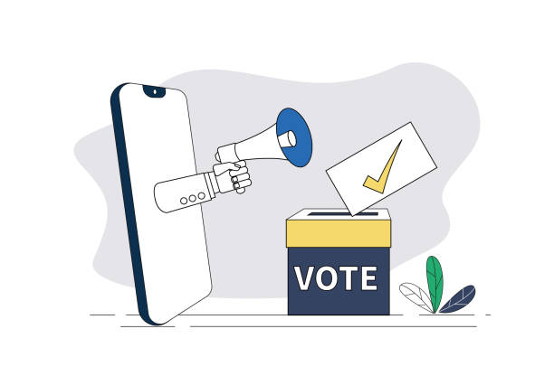
MOBILE BASED REALTIME E-VOTING APPLICATION FOR ELCOM COMPUTER SCIENCE KADUNA POLYTECHINC
PREPARED BY: GIFT EZINNE IKECHUKWU
CST20HND0120
SUPERVISED BY: MR. MICHEAL IZUEGBU

Slide 2
TABLE OF CONTENT
Background of study
Statement of the problem
Aim and objectives of the study
Significance of the study
Summary of Literature Review
Research methodology
System modelling
Proposed interface design
Summary/Conclusion

Slide 3
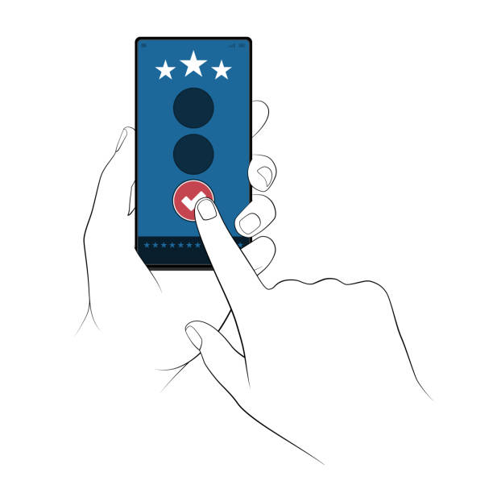
INTRODUCTION
Voting is the process that allows the general public or the people to choose their leaders and articulate views on how they will be governed.
Real-time refers to a system in which input data is processed within milliseconds so that it is available virtually immediately as feedback to the process from which it is coming.
E-Voting refers the application of electronic technology to cast and count votes in an election. One of the fundamental mechanisms for democracy is election.
This project's focus is on creating an electronic voting tool that allows students to cast their votes from the comfort of their homes while simultaneously monitoring the compilation results in real time.

Slide 4
STATEMENT OF PROBLEM
Since voting is done manually and there are thousands of students, the procedure looks to be laborious among the computer science department students at Kaduna Polytechnic. Due to unfavourable voting times, circumstances, environments, intolerable lines, or the overwhelming throng at the voting locations, there are now a lot of situations of real students who are eligible to vote not participating in the process.

Slide 5
AIM &
OBJECTIVES
The aim of this project is to build a mobile based real-time e-voting application.
And the objectives of this research work are as follows:
The student data set will be extracted from the department based on criteria’s involving payment of school fees, as registration is not performed on the site since the registration is automated.
The application will be generally hosted so that the general audience (students) can have access to it.
Modern technology like flutter will be employed in creating interactive user interface and experience.
To ensure effectiveness and efficiency several system test will be carried out.

Slide 6
SIGNIFICANCE OF STUDY
The main goal of this project's development is to end the limitations on voting, such as the use of ballots alone, election-day vote-rigging, and congested polling places, as well as to extend the time between voting and vote-counting. These issues have been a major concern for students and the electoral commission, therefore our real-time mobile voting software aims to fix them.

Slide 7
SUMMARY OF LITERATURE REVIEW
TITLE | AUTHOR & YEAR | DESCRIPTION | MERIT | DEMERIT
Secure voting system through sms and using smart phone application. | Selvarani et al (2017) | The study proposed a system developed to select their candidate through smart phone application. And they can cast their votes and display results, through the concept of SMS (short messaging service). | Voters can more effectively cast their ballots online at any time and from any location with their mobile phones | The system is strictly mobile based.
Block chain-enabled e-voting (BEV) | Kshetri & Voas (2018) | The study pointed out that (BEV) could reduce vote fraud and increase voters access. Eligible voters cast a ballot anonymously using a computer or smartphone. | The system will reduce vote fraud and increase voters confidence and access. | The system may lack scalability due to influx of users

Slide 8
SUMMARY OF LITERATURE REVIEW
TITLE | AUTHOR & YEAR | DESCRIPTION | MERIT | DEMERIT
Development of a mobile android voting application for tertiary institutions in nigeria. | Okpara R. et al (2018) | The study's goal was to find solutions to issues with voting in tertiary institutions, such as vote rigging during elections, congested voting locations, inaccessible and unsafe polling places, and unskilled staff, among others. | Voting can be carried out at anytime and from the comfort of ones home | It requires internet connection
Design and development of real-time e-voting system with high security features. | Amit & Abdullahi (2019) | The point of the study was to exhibit an electronic voting system (E-Voting) to be connected to organizations constituent body. The software application was developed utilizing web API’s and the concept of Dynamic systems development method (DSDM) was used together with object oriented methodology. | Users can view polling results in real-time | The system may lack scalability due to influx of users

Slide 9
SUMMARY OF LITERATURE REVIEW
TITLE | AUTHOR & YEAR | DESCRIPTION | MERIT | DEMERIT
QR code voting in election. | Visalakshi et al (2020) | The study’s goal was to suggest a real-time Quick Response code capture system for use with electronic voting on our mobile device. Each voter is provided with a unique QR code which is scanned by a mobile scanner application and used by voters to cast their votes. | The system will minimize the amount of time used during voting exercises | Poor user interface
secure mobile internet voting system using biometric authentication and wavelet based AES | Ajish & AnilKumar (2021) | The study looked at presenting a secure mobile internet voting system in which a biometric method authenticates the voter. The biometric image can either be encrypted at the mobile device or sent to the server or process the biometric image at the mobile device to generate the biometric template and send it to the server. | The system offers high security with biometric authentication | The system is strictly mobile based

Slide 10

RESEARCH METHODOLOGY
CHOICE OF PROGRAMMING LANGUAGE
The proposed design will be implemented using flutter for its user interface (frontend) while Django will be used for the backend, Sqlite3 will be used for its database and Django REST Framework for it REST-full API, combination of the above modern technology forms the technology for this research work.
METHOD OF DATA COLLECTION
To acquire data and facts about the current system, two techniques were used to conduct this study.
Observation: This strategy was used to collect information and data for this study by observing how the manual system functioned and through close inspection, the system's obvious flaws were found.
Documentation: This type of data collecting is employed because it provides a foundation for comparison with previous research.

Slide 11
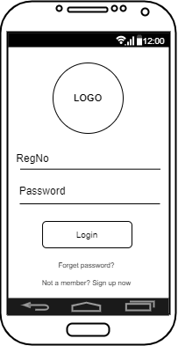
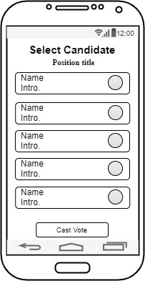
PROPOSED INTERFACE DESIGN
User Login Screen
Voting Screen
11

Slide 12
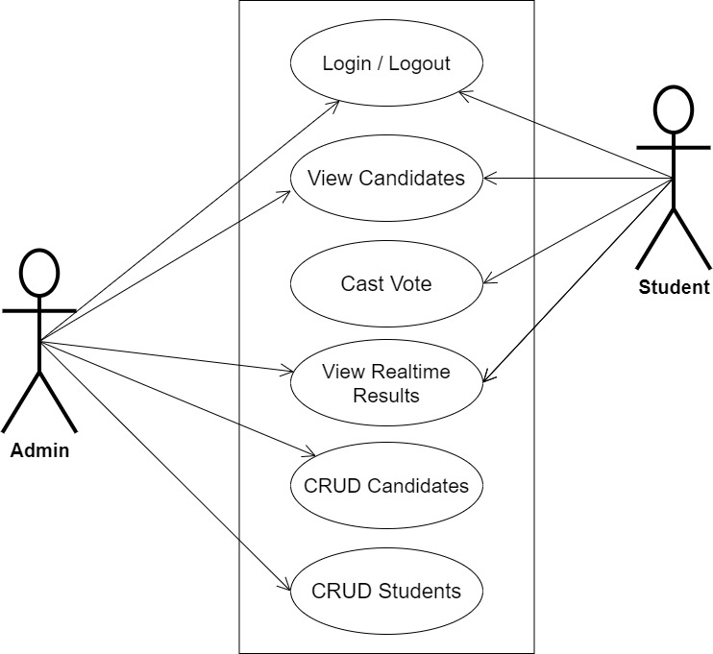
SYSTEM MODELLING
System Use Case Diagram
12

Slide 13
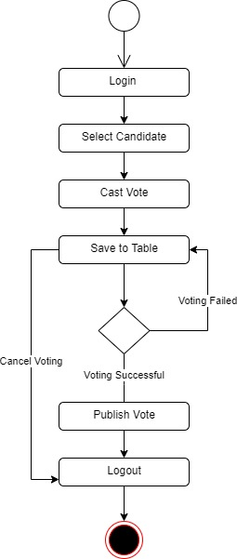
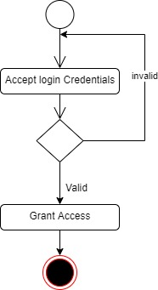
SYSTEM MODELLING
Login Activity Diagram
Voting Activity Diagram
13

Slide 14
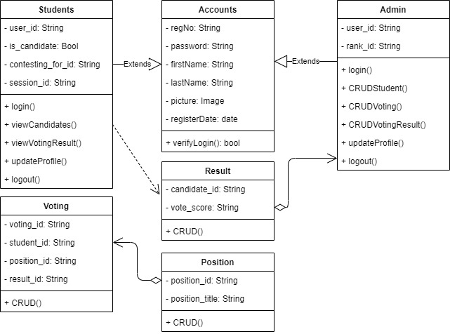
SYSTEM MODELLING
Class Diagram
14

Slide 15

SUMMARY
Since there are thousands of students studying computer science at Kaduna Polytechnic, the current voting method, which uses ballot papers and manual accreditation, has proven to be tiresome and burdensome for the students. As a result, a real-time electronic voting system is required.
CONCLUSION
This application would successfully introduce a brand-new Android platform E-voting application design. It is intended that the proposed approach would offer voters comfort and security as well as real-time poll results, enabling online voting and bringing accuracy, increased privacy, a nice user interface, and dependability to the entire election process.

Slide 16


