Slide 1
SALES RECORD MANAGEMENT SYSTEM FOR DEIFAK NGERIA LIMITED
PREPARED BY: AGBO DOMINIC SAMUEL
(CST20HND0448)
SUPERVISED BY: MISS. BAYYINA KANKIA LAWAL

Slide 2
Table of content
Background of the Study
Statement of the Problem
Aims and Objective of the Study
Significance of the Study
Summary of Literature Review
Research Methodology
System Modeling
Proposed Interface Design
Summary / Conclusion

Slide 3
Background of Study
Because information development has progressed so quickly at this time, many firms have employed information systems to better their operations. To enhance a company's business, a good information system must be built, and the prerequisite to developing a strong information system is the speed and accuracy with which the information is obtained. In today's world, computers play an important role. Nowadays, we utilize computers to make our jobs easier and save time. Almost all sectors or institutions, such as convenience shops, malls, restaurants, hospitals, and hotels, employ computers for simple and convenient transaction processing. Nonetheless, organizations still employ manual processes since they do not use computers to operate. (Margareta & Pataropura, 2018).
The process of gathering, entering, storing, categorizing, summarizing, and analyzing data is known as record keeping. Financial record keeping and management record keeping are two aspects of record keeping. The primary goal of a financial record is to aid decision-makers in analyzing a company's financial soundness, profitability, and future prospects

Slide 4
Statement of the Problem
The following are some of the study's issues:
The recording of sales and money received is done manually on a rough book.
It is difficult to predict when specific things must be refilled.
The manual inventory approach is both demanding and time-consuming.
Human mistake causes inaccuracies in record keeping.

Slide 5
Aim and Objectives
aim
objectives
The project is aimed at developing and implementing a sales record management system for Delfak Nigeria Limited
To create a database to aid in the storage of sales records.
To ensure account consistency and error minimization due to damage.
To automate sales and inventory tasks/activities

Slide 6
Significance of the Study
The importance of this study is to Delfak Nigeria Limited, which would give an easy-to-use and easily accessible system, allowing transactions to be more reliable and faster, eliminating the need to pay another company to complete the task. It provides more accurate and secure sales and product list records. It will aid in a variety of ways in easing the queue process at supermarkets. This will also aid in the maintaining of correct records. The study will be particularly relevant to the following:
i. Admin: is in charge of adding stocks, maintaining inventory, and deciding system users.
ii. Customers benefit from printed receipts immediately after purchasing an item

Slide 7
Summary of literature review
Title | Author & Year | Description | Merit | Demerits
Design And Development of Sales E-Monitoring Information System. | Margareta and Pataropura (2018). | The study focuses on developing a sales monitoring system at PT. Pratama Inti Distribusindo, which will provide sales system solutions at PT. | The system aided in the generation and verification of reports. | Strictly limited to the web.
Sales Management Information System | Lubwama (2017). | The system is customized for the use by Nawab Asian Bistro's workers to access and manage sales data through a single dashboard. | The system has a great impact to decision making in the restaurant | The study scope is limited to just one department of the restaurant.

Slide 8
Summary of literature review
Title | Author & Year | Description | Merit | Demerits
Inventory Record Inaccuracy and Store-Level Performance. | Shabani et al. (2021). | This article examines the effects of IRI on retail shop inventory and sales management performance. | Numerical studies show that IRI improvement is moderate for near-efficient stores. | Numerical studies show that IRI is strikingly great for extremely inefficient businesses.
A Review of Inventory Management Systems | Varalakshmi and Shivaleel (2021). | This article describes an Inventory Management System that saves sales data for a specific desktop application | It also gives sales data on a daily, weekly, and monthly basis. | The application is limited to just desktop users.

Slide 9
Research methodology
Choice of programming language
Method of data collection
This research work will be a web-based application and will be implemented on a relational database system (MySQL). HTML (hypertext markup language), CSS (cascading style sheet), and JavaScript will be employed in the front end while PHP will be employed for the backend programming. The above are the modern languages used in implementing this system.
Before constructing any system, it is necessary to collect data and facts about the existing system to comprehend what is going on. Two approaches were used in this study.
Observation of the Work Environment
Documentation

Slide 10
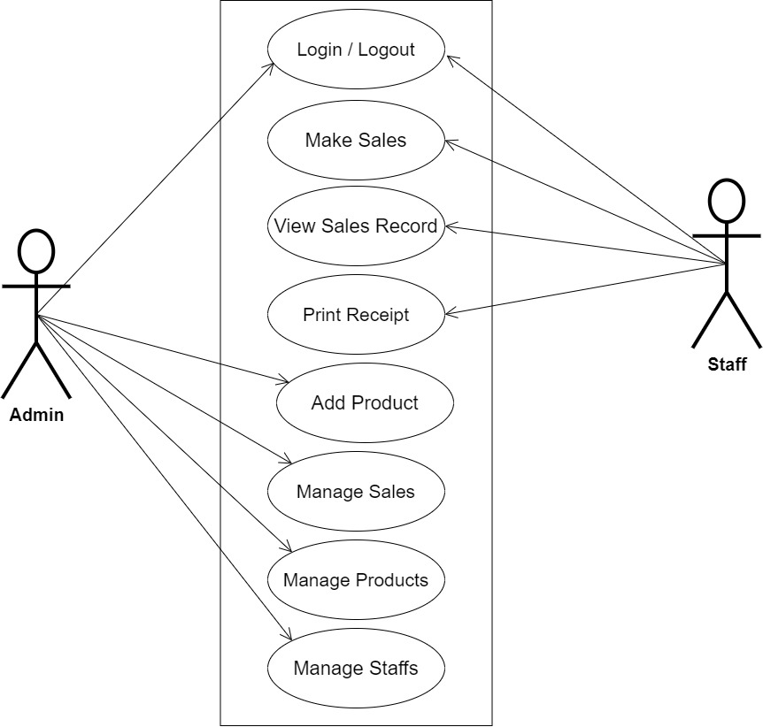
SYSTEM MODELING (USE CASE DIAGRAM)

Slide 11
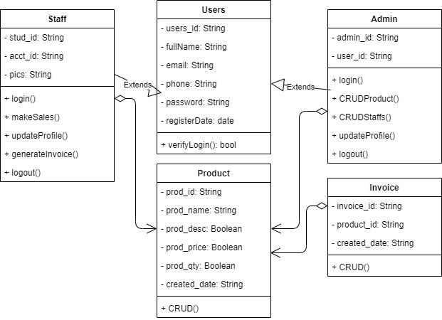
SYSTEM MODELING (CLASS DIAGRAM)

Slide 12
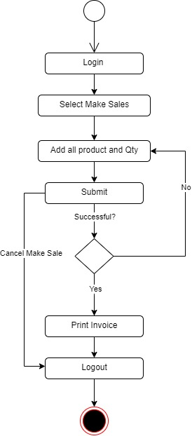
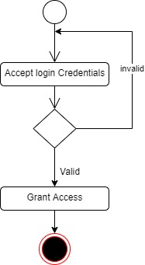
SYSTEM MODELING (ACTIVITY DIAGRAM)
User Login Activity
Make Sales Activity

Slide 13
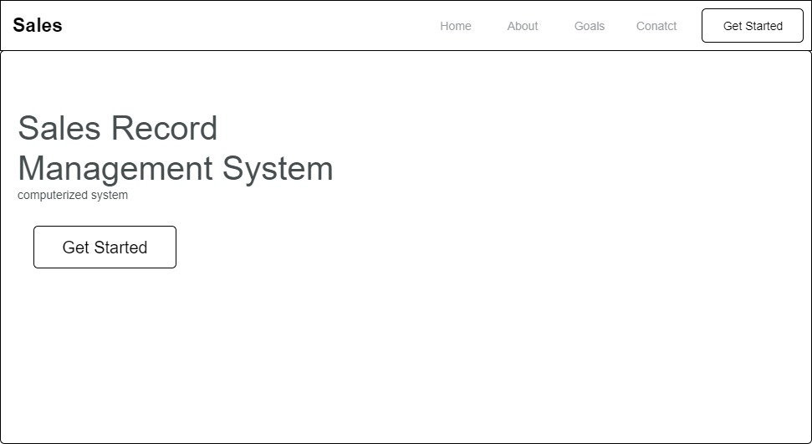
PROPOSED INTERFACE DESIGN
Home Page

Slide 14
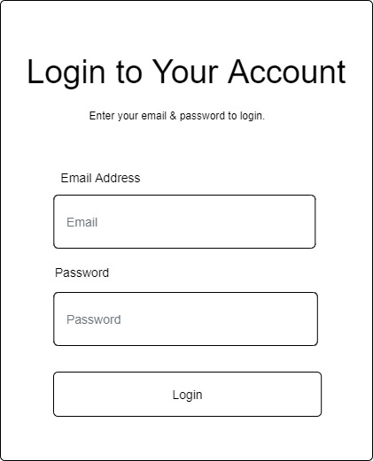
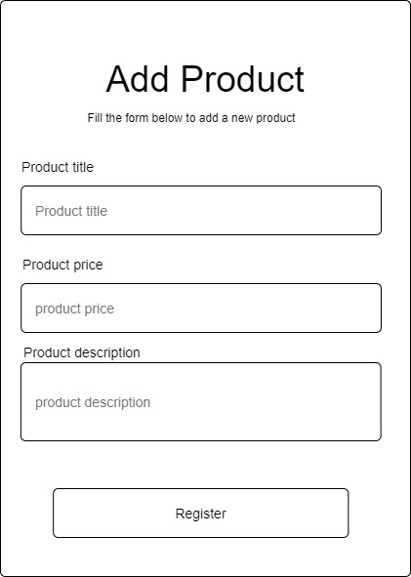
PROPOSED INTERFACE DESIGN
Login Form
Add Product Form

Slide 15
SUMMARY
SALES RECORD MANAGEMENT SYSTEM FOR DEIFAK NGERIA LIMITED
This research work will concentrate on Delfak Nigeria Limited employees as they may view and manage sales data from a single dashboard. In this scenario, the system concentrated on daily sales, costs, invoice statements, and the generation of adequate reports. However, because there are severe difficulties with the Company, the system will not be able to run beyond this point, for example, accounting information such as income statements, balance sheets, and trial balances, among others

Slide 16
THANK YOU

