Slide 1
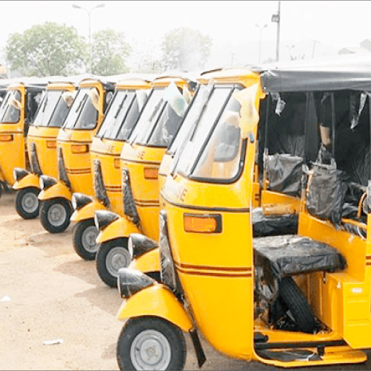
Tricycle booking application for students at Kaduna polytechnic main campus
PREPARED BY: TEMITOPE ADEOYE (CST20HND0235)
SUPERVISED BY: MR. IBRAHIM ALIYU IBRAHIM
1

Slide 2

Table of content
Background of the Study
Statement of the Problem
Aims and Objective of the Study
Significance of the Study
Summary of Literature Review
Research Methodology
System Modeling
Proposed Interface Design
Summary / Conclusion

Slide 3
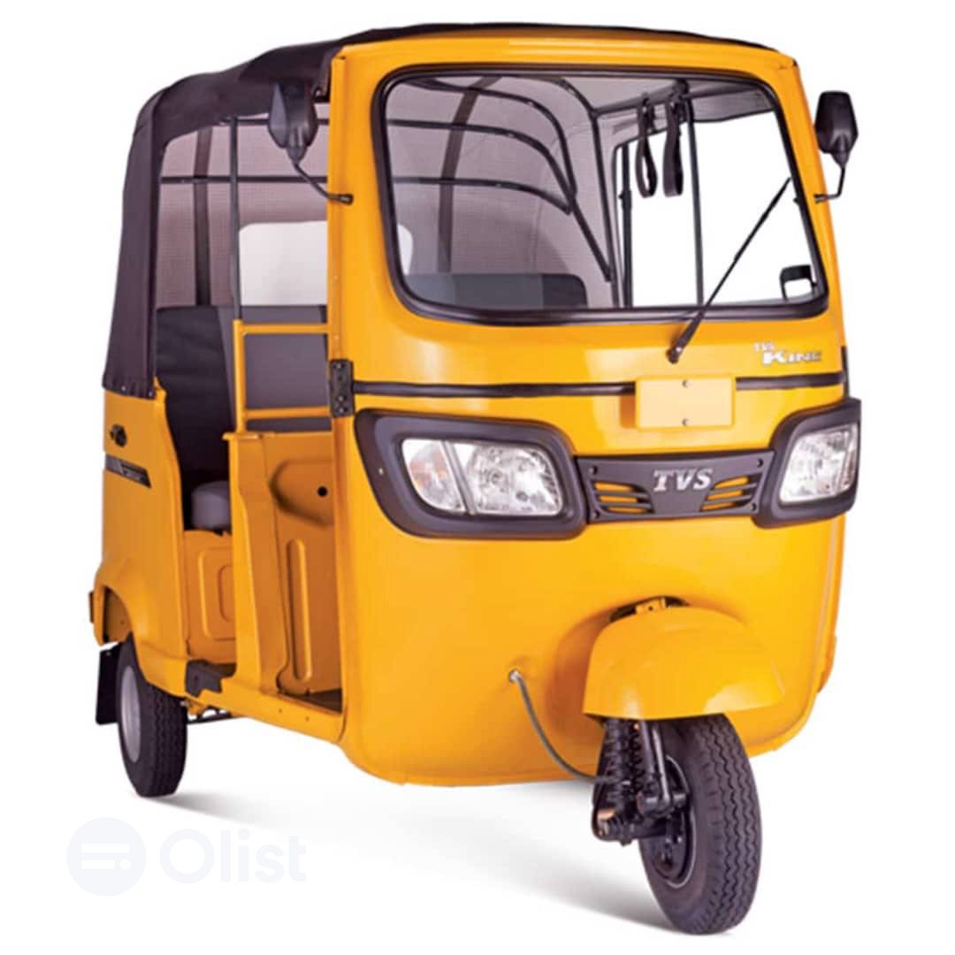
BACKGROUND OF STUDY
Transport refers to the movement of people or goods from one location to another by numerous modes of transportation such as automobiles, trains, aircraft, and even animals such as donkeys and camels.
Every economy relies on transportation. It facilitates the movement of people and things and has a direct impact on service delivery. When choosing a mode of transportation, commuters evaluate safety, availability, cost, dependability, comfortability, and efficiency

Slide 4

Statement of the problem
The unavailability of tricycles within the school is due to how the manual method is structured, in trying to introduce comfort to the student in acquiring tricycles and to that of tricycle drivers in acquiring passengers (students) some problems were found. Currently, Students must go to the loading point to get on a tricycle, they also have to line up for a long time waiting for the loaded tricycle to go and come back, without prior knowledge of how soon they will be back. Students must pay cash when getting on the tricycle with that aside there is also the problem of price indifferences.

Slide 5



Aim and Objectives of the Study
Objective 01
objective 02
Unit and integration testing will be performed to validate the design's effectiveness and efficiency, as well as to guarantee that the functionalities are error-free
To develop a mobile application with a user-friendly interface that allows users to book tricycles within the campus environs

Slide 6

Significance of Study
This study has a potential impact on the people who will be using the booking system by providing students with an easy and convenient way to book rides on tricycles, the system could potentially improve their mobility and access to transportation, which could in turn improve their ability to attend classes and participate in campus activities on time. Additionally, the system could help to streamline processes within the campus and make it easier for students to get the transportation they need

Slide 7
Summary of literature review
Title | Author & Year | Description | Merit | Demerits
Android Mobile Application for Online Bus Booking System | Duraisamy et al. (2018). | The system enables consumers to book tickets at the touch of a button without having to wait in line or go to the counter | Well-designed payment platform. | The system is limited to only Android-based users.
ISAKAY: Android-based booking system for tri-bike operators and drivers associated with cloud-based data analytics. | Balba et al. (2019) | The researchers devised the concept of building and developing an Android-based booking system that centralizes the transportation management of tricycles in rural locations around the Philippines. | The booking system can mass-produce a dashboard by displaying data analytics for future tri-bike management system upgrades. | The system is limited to only Android-based users.

Slide 8
Summary of literature review
Title | Author & Year | Description | Merit | Demerits
Online Booking Systems for Managing Queues at The Road Transport Department. | Mohamad et al. (2019). | The purpose of this research is to suggest an online system for managing queues during service and, as a result, reducing waiting time. | This system informs clients of the length of their wait so that they can arrive at the counter in time for their allotted service. | The system requires internet connectivity
An Online Road Transport Booking System. | Adekola et al. (2021). | This research focuses on automating the Road Transportation Booking System so that customers and employees can buy and sell tickets online. | customers and employees can buy and sell tickets online. | The system lack scalability, high influx of user makes the site slow
Bus Ticket Booking Information System | Wibawa et al. (2021). | Tickets can be purchased using this bus ticket booking website instead of going straight to the ticket sales shop. | Buyers can purchase tickets using their smartphones or laptops. | No refund if a ticket is cancelled

Slide 9

Research methodology
Method of data collection
It is crucial to acquire data and facts about the current system before implementing any system since one has to understand what is happening. Two techniques were used to conduct this study.
Observation of the Work Environment
Interview
Choice of programming language
The proposed design will be implemented using flutter for its user interface (frontend) while Django will be used for the backend programming, firebase will be used for its database due to its portability, and Django REST Framework will be employed for its REST-full APIs, the combination of the above modern technology forms the technology for this research work.

Slide 10
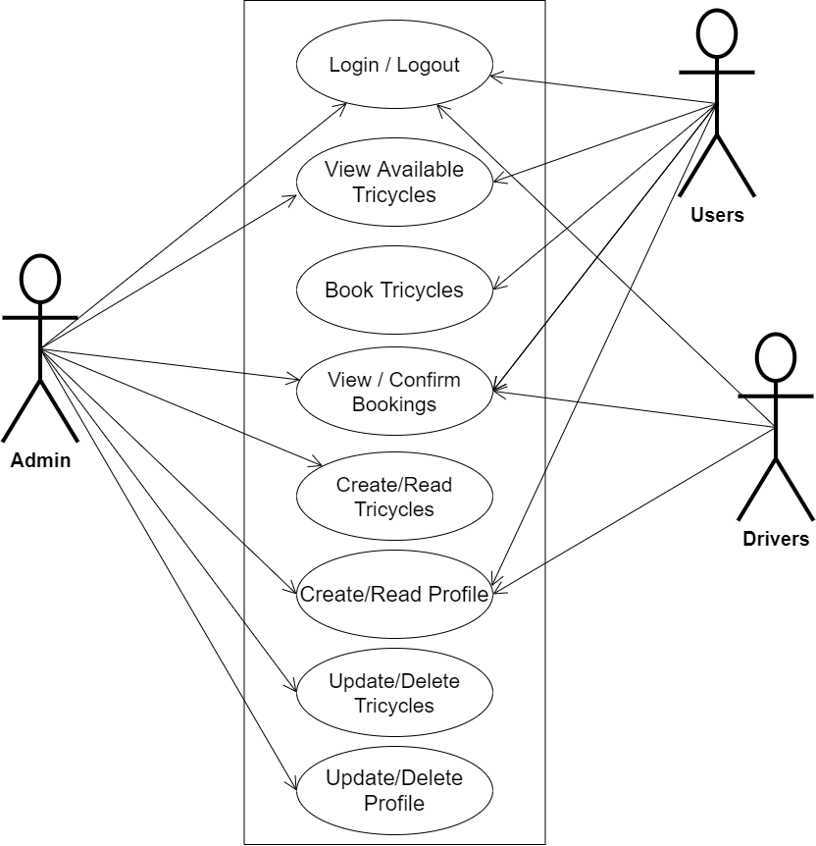
SYSTEM MODELING (USE CASE DIAGRAM)

Slide 11
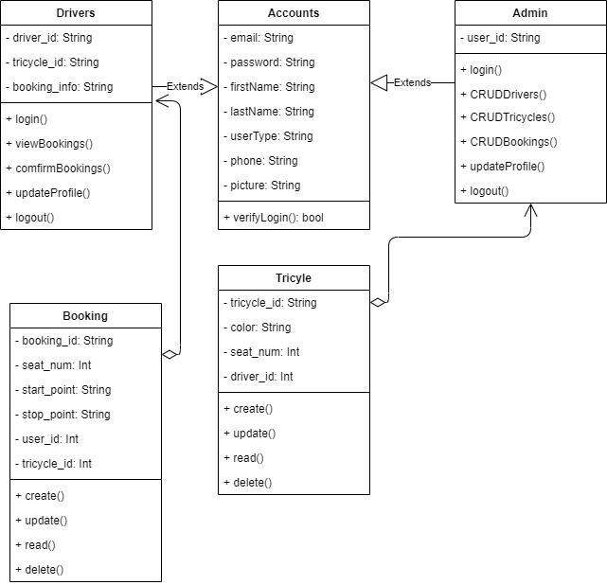
SYSTEM MODELING (CLASS DIAGRAM)

Slide 12
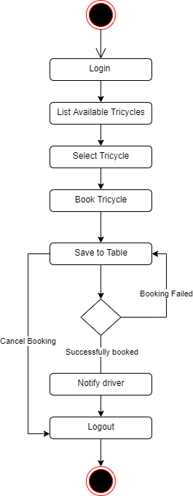
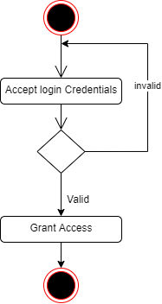
SYSTEM MODELING (ACTIVITY DIAGRAM)
User Login Activity
Book Tricycles Activity

Slide 13
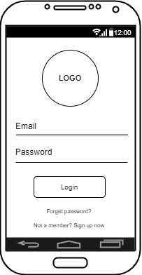
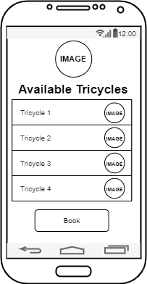
Proposed interface design
User Login Screen
Available Tricycles Screen

Slide 14
System Testing and Evaluation
Unit Testing
Integration Testing
In this section, individual units or single components of the system are tested independently to ensure that individual phases are working effectively without errors
Testing of the program was implemented using integration testing all the units were put together as one so they function as one. The link between the various units was tested to be sure that they are correctly integrated, and also to be sure that the units can function correctly together as one

Slide 15
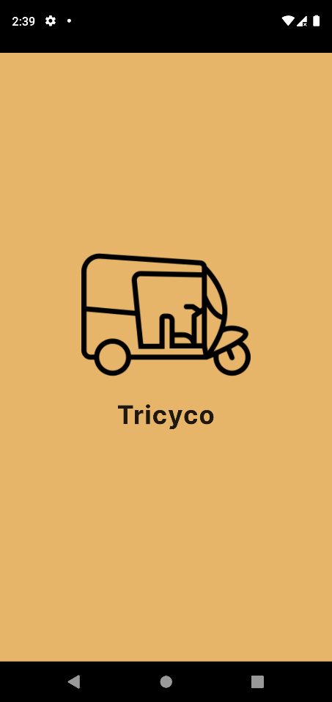
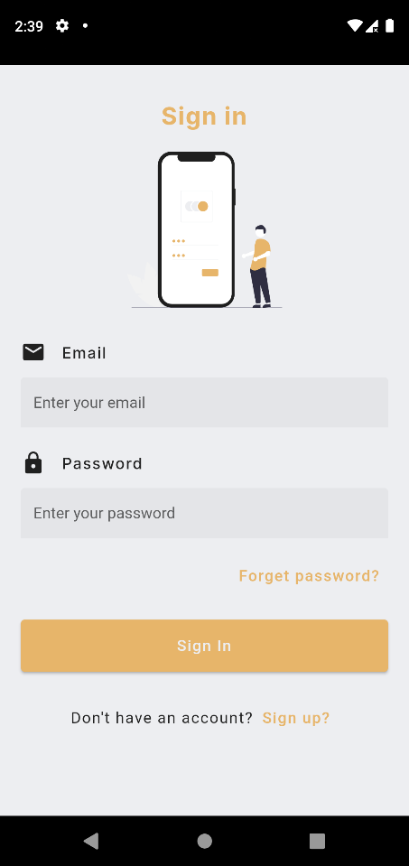
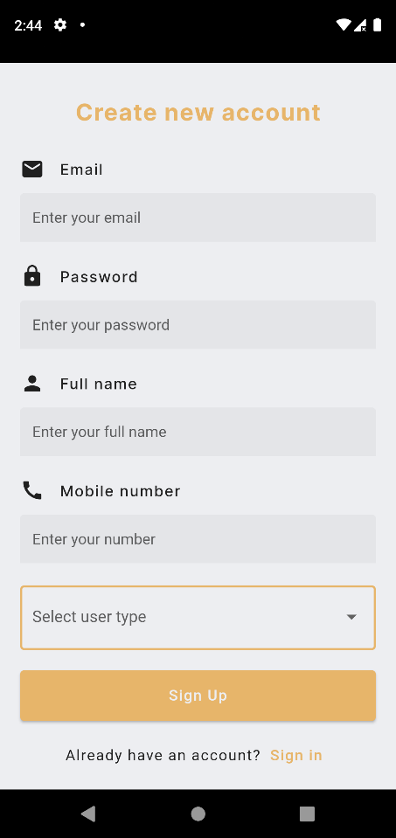
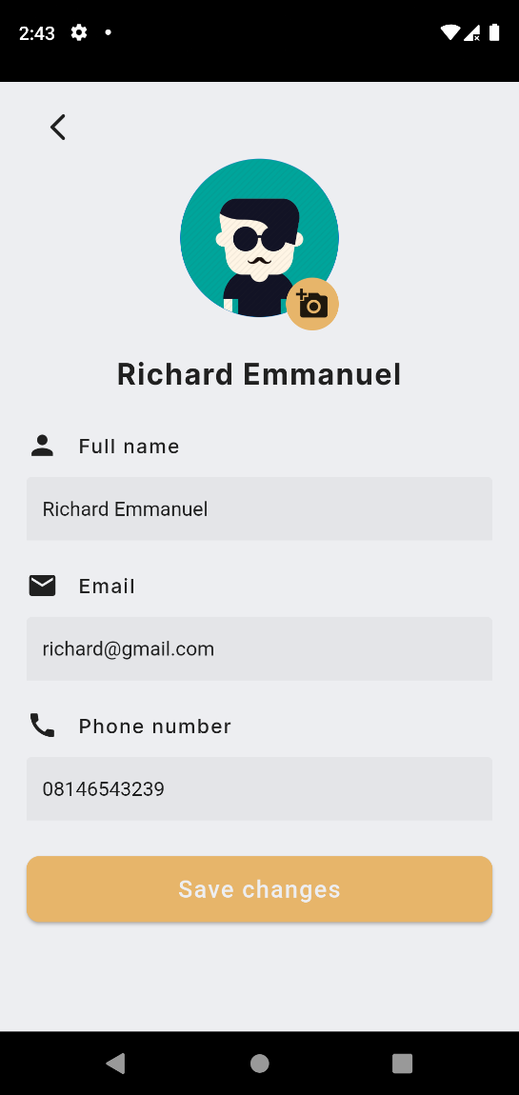
SAMPLE OUTPUT (User and driver)
Splash Screen
Sign-in Screen
Sign-up Screen
User Profile

Slide 16
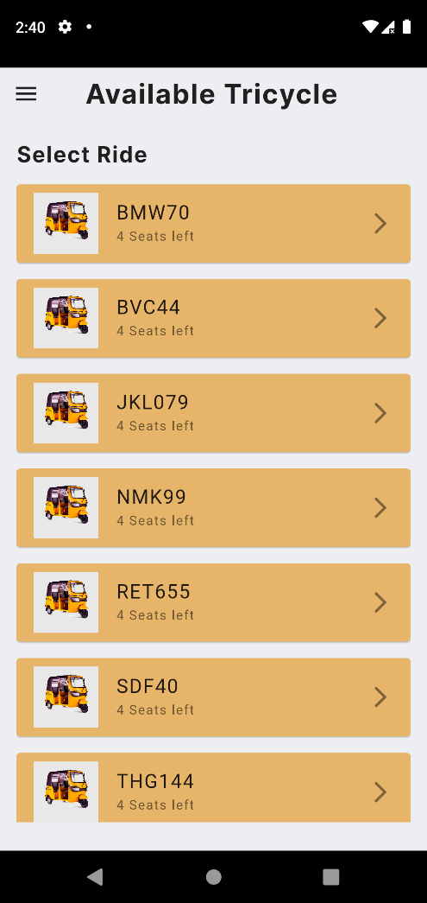
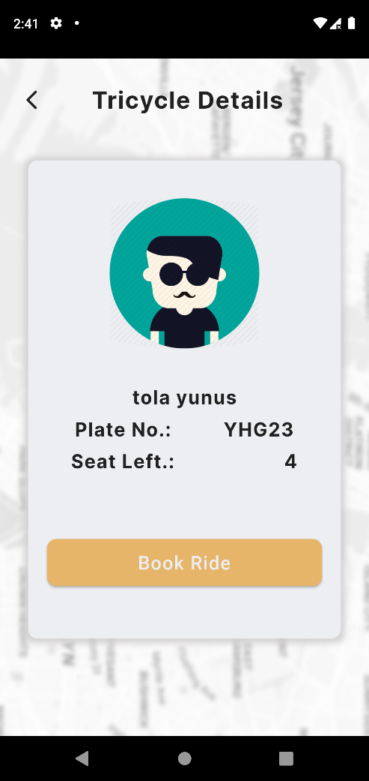
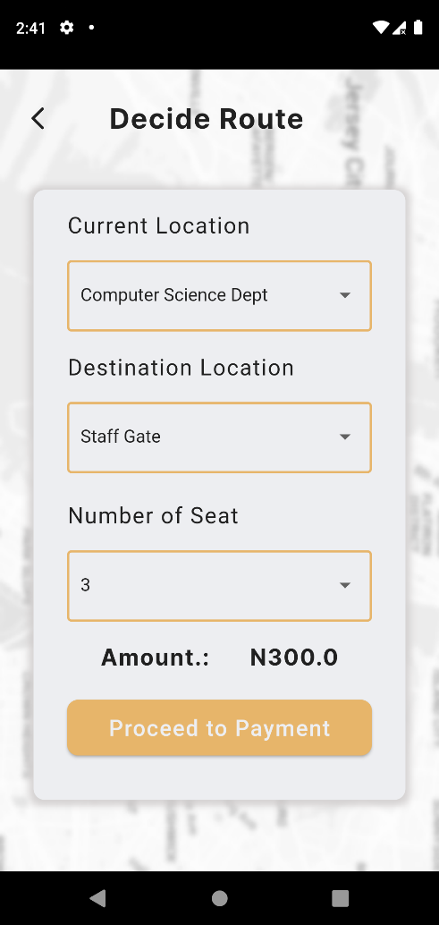
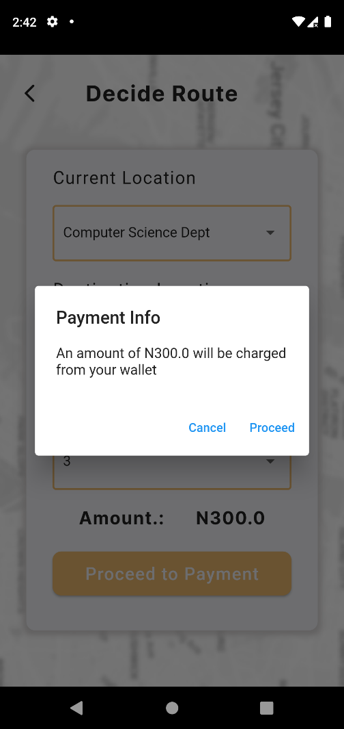
SAMPLE OUTPUT of user screen
Available Tricycle
Tricycle Details
Decide Route Screen
Payment Confirmation

Slide 17
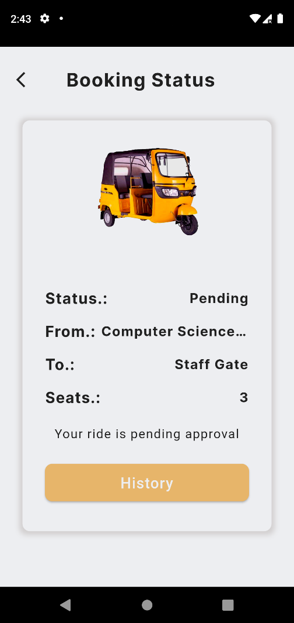
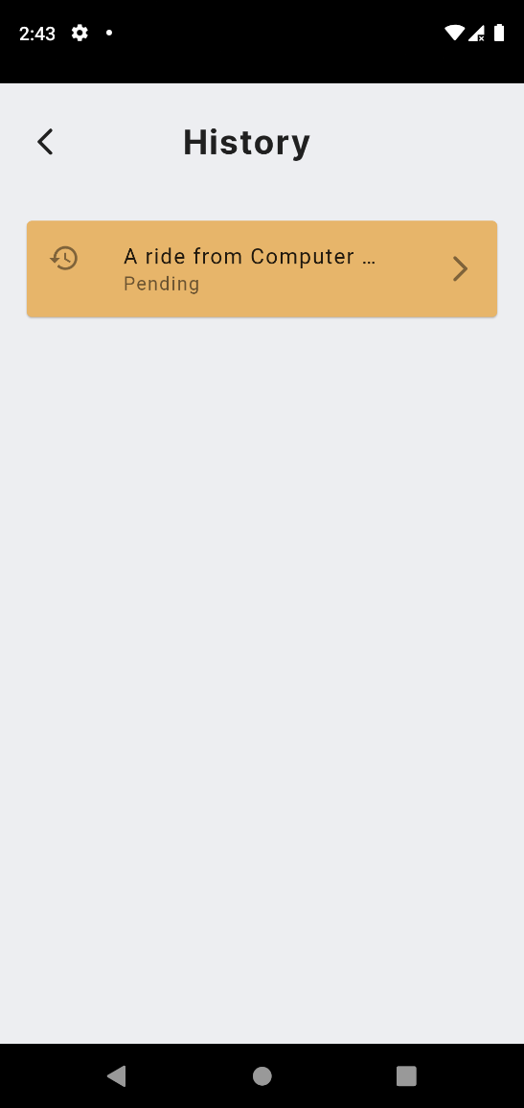
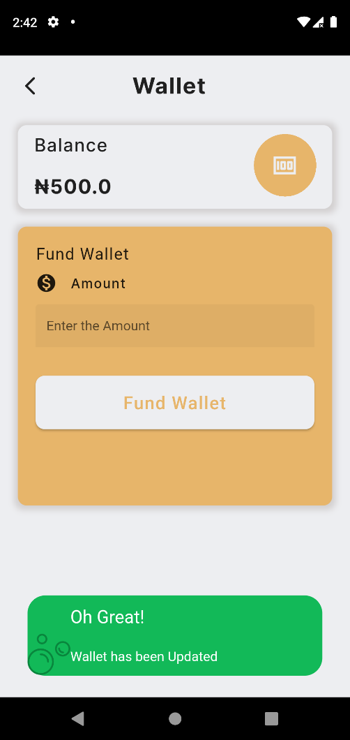
SAMPLE OUTPUT of user screen
Booking Status
History Page
Fund Wallet

Slide 18
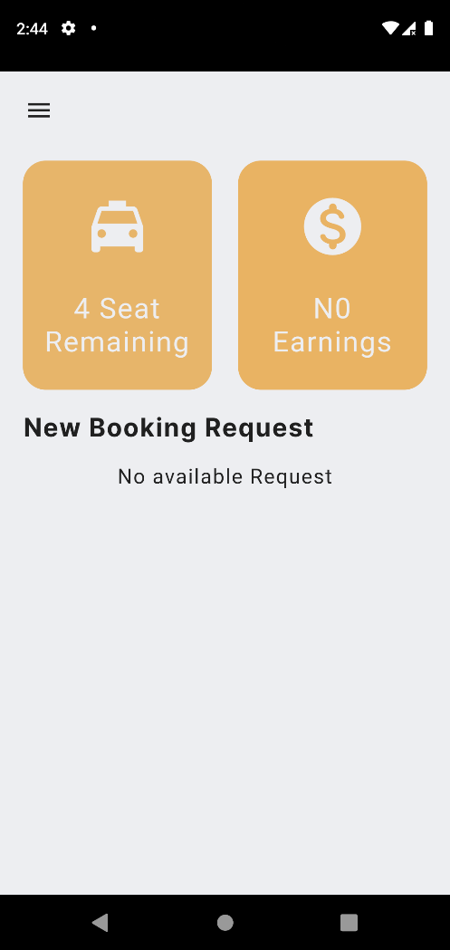
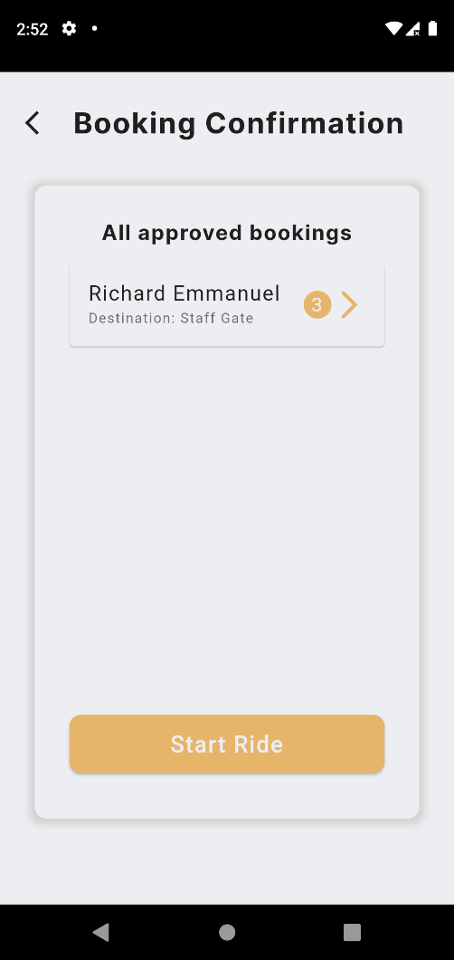
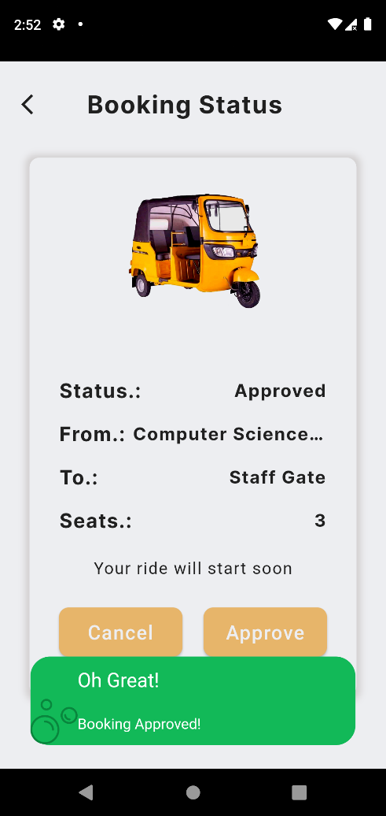
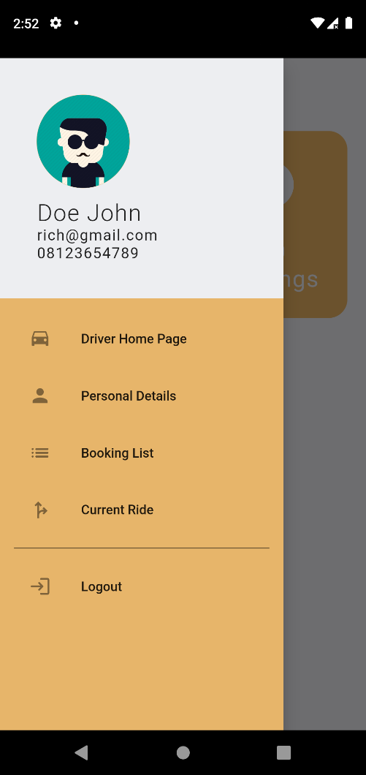
SAMPLE OUTPUT of driver screen
Tricycle Details
Decide Route Screen
Payment Confirmation
Booking Status

Slide 19

Summary
The safe, efficient transportation of students within the school environment is a challenge faced by higher institutions across the country hence the need for this system
conclusion
In conclusion, the system can help to streamline processes within the campus and make it easier for students to get the transportation they need
14

Slide 20

Thank you!
Flora@contoso.com
http://www.contoso.com/

