Slide 1

DEVELOPMENT OF E-PLATFORM FOR HUMAN RESOURCES MANAGEMENT
PREPARED BY: ASMA’U LAMI MUSA
KPT/ODFeL/CST/21/012
SUPERVISED BY: Mal Yusuf Abubakar

Slide 2
TABLE OF CONTENT
Abstract
Introduction
Background of the study
Problem Statement
Motivation
Aim and objectives of the study
Scope of the study
Significance of the study
Methodology
Literature Review
Summary/Conclusion

Slide 3

ABSTRACT
The current and future wellbeing of an organization depends mostly on the activities and management of its human resources element. All activities towards improved productivity such as profit; organizational efficiency and effectiveness can only be made possible by the manner and method in which the human resources are managed. Human resources management therefore occupies a critical position in wellbeing of an organization more especially in the area of facilitating positive changes towards effective performance. Because of this, there is need to improve some areas of operations of human resources department which require improvement or replace areas that may require replacement this initiated. This project focus in computerization of the human resources department that leads or aims at reducing time constraints job involves in the organization including improving inadequate records maintenance in the system that leads to the system problem inadequate production of the product that will satisfy the customers. A computer model will be developed to take care of the problem areas that require computerization and improvement strategies proffered in areas of require appraisal. This will go along way to help the human resources management to meet up with the challenges posed by the development of information technology and go a long way to help around the globe.

Slide 4
INTRODUCTION
The human resources management (HRM) function includes a variety of activities, and key among them is deciding what staffing needs you have and whether to use independent contractors or hire employees to fill these needs, recruiting and training the best employees, ensuring they are high performers, dealing with performance issues and ensuring your personnel and management practices conform to various regulations. Activities also include managing your approach to employee benefits and compensation, employee records and personnel policies. Usually small businesses (for profit or men profit) have carry out these activities themselves because they cannot yet afford part- or full-time help. However, they should always ensure that employees have and also aware of personnel policies which conform to current regulations. These policies are often in the form of employee manuals which all employees have. (Alan et al. 2017)

Slide 5
BACKGROUND OF THE STUDY
Human resource management (HRM), in the sense of getting things done through people. It is an essential part of every manager’s responsibility, but many organizations find it advantageous to establish a specialist division to provide an expert service dedicated to ensuring that the human resource function is performed efficiently.
The rate of change facing organization has never been greater and organizations must absorb and manage change at a much faster rate than in the past. In other to implement a successful business strategy to face this challenge, organizations, large or small, must ensure that they have the right people capable of delivering the strategy. The market place for talented, skilled people is competitive and expensive. Taking on new staff can be disruptive to existing employees. Also it takes time to develop cultural awareness product/process/organization knowledge and experience for new staff members. (Carz et, al 2020)

Slide 6
PROBLEM STATEMENT
It is pertinent to note that adequate emphasis have not been laid by parastatals in terms of promoting a favorable ground for human resources managers and this has greatly affected their performances. The dynamic nature of the environment in which business operates constitutes an important factor that affects management decision and actions. The environment here mans both internal and external factors such as economic social political government technological top management employee task forces among others. For an organization to remain in business it has to help to shape its environment due to the rapid change that the organizations operating environment undergoes.

Slide 7

MOTIVATION
The type of image which an organization projects determines its areas of procurement, recruitment and selection training and development. This is one of the problems which rules human resource management. What a human resource (manpower) is articulated towards the attainment of the organizational goal and aspiration is one of the outstanding problems of resource. Managers in Nigeria organization.

Slide 8
AIM & OBJECTIVES OF THE STUDY
The aim of this project is to design, develop and implement a Human Resource Management system. The objectives of this project are:
To design a fast processing system for human resources management system which stores information about all employees of an organization
To design and develop a central database for managing employee records in an organization
To Evaluate the system in order to ascertain whether the system achieve its primary purpose

Slide 9

SCOPE OF THE STUDY
The study will be focused basically on staff information management, staff training, annual leave processing and staff postings

Slide 10
SIGNIFICANCE OF STUDY
The use of human resource management system gives a long way to solve the problems of manual processing. However, the computerization of manual operations will provide advantages such as proper management of staff information, both existing and new recruits. It will also help in the fast generation of report of all staff present in the company and also their payroll. It will provide security for staff information

Slide 11
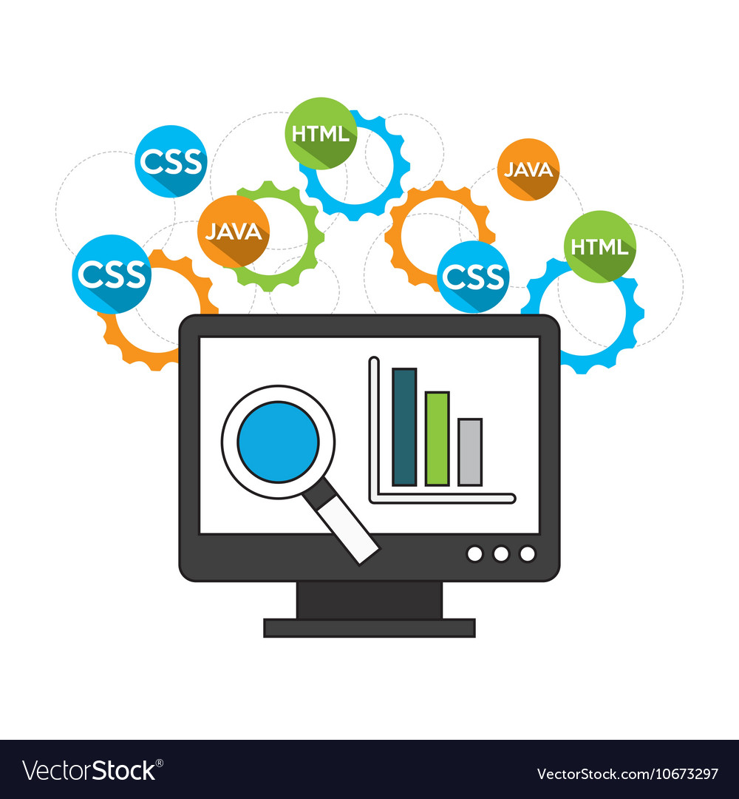
METHODOLOGY
This section explains and elaborates on the research methodology to be used in this project. Methodology is used to ensure a consistent approach that is applied to all phases of a project (Awal, et al, 2019). Methodology also facilitates project accomplishment by structuring the related processes according to the phase defined. In this project, a number of design tools such as class diagrams, use case diagram and activity diagrams will be used, for the software development, PHP/MySQL technology will be used.

Slide 12
LITERATURE REVIEW
e-HRM enables enterprises to investigate the possibilities of information transformation through electronic means to realize strategic objectives like long-term e-HRM systems (Golden-Biddle, 2020). According to eminent academics (Guerci et al., 2019), automating human resource operations improves the organization’s long-term sustainability and provides cost control. Additionally, it supports effective and accurate decision-making about activities related to human resources (Muisyo & Qin, 2021). Kupper et al. (2021) discussed the tactical and overarching e-HRM viewpoints. Strategic e-HRM guides toward higher organizational performances, whereas operational e-HRM assists organizations in increasing return on investment. However, different organizations or businesses have various challenges in adopting e-HRM and its related operations

Slide 13
LITERATURE REVIEW CONT’D
Regarding the definition of e-HRM, there is neither consistency nor consensus. So, a variety of definitions have been put forth. According to Ruël, Bondarouk, and Looise (2004), the term “e-HRM” refers to any combination of HRM and IT to benefit specific managers and employees. The design, implementation, and use of information technology for networking and supporting at least two individual or collective actors in the joint performance of human resource activities are called electronic human resource management (e-HRM). It is utilized for transactional tasks, hiring, choosing, training, paying, and managing performance (Winarto, 2018).
Wege, Ngige, and Dieli (2019) highlighted that electronic, human resources management is the administrative assistance provided to the human resources (HR) unit to facilitate business transactions and implement HR plans, policies, and practices in businesses. According to Zafar (2013),

Slide 14

CONCLUSION
This application would successfully computerize the manual operations and will provide advantages such as proper management of staff information, both existing and new recruits

Slide 15


