Slide 1
LectureMind AI — AI-powered Learning Companion
Presented By:
UTTAM RAWAT
THDC-IHET ,TEHRI , UTTARAKHAND
B. Tech CSE (Ongoing 2023-2027).

Slide 2
OUTLINE
Problem Statement
Proposed System/Solution
System Development Approach
Algorithm & Deployment
Result
Conclusion
Future Scope
References

Slide 3
Problem Statement
Students struggle to convert long lecture audio into structured study material.
Manual note-taking is time-consuming and error-prone.
Existing tools are : Cloud-dependent.
Costly (paid APIs)Limited to transcription only.
Lack of interactive learning from lecture content.
No unified system for notes, flashcards, quizzes, and Q&A.

Slide 4
Proposed Solution
End-to-end local-first web application powered by AI
Automatic transcription, cleaning, and structured content generation
RAG-based chatbot for intelligent Q&A with lectures
No paid API required — fully open-source and self-hosted

Slide 5
System DEVELOPMENT Approach
Modular architecture: separate concerns (transcription, cleaning, generation, RAG)
Streamlit for UI — rapid prototyping and user-friendly dashboard
Local vector database (FAISS) for efficient retrieval
Fallback heuristics for LLM functions when API unavailable

Slide 6
Algorithm & Deployment
Whisper STT: Convert audio to raw transcript
Text Cleaning: Remove fillers, fix punctuation, split paragraphs
Content Generation: Notes, flashcards, quizzes via LLM or heuristic

Slide 7
Algorithm & Deployment
Embedding & Indexing: SentenceTransformers + FAISS vector store
RAG Chat: Retrieve chunks → Generate contextual answers
Deployment: Run via Streamlit; no external service required

Slide 8
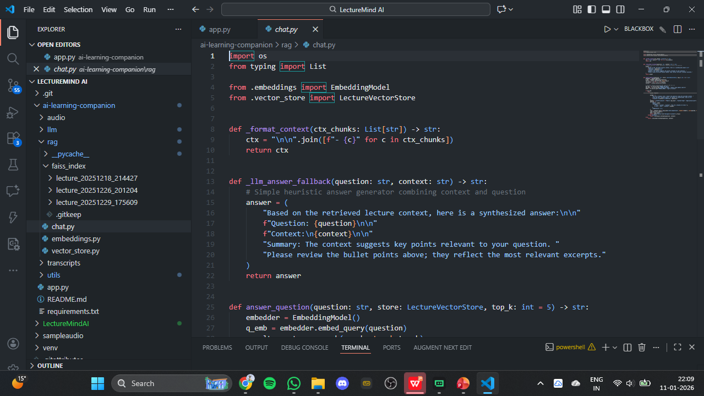
RESULTS

Slide 9
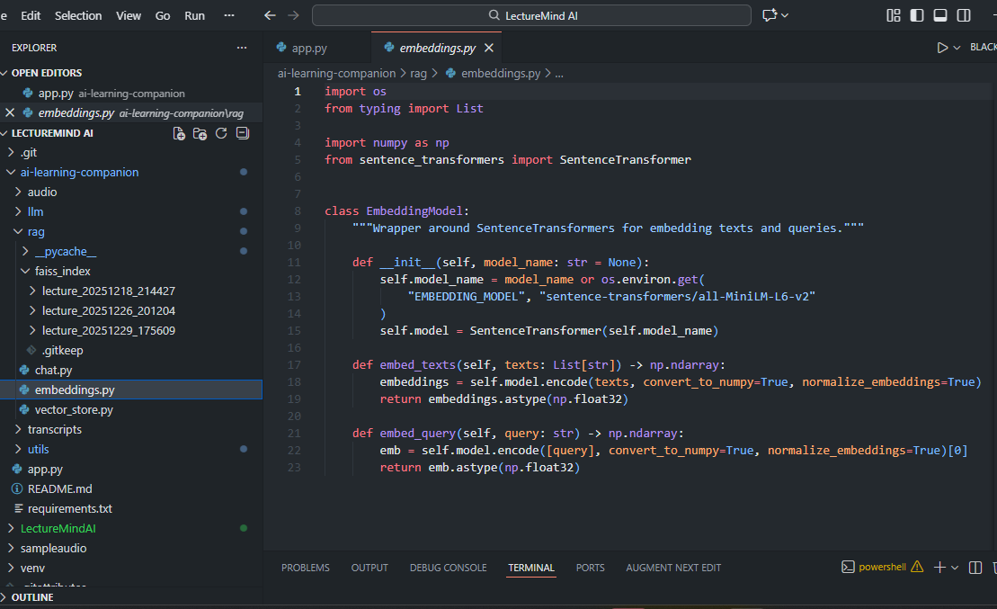
RESULTS

Slide 10
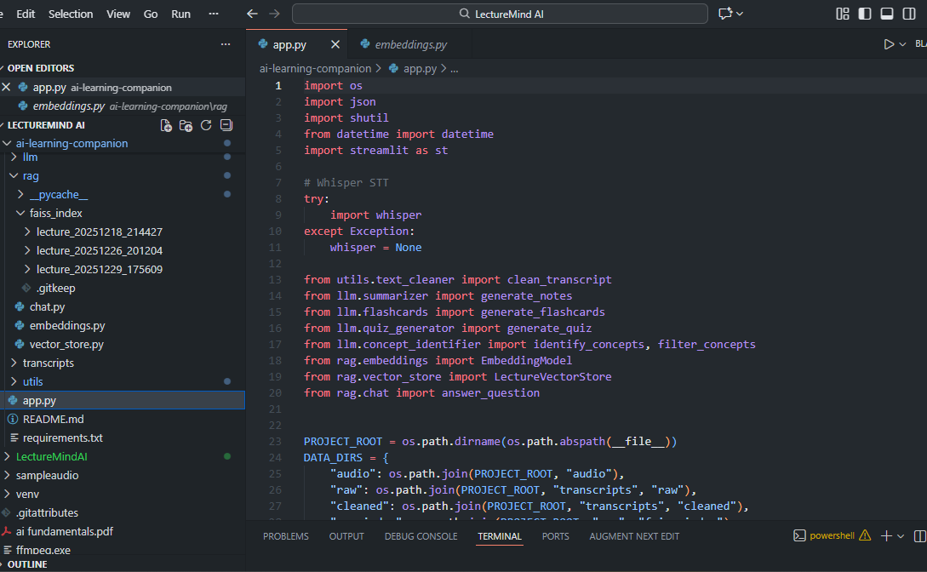
RESULTS

Slide 11
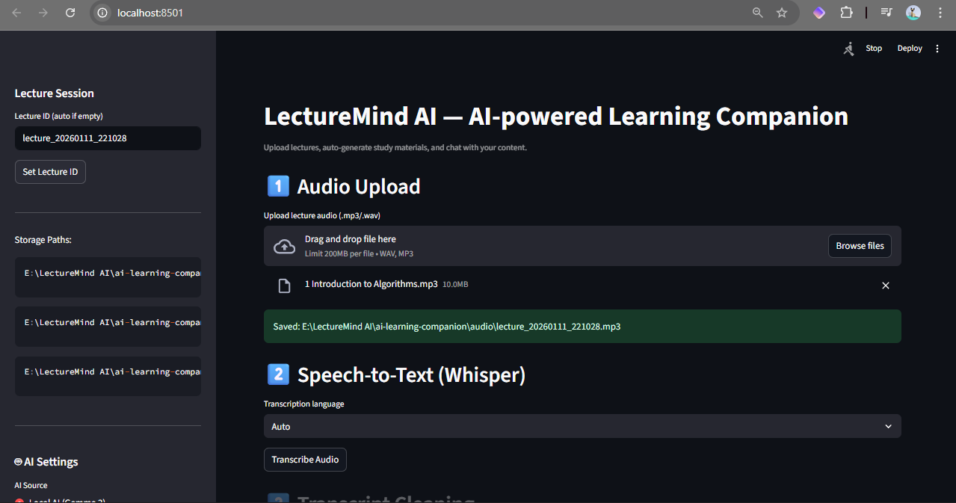
RESULTS

Slide 12
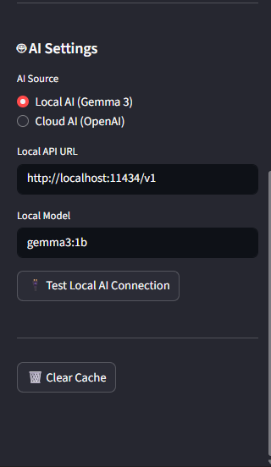
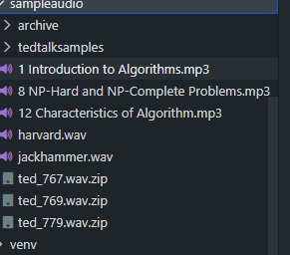
RESULTS

Slide 13
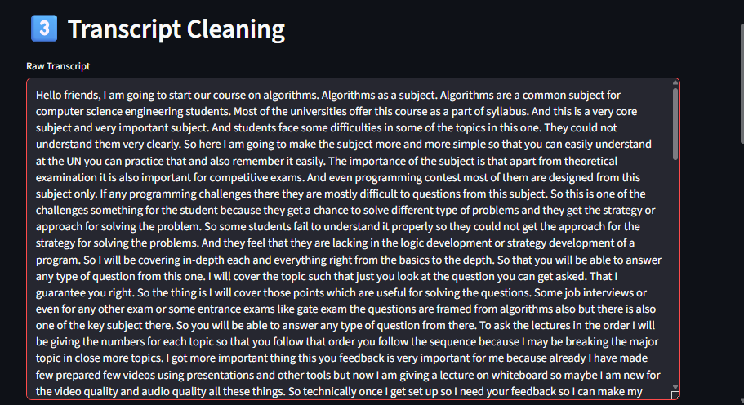
RESULTS

Slide 14
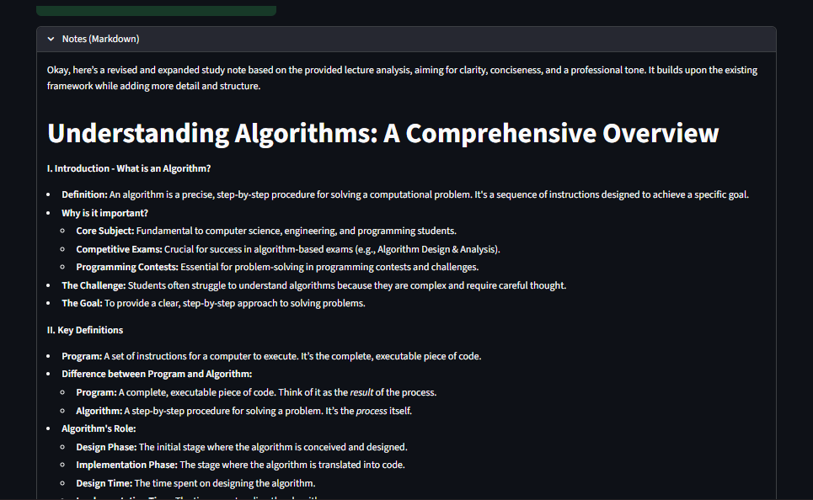
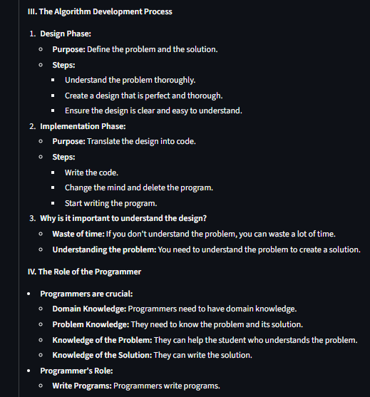
RESULTS

Slide 15
References
OpenAI Whisper: Speech-to-text models
FAISS: Efficient similarity search and clustering
Streamlit: Rapid web application development
SentenceTransformers: Semantic text embeddings
LangChain: RAG pipeline inspiration and chunking strategies

Slide 16
Future scope
Multilingual transcription and content generation
Real-time speaker diarization for multi-speaker lectures
Collaborative RAG for shared lecture repositories
Mobile app for on-the-go access to study materials
.

Slide 17
Conclusion
LectureMind AI democratizes learning by transforming raw lecture content into actionable study materials. With a modular, local-first architecture, it empowers students to learn smarter without infrastructure or cost barriers. The project is production-ready and scalable for classrooms and institutions.

Slide 18
THANK YOU

Slide 19
Github link
Github Link : https://github.com/the-introvert20/LectureMind.AI.git
Deployment link : https://lecturemindai-najuzbv6topc4zgedyafxh.streamlit.app/

