Slide 1
offset.io
CALCULATION TRACE
390 km/monthly
× 0.192 kg CO₂e/km (emission factor)
Personal Carbon Intelligence & Reduction Platform
× 12 (frequency multiplier)
= 898.56 kg CO₂e / year
Measure
›
Understand
›
Simulate
›
Optimize
›
Track
MEDIUM
confidence band ± 15% · estimate, not a measurement
A prototype platform that measures an estimated personal carbon footprint, explains it, and helps plan reductions.
23
6
16
67
Uttam Rawat
THDC – Institute of hydropower engineering and technology
1M1B AI for Sustainability
Virtual Internship
IBM SkillsBuild · AICTE
seeded emission factors
pure domain engines
REST API routes
automated tests
Notes:
Open: "This is offset.io - a personal carbon intelligence and reduction platform I built for the 1M1B AI for Sustainability internship with IBM SkillsBuild and AICTE."
Say the tagline as the story of the product: Measure, Understand, Simulate, Optimize, Track.
Point at the trace on the right: "This is a real calculation from the app. 390 km driven per month, times the emission factor for that fuel type, times 12 months, equals about 899 kg of CO2 a year. Nothing is hidden, and we show the confidence band because this is an estimate."
Transition: "To explain why I built it this way, let me start with the problem."

Slide 2
Knowing your footprint isn't enough.
Most calculators hand you a number and stop there.
THE USUAL EXPERIENCE
1
Answer ~10 questions
Where do my emissions actually come from?
Which of these can I realistically change?
2
Get one static estimate
3
Close the tab
What happens to my footprint if I change it?
Am I actually improving over time?
One number. One time. No next step.
These four questions are where behaviour change actually happens — and where a static calculator leaves the user alone.
Notes:
Explain simply: "Almost every carbon calculator works like a quiz. You answer a few questions, it gives you a number like 4.5 tonnes, and that's the end."
"The number itself doesn't change anything. To actually reduce emissions a person needs four things: where the emissions come from, what they can change, what would happen if they changed it, and whether they are improving."
Keep it conversational - ask the audience: "If I told you your footprint is 4.5 tonnes, what would you do tomorrow morning?" That lands the gap.
Transition: "So there is a clear gap between measuring and deciding."

Slide 3
The gap
Measurement is a moment. Decisions are a loop.
TRADITIONAL CALCULATOR
Questionnaire
→
Footprint
→
Done
✕ dead end
OFFSET.IO
Measure
→
Understand
→
Simulate
→
Optimize
→
Track
↑ new data feeds the next cycle
offset.io turns carbon measurement into an ongoing decision-support system, not a one-time score.
Notes:
Say: "Traditional tools are a straight line - questionnaire, footprint, done. The user hits a dead end."
"offset.io is a loop. You measure, you understand where the emissions come from, you simulate a change before committing to it, you optimise a plan within your budget, and then you track it. The tracking data feeds back into the next cycle."
Emphasise the one sentence at the bottom - this is the core idea of the whole project.
Transition: "Here is what that loop actually looks like as a product."

Slide 4
offset.io
One product, built around the loop.
01 · MEASURE & UNDERSTAND
02 · SIMULATE & DECIDE
03 · TRACK & IMPROVE
Activity-based calculation
What-If simulator
Carbon diary
Persistent travel, energy, diet and waste activities
Re-calculate a hypothetical lifestyle without touching your baseline
Daily logging with a live estimate before you save
Transparent emission factors
Scenario manager
Anomaly detection
Region-aware lookup with source attribution
Save, edit and compare alternative lifestyles
Flags unusual emission spikes statistically
Uncertainty & confidence
Recommendations
Carbon Coach
Weighted score plus a likely min–max range
Seven deterministic rules matched to your own footprint
Answers questions using your real footprint numbers
Reduction plan optimizer
Best CO₂e saved per unit of spend, within a budget
Every capability runs on the same stored activity data — so a change in one place is reflected everywhere.
Notes:
Don't read all ten features. Read the three column headers - Measure and Understand, Simulate and Decide, Track and Improve - and then pick one feature from each.
Suggested picks: transparent emission factors (you can see the maths), the What-If simulator (test a change before making it), and the Carbon Coach (ask questions about your own numbers).
Key line: "All of this sits on one stored activity model, so the simulator, the plan and the diary are always talking about the same footprint."
Transition: "Let me show you what happens under the hood when you enter an activity."

Slide 5
How it works
From a raw activity to a tracked reduction plan.
User activities
THE CORE FORMULA
↓
Emission factor database
Annual emissions =
quantity × emission factor × frequency multiplier
↓
Carbon calculation engine
Deterministic. Same inputs always give the same output.
↓
Footprint + uncertainty
FREQUENCY MULTIPLIER
↓
Dashboard / What-If / Recommendations
365
52
12
1
↓
Optimization
Daily
Weekly
Monthly
Yearly
↓
Reduction plan
If a factor cannot be resolved, the engine fails loudly with an error — it never invents a placeholder number. Every result stores an audit record of the exact factor, formula and confidence used.
↓
Tracking
Notes:
Walk down the left flow slowly with your hand: activities go in, factors are looked up, the engine calculates, you get a footprint with an uncertainty range, that powers the dashboard, simulator and recommendations, the optimizer builds a plan, and the diary tracks it.
Then the formula: "Quantity times emission factor times frequency multiplier. If you drive 390 km a month, the multiplier is 12 because monthly means twelve times a year."
Say the multipliers out loud: daily 365, weekly 52, monthly 12, yearly 1. Non-technical audiences understand the product instantly once they hear this.
End on the box at the bottom right: the engine refuses to guess. Missing factor equals a visible error, not a fake number.
Transition: "Now, the question everyone asks - where is the AI?"

Slide 6
Where AI is used — and where it is not.
The Carbon Coach explains the numbers. It does not produce them.
LOCAL MODE
Default
GROQ MODE
Optional
AI does not calculate the carbon footprint.
· Deterministic keyword rules
· Conversational LLM replies
· Zero external API calls
· Richer, friendlier explanations
· Answers from your real footprint
· Same footprint data as context
Every number comes from the deterministic calculation engine. The Coach only reads results that already exist.
· Works fully offline
· Silent fallback to local mode
THE ACTUAL PIPELINE
Real data
→
Calculation engine
→
Recommendations & insights
→
Carbon Coach
→
User explanation
Engineering decision: numerical trust comes from deterministic code; language comprehension is where AI adds value.
Notes:
This is the most important slide for the internship evaluation. Say this line exactly: "AI does not calculate the carbon footprint."
Explain: "The numbers come from a deterministic engine - the same inputs always give the same output, and every step is auditable. The AI layer is the Carbon Coach, which explains those numbers in plain language."
Two modes: local mode is the default, uses deterministic rules over your real footprint, needs no internet or external AI. Groq mode is optional and gives richer conversational answers, and if the key is missing or the request fails it silently falls back to local.
Walk the pipeline left to right: real data, calculation engine, recommendations, coach, explanation. AI sits at the end, not at the start.
Transition: "That separation is enforced by the architecture."

Slide 7
Technical architecture
Layered, with pure calculation logic isolated from the framework.
Next.js 14 / React / TypeScript
Pages, dashboard, simulator, diary UI
SIX PURE DOMAIN ENGINES
↓
calculator.ts
API route handlers
16 REST endpoints
quantity × factor × frequency
↓
uncertainty.ts
Authentication + validation
JWT session cookie, Zod schema checks
confidence score & ± range
↓
recommendation.ts
Application services
Orchestration, factor caching, goal workflows
7 rules matched to the footprint
↓
optimizer.ts
Pure domain engines
Side-effect-free business maths
greedy knapsack under budget
↓
anomaly.ts
Prisma ORM
Type-safe data access, 11 models
rolling z-score ≥ 2.0 spike flag
↓
coach.ts
SQLite
Local single-file database
local rules / optional Groq
No database or UI imports inside the engines — so they are unit-testable in isolation (67 tests, 18 suites).
Notes:
Keep this slide short and confident. "The app is layered. The browser talks to API routes, every request is authenticated and validated, services orchestrate the work, and the actual maths lives in pure engines that know nothing about React or the database."
Why it matters: "Because the engines are pure functions, I can unit test them directly. There are 67 automated tests across 18 suites."
Name the six engines quickly - calculator, uncertainty, recommendation, optimizer, anomaly, coach - and note the optimizer is a greedy knapsack algorithm and the anomaly detector is a z-score, in case a technical evaluator wants to dig in.
Transition: "Here is how that appears to the user."

Slide 8
The Prototype
Six screens that carry the loop.
Transparent calculation
What-If simulator
Scenario manager
Input × factor = result, with source, region and ± confidence for each activity.
Seven controls re-calculate a hypothetical footprint without touching your baseline.
Save, edit and compare alternative lifestyles side by side against your goal.
Reduction plan optimizer
Carbon diary
Carbon Coach
Picks the actions with the best CO₂e saved per unit of spend, within your budget.
Daily logging with a live estimate and automatic anomaly flags on unusual spikes.
Question and answer over your own footprint numbers, local or Groq mode.
Diagrams above are layout mockups. Replace them with live screenshots from your running build before the final demo.
Notes:
This is your demo slide. If you have a live build, open it here instead of talking over the mockups - and replace these placeholder diagrams with real screenshots before submission.
If demoing: show the calculate page first (transparency), then move a slider in the simulator, then generate a reduction plan, then log one diary entry.
If not demoing: pick two features and describe them in one sentence each. Do not read all six.
Be honest that this is a prototype - nothing here is a claimed commercial result.
Transition: "Because this deals with people's data and with estimates, responsible AI mattered from day one."

Slide 9
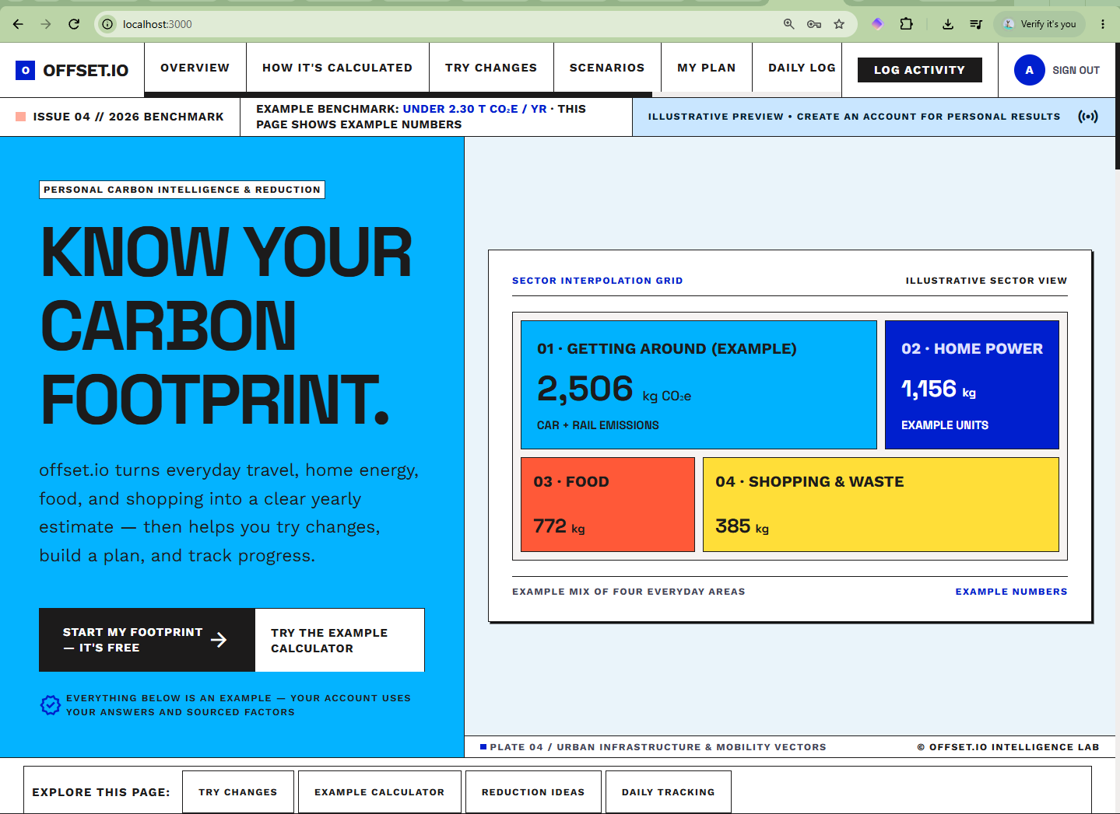
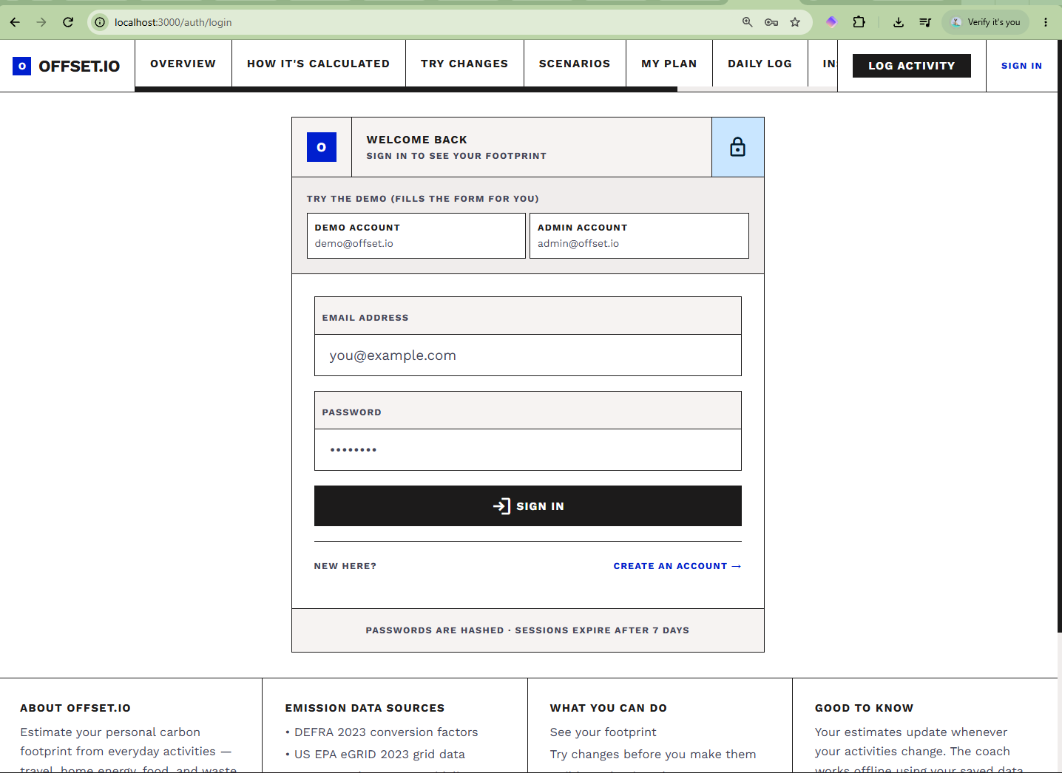

Slide 10
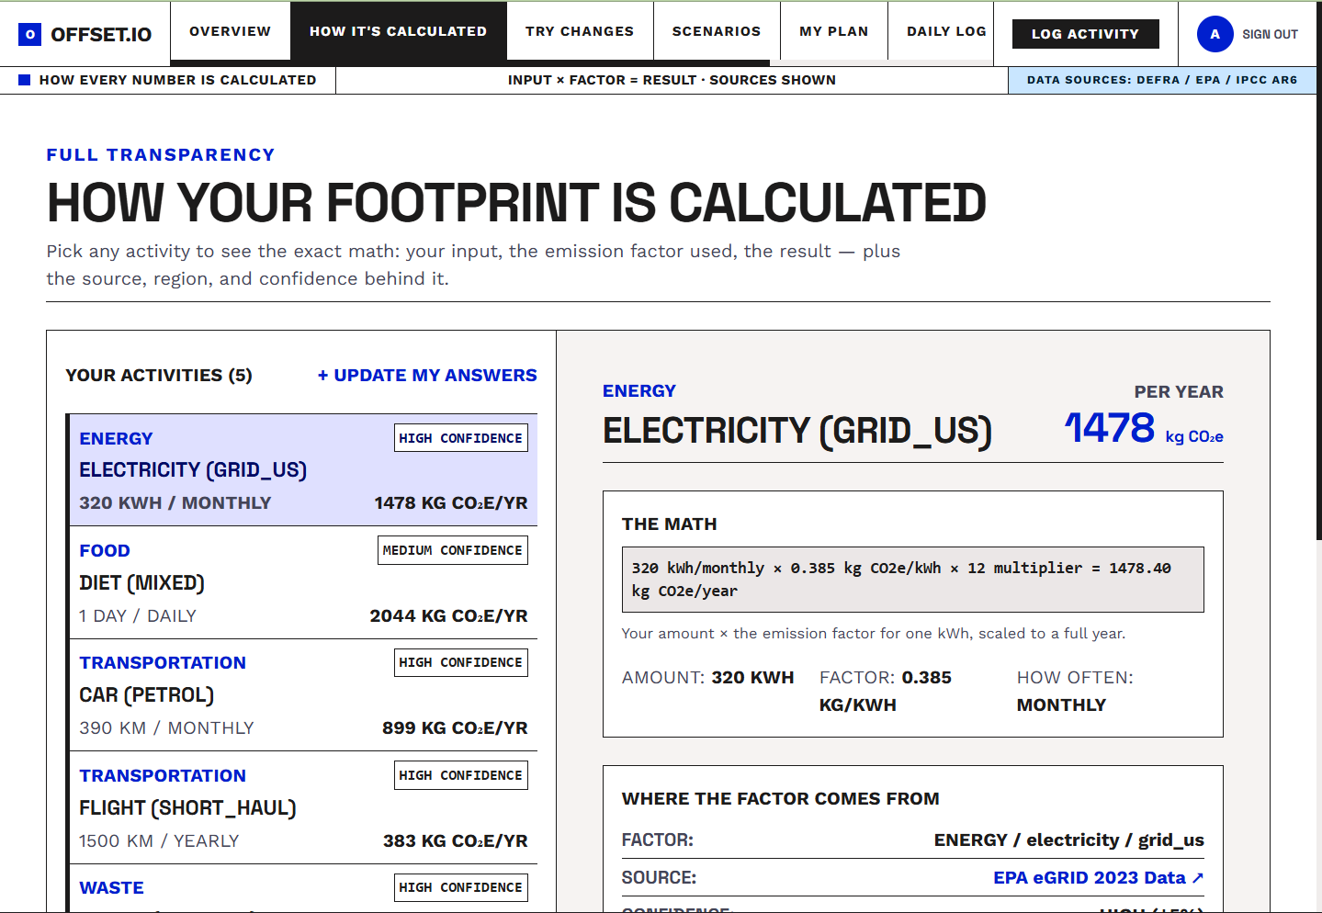
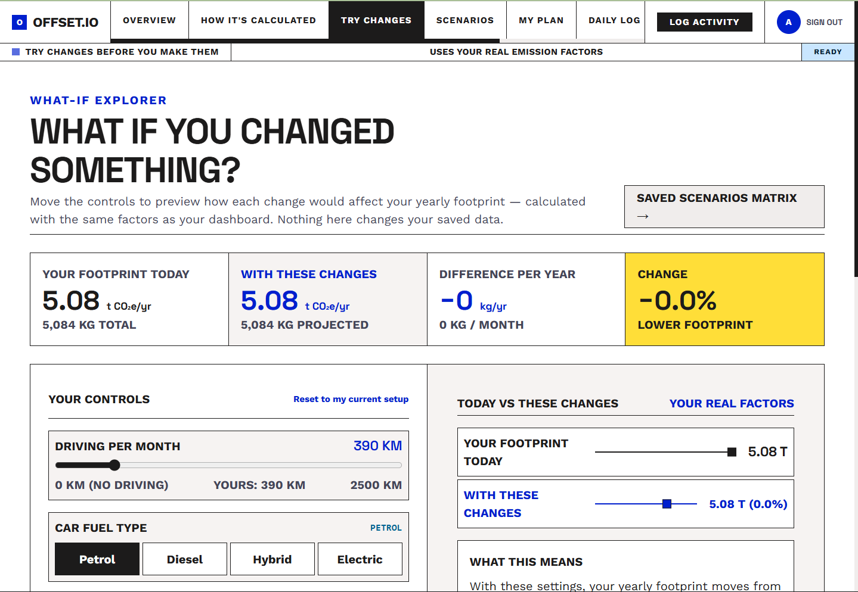

Slide 11
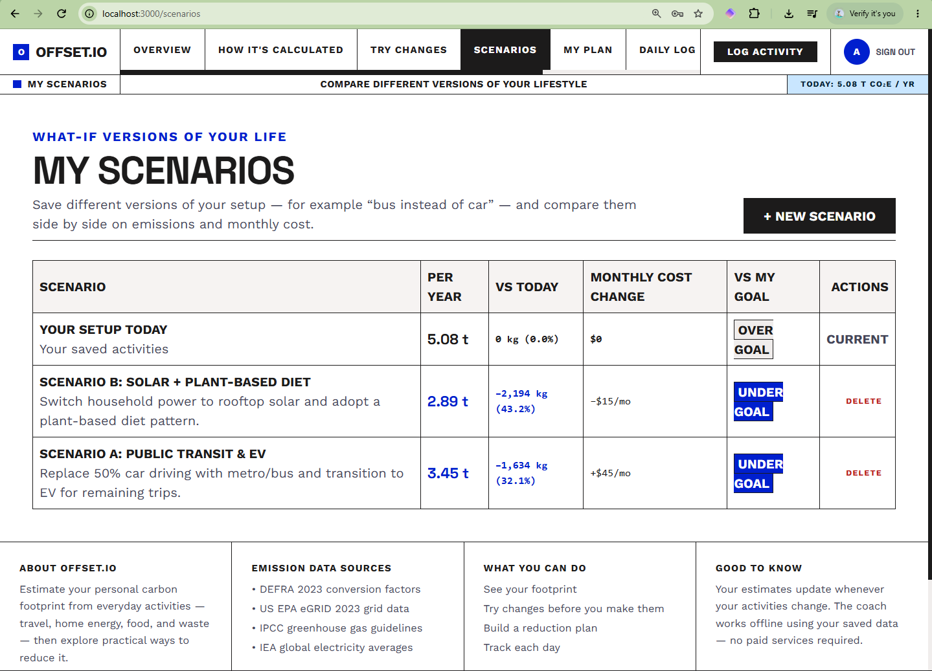
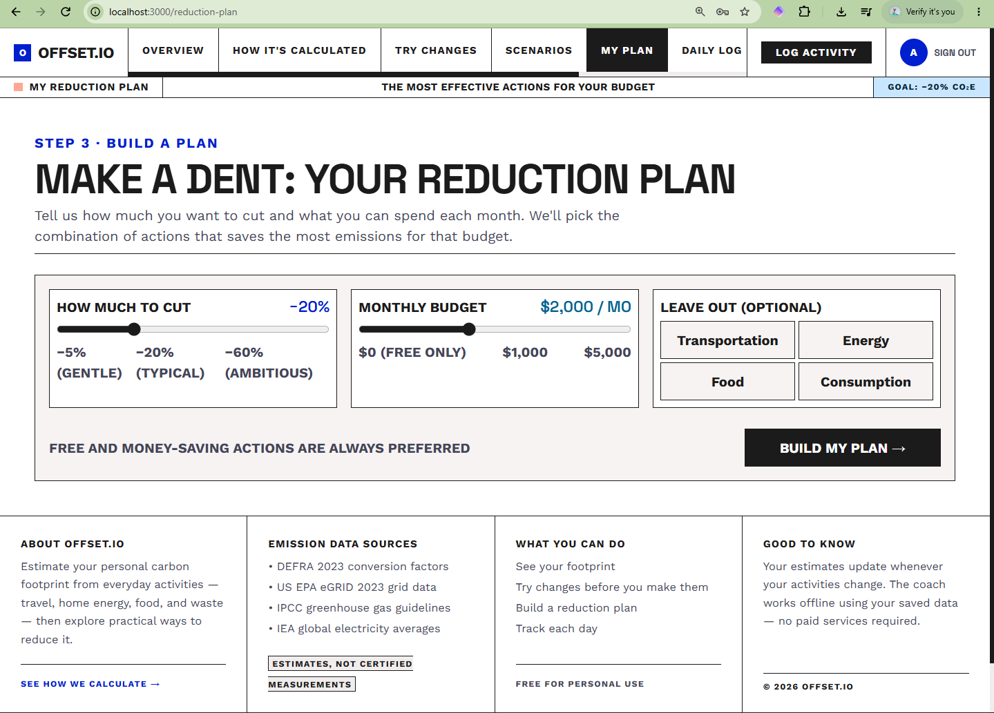

Slide 12
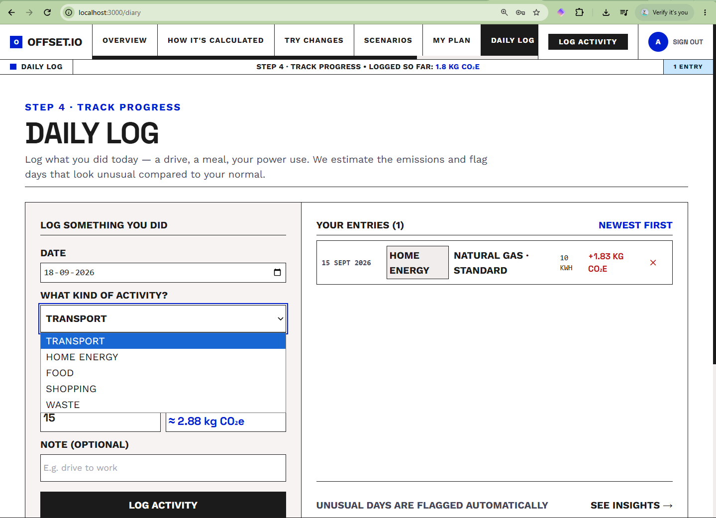
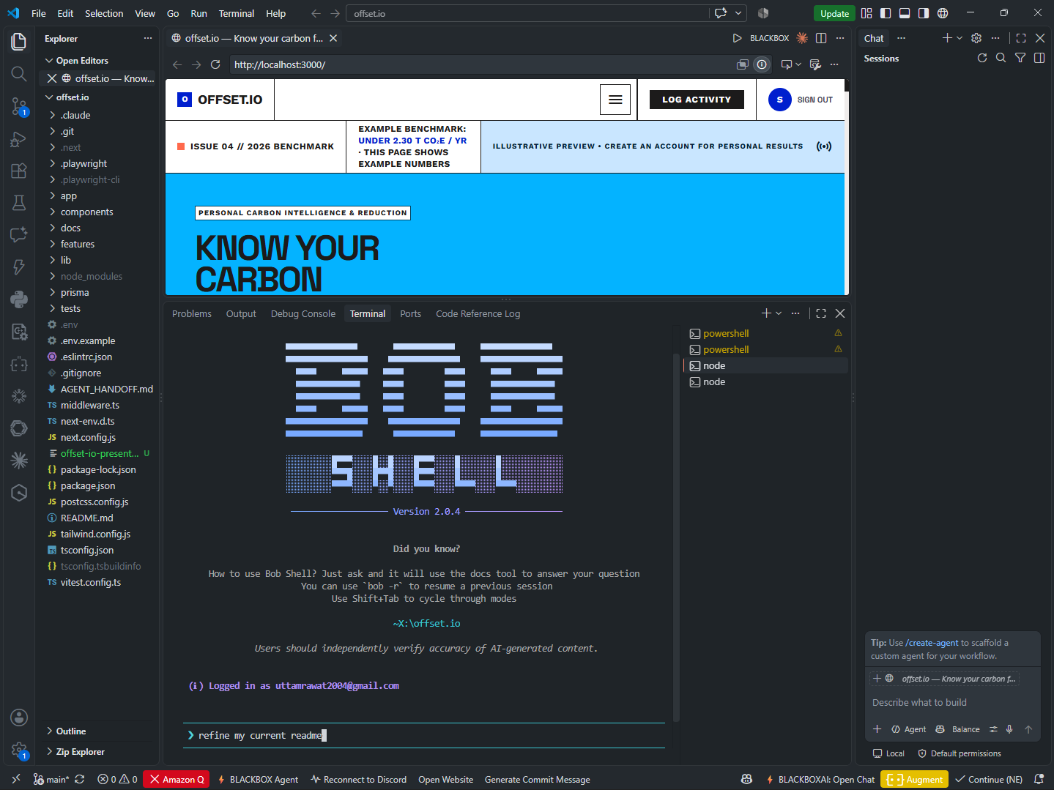

Slide 13
Responsible AI, built into the product
Not a policy page — these are implementation decisions.
01
02
03
04
05
Transparency
Fairness
Privacy
Honesty
Human control
Factors, formulas, sources, region and confidence are all visible in the app.
Region-specific factors where supported, with a documented global fallback.
Authenticated, user-scoped data. Every record belongs to one signed-in account.
Results are labelled estimates with a ± range, never exact measurements.
The user chooses what to simulate and which actions to adopt. Nothing is automatic.
Known limits are documented, not hidden: SQLite single-file storage, diary logging restricted to global-region factors, no consumption activities in the simulator, and no browser end-to-end tests yet.
Notes:
Frame it as engineering, not paperwork: "Each of these principles maps to something I actually built."
Transparency - the calculate page shows input times factor equals result with the source link. Fairness - factors are region-aware with a documented global fallback. Privacy - every record is scoped to a signed-in user with a secure session cookie. Honesty - the app shows a confidence band instead of pretending to be exact. Human control - the user decides what to simulate and what to adopt.
The bottom strip is important: I documented the known limitations in the README rather than hiding them. Evaluators respect that.
Transition: "So what impact is this meant to have?"

Slide 14
SDG alignment and expected impact
EXPECTED IMPACT PATHWAY
PRIMARY
SDG 13
1
Measure
A baseline footprint from real activities
Climate Action
2
Awareness
Individual emission awareness and reduction planning.
The user sees the size of their own emissions
3
Understanding
They see which activities actually dominate
SECONDARY
SDG 12
Responsible Consumption and Production
4
Action
They test changes and get a budget-fit plan
Diet, energy, travel and waste choices made visible and comparable.
5
Tracking
They log daily and watch the trend
This is the intended impact of a prototype. No measured environmental outcome is claimed — the platform reports estimated emissions, not verified reductions.
Notes:
Say: "The primary alignment is SDG 13, Climate Action, because the whole product is about personal emissions. The secondary is SDG 12, Responsible Consumption and Production, because the categories are travel, energy, diet and waste - all consumption choices."
Walk the pathway: measure, awareness, understanding, action, tracking.
Then say the honest line at the bottom out loud, do not skip it: "This is expected impact from a prototype. I am not claiming any measured carbon reduction, and the platform reports estimated emissions." That honesty is itself part of the evaluation criteria.
Transition: "Finally, where this goes next."

Slide 15
What's next
Roadmap items still open in the GitHub repository.
GITHUB LINK : CLICK HERE
Admin factor edit & deactivation
Currently list and create only
Don't just calculate your footprint.
Browser end-to-end testing
Cypress or Playwright on top of the 67 existing tests
Understand it. Change it. Track it.
PostgreSQL / multi-tenant support
Move beyond a single-file SQLite database
Persisted reduction plans linked to goals
With automatic re-evaluation as the footprint changes
offset.io turns carbon measurement into an ongoing feedback loop for more informed personal decisions.
Improved simulator cost modelling
More realistic spend estimates per action
Broader consumption coverage
Measure
Understand
Simulate
Optimize
Track
Clothing and electronics in onboarding and the simulator
Thank you · 1M1B AI for Sustainability · IBM SkillsBuild · AICTE
Notes:
Keep the roadmap brisk - read three of the six, and mention that these are genuinely open items in the repo, not marketing promises.
Then slow down and deliver the closing line with a pause between the sentences: "Don't just calculate your footprint. Understand it. Change it. Track it."
Finish with the one-line description and thank the panel. Then stop talking and invite questions - do not keep adding detail after the closing line.

