Slide 1
Students Attention Monitoring System using Facial Landmark Points
Debaleen Das Spandan, Jeniya Sultana, Shusmoy Chowdhury
Missouri State University

Slide 2
Problem Statement
Student Engagement can significantly impact their academic performance
Eye-tracking systems can be used to examine human attention and cognitive functions by monitoring eye movement data
Focus on developing a system to monitor student's attention using facial landmark points
Will Detect if the student is engaged in the classroom or not

Slide 3
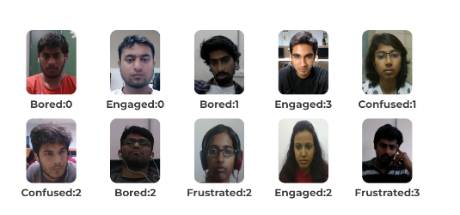
Data Collection
DAiSEE Dataset
Contains 9068 video snippets captured from 112 user
4 different user activities boredom, confusion, engagement, and frustration.
The dataset has four levels of labels namely - very low(0), low(1), high(2), and very high(3) for each of the affective states

Slide 4
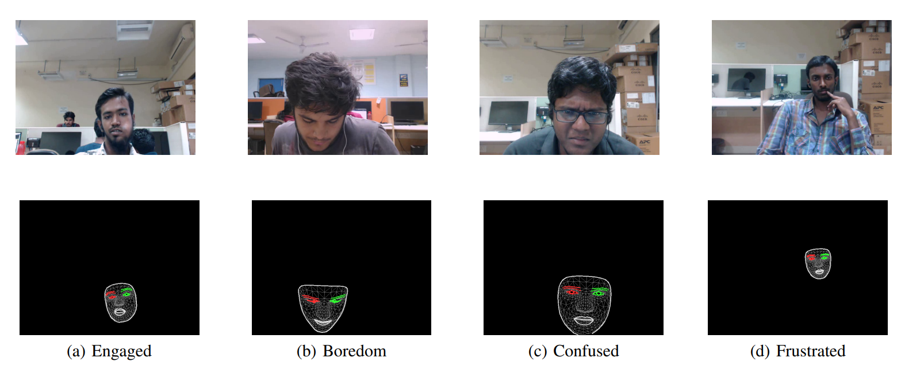
Pre-processing

Slide 5

Pre-Processing (Contd.)

Slide 6
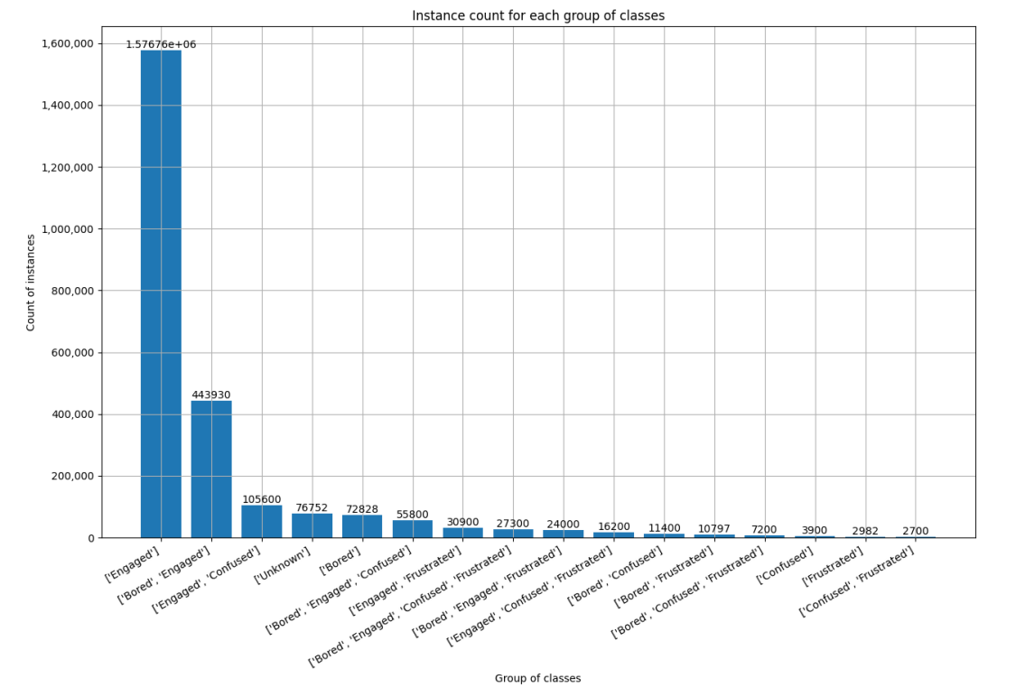
Class label Distribution

Slide 7
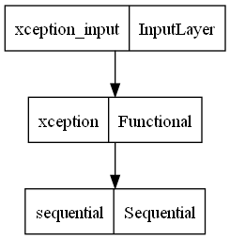
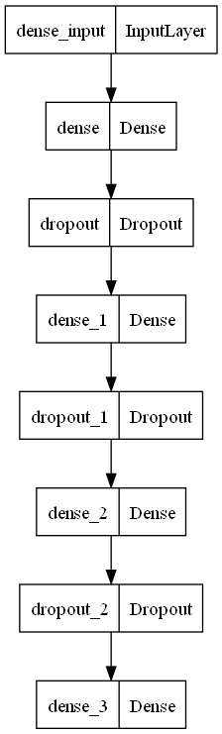
Method(Xception)
16 classes
Combination of Engaged, Frustrated, Confused and Boredom
Input shape of (299, 299, 3) for each instance

Slide 8
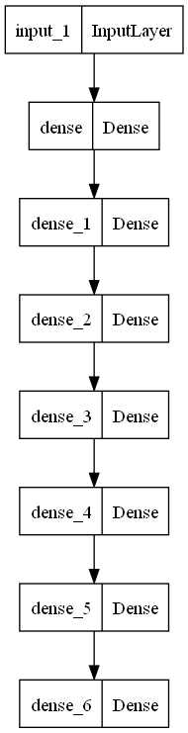
Method (Fully Connected Deep Neural Network)
Two classes
Engaged
Not Engaged
Input is a vector of shape (478, )

Slide 9
Results
Model | Number of Classes | Accuracy
Xception | 16 | 65.3%
Fully Connected Deep Neural Network | 2 | 63.3%

Slide 10
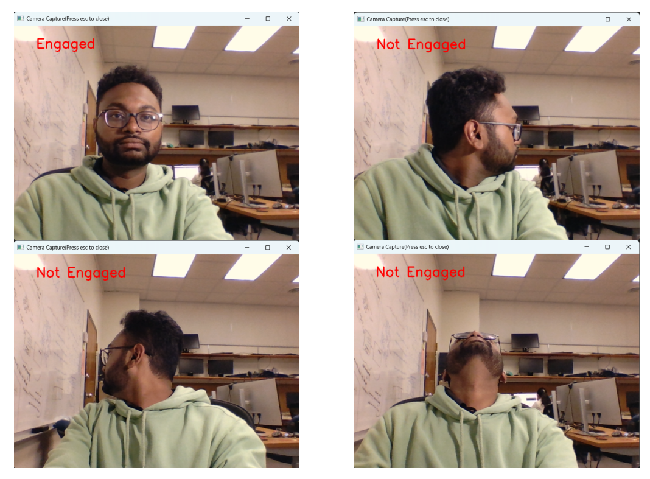
Results
Real Time

Slide 11
Thank you
Any questions?

