Slide 1
Natural disaster damage estimation
Supervisor
Dr Rafi
Group Members
Muhammad Ali Zia (k15-2123)
Saad Kamran (k15-2206)
Sarim Balkhi (k15-2173)

Slide 2
Contents
The Problem, "Damage Estimation of Natural Disasters"
Importance of Damage Estimation
Proposed Solution
Introduction to Project
How it works
Demo
Q&A's

Slide 3
The Problem

Slide 4
Natural Disasters
“A natural disaster is a major adverse event resulting from natural processes of the Earth; examples are floods, hurricanes, earthquakes, and other geologic processes. A natural disaster can cause loss of life or property damage, and typically leaves some economic damage in its wake, the severity of which depends on the affected population's resilience. For example, Nepal during the 2015 earthquake, which had disastrous consequences.” (Source: Wikipedia)

Slide 5
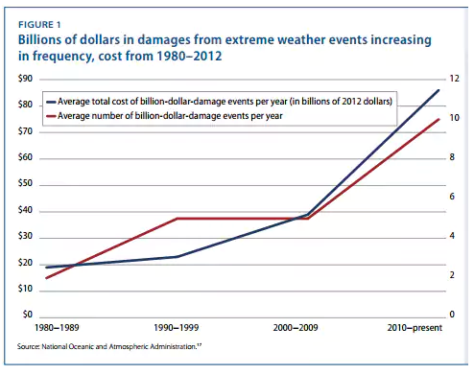
“The government is spending way more on disaster relief than anybody thought”
(Source: The Washington Post 2013)

Slide 6
How to quantify and estimate damage?
Following sources were highlighted by NOAA's National Centers for Environmental Information (NCEI) which contributes in natural disasters’ damage estimation in United States
National Weather Service
Federal Emergency Management Agency
U.S. Department of Agriculture
National Interagency Fire Center
U.S. Army Corps
Individual state emergency management agencies
State and regional climate centers
Media reports
Insurance industry estimates
Non Governmental Organization (NGO)

Slide 7
Importance of damage estimation

Slide 8
Why it is so important?
Effects on Economy
In the first 7 months there have been 6 weather and climate disaster events, in U.S, with losses exceeding $1 billion each across the United States. This had significant economic effects on the areas impacted.
Rehabilitation
Effected population and rehabilitation programs for the population.

Slide 9
Proposed Solution
Automated
More Cost Efficient
More Time Efficient
Real Time Analysis
Resource Management

Slide 10
Introduction to project

Slide 11
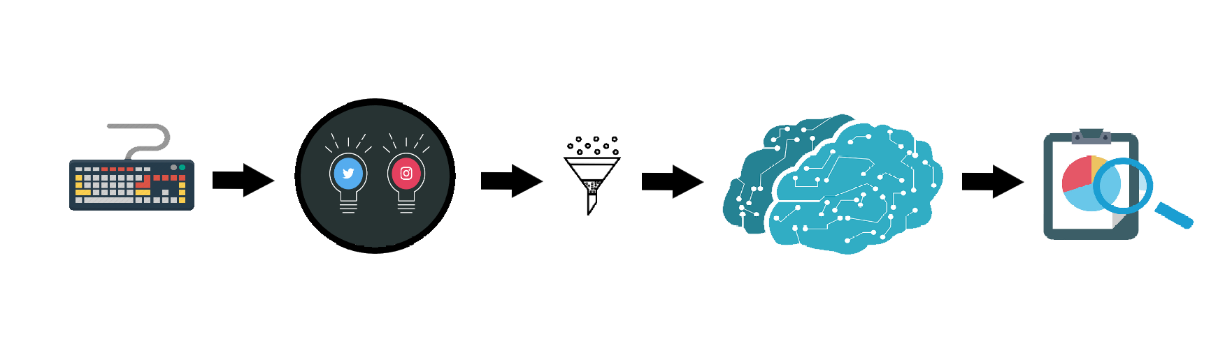
Project Overview
The system can be divided into two major parts.
Scraping data from social media.
Evaluating damage by processing text and images.

Slide 12
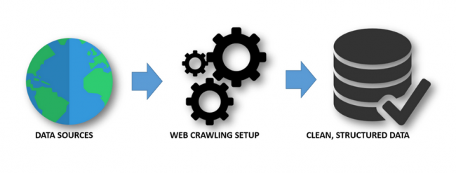
Scraping Data From Twitter & Instagram

Slide 13
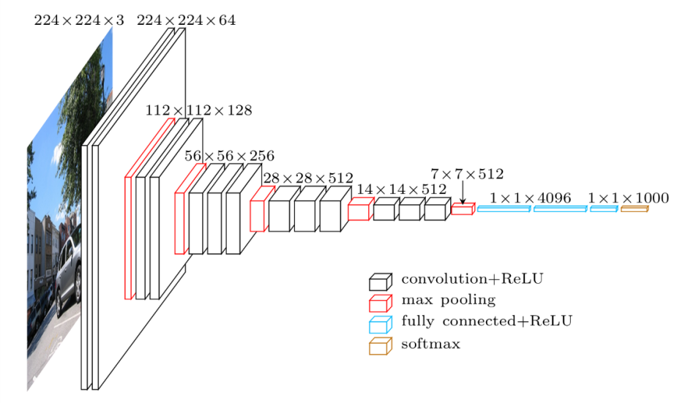
Convolutional Neural Networks

Slide 14
Challenges
Irrelevant data (Example: Memes)
Post Incident Images Only

Slide 15
How it works

Slide 16
Technologies Used
Python
Selenium
Tweepy
Keras
Tensorflow

Slide 17
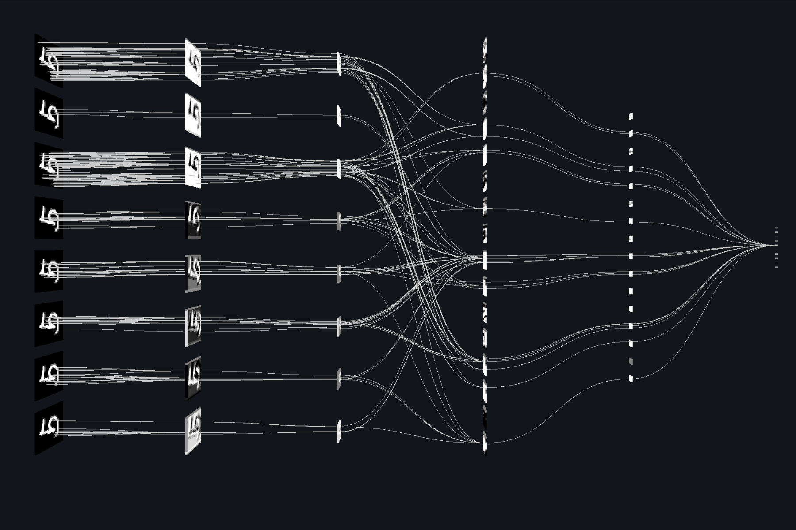
Filtering out irrelevant data
Transfer Learning
Improvement of learning in a new task through the transfer of knowledge from a related task that has already been learned

Slide 18
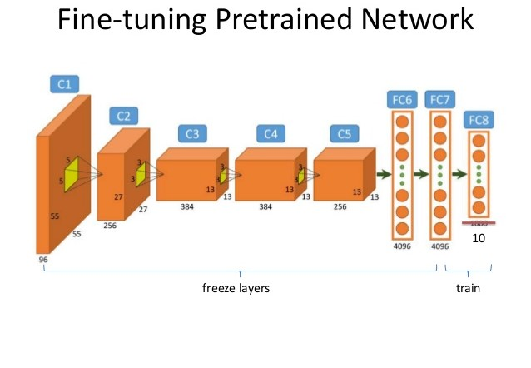
Damage Estimation
Goal
A hybrid Model to estimate damage on the basis of input data, i.e. images and text.
Baseline for Performance
Fine Tuning
Accuracy: 82% (+-2%)

Slide 19
DEmo

Slide 20
Any questions?

Slide 21
Thank you

