Slide 1

KnowsItAll
A Decentralized Peer-to-Peer Knowledge Economy
Master of Computer Applications (MCA)
· Presented by: Kunal Gangani [25]
Mahesh Mathpati [28]

Slide 2

The Knowledge Gap
The Problem
High Cost
Traditional learning is costly, centralized, and disconnected from local talent. Skilled individuals in your neighborhood remain invisible — their expertise locked behind no platform, no visibility, no trust.
Online courses & tutors demand premium pricing most learners can't sustain
Hidden Talent
Local experts are unorganized, undiscoverable, and underutilized
Zero Trust
No verifiable mechanism to validate peer credentials or past performance

Slide 3
Introducing KnowsItAll
A unified mobile ecosystem that connects local skill-seekers with local skill-givers — within a 5km radius — through transparent barter and token-based exchange.
Localized Discovery
Hybrid Barter / Token Economy
Verifiable Trust
GPS-powered Skill Radar surfaces nearby experts in real time within a geofenced radius
Every transaction cryptographically sealed via the Trust Ledger — immutable, auditable, tamper-proof
Trade skills directly or use SkillTokens — a dual-mode value exchange built for equity

Slide 4

Core Objectives
Hyper-Local Connectivity
1
Geospatial discovery within a precise 5km Radius using GPS clustering
Dual-Mode Trade
2
Flexible value exchange: direct skill barter or SkillToken transactions
Immutable Reputation
3
Cryptographic hashing via SHA-256 ensures tamper-proof ledger entries
Verified Skill Passports
4
User-owned credentials validated through community attestation and transaction history

Slide 5
Technical Stack
Built on a modern, production-grade architecture optimized for mobile-first performance and cryptographic integrity.
Frontend
Backend
Kotlin · Jetpack Compose
Java · Spring Boot
Declarative UI with reactive state management
RESTful APIs with layered service architecture
Database
Security
PostgreSQL (Cloud) · Room DB (Local)
JWT Auth · SHA-256 Hashing
Dual-layer persistence for offline resilience
Stateless sessions with cryptographic integrity

Slide 6
System Features
Skill Radar
Trust Ledger
A GPS-based discovery engine that renders a live map of nearby skill-providers. Users broadcast availability with category tags, session slots, and rating badges — all rendered within the 5km Radius geofence.
Each completed session generates a cryptographic transaction record, hashed via SHA-256 and appended to a linear, append-only ledger — mimicking blockchain immutability without full decentralization overhead.
Real-time geospatial clustering
Category filters & availability windows
Distance-sorted ranked results
QR + Video handshake proof-of-completion
Hash-chained immutable entries
Auditable reputation timeline per user

Slide 7
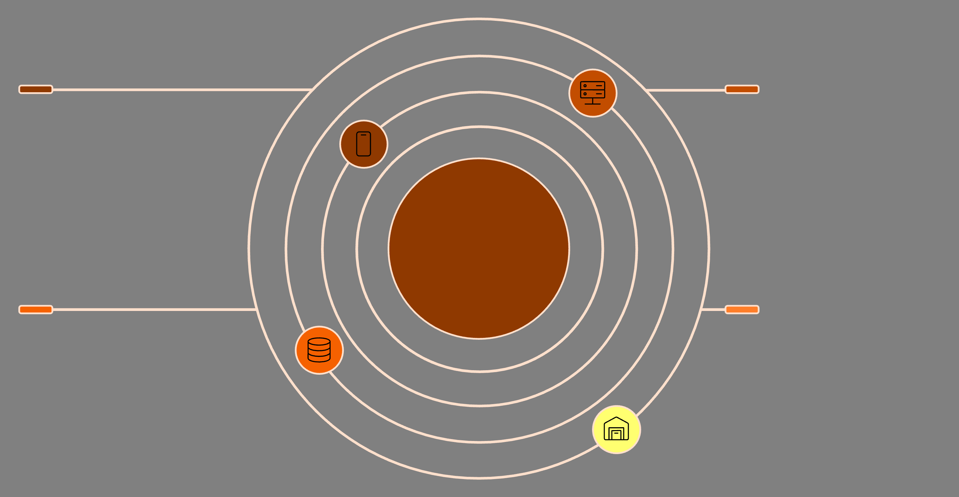
System Architecture
Mobile Client
Spring Boot Backend
Kotlin + Jetpack Compose; sends API requests
Three-Layer System Architecture
REST APIs, JWT auth, business logic
PostgreSQL Cloud
Room DB (Local)
Primary database; cloud persistence and sync
Local cache synced with cloud database
The architecture follows a clean three-tier separation: the mobile client handles UI and local persistence via Room DB; the Spring Boot layer enforces business logic, authentication, and hashing; PostgreSQL serves as the cloud-authoritative data store.

Slide 8





Trust Ledger Workflow
A five-stage cryptographic pipeline ensures every skill exchange is verified, escrowed, and permanently recorded.
1. User Request
Seeker sends a session proposal to Provider via Skill Radar
2. Token Escrow
SkillTokens are locked in escrow pending session completion
3. QR / Video Handshake
Both parties confirm session via QR scan or video proof-of-presence
4. Hash Generation
SHA-256 hash computed from session metadata and stored immutably
5. Payout & Ledger Entry
Escrow released, reputation updated, ledger entry appended

Slide 9
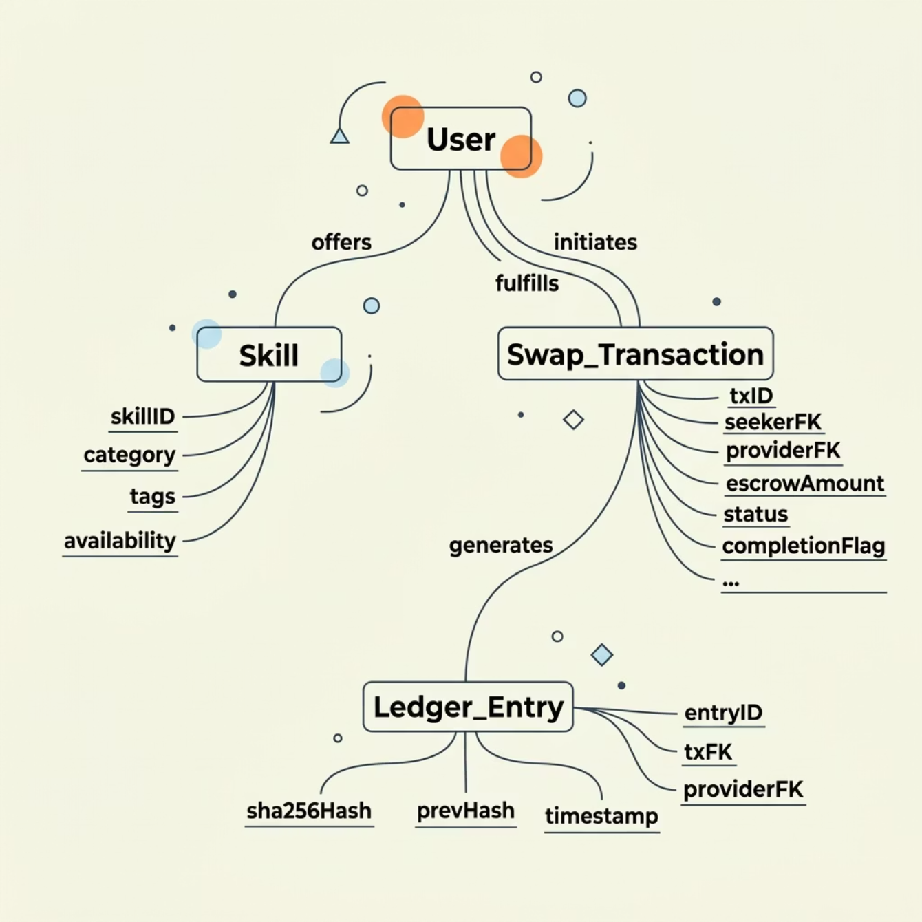

Database Schema
Core Entities
The schema is designed around four primary entities with clear relational integrity, enabling efficient querying for geospatial, transactional, and reputational data.
User
Skill
Swap_Transaction
Ledger_Entry
Profile, GPS location, token balance, skill passport hash
Category, tags, provider FK, availability schedule
Session metadata, escrow status, barter/token mode, completion flag
Transaction FK, SHA-256 hash, prev_hash, timestamp

Slide 10

Drawbacks & Limitations
GPS Accuracy Dependency
User-Provided Data Accuracy
Indoor environments, signal degradation, and rural dead zones can compromise geospatial discovery precision — affecting the core 5km Radius experience
Skill self-declarations and session descriptions rely on user honesty. Without third-party credential verification, initial trust bootstrapping remains a challenge
Connectivity Constraints
While Room DB enables offline caching, real-time ledger writes and escrow resolution require stable internet connectivity

Slide 11

Future Roadmap
Our 3-year vision transforms KnowsItAll into a hyper-intelligent, globally interconnected, and fully decentralized knowledge ecosystem.
AI-Driven Matchmaking
Transition to a Learning Compatibility Engine that suggests mentors based on past success, learning speed, and teaching style preferences, moving beyond simple proximity filters.
Augmented Reality (AR) Instruction
Introduce AR-Handshakes allowing mentors to overlay digital annotations on physical objects in real-time, enhancing hands-on learning experiences during physical sessions.
Decentralized Blockchain Migration
Migrate the Trust Ledger to a public/consortium blockchain (e.g., Ethereum L2), enabling globally verifiable Skill Passports shareable directly with professional networks.
Gamification & Ecosystem Incentives
Implement a Mastery Hierarchy with digital badges, "Top Mentor" leaderboards, and a token-rebate system to reward consistent contributions in high-demand skill areas.
Localized Language Support
Integrate Natural Language Processing (NLP) for real-time translation of skill descriptions and chat, fostering cross-cultural skill sharing in diverse linguistic regions.

Slide 12
Conclusion
Bridging the Knowledge Gap
Scalable & Secure Architecture
Social & Educational Impact
The Skill Radar transforms local talent into a verifiable, decentralized economy, removing all discovery friction.
Leveraging a Spring Boot backend and SHA-256 Trust Ledger ensures enterprise-grade scalability and professional security.
KnowsItAll lowers barriers to high-quality learning, fostering community growth as an accessible, software-driven alternative.
Final Thought
"By digitizing trust and localizing discovery, KnowsItAll turns every community into a self-sustaining campus."

