Slide 1

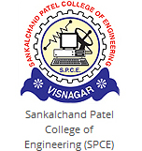
MINI PROJECT - 1 Presentation On Employee Management System
PRESENTED BY
Jeet Patel PRN : 2019095900007061
Jeneesh Patel PRN : 2019095900007045
Vidhin Patel PRN : 2019095900007567
CARRYED OUT AT;
SANKALCHAND PATEL COLLEGE OF ENGINEERING
SUBMITTED TO;
DEPARTMENT OF INFORMATION TECHNOLOGY
SANKALCHAND PATEL COLLEGE OF ENGINEERING,VISNAGAR

Slide 2
Content
What is EMS ?
Software requirement
Objective four our project
Flow-Chart
Output of project
Purpose
Scope
Advantage
Disadvantage
Conclusion

Slide 3
What is EMS ?
Employee Management System is a distributed application, developed to maintain the details of employees working in any organization.
The EMS has been developed to override the problems prevailing in the practicing manual system.
It maintains the information about the personal and official details of the employees.

Slide 4

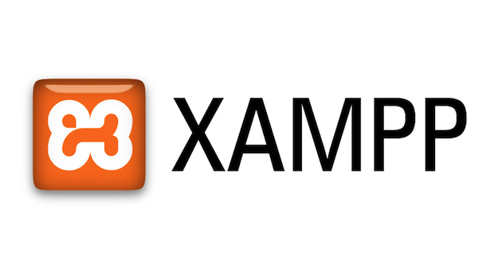
Software Requirement

Slide 5
Objectives for our project
This project aims to simplify the task of maintaining records of the employees of Company.
To develop an well-designed database to store employee information
Provides full functional reports to management of Company.
The objective of this project is to provide a comprehensive approach towards the management of employee information.

Slide 6
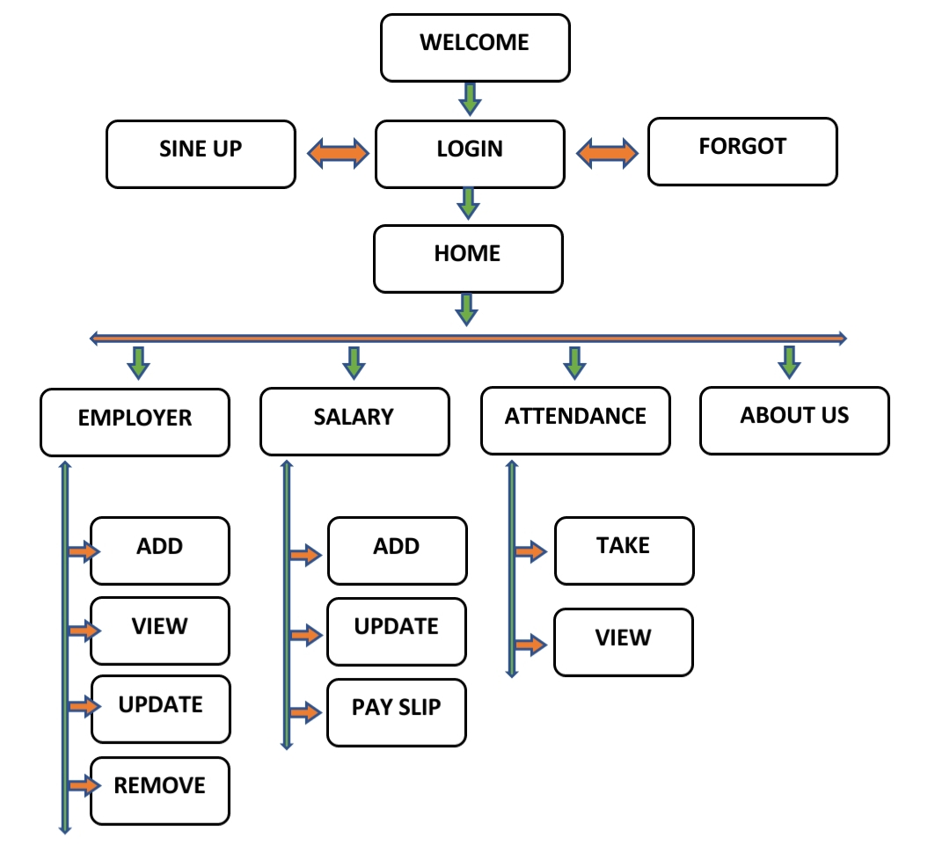
Flow-Chart

Slide 7
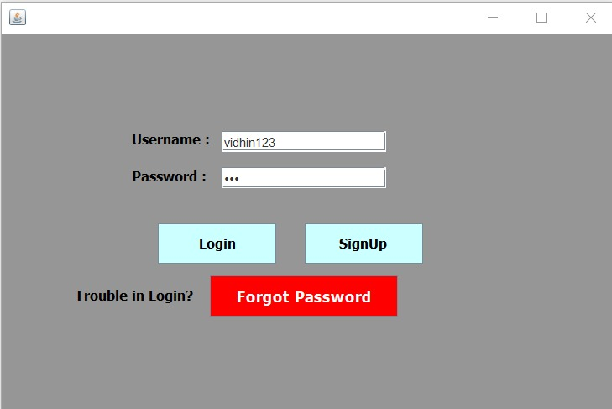
Output of Login Page

Slide 8
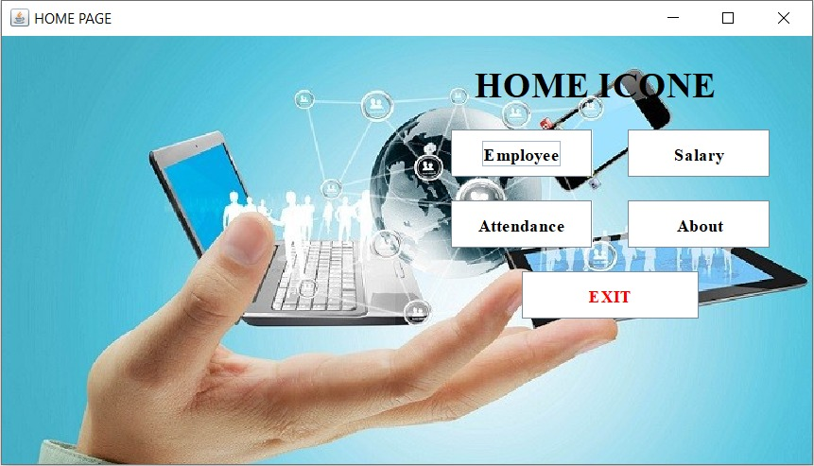
Output of Home page

Slide 9
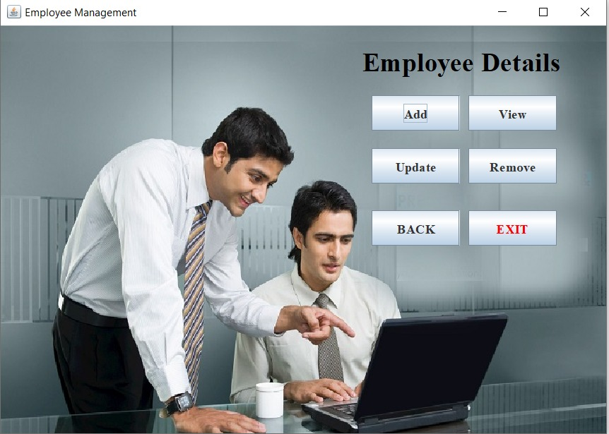
Output of Employee page

Slide 10
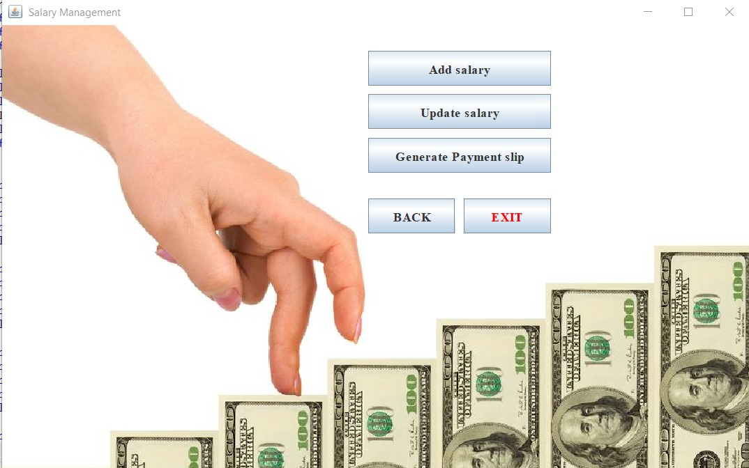
Output of Salary page

Slide 11
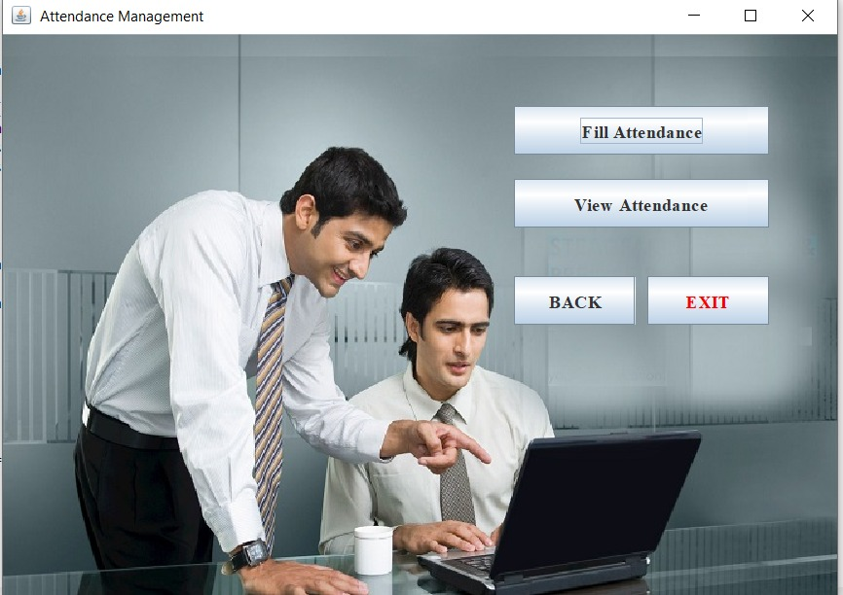
Output of Attendance page

Slide 12
Purpose
Manages the employees in a better way.
Easy to find the various information related to employees.
Maintains the date of Hiring and Retirement.
Maintains the salary, attendance, events, leaves and requests.

Slide 13
Scope
Works in multiple pc's with Employee's & administrator both can use it with ease.
Can be used simultaneously and editing & updates can be made easily accordingly.

Slide 14
Advantage
Provide computerized system for maintaining records.
More efficient & reliable.
Less time consuming and easy to use.
Huge data storage with less computer memory.
Avoid Human errors & efforts for Maintaining daily data.
Avoid Data manipulations.
Also avoids Data inconsistency &redundancy

Slide 15
Disadvantage
Everyone can excess data.
Confidential & security risk.
Lack of experience.

Slide 16
Conclusion
This project is used for computerizing employee management work in offices, schools, etc.
The software keeps record of employee's provident fund, gratuity and salary and generates the slip of salary too.
The software is capable of easy storage of information related to employee through database.

Slide 17


