Slide 1
Generics

Slide 2
Generics
Generics help us detect errors at compile time, rather than runtime.

Slide 3
Generics
Generics is the capability to parameterize types.
A class or a method can be defined with generic types that can be substituted using concrete types by the compiler.
Ex: Define a generic stack class that stores the elements of a generic type. Then, you can instantiate objects of concrete types to replace the generic type: a stack object for holding strings and a stack object for holding numbers.

Slide 4
Generics
Generic types must be reference types.
You cannot replace a generic type with a primitive type (char, int, duble, etc.)
Example:
ArrayList<int> myList = new ArrayList<int> (); // Wrong!!
Instead, use:
ArrayList<Integer> myList = new ArrayList<Integer> ();

Slide 5
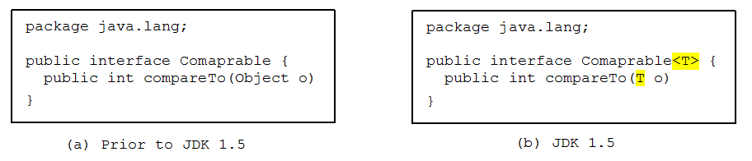
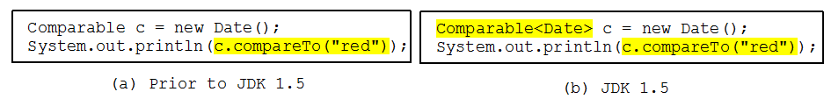
Generic Type
Runtime error
Generic Instantiation
Improves reliability
Compile error

Slide 6
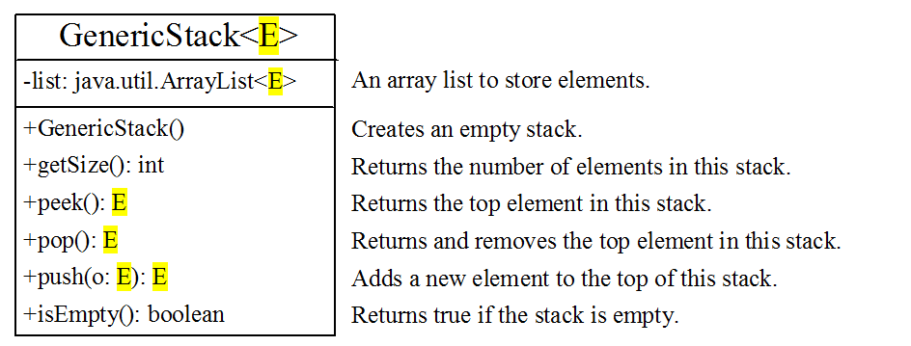
Declaring Generic Classes and Interfaces

Slide 7
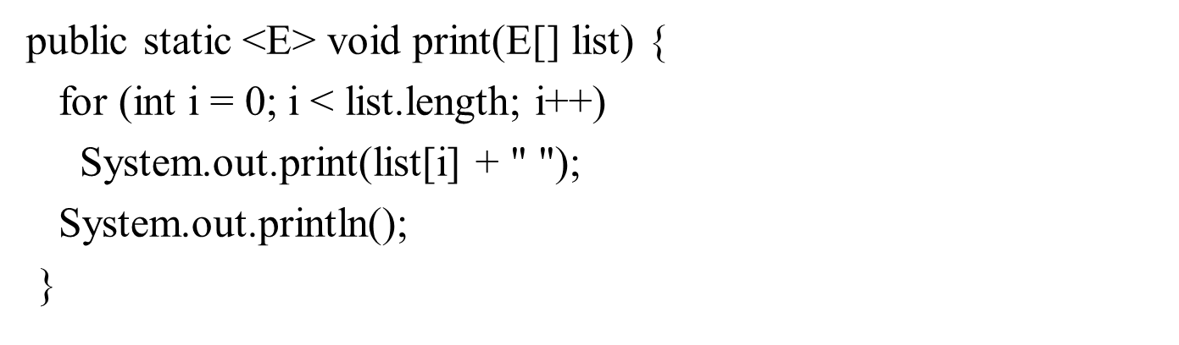
Declaring Generic Methods
You can define a generic method that works on generic parameters.
To declare a generic method, you place the generic type <E> immediately after the keyword static in the method header

Slide 8
Calling Generic Methods
To call a generic method, prefix the method name with the actual type in angle brackets.
GenericMethodDemo.<Integer>print(integers);

Slide 9
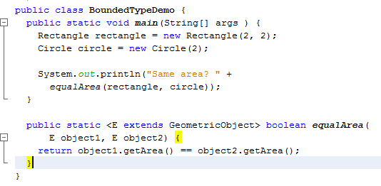
Bounded Generic Type
A generic type can be specified as a subtype of another type. Such a generic type is called bounded.
Bounded generic type

