Slide 1
Recursion

Slide 2

What is Recursion?
A programming technique that uses recursive methods, i.e. the methods that call themselves.

Slide 3
Characteristics of Recursion
The recursive method is implemented using an if-else or switch statement that leads to different cases.
One or more base cases (the simplest case) are used to stop recursion.
Every recursive call reduces the original problem, bringing it increasingly closer to a base case until it becomes that case.

Slide 4
How to write recursively?
int recFunc(parameters){
if(base condition)
return stopping value;
// other base conditions, if there is any
else return recFunc(revised parameters)
}

Slide 5
Problems defined recursively
There are many problems whose solution can be defined recursively
Examples:
Factorial
Fibonacci numbers
Search algorithms
Sort algorithms
etc.

Slide 6
Factorial
1 if n = 0
n!= (recursive solution)
(n-1)!*n if n > 0
1 if n = 0
n!= (iterative solution)
1*2*3*…*(n-1)*n if n > 0

Slide 7
Iterative Factorial Function
int iterativeFactorial(int n) {
int fact = 1;
for( int count = 2; count <= n; count++) {
fact = fact * count;
}
return fact;
}

Slide 8
Recursive Factorial Function
int recursiveFactorial(int n)
{
if (n==0) // base case
return 1;
else
return n * recursiveFactorial(n-1);
}

Slide 9
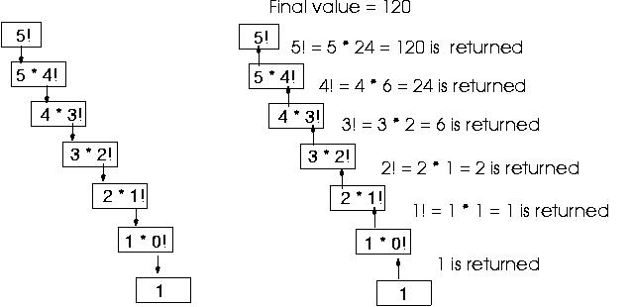
Recursive Factorial Function

Slide 10
The Fibonacci numbers
Fibonacci Numbers:
0, 1, 1, 2, 3, 5, 8, 13, 21, 34, ...
where each number is the sum of the preceding two.
Recursive definition:
f(0) = 0, f(1) = 1
f(n) = f(n – 1) + f(n - 2)
f(0) = 0
f(1) = 1
f(2) = f(1) + f(0) = 1 + 0 = 1
f(3) = f(2) + f(1) = 1 + 1 = 2
f(4) = f(3) + f(2) = 2 + 1 = 3
f(5) = f(4) + f(3) = 3 + 2 = 5
f(6) = f(5) + f(4) = 5 + 3 = 8

Slide 11
Iterative Fibonacci Algorithm
int iterativeFibo(int n)
{
int f[100];
f[0] = 0; f[1] = 1;
for (int i=2; i<= n; i++) {
f[i] = f[i-1] + f[i-2];
}
return f[n];
}

Slide 12
Recursive Fibonacci Algorithm
int recursiveFibo(int number) {
if (number == 0) return 0;
else if (number == 1) return 1;
else return (recursiveFibo(number-1)
+ recursiveFibo(number-2));
}

Slide 13
Recursive Fibonacci Evaluation
f(4)
f(3)
f(2)
f(2)
f(1)
f(1)
f(0)
f(1)
f(0)

Slide 14
Binary Search
Given an ordered list:
Compare the search element with the middle element of the array
If not equal, then apply binary search to half of the array (if not empty) where the search element would be.

Slide 15
Iterative Binary Search
int iterativeBS(int data[], // array
int size, // array size
int value // value searched
){ // output: if found, return
// Program returns index if value is found, otherwise returns –1
int first, last, upper;
first = 0;
last = size - 1;
while (true) {
middle = (first + last) / 2;
if (data[middle] == value)
return middle;
else if (first >= last)
return -1;
else if (value < data[middle])
last = middle - 1;
else
first = middle + 1;
}
}

Slide 16
Recursive Binary Search
int recursiveBS(int data[], // array
int first, // lower bound
int last, // upper bound
int value // value searhced )
// Program returns index if value is found, otherwise returns –1
{
int middle = (first + last) / 2;
if (data[middle] == value)
return middle;
else if (first >= last)
return -1;
else if (value < data[middle])
return recursiveBS(data, first, middle-1, value);
else
return recursiveBS(data, middle+1, last, value);
}

Slide 17
Recursive Exponent Function
int recursiveExp(int number, int power) {
if (power ==0)
return 1;
else return number * recursiveExp(number, power -1);
}

Slide 18
Recursive Palindrome Test
bool isPalindrome(char * const s) {
if (strlen(s) <= 1) // Base case
return true;
else if (s[0] != s[strlen(s) - 1]) // Base case
return false;
else
return isPalindrome(substring(s, 1, strlen(s) - 2));
}

Slide 19
Printing a Message n Times
You can break the problem into two subproblems:
one is to print the message one time
and the other is to print the message for n-1 times. The second problem is the same as the original problem with a smaller size. The base case for the problem is n==0. You can solve this problem using recursion as follows:
public static void nPrintln(String message, int times) {
if (times >= 1) {
System.out.println(message);
nPrintln(message, times - 1);
} // The base case is times == 0
}

Slide 20
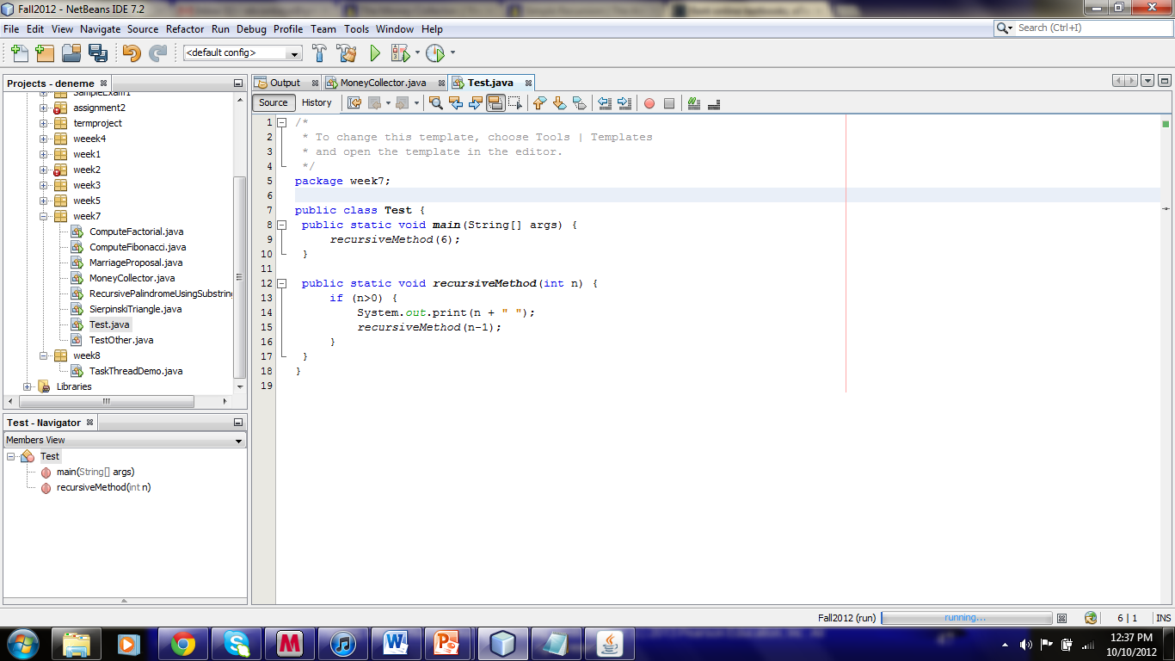
What will the following program print?

Slide 21
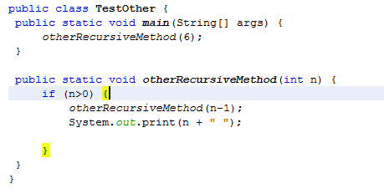
How about this program?

Slide 22
Fundraiser Problem solved with Recursion
Aim: To raise $1000.
Iterative solution: Selling cookies $1 each.
Not too convenient. You may need to visit so many houses to sell cookies.
Recursive: Delegate the fundraising task to 10 friends so that each friend will raise $100
The problem becomes simplified for each subcollector.
Now each friend can use the same technique and solicit 10 more friends to raise $10 each.
So, each subcollector performs the same task, but the amount is reduced each time.
Eventually, we reach the base case where the collector needs to contribute only $1 himself.

Slide 23
Tail Recursion
A recursive method is tail recursive if there are no pending operations to be performed on return from a recursive call.
Tail recursive methods are preferred over not tail recursive methods
because a tail recursive method reduces the required stack size.

Slide 24
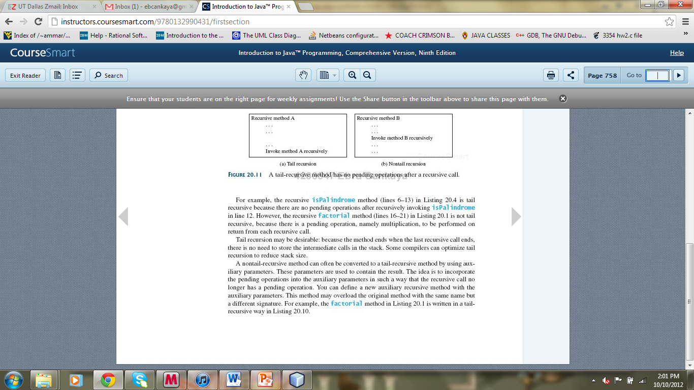
Tail Recursion

Slide 25
Recursion vs. Iteration
Speed (in iteration) vs. elegance (in recursion)
Iteration
Keep repeating until a task is done
e.g.: loop counter reaches the limit, linked list reaches null pointer, EOF becomes true
Recursion
Solve a large problem by breaking it up into smaller pieces until you can solve it, then combine the results.
e.g.: calculate factorial recursively

