Slide 1
Exceptions

Slide 2

What is an Exception?
When a program violates the semantic constraints of Java, the JVM signals this error to the program as an exception.
An exception is an object that represents an error or condition that prevents execution from proceeding normally
Non-handled exceptions cause program to terminate abnormally
Every exception is represented by an instance of the class Throwable or one of its subclasses. This object carries information from where the exception occurs to the handler that catches it.

Slide 3
Is Exception Handling really needed?
One can write a function (method) to accomplish the required action
But if the method encounters a problem, then it won’t return to the caller
But in programming, we want the caller to have control over things
Then, throw an exception in the callee method, and handle the exception in the caller

Slide 4
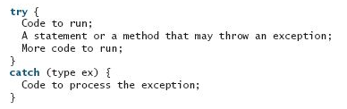
Throwing an Exception
When an exception is thrown, the normal execution flow is interrupted.
The try block contains the code that is executed under normal circumstances.
The exception is caught by the catch block, which is executed to handle the exception.
Regardless, the statement after the catch block is executed.

Slide 5
An Example: QutioentWithException.java
Exception is the value thrown, which is ArithmeticException(" Divisor cannot be zero").
The exception is an object created from an exception class (in the example from class java. lang. ArithmeticException).
ArithmeticException( str) constructor is invoked to construct an exception object
str is a message that describes the exception and is optional.
Advantage: The caller decides what to do in case of an exception, not the called method

Slide 6
Exception Types

Slide 7
System Errors
System errors are thrown by JVM and represented in the Error class. The Error class describes internal system errors. Such errors rarely occur. If one does, there is little you can do beyond notifying the user and trying to terminate the program gracefully.

Slide 8
Exceptions
Exception describes errors caused by your program and external circumstances. These errors can be caught and handled by your program.

Slide 9
Runtime Exceptions
RuntimeException is caused by programming errors, such as bad casting, accessing an out-of-bounds array, and numeric errors.

Slide 10
Checked Exceptions vs. Unchecked Exceptions
RuntimeException, Error and their subclasses are known as unchecked exceptions
Manifest at running time. All other exceptions are known as checked exceptions
Exceptions are checked and dealt with by the programmer in a try-catch block
Exceptions are anticipated at programming time, not at running time

Slide 11
Unchecked Exceptions
Mostly programming logic errors that are not recoverable, e.g.
a NullPointerException is thrown if you access an object through a reference variable before an object is assigned to it
an IndexOutOfBoundsException is thrown if you access an element in an array outside the bounds of the array
Unchecked exceptions can occur anywhere in the program
These are the logic errors that should be corrected in the program
To avoid cumbersome overuse of try-catch blocks, Java does not mandate you to write code to catch unchecked exceptions

Slide 12
Unchecked Exceptions

Slide 13
Declaring, Throwing, and Catching Exceptions
Java’s Exception handling model
Declare an exception
Throw an exception
Catch an exception

Slide 14
Declaring Exceptions
Every method must state the types of checked exceptions it might throw
This is known as declaring exceptions
public void myMethod()
throws IOException
public void myMethod()
throws IOException, OtherException

Slide 15
Throwing Exceptions
When the program detects an error, the program can create an instance of an appropriate exception type (class) and throw it
This is known as throwing an exception
Here is an example:
throw new TheException();
or
TheException ex = new TheException(); throw ex;

Slide 16
Throwing Exceptions Example
/** Set a new radius */
public void setRadius(double newRadius)
throws IllegalArgumentException {
if (newRadius >= 0)
radius = newRadius;
else
throw new IllegalArgumentException(
"Radius cannot be negative");
}

Slide 17
Catching Exceptions
try {
statements; // Statements that may throw exceptions
}
catch (Exception1 exVar1) {
handler for exception1;
}
catch (Exception2 exVar2) {
handler for exception2;
}
...
catch (ExceptionN exVar3) {
handler for exceptionN;
}
If no exceptions arise during the execution of the try block, the catch blocks are skipped.
If any statement in the try block throws an exception, Java skips the remaining statements in the try block and tries to find the code to handle the exception by propagating the exception backward through a chain of method calls, starting from the current method.

Slide 18
Catching an Exception
Each catch block is examined in turn, from first to last, to see whether the type of the exception object is an instance of the exception class in the catch block.
If so, the exception object is assigned to the variable declared, and the code in the catch block is executed.
If no handler is found, Java exits this method, passes the exception to the method that invoked the method, and continues the same process to find a handler.
If no handler is found in the chain of methods being invoked, the program terminates and prints an error message on the console.

Slide 19
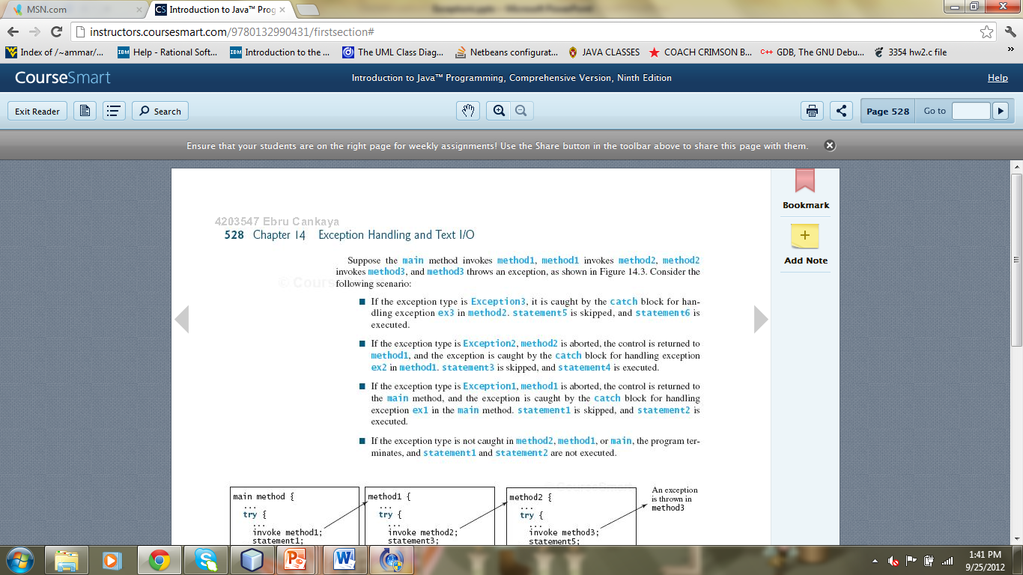

Slide 20
Catch or Declare Checked Exceptions
Java forces you to deal with checked exceptions.
If a method declares a checked exception (i.e., an exception other than Error or RuntimeException), you must invoke it in a try-catch block or declare to throw the exception in the calling method. For example, suppose that method p1 invokes method p2 and p2 may throw a checked exception (e.g., IOException), you have to write the code as shown in (a) or (b).

Slide 21
The finally clause
The finally clause guarantees that its content will be executed regardless
Finally is useful, particularly if there are immature endings to the program due to return, continue, or break statements.
try {
statements;
}
catch(TheException ex) {
handling ex;
}
finally {
finalStatements;
}

