Slide 1
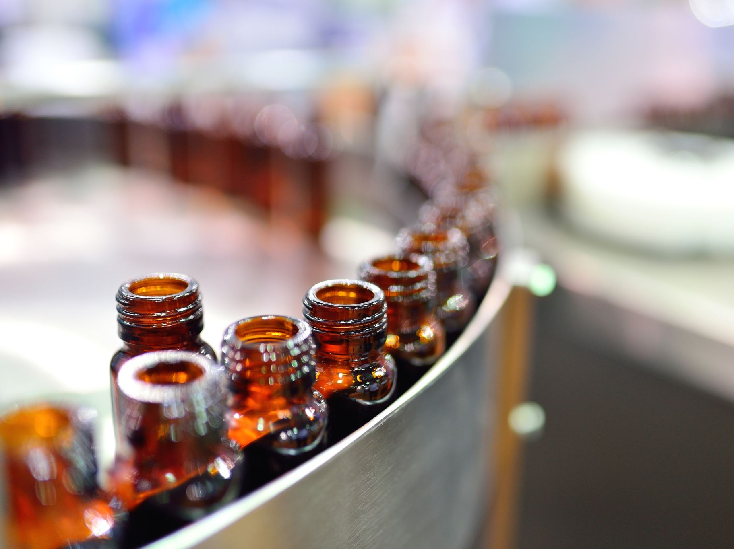
Case Study 1
Amy Adyanthaya & Christopher Williams
22Oct2022
Notes:
Hello, We are Amy Adyanthaya & Christopher Williams, and we will be discussing our preliminary findings on craft beers produced in the United States.

Slide 2
Craft Beers Produced in US
Objective is to provide context on the craft beers produced within the United States
552 Breweries
2407 Craft beers produced
Notes:
552 – breweries that made a beer (after filtering entry mistakes)
2407 – total beers
Our objective is to provide context on the craft beers manufactured in the United States. We identified 552 breweries which produced 2407 craft beers.

Slide 3
Number of Breweries per State
Alabama - 3 | Kentucky - 4 | North Dakota - 1
Alaska - 7 | Louisiana - 5 | Ohio - 15
Arizona - 11 | Maine - 9 | Oklahoma - 6
Arkansas - 2 | Maryland - 7 | Oregon - 29
California - 39 | Massachusetts - 22 | Pennsylvania - 24
Colorado – 46 | Michigan - 32 | Rhode Island- 5
Connecticut - 8 | Minnesota - 11 | South Carolina - 4
Delaware - 2 | Mississippi - 2 | South Dakota - 1
District of Columbia - 1 | Missouri - 9 | Tennessee - 3
Florida - 15 | Montana - 9 | Texas - 28
Georgia - 7 | Nebraska - 5 | Utah - 4
Hawaii - 4 | Nevada - 2 | Vermont - 9
Idaho - 5 | New Hampshire - 3 | Virginia - 16
Illinois - 18 | New Jersey - 3 | Washington - 23
Indiana - 22 | New Mexico - 4 | West Virginia - 1
Iowa - 5 | New York - 16 | Wisconsin - 19
Kansas - 3 | North Carolina - 19 | Wyoming - 4
Notes:
Shows the breakdown of the number of breweries per state.
Colorado has the highest number of breweries (46)
North Dakota, South Dakota, West Virginia, and DC only have 1
6 breweries were excluded from this list since they were either duplicates or did not produce beer.

Slide 4

Styles of Beer
99 different beer styles were identified
Beer styles were grouped into 15 categories
Referenced Beer Advocate
Categories were essential for:
Processing of missing data
Gathering insights from data
Notes:
We identified 99 different styles of beers
We referenced the https://www.beeradvocate.com/beer/styles/ on how to group the beers into 15 categories
The categories were essential for processing of missing data and gathering insights of the data
Similarities on a beer's appearance, aroma, taste, and feel

Slide 5
Missing Data Handling
Processing of missing ABV values
62 records (2.6%) did not contain an ABV value
Styles of beers were categorized
Median value was obtained for each category
Missing ABV value was assigned per median ABV value of the respective category
Processing of missing IBU values
1005 records (41.7%) did not contain an IBU value
Records with missing IBU values were censored for any analysis where IBU was a factor
Notes:
ABV = Alcohol by Volume
IBU = International Bitterness Units
For the ABV missing values
62 records did not contain an ABV value
The beer styles were categorized, and the median value was obtained for each category
An ABV value was then assigned the median ABV value of the respective category
For the missing IBU values
1005 records did not contain an IBU value therefore, those records were censored for any analysis where IBU was a factor.

Slide 6
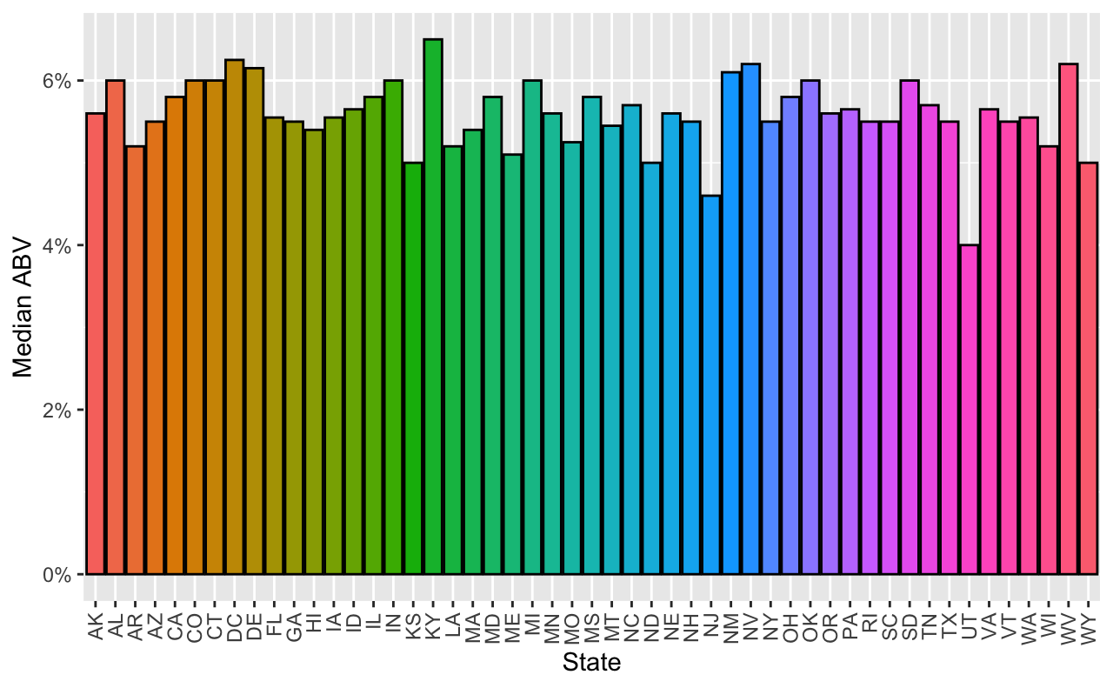
Median Alcohol by Volume (ABV) per State
KY 6.5%
DC 6.25%
NJ 4.6%
UT 4%
Notes:
For the median alcohol by volume, or ABV, per state
KY breweries had the highest median ABV at 6.5% with DC just below at 6.25%. followed by NV & WV at 6.2%.
UT breweries had the lowest median ABV at 4% with NJ slightly higher at 4.6%, then KS, ND, WY at 5%
This bar chart does not show much variability in the median ABV values of beer across the states.

Slide 7
Maximum ABV
The beer with the highest ABV value was brewed in Colorado
Lee Hill Series Vol. 5 - Belgian Style Quadrupel Ale
ABV = 12.8%
The state with the highest median ABV was Kentucky
ABV = 6.5%
Notes:
The beer with the highest ABV value was brewed in CO, this was the Lee Hill Series volume 5 – Belgian style quadruple ale with an ABV of 12.8%
The state with the highest median ABV, KY, had a median ABV value of 6.5%

Slide 8
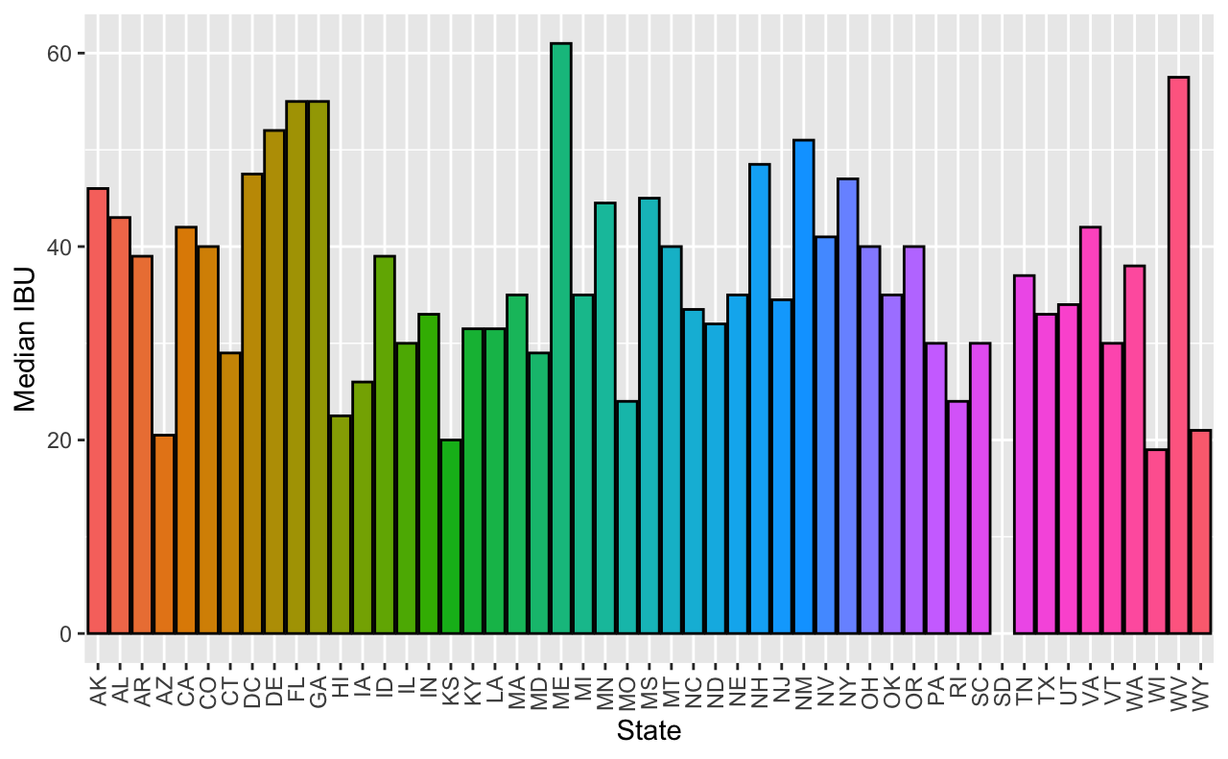
Median International Bitterness Units (IBU) per State
ME 61
WV 57.5
SD
Notes:
For the median international bitterness units, or IBU, per state
ME breweries were identified to have the highest median IBU at 61 units, followed by WV at 57.5 units. , then FL and GA at 55 units.
SD, with just one brewery, did not report any IBU values.
The chart may not be truly reflective of the data due to the quantity of the missing IBU data.

Slide 9
Maximum IBU
The beer with the highest IBU was brewed in Oregon
Bitter Bitch Imperial IPA
The state with the highest median IBU was Maine
IBU = 61
IBU = 138
Notes:
For the maximum beer IBU, the state with the highest beer IBU was brewed in OR, which was the Bitter Bitch Imperial IPA with an IBU of 138.
The state with the highest median IBU was ME with the median IBU value of 61

Slide 10
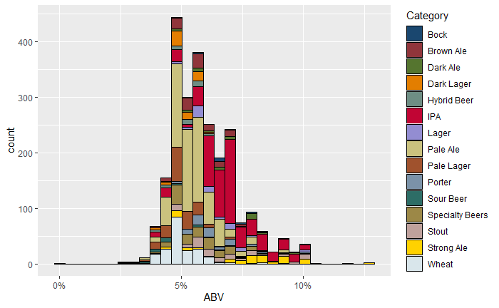
Distribution of Beer ABV
Summary Statistics
Min. :0.00100
1st Qu.:0.05000
Median :0.05600
Mean :0.05974
3rd Qu.:0.06700
Max. :0.12800
SD. :0.01342
Notes:
Using the beer categories, this display is showing the distribution of the median beer ABV values for each category.
The bar chart is showing a right skewed distribution, in which the mean beer ABV of 5.97% is slightly larger than the median ABV of 5.6%.
The spread of the data is relatively close with a standard deviation of 1.34%.
This distribution would imply that the many of the craft beers produced in the United States have an ABV value close to that of the the median ABV value identified in the analysis.

Slide 11
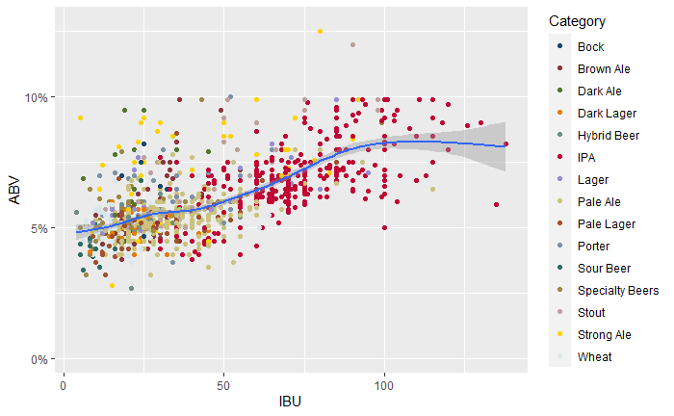
Distribution of ABV vs IBU
Correlation coefficient (IBU~ABV) = 0.6706215
ABV Median = 5.6%
IBU Median = 35
Notes:
There appears to be a moderate direct relationship between a beers ABV and IBU.
The strongest relationship appear to be when the values of ABV and IBU are slightly below the median values of each.
It is important to note that records with a missing IBU value were censored for this analysis.
Every beer missing an ABV was also missing an IBU
Both right skewed distributions, IBU more so than ABV.

Slide 12
India Pale Ales (IPA) vs Ales
“Other” Ales consists of the following:
Investigate the difference between IPAs vs other Ales in respect to IBU vs ABV
Dark Ale Brown Ale
Pale Ale Strong Ale
Wheat Stout
Porter Sour Beer
Notes:
To investigate the difference between IPAs and other ales, with respect to a beer’s ABV vs IBU, the non-IPA beers were grouped as noted here.

Slide 13
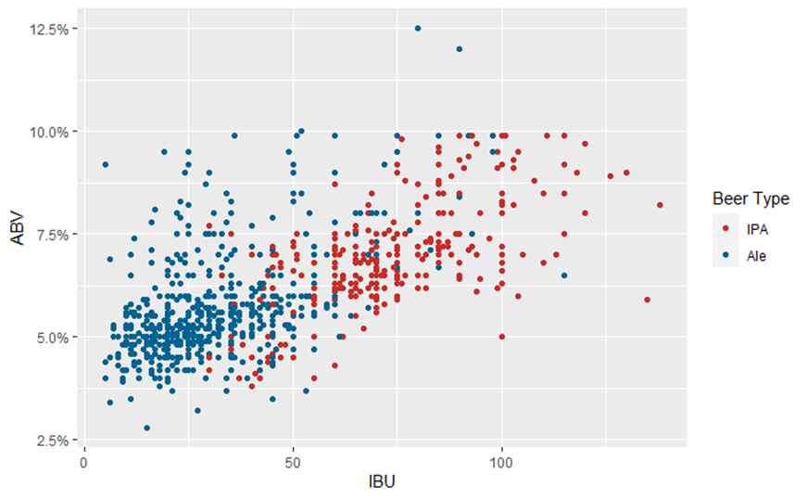
Distribution of ABV vs IBU for IPA and Ales
Notes:
When collapsing the beer categories to IPAs vs all ales there appears to be a moderate relationship between the ABV and the IBU of beers.
Collapsing the beer into IPAs and other ales showed similar results as including all beers in the analysis.

Slide 14
Differences between IPAs and Other Ales
Notes:
To determine if there is a difference with between IPA vs other ales, with respect to a beers IBU and ABV, the individual models were run and then an ensemble was run from the results of those three models.
All three models had similar results, however the Randomforest model provided the best results with an accuracy rate of approximately 87%, a sensitivity rate of 89% and a specificity rate of 83%.
The results from the three individual models were combined and evaluated by the Ensemble model. By aggregating the individual predictions, we reduce the error rate of our predictions and showed that there is a difference between IPAs and Ales with respect a beers ABV and IBU.

Slide 15
Question of Interest
Is the category of a beer related to it’s ABV?

Slide 16
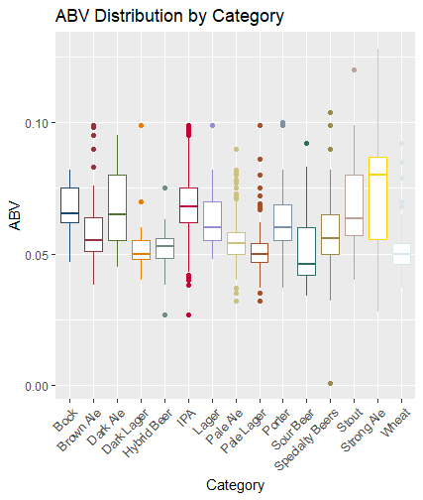
ABV vs Beer Categories
Assumptions
ABV distribution does not reflect a normal distribution
Variation in standard deviations
Independence of each recorded beer is questionable
Duplicate beers may be included in the data
ANOVA assumptions not met
Kruskal-Wallis to determine assess distributions of beer categories
Notes:
The ABV for some of the different categories of beer appear to have distributions vastly different than the normal distribution.
The standard deviations of the different categories of beer appear to differ significantly.
Independence of each recorded beer is questionable, needing further information from Budweiser, so conclusions should be taken with a grain of salt.
Assumptions for ANOVA are severely violated, thus a Kruskal-Wallis test will be run to assess if the ABV of at least one pair of beer categories have different distributions.

Slide 17

Kruskal-Wallis Test
H₀: $∀ i,j∈Category;$ $M_{i}= M_{j}$
H_{A}: $∃ i,j∈Category;$ $M_{i}≠ M_{j}$
Overwhelming evidence at least one pair of beer categories had differing ABV medians
$p<2.2×{10}^{−16}$ with 14 df
Significant evidence of differing ABV distributions among the different beer categories
Ran a Dunn’s test for multiple pairwise comparisons
Notes:
We found overwhelming evidence that at least one pair of beer categories had differing medians of ABV ($p<2.2×{10}^{−16}$ from K-W test with 14 degrees of freedom).
Due to finding significant evidence of differing ABV distributions among the different categories of beer, we ran a Dunn’s test for multiple pairwise comparisons.

Slide 18
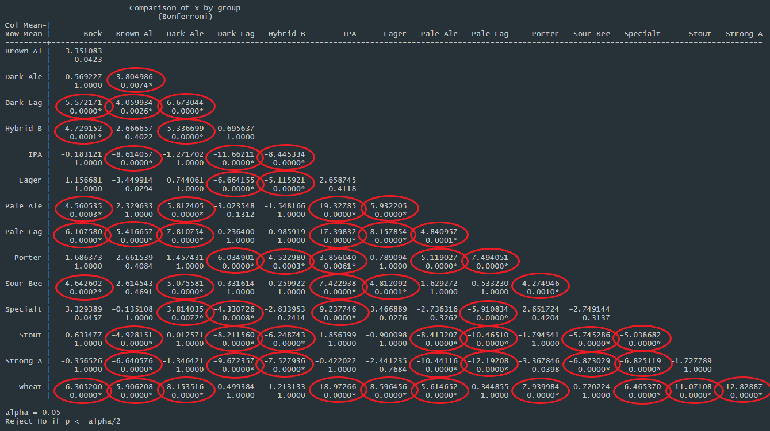

Dunn’s Test
$$∀ i,j∈Category:$$
H₀: $M_{i}= M_{j}$
H_{A}: $M_{i}≠ M_{j}$
Bonferroni Correction to adjust the error of the family of simultaneous tests
Pairs of beer categories with significant differences in median ABV
Notes:
Using a Bonferroni Correction to adjust the error of the family of simultaneous tests, we found the following pairs of beer categories to have significant differences in median ABV.

Slide 19
Conclusion
ABV vs Beer Category
Significant evidence that 59 pairs of the 15 beer categories have different median ABV
Alpha level of 0.05
Suggests a strong relationship exists between the category of beer and its ABV
Scope of Inference
Due to unclear independence of the individual beer records the validity of these conclusions are questionable
Further investigation with cleaner data is necessary to provide a definitive conclusion
Notes:
We found significant evidence, at an alpha level of 0.05, that 59 pairs of the 15 beer categories have different median ABV. This finding suggests a strong relationship exists between the category of beer and its ABV.
It must be kept in mind, that due to the unclear independence of the individual beer recordings the validity of these conclusions is questionable. At the very least, these findings beg for further investigation with cleaner data.
Not clear if random sample of all beers advise against generalizing this conclusion to all beers & breweries
Beer category wasn’t randomly assigned can’t attribute causation of abv to beer category

Slide 20
Thank You
Amy Adyanthaya: aadyanthaya@mail.smu.edu
Christopher Williams: chriswilliams@mail.smu.edu

Slide 21
Missing Data Handling
Missing data was identified in ABV and IBU values
Processing of missing ABV values
62 beers did not contain an ABV value
The styles of beers were categorized
The median value was obtained for each category
The missing ABV was assigned the median value per the category of the ABV
Processing of missing IBU values
1005 beers did not contain and IBU value
Due to this high number these IBU records were censored for any analysis where IBU was factor
Notes:
ABV = Alcohol by Volume
IBU = International Bitterness Units
99 styles of beer, 15 categories
3 beer entries removed, because they were not actual beers.
https://www.beeradvocate.com/beer/styles/

Slide 22
ABV vs IBU
 | K(5)-NN Model |  |  | Naive Bayes |  |  | Randomforest |  |  | Ensemble
Confusion Matrix |  | Ale | IPA |  | Ale | IPA |  | Ale | IPA |  | Ale | IPA
 | Ale | 204 | 20 | Ale | 194 | 12 | Ale | 206 | 19 | Ale | 207 | 16
 | IPA | 28 | 91 | IPA | 38 | 99 | IPA | 26 | 92 | IPA | 25 | 95
Accuracy | 0.8601 |  |  | 0.8542 |  |  | 0.8688 |  |  | 0.8805
95% CI | (0.8188, 0.895) |  |  | (0.8124, 0.8898) |  |  | (0.8284, 0.9027) |  |  | (0.8413, 0.9128)
Sensitivity | 0.8793 |  |  | 0.8362 |  |  | 0.8879 |  |  | 0.8922
Specificity | 0.8198 |  |  | 0.8919 |  |  | 0.8288 |  |  | 0.8559
'Positive' Class | Ale |  |  | Ale |  |  | Ale |  |  | Ale
Notes:
Four different models were ran to investigate the difference between IPAs and Ales in respect to the IBU and ABV of these beers. ➔predictions
Combine the three models

Slide 23
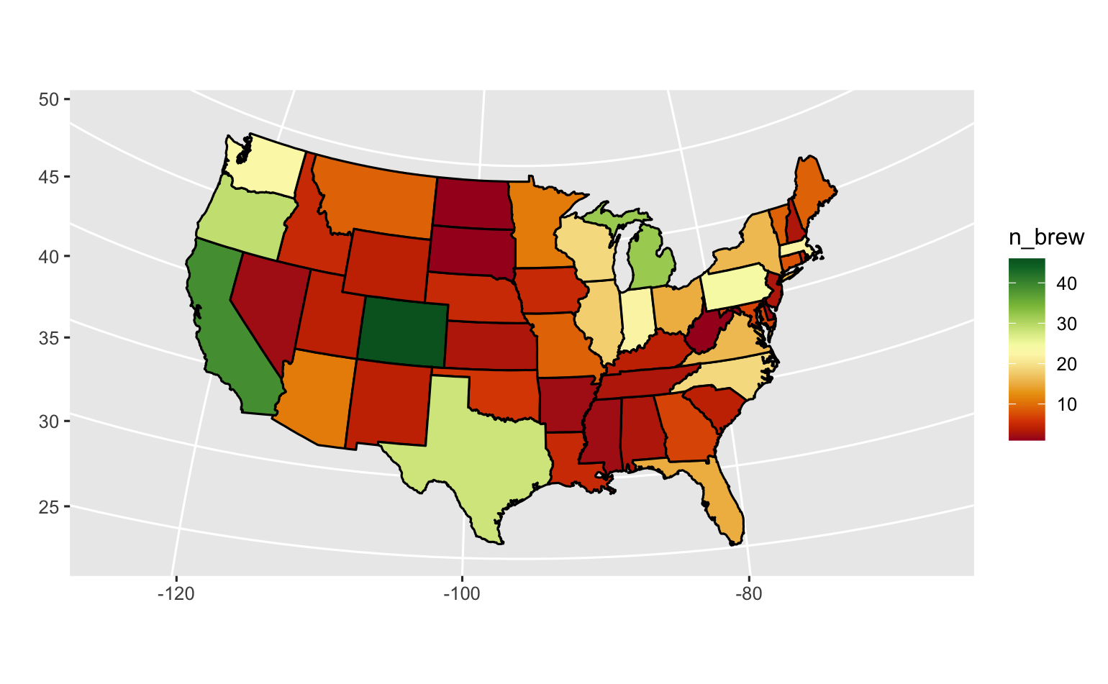
Number of Beers per State
# Beers
Notes:
Come back to this
Colorado has the highest number of breweries (46)
North Dakota, South Dakota, West Virginia, and DC only have 1
6 breweries were excluded from this list since they were either duplicates or did not produce beer.

Slide 24
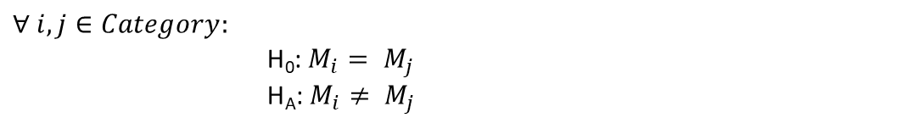
ABV and Beer Category
Dunn’s Test
Using a Bonferroni Correction to adjust the error of the family of simultaneous tests, we found the following pairs of beer categories to have significant differences in median ABV.
$$∀ i,j∈Category:$$
H₀: $M_{i}= M_{j}$
H_{A}: $M_{i}≠ M_{j}$
Bock - Dark Lager
Bock - Hybrid Beer
Bock - Pale Ale
Bock - Pale Lager
Bock - Sour Beer
Bock - Wheat Ale
Brown Ale - Dark Ale
Brown Ale - Dark Lager
Brown Ale - IPA
Brown Ale - Pale Lager
Brown Ale - Stout
Brown Ale - Strong Ale
Brown Ale - Wheat Ale
Dark Ale - Dark Lager
Dark Ale - Hybrid Beer
Dark Ale - Pale Ale
Dark Ale - Pale Lager
Dark Ale - Sour Beer
Dark Ale - Specialty
Dark Ale - Wheat Ale
Dark Lager - IPA
Dark Lager - Lager
Dark Lager - Porter
Dark Lager - Specialty
Dark Lager - Stout
Dark Lager - Strong Ale
Hybrid Beer - IPA
Hybrid Beer - Lager
Hybrid Beer - Porter
Hybrid Beer - Stout
Hybrid Beer - Strong Ale
IPA - Pale Ale
IPA - Pale Lager
IPA - Porter
IPA - Sour Beer
IPA - Specialty
IPA - Wheat Ale
Lager - Pale Ale
Lager - Pale Lager
Lager - Sour Beer
Lager - Wheat
Pale Ale - Pale Lager
Pale Ale - Porter
Pale Ale - Stout
Pale Ale - Strong Ale
Pale Ale - Wheat
Pale Lager - Porter
Pale Lager - Specialty
Pale Lager - Stout
Pale Lager - Strong Ale
Porter - Sour Beer
Porter - Wheat Ale
Sour Beer - Stout
Sour Beer - Strong Ale
Specialty - Stout
Specialty - Strong Ale
Specialty - Wheat Ale
Stout - Wheat Ale
Strong Ale - Wheat Ale
Notes:
Following parirs to have sign diff
Reject hull when true. Type 1
Dist of abv for bock vs lager median, rank sum test how deviated bock & dark larger different median
Done on the
Dunn pairwiase mult correction ➔ then need to accountfor the type 1 error

Slide 25

ABV and Beercvcc Category
Kruskal-Wallis Test
We found overwhelming evidence that at least one pair of beer categories had differing medians of ABV ($p<2.2×{10}^{−16}$ from K-W test with 14 degrees of freedom).
We found overwhelming evidence that at least one pair of beer categories had differing medians of ABV (𝑝<2.2×10^(−16) from K-W test with 14 degrees of freedom).
Due to finding significant evidence of differing ABV distributions among the different categories of beer, we ran a Dunn’s test for multiple pairwise comparisons.
H₀: $∀ i,j∈Category;$ $M_{i}= M_{j}$
H_{A}: $∃ i,j∈Category;$ $M_{i}≠ M_{j}$
Notes:
Cant run anova ➔ not normal dist with very diff sd
Founds this then do dunn test

Slide 26
ABV and Beer Category
Conclusion
We found significant evidence, at an alpha level of 0.05, that 59 pairs of the 15 beer categories have different median ABV. This finding suggests a strong relationship exists between the category of beer and its ABV.
Scope of Inference
It must be kept in mind, that due to the unclear independence of the individual beer recordings the validity of these conclusions is questionable. At the very least, these findings beg for further investigation with cleaner data.
Notes:
Is the cat of beer related to abv ➔ yes
Not clear if random sample of all beers advise against generalizing this conclusion to all beers & breweries
Beer category wasn’t randomly assigned can’t attribute causation of abv to beer category

Slide 27
ABV vs Beer Categories
Assumptions
ABV distribution does not reflect a normal distribution
Variation in standard deviations
Independence of each recorded beer is questionable
ANOVA assumptions not met
Kruskal-Wallis to determine assess distributions of beer categories
Duplicate beers may be included in the data
Notes:
The ABV for some of the different categories of beer appear to have distributions vastly different than the normal distribution.
The standard deviations of the different categories of beer appear to differ significantly.
Independence of each recorded beer is questionable, needing further information from Budweiser, so conclusions should be taken with a grain of salt.
Assumptions for ANOVA are severely violated, thus a Kruskal-Wallis test will be run to assess if the ABV of at least one pair of beer categories have different distributions.

Slide 28
Conclusion
ABV
The distribution of the median ABV values was right skewed with a median value of 5.6%, slightly smaller than the mean.
The spread of the median ABV values was small indicating 95% of the median ABV values were between 3.3% and 8.7%.
IBU
Many of the beer IBU values were missing from the data limiting the validity of any analysis.
The beer IBU values that were included in the data, were found to have large spread.
IPAs vs Ales
The modeling was able to show that there is a relationship between the classification of the beers and the characteristics of the beer.
There is a difference between IPAs and Ales with respect to ABV and IBU.
Overall
There appears a moderate correlation between ABV & IBU requiring further investigation.
Notes:
ABV range: 0.1% (Scotty K NA, CA) - 12.8% (Lee Hill Series Vol. 5 - Belgian Style Quadrupel Ale, CO)
IBU range: 4 (3 cream ales from same brewer, CA) – 138 (Bitter Bitch Imperial IPA, OR)

Slide 29
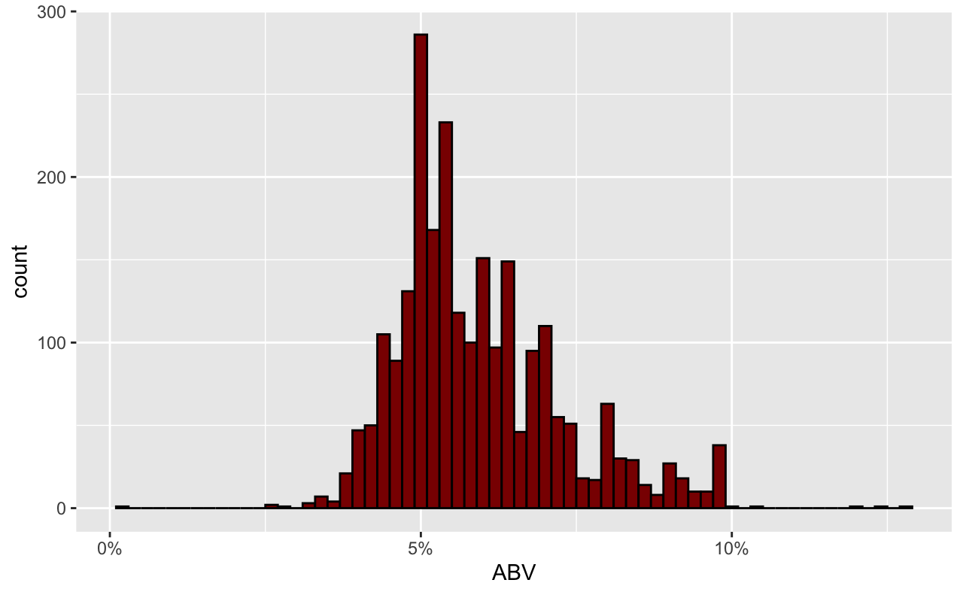
Distribution of ABV
Min.: 0.1%
1st Qu.: 5%
Median: 5.6%
Mean: 5.97%
3rd Qu.: 6.7%
Max.: 12.8%
Notes:
Count explains the number of beers for each ABV value
Right skewed distribution
Mean ABV of 5.97% is greater than the Median ABV of 5.6%

