Slide 1
Fish Population Dynamics in Lake Constance
Rebecca Siebeneicher, ZHAW
Spyridon Margomenos, ZHAW
Anika Heim, ZHAW
29.10.2026

Slide 2
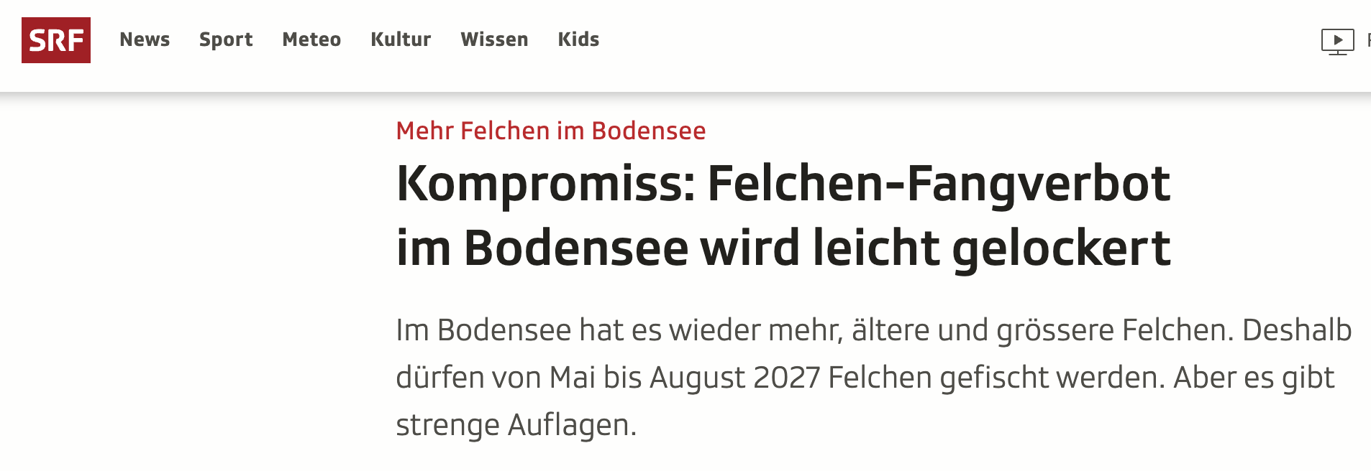
Model Idea

Slide 3
Model Idea
Whitefish: key role in ecosystem & important food fish
  1978 Peak fishing catch with 1200 tonnes
  2023 only 9.8 tonnes fishing
2024 - 2027 fishing ban
Stickleback as rival

Slide 4
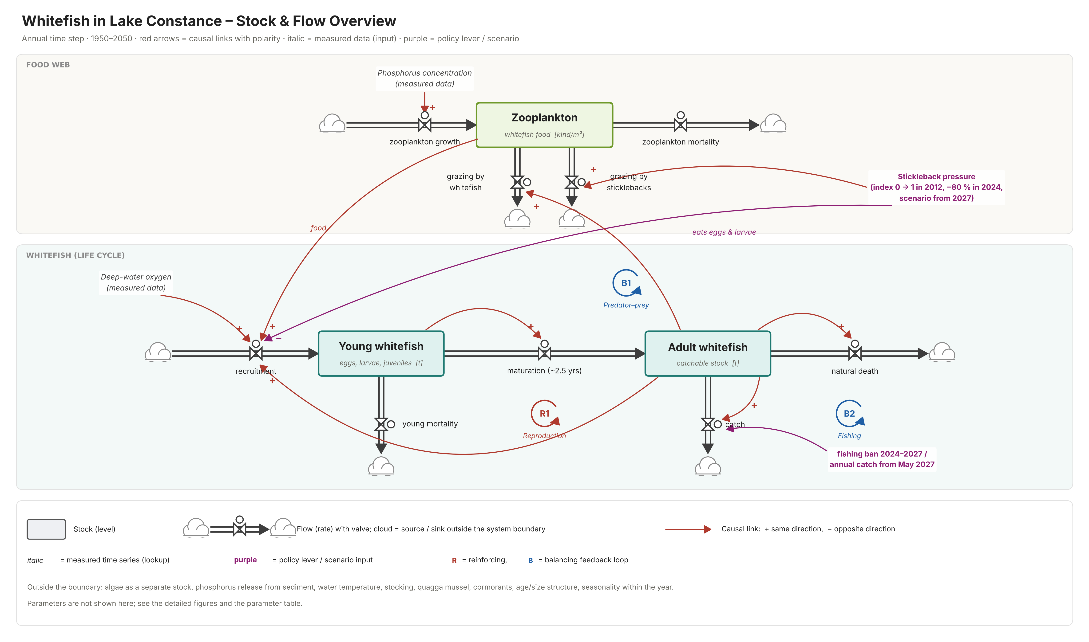
Model Idea

Slide 5
Model boundaries
Model focuses on whitefish population in Lake Constance
Timeframe: 1950 – 2050, seasons not included
Water temperature/ climate change not included
Release of phosphorus from the sediment is not included
Stickleback only included as a pressure index, not as its own population
Algae not modelled as a stock (included in zooplankton growth)

Slide 6
Hypothesis
H1: The model can reproduce the historical data.

Slide 7
Hypothesis
H2: The model can show the contribution effects of the 2024 fishing ban and the decline of the stickleback population to the recovery of the whitefish stock.

Slide 8
Hypothesis
H3: The model can simulate the maximum annual catch that can be permitted from 2027 onwards, to ensure that the stock remains above a reference level until 2050
  on low and renewed stickleback pressure

Slide 9
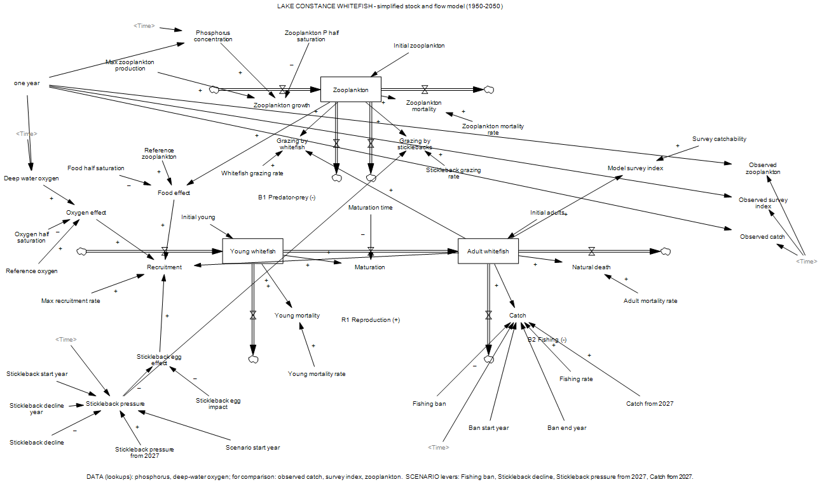
Model - Overview

Slide 10
Model - Overview

Slide 11
Model - Variables
State Variable | Input Flows | Output Flows
Adult Whitefish | Maturation | Natural death Catch
Young Whitefish | Recruitment | Maturation Young mortality
Zooplankton | Zooplankton growth | Zooplankton mortality Grazing by whitefish Grazing by stickleback
Auxiliary Variables: Food effect, Oxygen effect, Stickleback egg effect, Stickleback pressure, Phosphorus concentration, Deep water oxygen, Observed catch

Slide 12
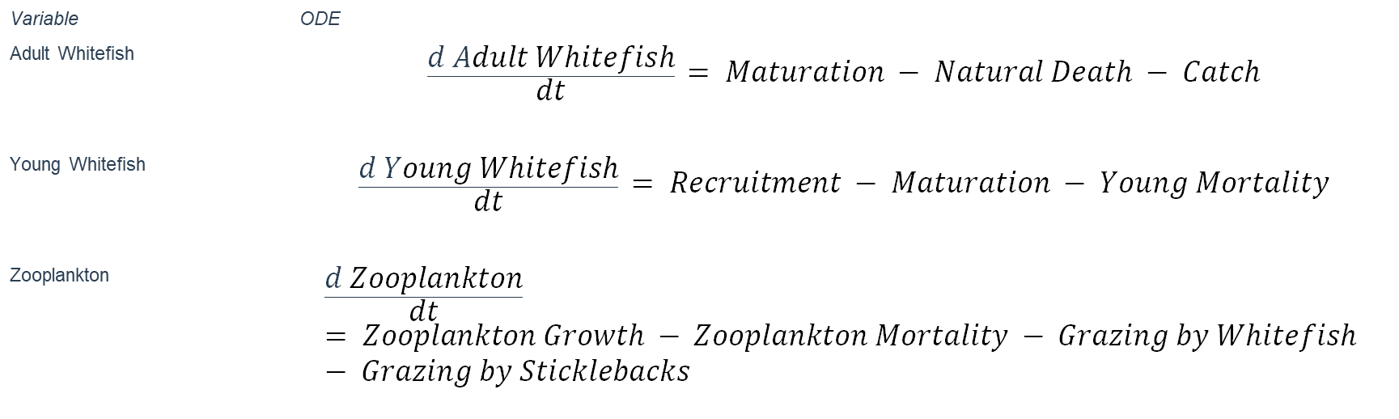
Model - ODE’s
Variable | ODE
Adult Whitefish | $$\frac{d Adult Whitefish}{dt} = Maturation − Natural Death − Catch$$
Young Whitefish | $$\frac{d Young Whitefish}{dt} = Recruitment − Maturation − Young Mortality$$
Zooplankton | $$\frac{d Zooplankton}{dt} = Zooplankton Growth − Zooplankton Mortality − Grazing by Whitefish − Grazing by Sticklebacks$$

Slide 13
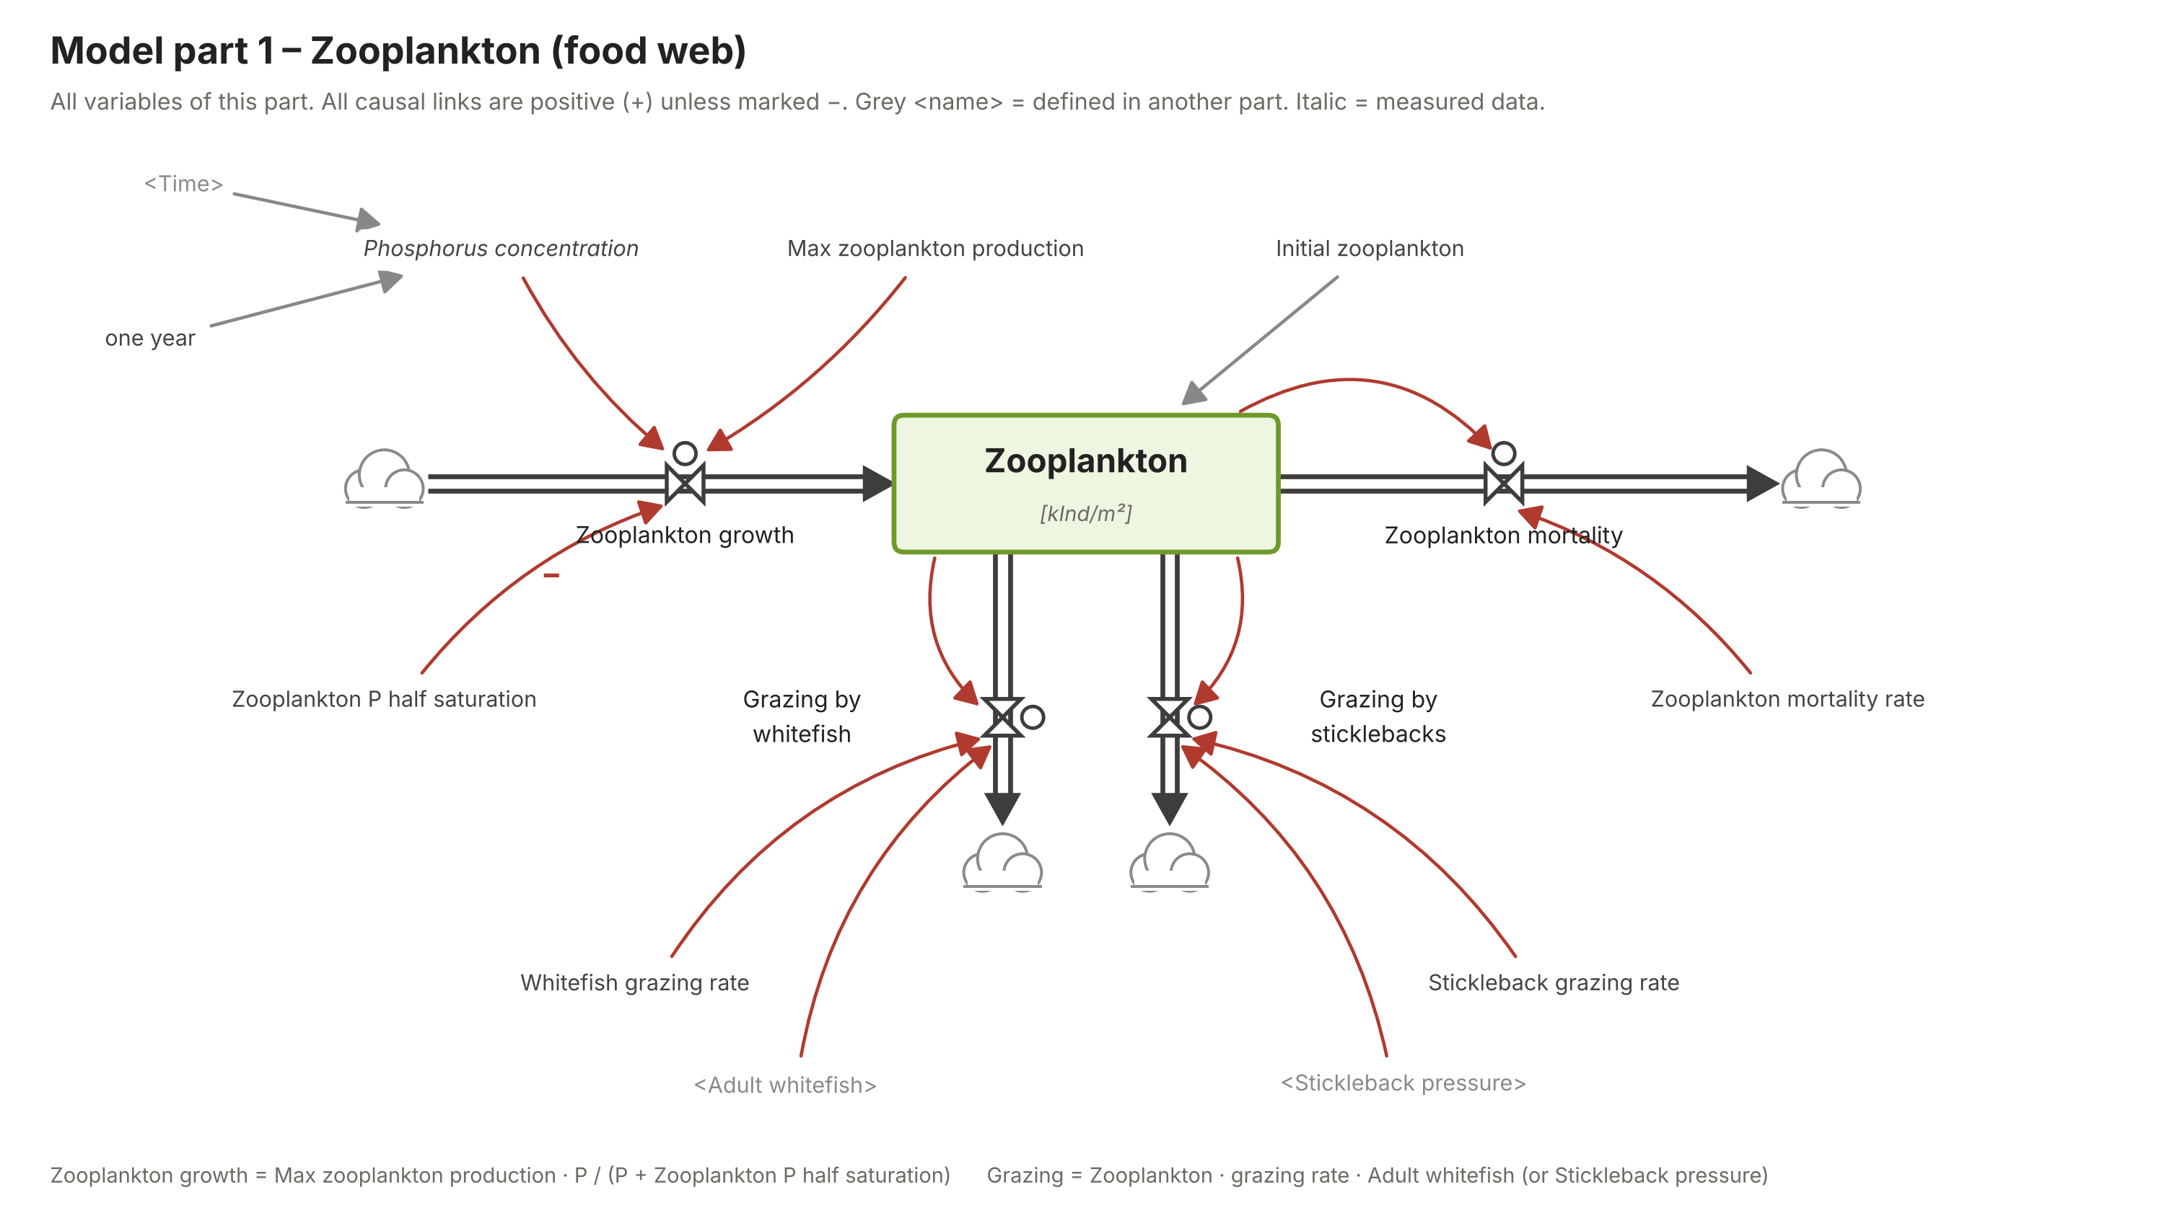
Model - Overview

Slide 14
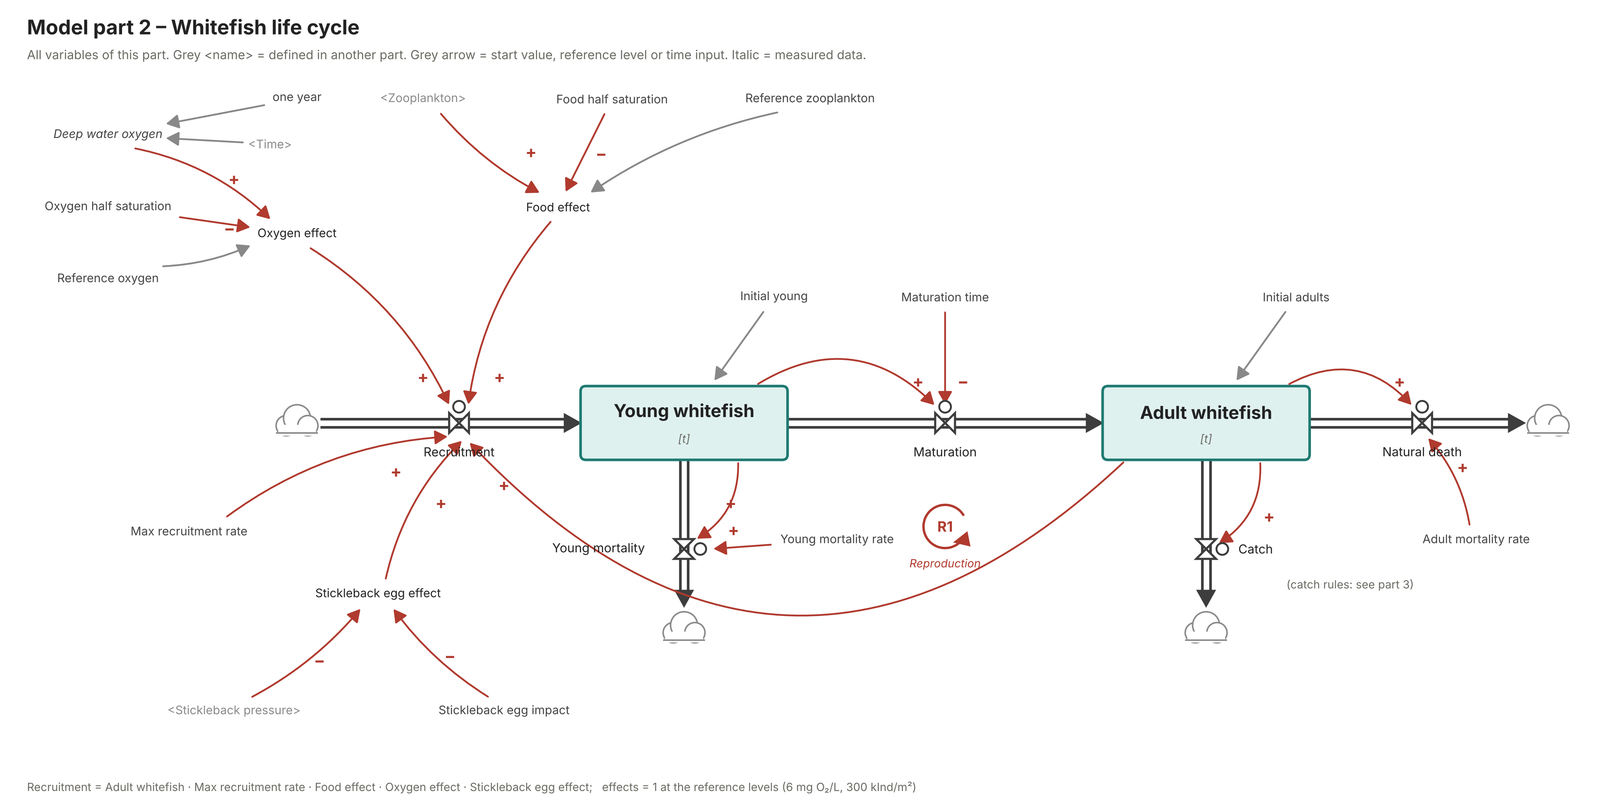
Model - Overview

Slide 15
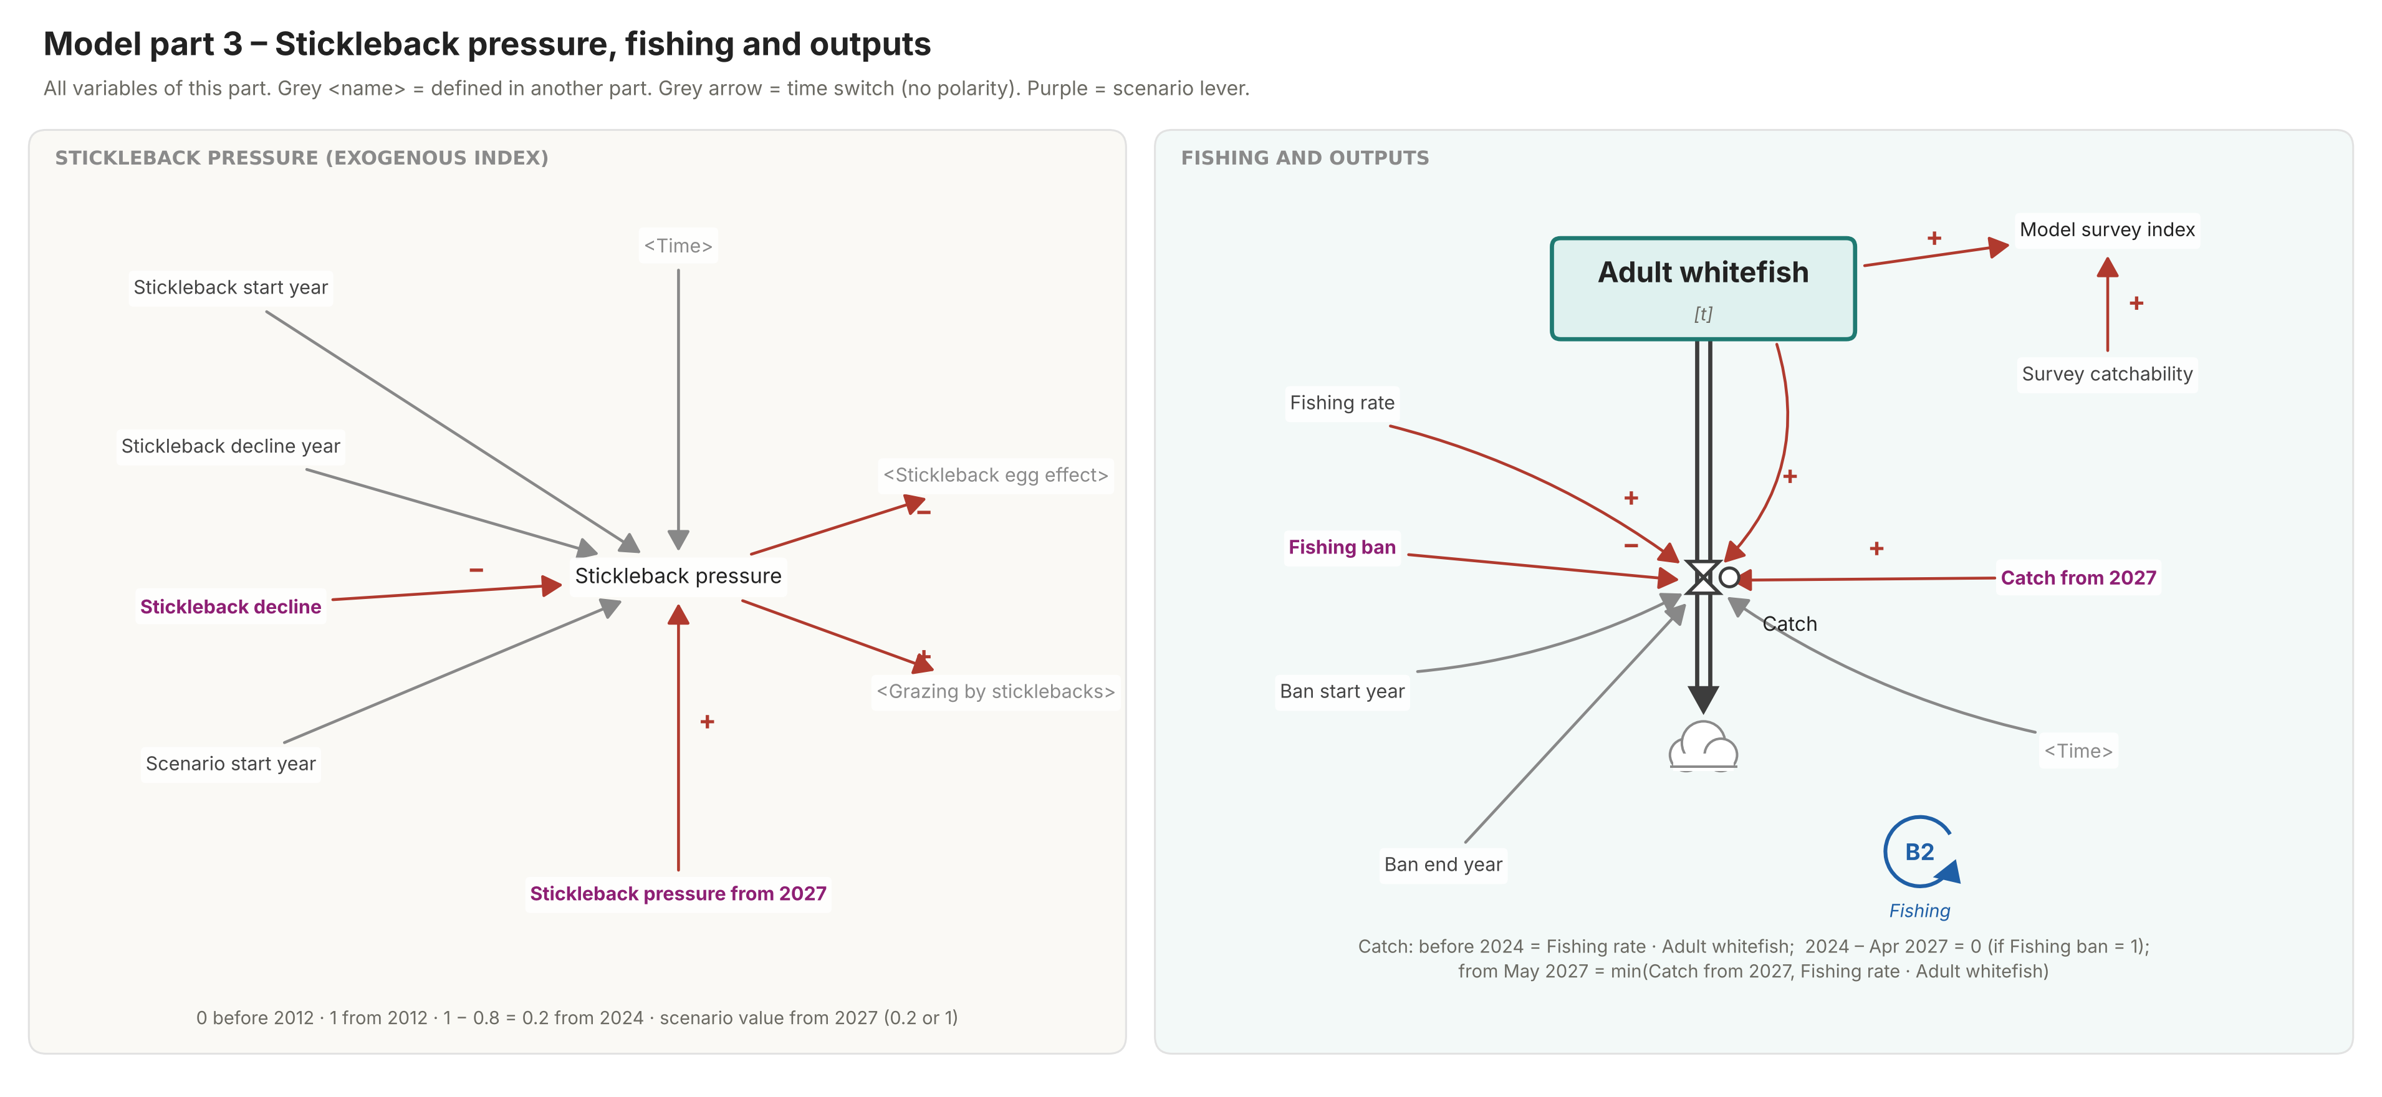
Model - Overview

Slide 16
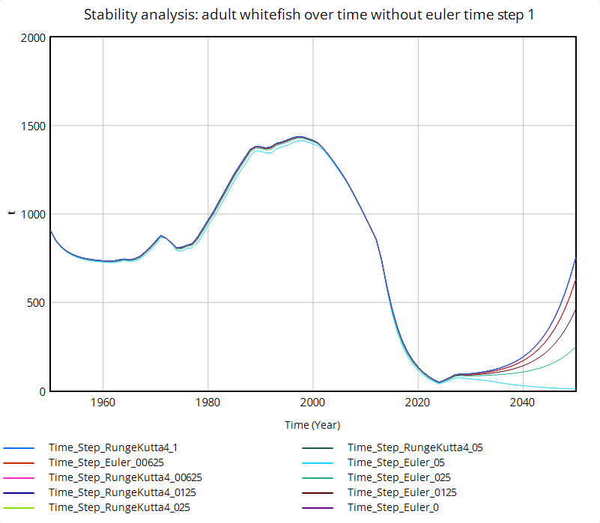
Model - Analysis
Numerical stability
  Euler and Runge-Kutta 4, different time steps (0.0625 to 1)
  Historical phase is robust, projection until 2050 depends on the time step
Validity
  Units checked with Vensim
  No decoupled variables
  Assumptions and calibration separately

Slide 17
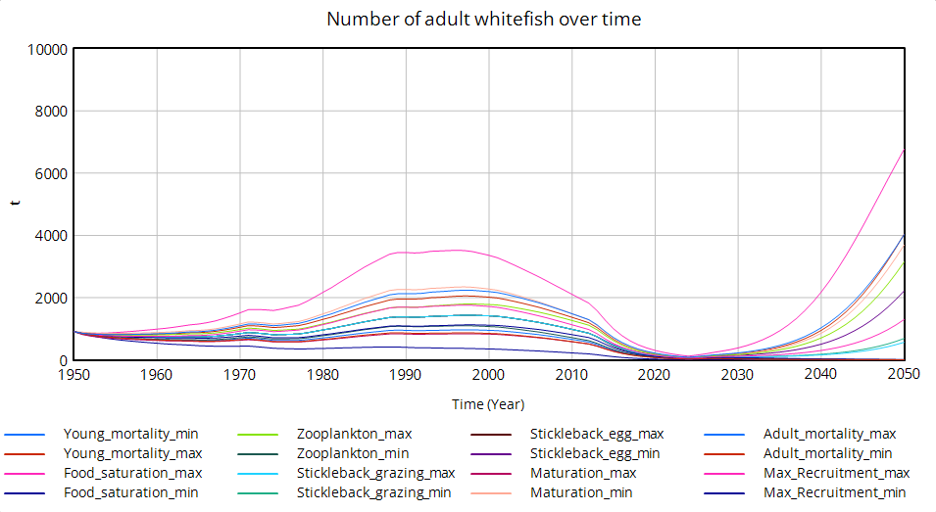
Model - Analysis
Sensitivity
  8 parameters, ±10% each, without recalibration
  Qualitative behavior is stable, but scale is sensitive

Slide 18
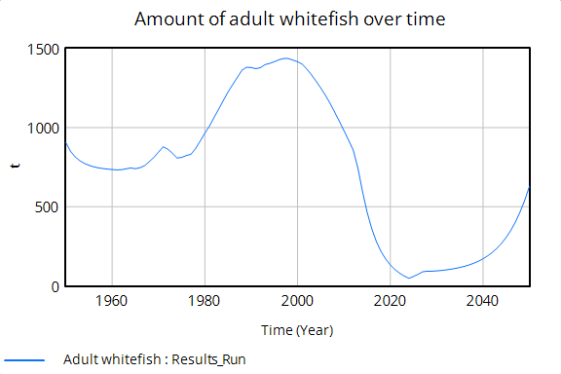
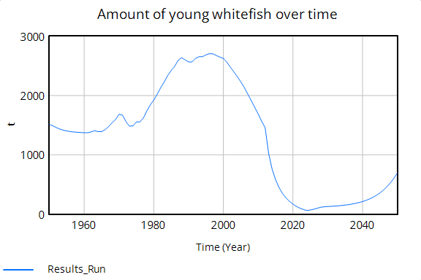
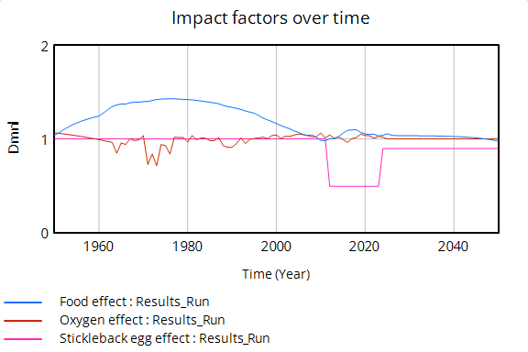
Results
Growth through 1997, decline beginning in 2000, recovery only in the model
Adults and young fish follow parallel trends
Explanation in the model:
  Food supply accounts for the increase and decline through 2012
  Sticklebacks are an additional factor

Slide 19
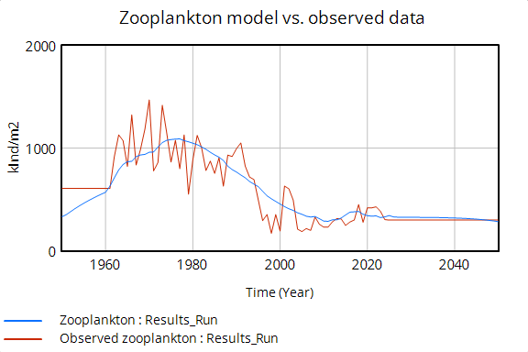
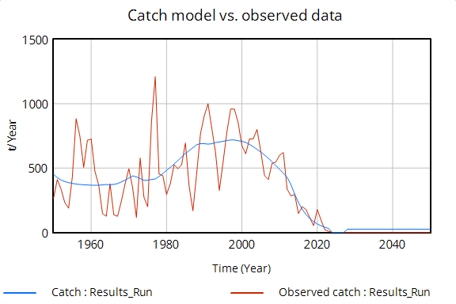
Results
H1: Reproducing the historical data
  Long-term trend and timing are right, but the peaks and annual fluctuations are not

Slide 20
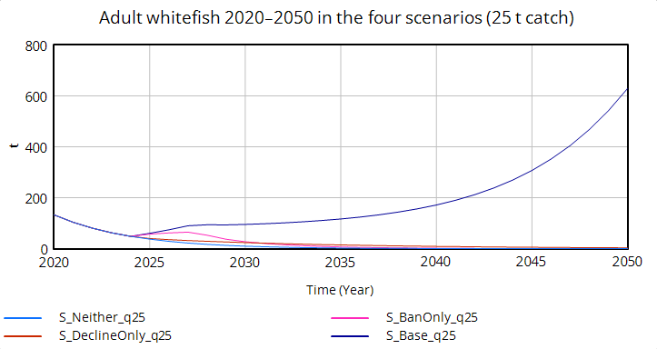
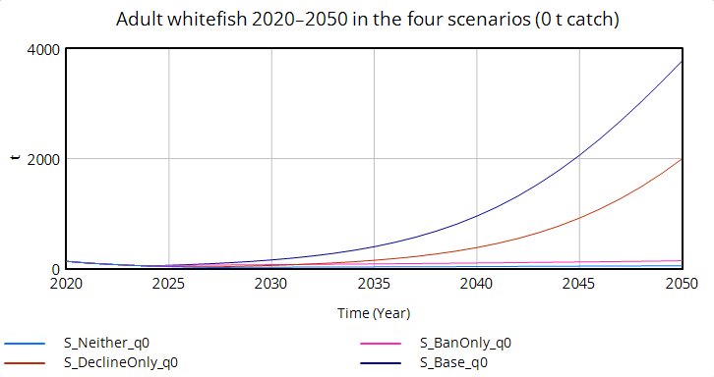
Results
H2: Fishing ban and decline of stickleback population contribution to the whitefish stock recovery
4 scenarios were plotted:
  Ban and decline (baseline), ban only, decline only, and neither
  Each with 0 t catch and 25 t catch per year
Neither a fishing ban nor a decrease in the stickleback population is sufficient on its own; they have a synergistic effect

Slide 21
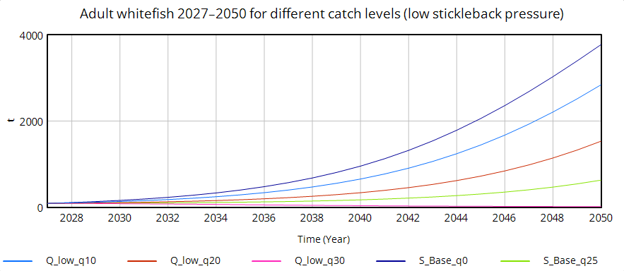
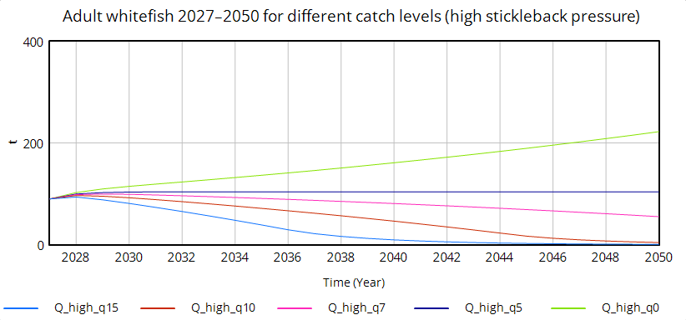
Results
H3: Calculation of the maximum annual catch from 2027 onwards to keep the stock above a reference level (50t) until 2050
Different catch limits:
  Approx. 27 t per year when stickleback pressure is low
  Only approx. 5 t per year if stickleback pressure increases again

Slide 22
Open issues
Water temperature not included
  Scenarios through 2050 assume constant conditions → climate change
  Warming could slow or accelerate recovery, the direction is uncertain
Other factors not included
  e.g. Quogga mussles, as a potential competition for food
Data mainly for upper part of the lake
→ The model is a tool for comparing scenarios based on known drivers, but it is not a complete representation of the ecosystem

Slide 23

Q&A
Git Repository: https://github.com/the-nerd-sloth/co1-semester-project

