Slide 1
zh
aw
Optimizing distribution of drinking water in remote areas of Nepal
Biner Nicolas, Giacomelli Robin, Giora Triantafyllia, Margomenos Spyridon
April 2, 2026

Slide 2
zh
aw
Table of Contents
Problem Formulation
The Lagrange Approach
Simulated Annealing
Method Comparison
Q&A

Slide 3
zh
aw
Problem Formulation
Goal: Distribute drinking water supply in remote areas of Nepal
Restrictions:
All houses must have some minimum access to water
Water amount must be proportional to their needs
There are losses due to the terrain/pipe quality
Methods used:
Lagrange Method
Simulated Annealing

Slide 4
zh
aw
Problem Formulation
a : delivery-loss factor
b : the smallest required amount of water per household
d : demand per household
w : house priority/vulnerability factor
S : total available water supply
Continuous variables, smooth objective function, constrained

Slide 5
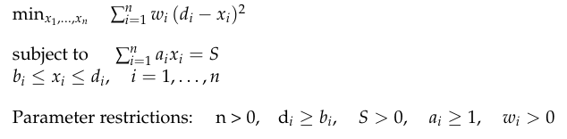
zh
aw
Lagrange Method

Slide 6
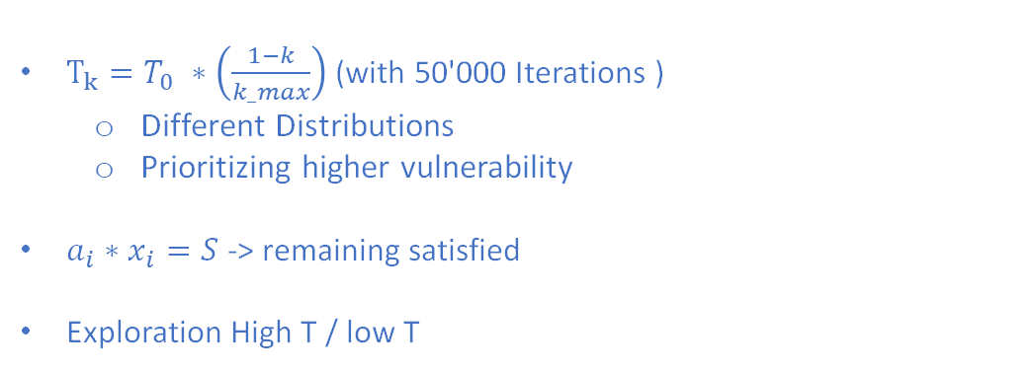
zh
aw
Simulated Annealing
$T_{k}=T_{0} ∗\left(\frac{1−k}{k_max}\right)$ (with 50'000 Iterations )
Different Distributions
Prioritizing higher vulnerability
$a_{i}∗x_{i}=S$-> remaining satisfied
Exploration High T / low T

Slide 7
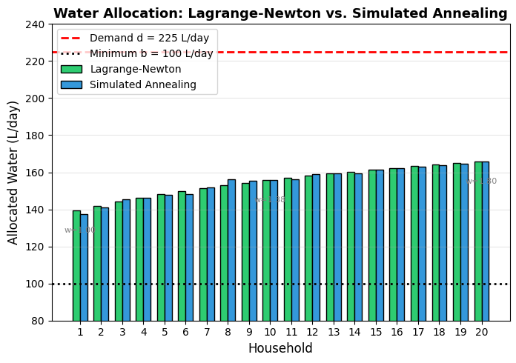
zh
aw
Method Comparison
Method Comparison: Lagrange-Newton vs Simulated Annealing
01
02
Metric one
Metric two

Slide 8
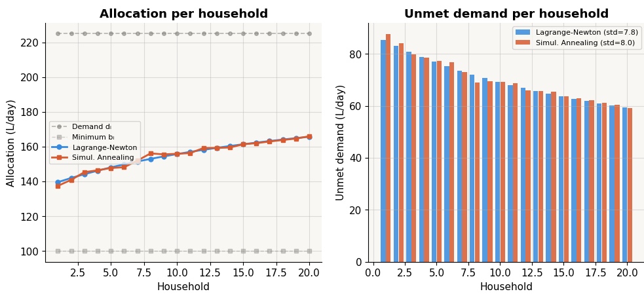
zh
aw
Method Comparison
Method Comparison: Lagrange-Newton vs Simulated Annealing
01
02
Metric one
Metric two

Slide 9
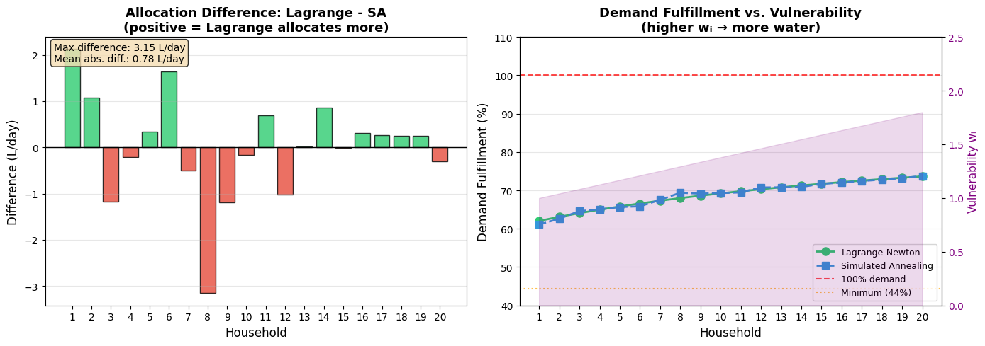
zh
aw
Method Comparison
Method Comparison: Lagrange-Newton vs Simulated Annealing
01
02
Metric one
Metric two

Slide 10
zh
aw
Questions
Thank you

