Slide 1
Architecture and Stone Stability in Norman Sicily
Please click the link below to fill out a Prior Knowledge Assessment.
Click here.

Slide 2
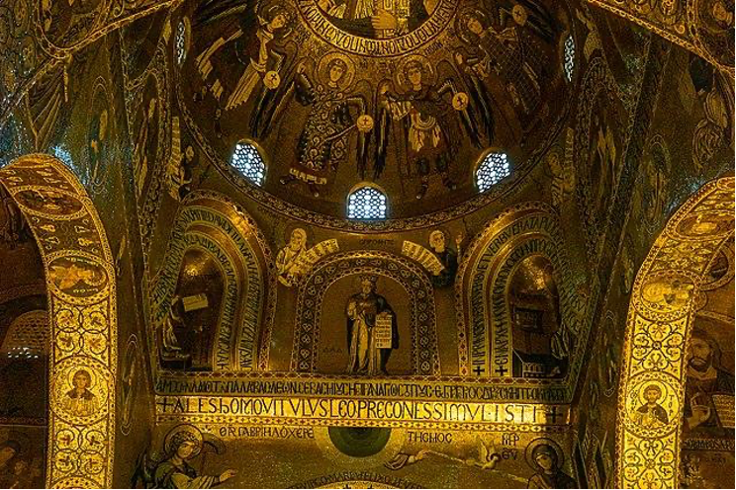
Norman Sicily Architecture
Sicily’s geographical location impacts its culture.
Sitting in the middle of the Mediterranean Sea, the island holds people of many different backgrounds, with the most popular ones being Muslims and Byzantines.
This impacts the architecture of the Norman Sicilians by being diverse to include all the cultures within the island.
This diversity is best seen in the Cappella Palatina
located in Palermo.
The building contains elements of Roman style as
well as Muslim and Byzantine

Slide 3
The Cultural Stone Stability Index
This index is used to measure natural and cultural stone.
The CSSI can be used to measure bridges, statues, arches, and buildings.
Practitioners will use the index to assess the rock decay and give it a final score.
The final score will be used to determine the structure’s stability.
Assessing these structures matters in order to preserve the heritage of the cultures to which the structures belong to.
Using the CSSI can also determine the danger risks of the stone structure. If left unchecked, the structure could collapse.

Slide 4
CSSI Activity
Some of the buildings of the Norman Sicilians are still around today.
Activity: Assess the image on the next slide. Use the scoring sheet through the provided link to complete the assessment.
Scoring sheet: http://normansicily.org/pdfs/cultural_stone_stability_index.pdf

Slide 5
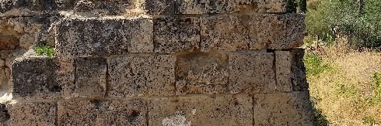
Santa Maria di Campogrosso – Brick Ruins

Slide 6
Discussion on CSSI
What physical observations can you make about the structure?
What overall score did you give it? Why?
End of lesson question: (Make a copy and share it)
Click here

Slide 7
References
CSSI information source:
SHR Alliance. “CSSI: Stone Heritage Research Alliance LLC.” StoneHeritage, 2019, https://www.shralliance.com/cssi.
Norman Sicily architecture and Cappella Palatine image source:
Cotugno, Emily. “The World the Normans Made · VI. Art and Architecture.” The Norman Sicily Project, 1 Sept. 2021, http://normansicily.org/en/resources/learn/group_four/.

