Slide 1
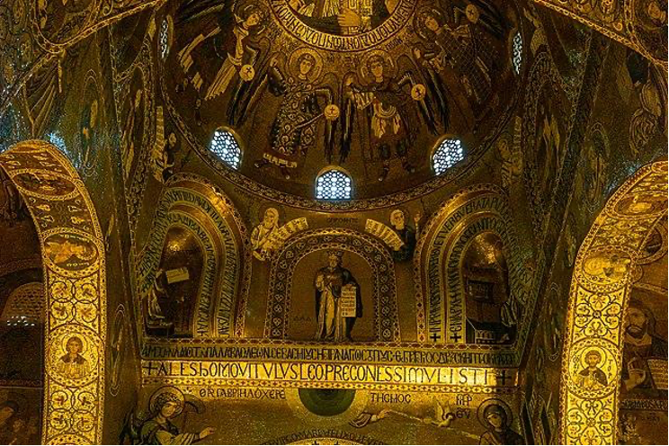
Monasteries and Religion of Norman Sicily

Slide 2
Preliminary Reading and Discussion Activity
Read the text and we will discuss it as a class.
“Roger I did not want to conquer through battles, but rather negotiations. They were greatly used in negotiations with other Muslim cities. Due to this, Muslims in the cities had some level of autonomy and Roger I gave them a sense of respect. Muslims who lived in villages did not have the same opportunity and had pressure to convert to Christianity instead. Roger I did not have any Muslim in the central government” (Ingwersen par. 2).

Slide 3
Religion
The Normans were traditionally Christians, but the island of Sicily was full of different religions such as Judaism, Eastern Orthodox Christianity, and Islam.
Due to the multicultural inhabitants of Sicily, the Normans were tolerable of the different religions and kept good relationships with their followers.
Since the Normans conquered Sicily, it was beneficial to incorporate people of different cultures into Norman systems, such as the military.
The heavy Muslim population of the island shifted culture of the Normans to that of the Muslims, influencing Christians to wear Mulsim garb and speak Arabic.

Slide 4
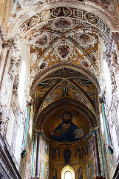
Coexistence
The religious tolerance of the Normans grew to an all time high under the rule of William I and William II.
The biggest example of tolerance is the participation of Muslims in Norman government.
Even though there was some violence between Christians and Mulsims, the tolerance of other religions shown by the Normans was extraordinary.

Slide 5
Monastery Class Research Activity
Sicily held many types of religious buildings during the Norman rule.
You will use the Norman Sicily Project website to research an article about the monasteries in Norman Sicily.
Use the link here to go to the activity and see further instructions!

Slide 6
Work Cited
Ingwersen, M. (2021, September 1). The World the Normans Made · V. Religion. The Norman Sicily Project. Retrieved July 6, 2022, from http://normansicily.org/en/resources/learn/group_four/

