Slide 1
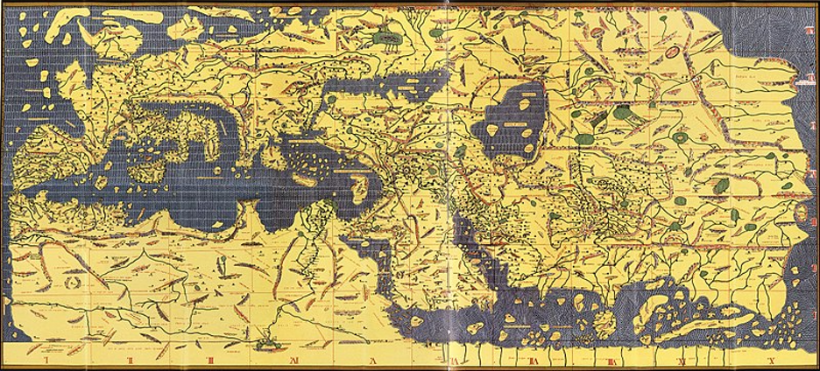
The People of Norman Sicily

Slide 2
Origins
The Normans descended from Scandinavians and settled in Normandy which is now present day northern France.
Normans went to Southern Italy and Sicily due to factors such as overcrowding in Normandy, work, wealth, and religious pilgrimages.
Using an array of military techniques, the Normans conquered the island and ruled over its diverse inhabitants from 1061 to 1194.
Powers waged war for the control of Sicily and Southern Italy because of its key geographical position that encouraged trade and influence of the Mediterranean Sea.

Slide 3
Lombards, Byzantines, and Arab Sicily
Prior to the Norman’s control over the region, Southern Italy and Sicily was under the influence of many powers.
The Lombards, a Germanic people, found Southern Italy as their home in the 6th century.
Civil war and conflicts with other powers led to their weakening and eventual downfall by the Normans.
The Byzantines also held influence in the region during the Middle Ages. Instability in the empire as well as a hostage situation involving Arab soldiers led to Arab Aghlabids invading Sicily.

Slide 4
Lombards, Byzantines, and Arab Sicily Cont’d
Due to a variety of factors, the Arabs successfully took control of the island and brought Islamic culture and prosperity to Sicily.
Exploiting political tensions and using their military skills, the Normans took control of the island over the Arabs.
Although the Normans were in power, the past Lombard, Byzantine, and Arab rule of Sicily was still apparent by the diversity of architecture, language, and religion on the island.

Slide 5
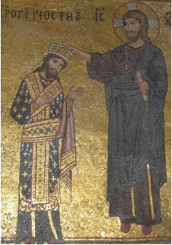
Norman Rulers Activity
Tancred de Hauteville’s sons would become the rulers of Norman Sicily. It is your task to analyze the impact of the Norman rulers.
In a group of no more than five people, you must research the rulers of Norman Sicily and present a short presentation on them and their impact on the culture of the region.
The ruler's you may choose from are:
Robert Guiscard, Roger I, and Roger II
The Task and more details can be found here

Slide 6
References
Schnell, Brian, et al. “The Norman Conquest of Southern Italy and Sicily · The Norman Sicily Project.” The Norman Sicily Project, 1 Sept. 2021, http://normansicily.org/en/resources/learn/group_one/.
Ahmed, Masud, et al. “The Worlds the Normans Found · The Norman Sicily Project.” The Norman Sicily Project, 1 Sept. 2021, http://normansicily.org/en/resources/learn/group_three/.
DeVivo, Richard, et al. “The Norman Rulers · The Norman Sicily Project.” The Norman Sicily Project, 1 Sept. 2021, http://normansicily.org/en/resources/learn/group_two/.
Cotugno, Emily. “The World the Normans Made · VI. Art and Architecture.” The Norman Sicily Project, 1 Sept. 2021, http://normansicily.org/en/resources/learn/group_four/. (Images)

