Slide 1
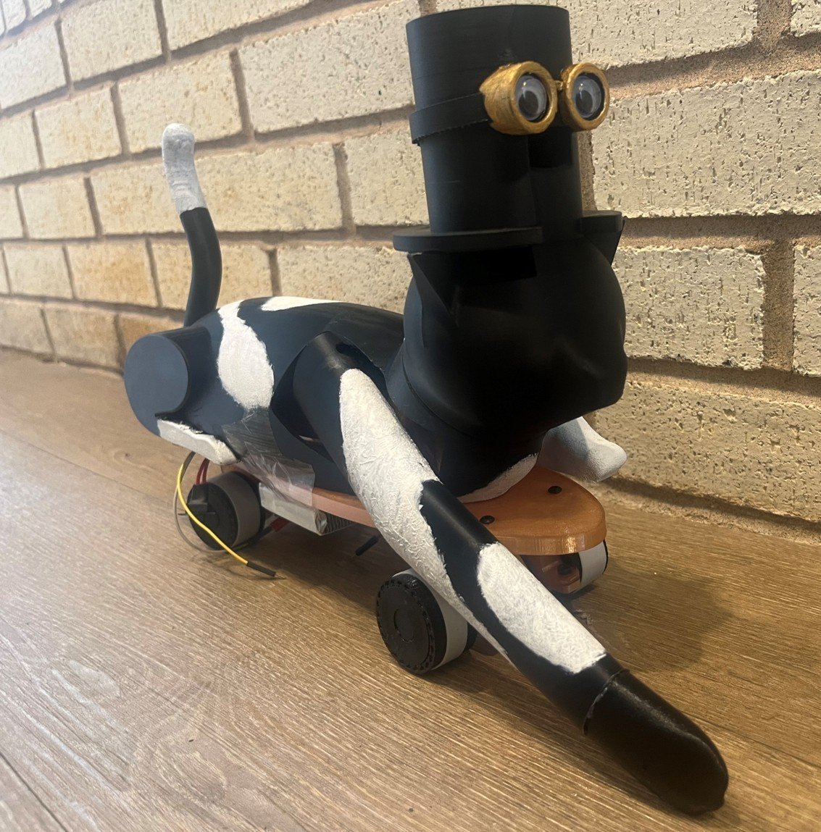
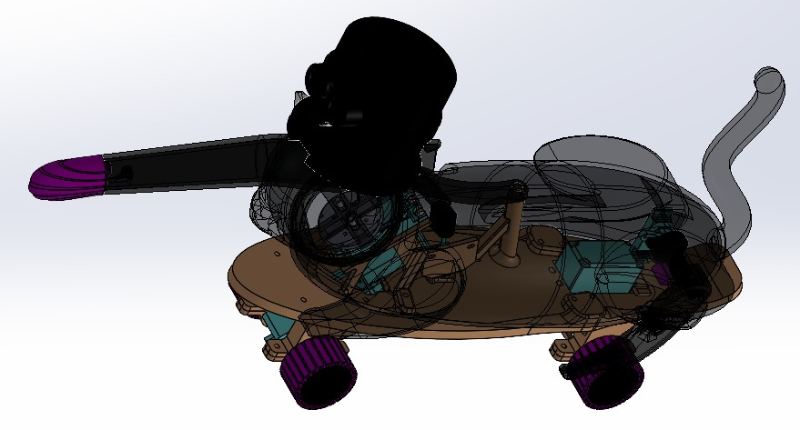
2026 / ME 444 · Interactive Toy Design
Felon the Freestylin’ Feline
Goals
• Create an interactive skateboard cat with at least two nontrivial electromechanical systems.
• Fit within a 10 × 10 × 10 inch envelope.
Contributions
• Split chassis separates shells from functional components
• Integrated driving, steering, swiping, and head rotation
• Revised interference points and enlarged fastening holes
Skateboard cat final build
Achievements
• Team earned Honorable Mention at toy fair
• Head and arm attachments still needed refinement
• Planned rear-leg swinging mechanism remained physically unfinished
Final integrated SOLIDWORKS assembly
Henry Luo | Engineering Portfolio | View project and supporting files
1
Notes:
id: feline
year: 2026
title: Felon the Freestylin’ Feline
context: ME 444 · Interactive Toy Design
summary: Contributed heavily to an interactive skateboard cat, including a split chassis that separates aesthetic pieces from functional components. The architecture supports easier 3D printing, revision, and assembly while integrating the toy’s electromechanical systems; the team earned an Honorable Mention.
objective: Create an interactive skateboard cat with at least two nontrivial electromechanical systems.
challenges: ['Fit within a 10 × 10 × 10 inch envelope.', 'Work within a $70 budget.', 'Integrate electromechanical systems while supporting fast revision and assembly.']
contribution: I contributed heavily to the interactive skateboard cat, including developing a split chassis that separates aesthetic pieces from functional components. This supported easier 3D printing, revision, and assembly.
tags: ['Mechatronics', 'DFA']
highlight: True
award: Team award: ME 444 Interactive Toy — Honorable Mention
outcome: The team demonstrated laser-responsive driving, steering, and arm motion and earned an Honorable Mention. Head retention and arm-motor attachment remained unreliable during the toy fair; the rear-leg swinging mechanism was not completed.
iterations: [{'title': 'From separate mechanisms to an integrated toy', 'before': 'Prototype parts had interference and difficult interfaces during assembly.', 'after': 'Rapid printed revisions and oversized fastening holes made assembly and disassembly easier. The final design combined front drive, rear steering, a swiping arm, and head rotation. Head retention and arm-motor attachment still needed another revision.', 'evidence': 'Final report: system integration, prototyping, and results. Individual dated CAD saves do not establish separate validated milestones.'}]
documents: []
presentation_bullets: ['Split chassis separates shells from functional components', 'Integrated driving, steering, swiping, and head rotation', 'Revised interference points and enlarged fastening holes', 'Team earned Honorable Mention at toy fair', 'Head and arm attachments still needed refinement', 'Planned rear-leg swinging mechanism remained physically unfinished']
# Felon the Freestylin’ Feline
## Purpose
Create an interactive skateboard cat with at least two nontrivial electromechanical systems.
## Requirements and constraints
- Fit within a 10 × 10 × 10 inch envelope.
- Work within a $70 budget.
- Integrate electromechanical systems while supporting fast revision and assembly.
## Engineering contribution
I contributed heavily to the interactive skateboard cat, including developing a split chassis that separates aesthetic pieces from functional components. This supported easier 3D printing, revision, and assembly.
## Outcome and limits
The team demonstrated laser-responsive driving, steering, and arm motion and earned an Honorable Mention. Head retention and arm-motor attachment remained unreliable during the toy fair; the rear-leg swinging mechanism was not completed.
## From separate mechanisms to an integrated toy
Before: Prototype parts had interference and difficult interfaces during assembly.
After: Rapid printed revisions and oversized fastening holes made assembly and disassembly easier. The final design combined front drive, rear steering, a swiping arm, and head rotation. Head retention and arm-motor attachment still needed another revision.
Images and demonstrations:
Skateboard cat final build: assets/project_descriptions/2026-skateboard-cat/media/images/final-build.jpg
Drive system CAD: assets/project_descriptions/2026-skateboard-cat/media/images/drive-system-cad.png
Shell-securing assembly: assets/project_descriptions/2026-skateboard-cat/media/images/shell-securing-assembly.png
Final integrated SOLIDWORKS assembly: assets/project_descriptions/2026-skateboard-cat/media/images/final-solidworks-assembly.png
Four-bar swiping arm subassembly: assets/project_descriptions/2026-skateboard-cat/media/images/arm-subassembly.png
Head-turn servo and snap-fit interface: assets/project_descriptions/2026-skateboard-cat/media/images/head-subassembly.png
Felon the Freestylin’ Feline: team showcase, mechanisms, and testing: assets/project_descriptions/2026-skateboard-cat/media/videos/cat-hype.mp4
Completed skateboard cat responding to a laser on the floor: assets/project_descriptions/2026-skateboard-cat/media/videos/laser-following-demo.mp4
Skateboard cat Creo assembly view: assets/project_descriptions/2026-skateboard-cat/media/images/full-creo-assembly.png

Slide 2
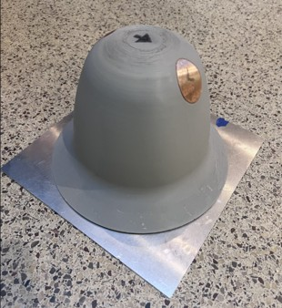
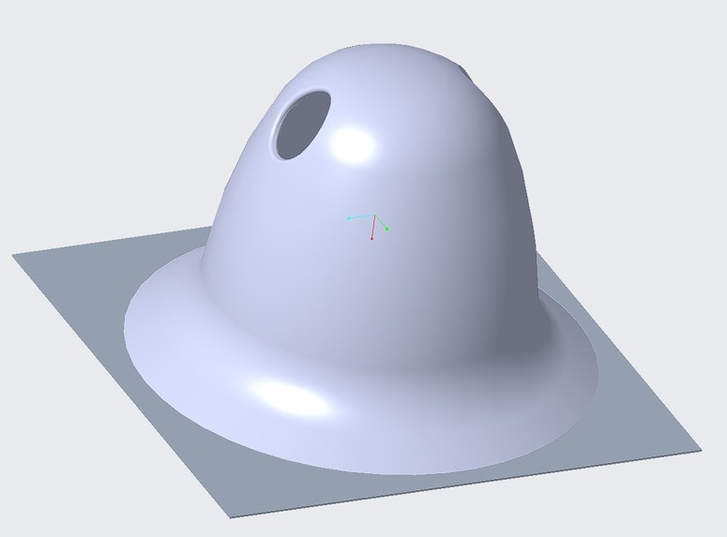
2026 / ME 444 · Battle Bot Competition
Tipping Hat Battle Bot
Goals
• Immobilize opposing robots while surviving field hazards under the course constraints.
• Fit within a 10 × 10 × 10 inch envelope.
Contributions
• Designed hat-inspired mechanism and compact drive system
• Revised motor clearances and bracket alignment geometry
• Removed casters to improve wheel floor contact
Tipping Hat battle bot final build
Achievements
• Loose constraints produced sideways tipping, not flipping
• Team earned first place in course competition
Complete battle bot Creo assembly
Henry Luo | Engineering Portfolio | View project and supporting files
2
Notes:
id: battle-bot
year: 2026
title: Tipping Hat Battle Bot
context: ME 444 · Battle Bot Competition
summary: Developed a hat-inspired lifting mechanism and integrated it with a compact drive system for a remotely controlled battle bot. The design packaged the mechanism and supplied electronics within a 10-inch cube and 5-pound limit; the team earned first place in the ME 444 competition.
objective: Immobilize opposing robots while surviving field hazards under the course constraints.
challenges: ['Fit within a 10 × 10 × 10 inch envelope.', 'Stay at or below 5 pounds.', 'Use the provided electronics.', 'Package the lifting mechanism and drivetrain together.']
contribution: Developed a hat-inspired lifting mechanism and integrated it with a compact drive system and full CAD assembly.
tags: ['Mechanical Design', 'CAD']
highlight: True
award: Team award: ME 444 Battle Bot — 1st Place
outcome: The team earned first place in the ME 444 Battle Bot competition.
iterations: [{'title': 'Drive bracket: fit and floor contact', 'before': 'Caster placement and printing were difficult; the alignment hole and motor geometry caused interference.', 'after': 'Removed the casters, changed the alignment-hole height, and revised motor clearances so the wheels could sit correctly against the floor.', 'evidence': 'Design report section 2.1 and figures 2.1.1-2.1.4.'}, {'title': 'Hat mechanism: intended lift versus observed motion', 'before': 'The shell was intended to lift vertically and flip an opponent.', 'after': 'Loose constraints produced a slower sideways hat-tip instead. The bot still won its lab and course battles, but the report does not document a later fix for the intended flipping action.', 'evidence': 'Design report: prototyping, results, and conclusion.'}]
documents: []
presentation_bullets: ['Designed hat-inspired mechanism and compact drive system', 'Revised motor clearances and bracket alignment geometry', 'Removed casters to improve wheel floor contact', 'Loose constraints produced sideways tipping, not flipping', 'Team earned first place in course competition']
# Tipping Hat Battle Bot
## Purpose
Immobilize opposing robots while surviving field hazards under the course constraints.
## Requirements and constraints
- Fit within a 10 × 10 × 10 inch envelope.
- Stay at or below 5 pounds.
- Use the provided electronics.
- Package the lifting mechanism and drivetrain together.
## Engineering contribution
Developed a hat-inspired lifting mechanism and integrated it with a compact drive system and full CAD assembly.
## Outcome and limits
The team earned first place in the ME 444 Battle Bot competition.
## Drive bracket: fit and floor contact
Before: Caster placement and printing were difficult; the alignment hole and motor geometry caused interference.
After: Removed the casters, changed the alignment-hole height, and revised motor clearances so the wheels could sit correctly against the floor.
## Hat mechanism: intended lift versus observed motion
Before: The shell was intended to lift vertically and flip an opponent.
After: Loose constraints produced a slower sideways hat-tip instead. The bot still won its lab and course battles, but the report does not document a later fix for the intended flipping action.
## Retained source
The design report retains the mechanical description, requirements, test results, and limitations. Embedded code screenshots were removed; editable source has credential literals replaced with configuration placeholders.
Images and demonstrations:
Tipping Hat battle bot final build: assets/project_descriptions/2026-tipping-hat-battle-bot/media/images/final-build.png
Complete battle bot Creo assembly: assets/project_descriptions/2026-tipping-hat-battle-bot/media/images/full-creo-assembly.jpg
Hat-tip lifting mechanism: assets/project_descriptions/2026-tipping-hat-battle-bot/media/images/hat-tip-mechanism.png
Compact drive system: assets/project_descriptions/2026-tipping-hat-battle-bot/media/images/drive-system.png
Tipping Hat battle bot competition footage: assets/project_descriptions/2026-tipping-hat-battle-bot/media/videos/battle-bot-match.mp4
Early drive bracket with caster features: assets/project_descriptions/2026-tipping-hat-battle-bot/media/images/early-drive-bracket.png
Revised bracket after clearance and alignment changes: assets/project_descriptions/2026-tipping-hat-battle-bot/media/images/final-drive-bracket.png

Slide 3
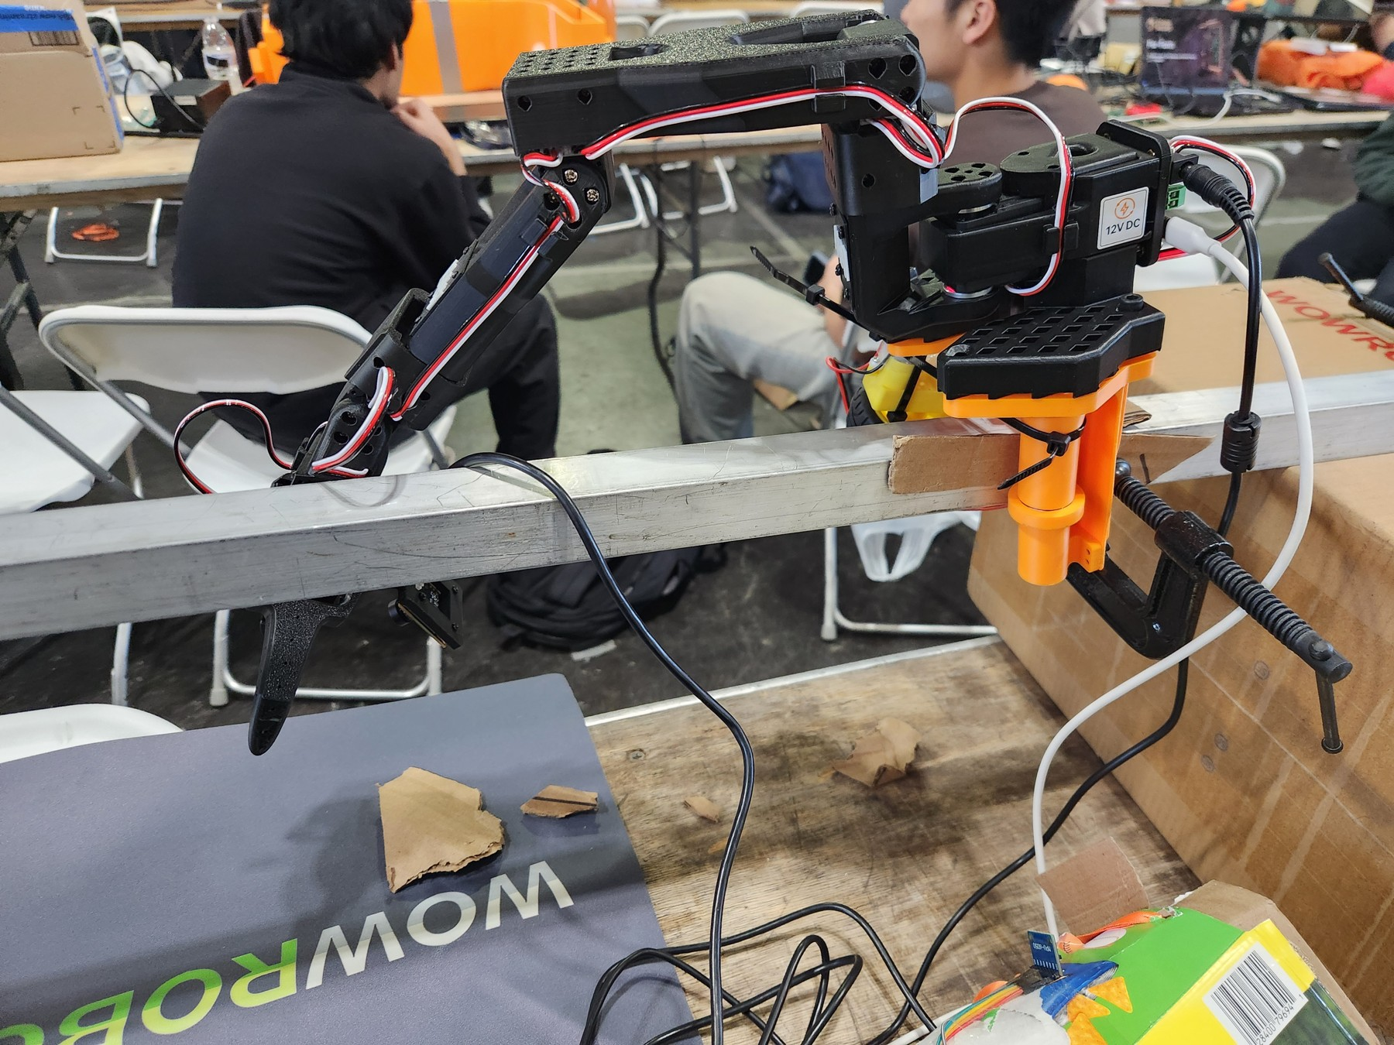
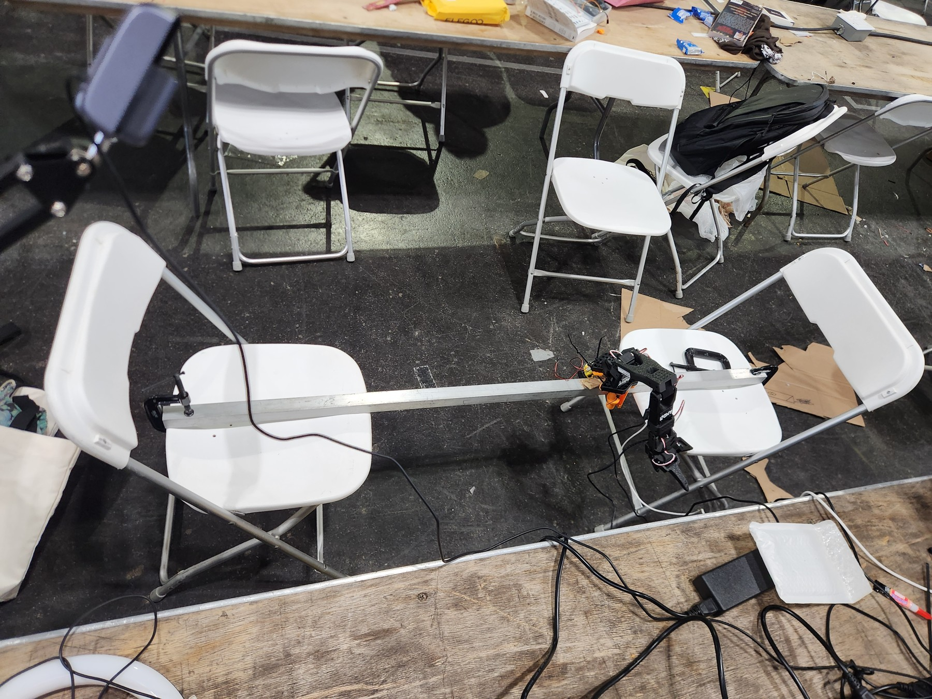
2026 / StarkHacks
Ghost Arm
Goals
• Develop a tele-operated robotic arm in 36 hours to improve manufacturing and maintenance ease and safety in dark, dirty, and difficult environments.
• 36-hour development window
Contributions
• Led purpose ideation and rapid cardboard prototyping
• Explored teleoperation for difficult industrial working environments
Ghost Arm robotic arm assembly
Achievements
• Rapid evolution outpaced CAD during short development
• Printing failure prevented a corrected mechanical iteration
• Team earned Best Implementation of Viam award
Ghost Arm support frame and demonstration setup
Henry Luo | Engineering Portfolio | View project and supporting files
3
Notes:
id: ghost-arm
year: 2026
title: Ghost Arm
context: StarkHacks
tags: ['Robotics', 'Rapid Development', 'Viam']
summary: I led purpose ideation and low-fidelity prototyping with cardboard and tape for this team robotics project, and worked on the 3D-printed mechanical system.
objective: Develop a tele-operated robotic arm in 36 hours to improve manufacturing and maintenance ease and safety in dark, dirty, and difficult environments.
challenges: ['36-hour development window', 'Only one attempt available to 3D-print the complete mechanical system', 'CAD relation verification before fabrication']
contribution: I led purpose ideation and low-fidelity prototyping with cardboard and tape, helping define the robotic arm’s purpose and explore the concept before fabrication. I also worked on the 3D-printed mechanical system. The concept evolved rapidly during the short project timeline, so CAD did not meaningfully carry through to the final design. Physical prototypes and demonstration footage document the final implementation.
outcome: A CAD relation error caused my fabrication attempt to fail, and the single-attempt constraint left no opportunity for a corrected print. This highlighted the importance of checking CAD relations and planning for fabrication risk. The team earned Best Implementation of Viam at StarkHacks 2026.
award: Team award: StarkHacks 2026 — Best Implementation of Viam
documents: []
presentation_bullets: ['Led purpose ideation and rapid cardboard prototyping', 'Explored teleoperation for difficult industrial working environments', 'Rapid evolution outpaced CAD during short development', 'Printing failure prevented a corrected mechanical iteration', 'Team earned Best Implementation of Viam award']
# Ghost Arm
## Purpose
Develop a tele-operated robotic arm in 36 hours to improve manufacturing and maintenance ease and safety in dark, dirty, and difficult environments.
## Requirements and constraints
- 36-hour development window
- Only one attempt available to 3D-print the complete mechanical system
- CAD relation verification before fabrication
## Engineering contribution
I led purpose ideation and low-fidelity prototyping with cardboard and tape, helping define the robotic arm’s purpose and explore the concept before fabrication. I also worked on the 3D-printed mechanical system.
## Outcome and limits
A CAD relation error caused my fabrication attempt to fail, and the single-attempt constraint left no opportunity for a corrected print. This highlighted the importance of checking CAD relations and planning for fabrication risk. The team earned Best Implementation of Viam at StarkHacks 2026.
## Design process
The concept evolved rapidly during the short project timeline, so CAD did not meaningfully carry through to the final design. Physical prototypes and demonstration footage document the final implementation.
Images and demonstrations:
Ghost Arm robotic arm assembly: assets/project_descriptions/2026-ghost-arm/media/images/ghost-arm.jpg
Ghost Arm support frame and demonstration setup: assets/project_descriptions/2026-ghost-arm/media/images/support-frame.jpg
Cardboard arm-sleeve prototype with electronics: assets/project_descriptions/2026-ghost-arm/media/images/arm-sleeve.jpg
Ghost Arm live demonstration: assets/project_descriptions/2026-ghost-arm/media/videos/live-demo-web.mp4

Slide 4
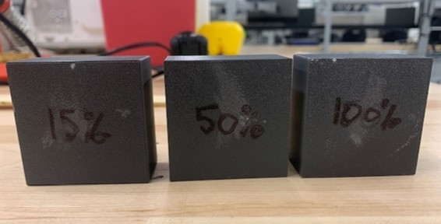
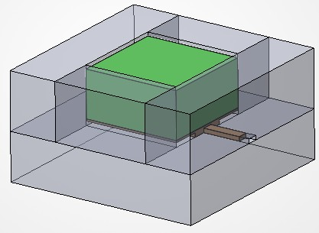
2026 / ME 315 · Self-chosen team experiment
Infill and Thermal Conduction
Goals
• Investigate how 15%, 50%, and 100% cubic infill affect the equivalent thermal conductivity and resistance of otherwise comparable PETG blocks.
• Hold block geometry, material, wall thickness, and layer height consistent while varying infill.
Contributions
• Led concept development and coordinated experimental teamwork
• Compared PETG specimens with three infill densities
• Combined patch heating, insulation, and forced convection
• Measured temperatures, heater power, and infrared imagery
PETG test blocks with 15%, 50%, and 100% infill
Achievements
• Equipment uncertainty and heat leakage limited conclusions
• Recommended improved instrumentation, insulation, and control tests
Experimental setup CAD with transparent enclosure
Henry Luo | Engineering Portfolio | View project and supporting files
4
Notes:
id: infill-thermal-conduction
year: 2026
title: Infill and Thermal Conduction
context: ME 315 · Self-chosen team experiment
tags: ['Heat Transfer', 'Experimental Design', 'FDM']
summary: Led concept development and coordinated a team-designed experiment on how infill percentage affects one-dimensional heat transfer through FDM-printed PETG blocks. Equipment limitations made the results inconclusive; the project produced a test method, data analysis, and a final report.
objective: Investigate how 15%, 50%, and 100% cubic infill affect the equivalent thermal conductivity and resistance of otherwise comparable PETG blocks.
challenges: ['Hold block geometry, material, wall thickness, and layer height consistent while varying infill.', 'Approximate one-dimensional, steady-state heat transfer with insulated side walls and controlled top-surface airflow.', 'Measure heater power and surface temperatures despite instrument noise and uncertainty.', 'Distinguish conduction from heat leakage, internal air effects, and temperature-dependent material behavior.']
contribution: I led concept development and coordinated the team’s work on this self-chosen project. Together, we designed the experiment around three 2 × 2 × 1 inch FDM-printed PETG blocks, a patch heater, an insulated enclosure, and forced convection over the top surface. Thermocouples, heater-power measurements, and infrared imaging supported the analysis of equivalent thermal conductivity and resistance.
outcome: The team completed the experimental design, testing, analysis, and final report. Results were inconclusive because of unreliable equipment and limitations in the experimental assumptions. The report identifies wattmeter uncertainty, thermocouple noise, heat leakage, nonuniform surface temperatures, and operation near PETG’s glass-transition range as limitations. It proposes better instrumentation, improved insulation, and a control test for a future iteration.
documents: [{'label': 'Read reviewed project notes and limitations', 'src': 'assets/project_descriptions/2026-infill-thermal-conduction/supporting/project-notes.md'}]
presentation_bullets: ['Led concept development and coordinated experimental teamwork', 'Compared PETG specimens with three infill densities', 'Combined patch heating, insulation, and forced convection', 'Measured temperatures, heater power, and infrared imagery', 'Equipment uncertainty and heat leakage limited conclusions', 'Recommended improved instrumentation, insulation, and control tests']
# Infill and Thermal Conduction
## Purpose
Investigate how 15%, 50%, and 100% cubic infill affect the equivalent thermal conductivity and resistance of otherwise comparable PETG blocks.
## Requirements and constraints
- Hold block geometry, material, wall thickness, and layer height consistent while varying infill.
- Approximate one-dimensional, steady-state heat transfer with insulated side walls and controlled top-surface airflow.
- Measure heater power and surface temperatures despite instrument noise and uncertainty.
- Distinguish conduction from heat leakage, internal air effects, and temperature-dependent material behavior.
## Engineering contribution
I led concept development and coordinated the team’s work on this self-chosen project. Together, we designed the experiment around three 2 × 2 × 1 inch FDM-printed PETG blocks, a patch heater, an insulated enclosure, and forced convection over the top surface. Thermocouples, heater-power measurements, and infrared imaging supported the analysis of equivalent thermal conductivity and resistance.
## Outcome and limits
The team completed the experimental design, testing, analysis, and final report. Results were inconclusive because of unreliable equipment and limitations in the experimental assumptions. The report identifies wattmeter uncertainty, thermocouple noise, heat leakage, nonuniform surface temperatures, and operation near PETG’s glass-transition range as limitations. It proposes better instrumentation, improved insulation, and a control test for a future iteration.
## Numerical qualification
The original report lists thermal resistance 0.147 K m^2/W and conductivity 1.35 W/(m K) for the 15% specimen at 81 C. Using its stated thickness of 0.0254 m, k = L/R would instead require approximately 0.0188 K m^2/W. The original PDF and unverified presentation were removed; no corrected measurement is asserted. Retained raw measurements and specimen CAD support further review.
Images and demonstrations:
PETG test blocks with 15%, 50%, and 100% infill: assets/project_descriptions/2026-infill-thermal-conduction/media/images/blocks.png
Insulated block assembly and blower setup: assets/project_descriptions/2026-infill-thermal-conduction/media/images/setup-diagram.png
Block enclosure cavity: assets/project_descriptions/2026-infill-thermal-conduction/media/images/block-cavity.png
Heat-transfer model used in the experiment: assets/project_descriptions/2026-infill-thermal-conduction/media/images/heat-transfer-diagram.png
Experimental setup CAD with transparent enclosure: assets/project_descriptions/2026-infill-thermal-conduction/media/images/experimental-setup-cad.png

Slide 5
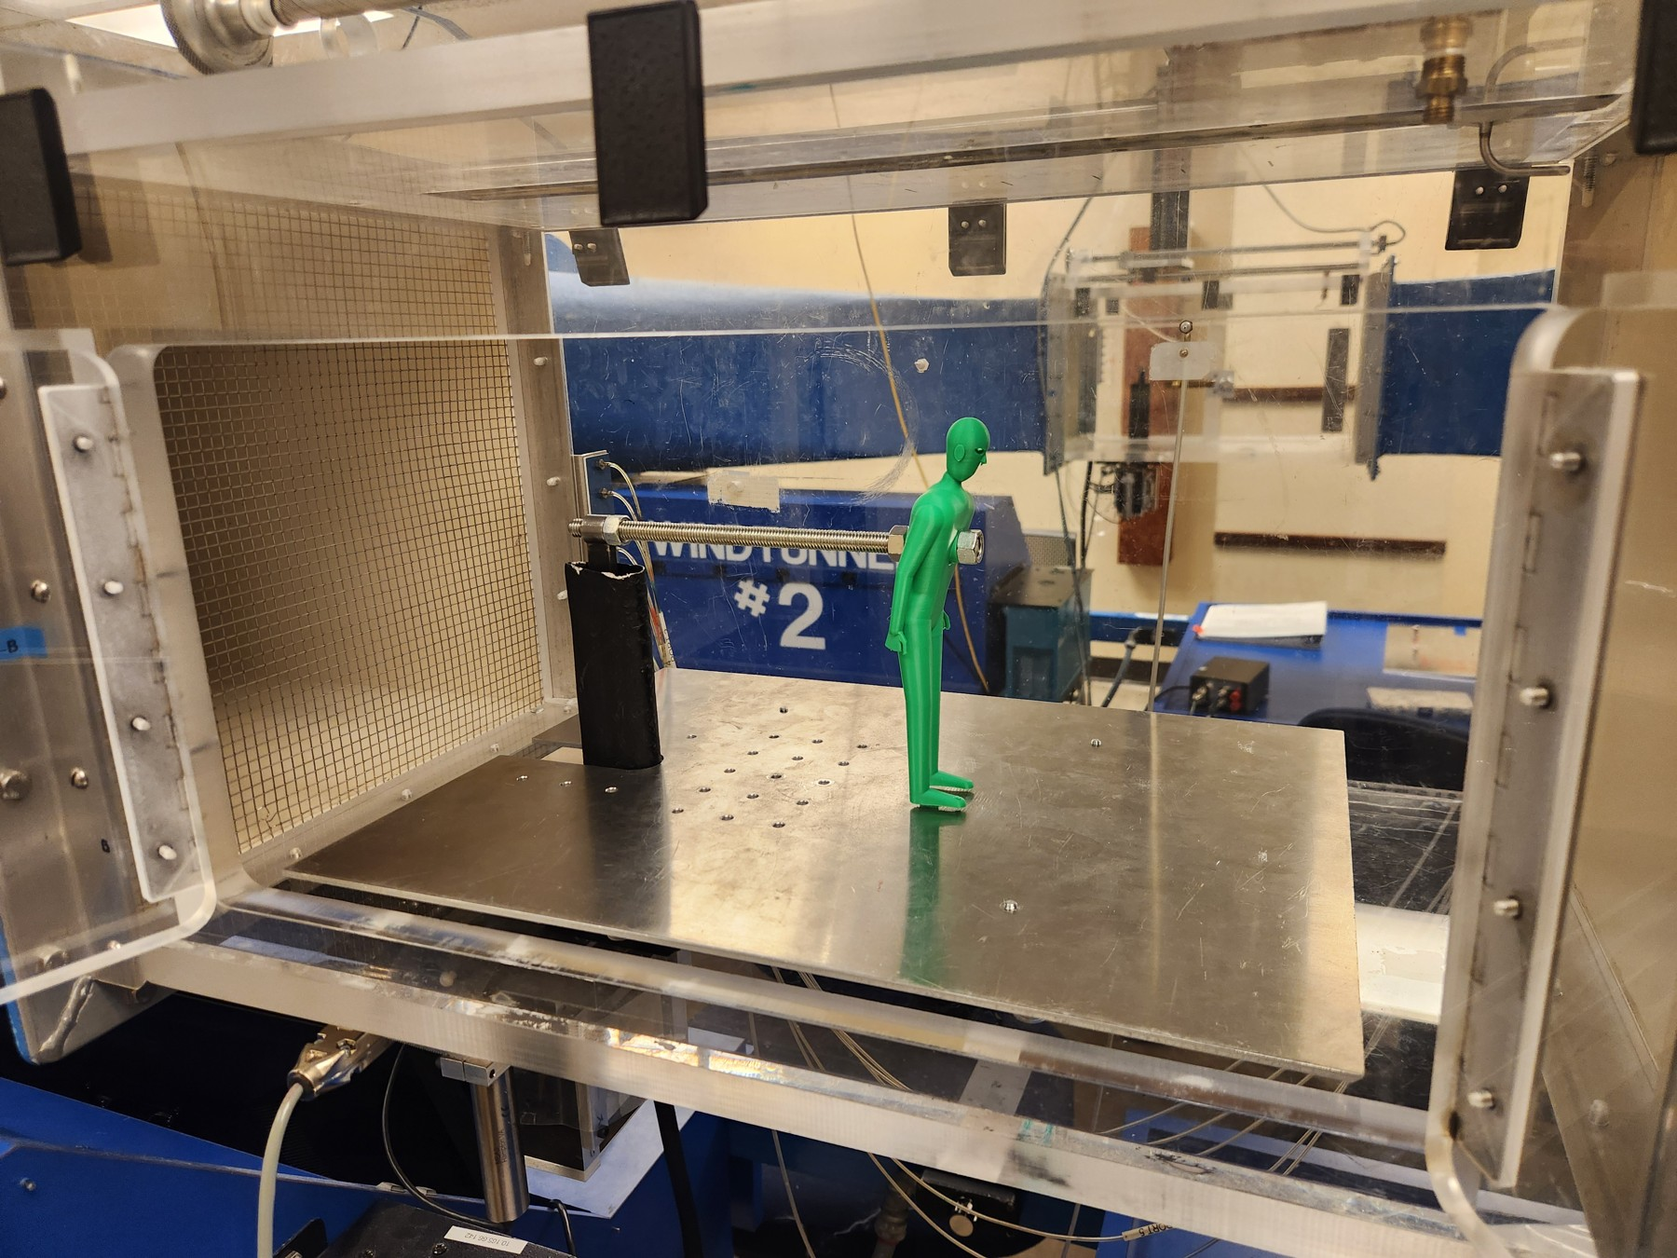
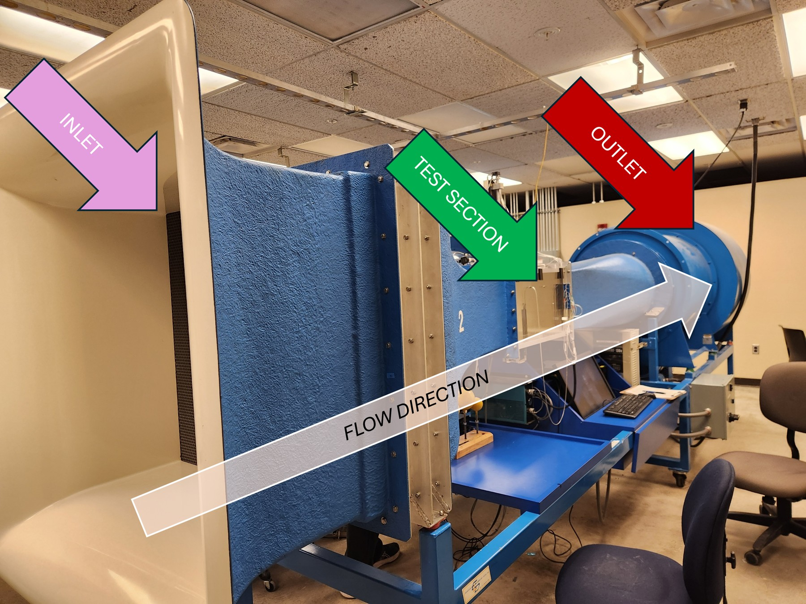
2026 / ME 30801 · Self-chosen team experiment
Headwind Safety: Hip-Bend Experiment
Goals
• Investigate how hip bend changes headwind-induced lift and drag, and explore their implications for slipping and liftoff using scaled human models.
• Compare 1:10-scale PLA human models at hip angles of 150°, 165°, and 180°.
Contributions
• Helped design wind-tunnel tests across three postures
• Measured lift and drag with baseline corrections
• Compared coefficients, uncertainty, and scaled force estimates
165-degree model mounted in the wind tunnel
Achievements
• Mounting interference and incomplete similarity limited conclusions
• Tests did not establish real-world safety thresholds
Annotated wind-tunnel setup
Henry Luo | Engineering Portfolio | View project and supporting files
5
Notes:
id: headwind-safety
year: 2026
title: Headwind Safety: Hip-Bend Experiment
context: ME 30801 · Self-chosen team experiment
tags: ['Fluid Mechanics', 'Wind Tunnel', 'Experimental Design']
summary: Helped formulate and design a wind-tunnel experiment comparing lift and drag on human models at three hip-bend angles. The study explored headwind-related slipping and liftoff, with its report documenting measurement and scaling limitations.
objective: Investigate how hip bend changes headwind-induced lift and drag, and explore their implications for slipping and liftoff using scaled human models.
challenges: ['Compare 1:10-scale PLA human models at hip angles of 150°, 165°, and 180°.', 'Measure lift and drag across approximately 22.7–34.0 m/s wind-tunnel speeds.', 'Account for test-stand forces, mounting interference, and imperfect ground clearance.', 'Assess the limits of extrapolating quasi-static, small-scale results to a person exposed to real wind.']
contribution: I helped formulate the project idea and design the experiment with the team. We developed a wind-tunnel test using three printed human models, a dynamometer, and a ground plate, including test-stand baseline measurements. The team’s analysis compared lift and drag coefficients, uncertainty, and modeled full-scale forces. I contributed to the written report, including its introduction, objective, and method.
outcome: The team designed and conducted the experiment and produced a final report. The findings did not establish a reliable ideal posture or real-world safety threshold. Mounting interference, incomplete dynamic similarity, ground-clearance effects, and the inability to reproduce gusts limited the conclusions. The report documents these limitations and recommends improvements to the mounting, model, and test conditions.
documents: [{'label': 'Read reviewed project notes and limitations', 'src': 'assets/project_descriptions/2026-headwind-safety/supporting/project-notes.md'}]
presentation_bullets: ['Helped design wind-tunnel tests across three postures', 'Measured lift and drag with baseline corrections', 'Compared coefficients, uncertainty, and scaled force estimates', 'Mounting interference and incomplete similarity limited conclusions', 'Tests did not establish real-world safety thresholds']
# Headwind Safety: Hip-Bend Experiment
## Purpose
Investigate how hip bend changes headwind-induced lift and drag, and explore their implications for slipping and liftoff using scaled human models.
## Requirements and constraints
- Compare 1:10-scale PLA human models at hip angles of 150°, 165°, and 180°.
- Measure lift and drag across approximately 22.7–34.0 m/s wind-tunnel speeds.
- Account for test-stand forces, mounting interference, and imperfect ground clearance.
- Assess the limits of extrapolating quasi-static, small-scale results to a person exposed to real wind.
## Engineering contribution
I helped formulate the project idea and design the experiment with the team. We developed a wind-tunnel test using three printed human models, a dynamometer, and a ground plate, including test-stand baseline measurements. The team’s analysis compared lift and drag coefficients, uncertainty, and modeled full-scale forces. I contributed to the written report, including its introduction, objective, and method.
## Outcome and limits
The team designed and conducted the experiment and produced a final report. The findings did not establish a reliable ideal posture or real-world safety threshold. Mounting interference, incomplete dynamic similarity, ground-clearance effects, and the inability to reproduce gusts limited the conclusions. The report documents these limitations and recommends improvements to the mounting, model, and test conditions.
## Interpretation limits
Mount interference, incomplete flow similarity, untested gusts, and model-to-ground clearance limit the experiment. Results do not establish practical safe walking conditions. The overreaching full report and presentations were removed. Original requirements/proposal material describes the planned study, not a validated outcome.
Images and demonstrations:
165-degree model mounted in the wind tunnel: assets/project_descriptions/2026-headwind-safety/media/images/model-165-deg-setup.jpg
Annotated wind-tunnel setup: assets/project_descriptions/2026-headwind-safety/media/images/wind-tunnel-setup.png
150-degree model assembly drawing: assets/project_descriptions/2026-headwind-safety/media/images/model-150-deg-assembly.jpg
165-degree model assembly drawing: assets/project_descriptions/2026-headwind-safety/media/images/model-165-deg-assembly.jpg
180-degree model assembly drawing: assets/project_descriptions/2026-headwind-safety/media/images/model-180-deg-assembly.jpg
Model clearance above the ground plate: assets/project_descriptions/2026-headwind-safety/media/images/ground-clearance.jpeg

Slide 6
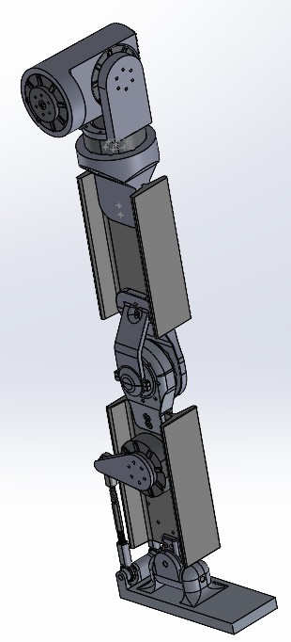
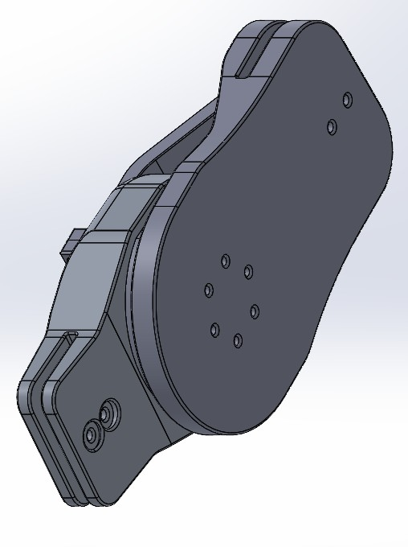
2025 / HRC · L2 Team
HRC L2 Humanoid Leg
Goals
• Develop a functional humanoid leg with coordinated shin, thigh, knee, and ankle components.
• Provide clearance for neighboring joints and actuators.
Contributions
• Explored structural shin, thigh, and knee concepts
• Used SOLIDWORKS, FEA, and MATLAB section studies
• Replaced custom shin concepts with stock sections
• Developed modular electronics platforms and bearing-supported knees
HRC L2 leg CAD assembly
Achievements
• Team produced a functional printed leg assembly
• Printed leg lacked stress testing and integration
Knee assembly CAD
Henry Luo | Engineering Portfolio | View project and supporting files
6
Notes:
id: hrc-l2-leg
year: 2025
title: HRC L2 Humanoid Leg
context: HRC · L2 Team
summary: Contributed structural design work for a humanoid leg as part of the HRC L2 team. The team produced a complete, functional 3D-printed leg; it was not stress-tested or integrated into a larger assembly.
objective: Develop a functional humanoid leg with coordinated shin, thigh, knee, and ankle components.
challenges: ['Provide clearance for neighboring joints and actuators.', 'Explore axial strength and forward/backward bending stiffness.', 'Support component integration and design iteration.']
contribution: My project work covered structural shin, thigh, and knee concepts, supported by SOLIDWORKS CAD, FEA, and MATLAB section-property studies. The design files explore I-beam geometry, modular electronics platforms, and a bearing-supported knee. These concepts belong to one L2 team project.
tags: ['Robotics', 'Structural Design', '3D Printing']
outcome: The HRC L2 team produced a complete, functional 3D-printed leg. It was never stress-tested or integrated into a larger assembly. The metal I-beam concepts and simulations in the design files are design studies, not evidence of load validation of the printed leg.
iterations: [{'title': 'From custom shin geometry to stock-section leg concepts', 'before': 'Phase 1 used a custom shin core and sliding electronics platforms, with substantial proposed machining.', 'after': 'Phase 2 develops shin and thigh cores from lightly modified stock I-beams and adds forked knee connectors and a bearing clamp. These metal concepts were design studies; the printed team leg was not stress-tested.', 'evidence': 'Phase 1 and Phase 2 source summaries and CAD inventories.'}]
documents: []
presentation_bullets: ['Explored structural shin, thigh, and knee concepts', 'Used SOLIDWORKS, FEA, and MATLAB section studies', 'Replaced custom shin concepts with stock sections', 'Developed modular electronics platforms and bearing-supported knees', 'Team produced a functional printed leg assembly', 'Printed leg lacked stress testing and integration']
# HRC L2 Humanoid Leg
## Purpose
Develop a functional humanoid leg with coordinated shin, thigh, knee, and ankle components.
## Requirements and constraints
- Provide clearance for neighboring joints and actuators.
- Explore axial strength and forward/backward bending stiffness.
- Support component integration and design iteration.
## Engineering contribution
My project work covered structural shin, thigh, and knee concepts, supported by SOLIDWORKS CAD, FEA, and MATLAB section-property studies. The design files explore I-beam geometry, modular electronics platforms, and a bearing-supported knee. These concepts belong to one L2 team project.
## Outcome and limits
The HRC L2 team produced a complete, functional 3D-printed leg. It was never stress-tested or integrated into a larger assembly. The metal I-beam concepts and simulations in the design files are design studies, not evidence of load validation of the printed leg.
## From custom shin geometry to stock-section leg concepts
Before: Phase 1 used a custom shin core and sliding electronics platforms, with substantial proposed machining.
After: Phase 2 develops shin and thigh cores from lightly modified stock I-beams and adds forked knee connectors and a bearing clamp. These metal concepts were design studies; the printed team leg was not stress-tested.
Images and demonstrations:
HRC L2 leg CAD assembly: assets/project_descriptions/2025-hrc-l2-humanoid-leg/media/images/archive-2--leg-3-30-2025-2.png
Knee assembly CAD: assets/project_descriptions/2025-hrc-l2-humanoid-leg/media/images/archive-2--phase-2--knee--knee-3-30-2025.png
Shin core structural concept: assets/project_descriptions/2025-hrc-l2-humanoid-leg/media/images/archive-2--notes-figs--shin-core.png
Shin core stress simulation: assets/project_descriptions/2025-hrc-l2-humanoid-leg/media/images/archive-2--notes-figs--shin-core-vmstress.png
Phase 1 shin design study: assets/project_descriptions/2025-hrc-l2-humanoid-leg/media/images/archive-1--notes-figs--shin-foot.png

Slide 7
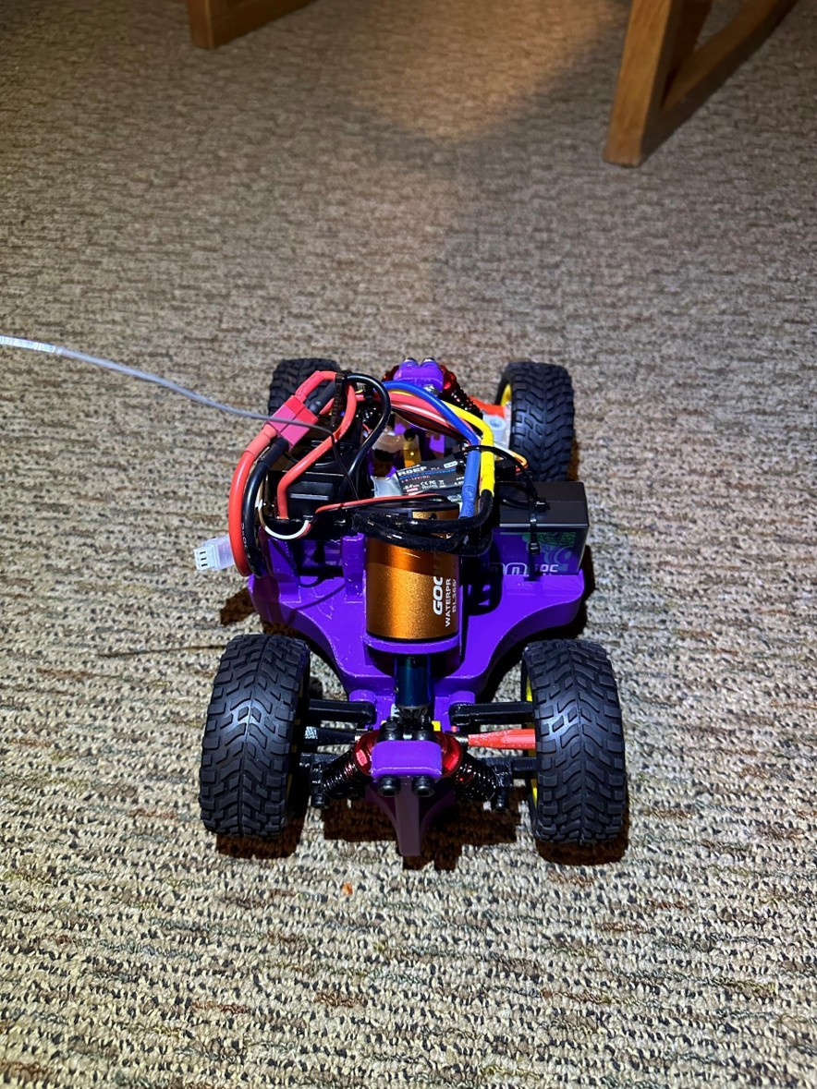
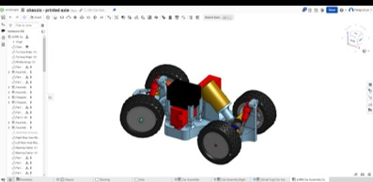
2024 / ASME Small Projects team
ASME Mini RC Car
Goals
• Develop a controllable RC car in 12 weeks for a course with jumps, bumps, turns, and straights.
• Fit within a 6 × 10 inch footprint.
Contributions
• Co-designed car with steering and axle focus
• Developed dogbone axles, holders, and motor clearances
• Integrated suspension, differential, and mostly printed chassis
ASME mini RC car final build
Achievements
• Team earned first place in ASME competition
• Completed three race laps in two minutes twenty-one seconds
Complete RC car Onshape assembly
Henry Luo | Engineering Portfolio | View project and supporting files
7
Notes:
id: rc-car
year: 2024
title: ASME Mini RC Car
context: ASME Small Projects team
summary: Helped design the entire RC car, focusing on steering linkages, both dogbone axle assemblies, and component holders and clearances—particularly the motor mount. The team earned first place in the mixed-terrain race.
objective: Develop a controllable RC car in 12 weeks for a course with jumps, bumps, turns, and straights.
challenges: ['Fit within a 6 × 10 inch footprint.', 'Spend less than $125.', 'Use mostly printed parts with minimal supports.', 'Maintain speed and control for at least three laps.']
contribution: I helped design the entire car, with my strongest focus on the steering linkages and both dogbone axle assemblies. I also designed holders and clearances for the components, particularly the motor. The team integrated these parts with four-wheel suspension, a differential, and a mostly 3D-printed chassis.
tags: ['Team Design', 'Mechanisms', '3D Printing']
highlight: True
award: Team award: ASME Mini RC Car — 1st Place
outcome: The team earned first place in the ASME Mini RC Car competition. The existing race record is three laps in 2:21.
documents: []
presentation_bullets: ['Co-designed car with steering and axle focus', 'Developed dogbone axles, holders, and motor clearances', 'Integrated suspension, differential, and mostly printed chassis', 'Team earned first place in ASME competition', 'Completed three race laps in two minutes twenty-one seconds']
# ASME Mini RC Car
## Purpose
Develop a controllable RC car in 12 weeks for a course with jumps, bumps, turns, and straights.
## Requirements and constraints
- Fit within a 6 × 10 inch footprint.
- Spend less than $125.
- Use mostly printed parts with minimal supports.
- Maintain speed and control for at least three laps.
## Engineering contribution
I helped design the entire car, with my strongest focus on the steering linkages and both dogbone axle assemblies. I also designed holders and clearances for the components, particularly the motor. The team integrated these parts with four-wheel suspension, a differential, and a mostly 3D-printed chassis.
## Outcome and limits
The team earned first place in the ASME Mini RC Car competition. The existing race record is three laps in 2:21.
Images and demonstrations:
ASME mini RC car final build: assets/project_descriptions/2024-asme-mini-rc-car/media/images/final-build.jpg
Complete RC car Onshape assembly: assets/project_descriptions/2024-asme-mini-rc-car/media/images/full-onshape-assembly.png
RC car component layout from above: assets/project_descriptions/2024-asme-mini-rc-car/media/images/top-view.jpg
Rear drivetrain assembly: assets/project_descriptions/2024-asme-mini-rc-car/media/images/rear.jpg
RC car jump demonstration: assets/project_descriptions/2024-asme-mini-rc-car/media/videos/performance--successfuljump.mp4
RC car half-throttle driving test: assets/project_descriptions/2024-asme-mini-rc-car/media/videos/performance--halfthrottle.mp4
RC car full race recording: assets/project_descriptions/2024-asme-mini-rc-car/media/videos/full-race-documentation.mp4
RC car short race clip: assets/project_descriptions/2024-asme-mini-rc-car/media/videos/performance--raceclip.mp4

Slide 8
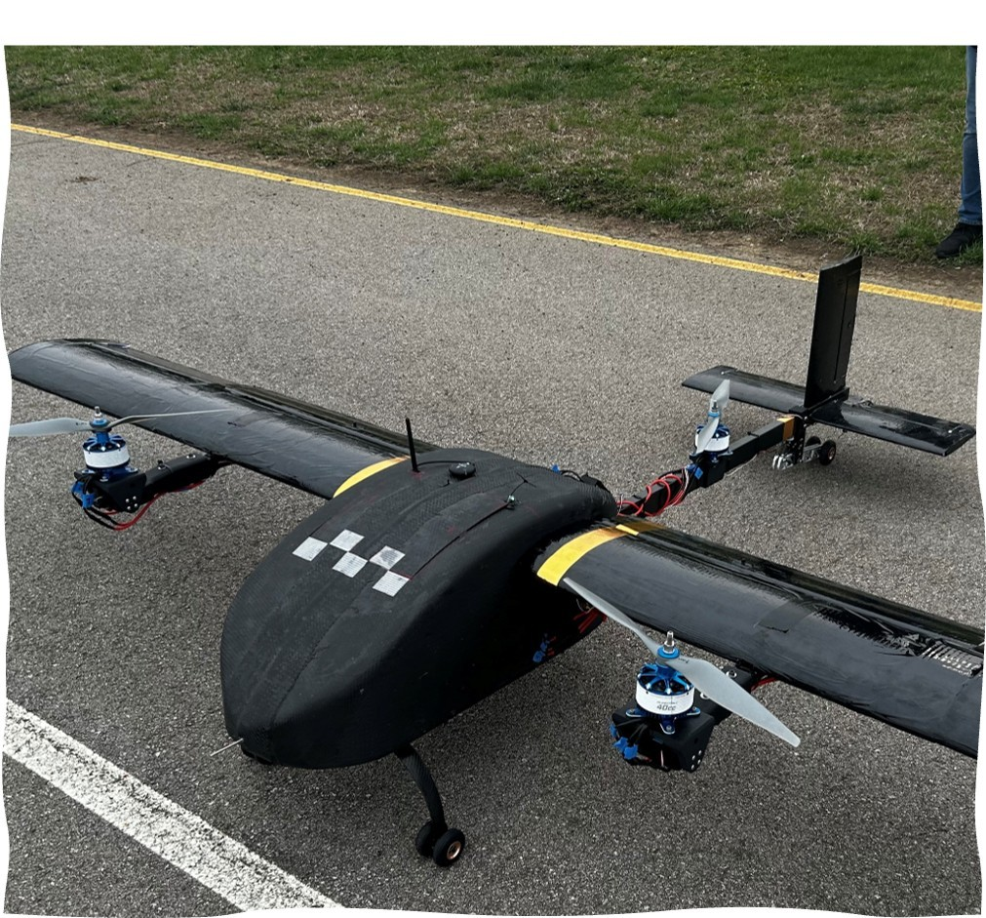
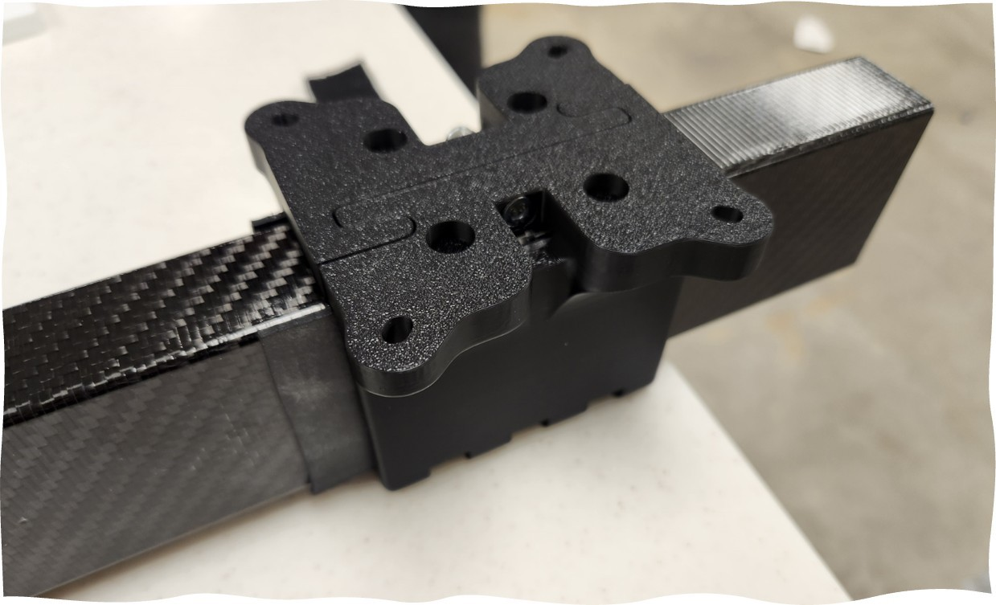
2024 / PART · R&D Mechanical Systems
Dodo Rear Motor Mount
Goals
• Secure the rear motor without modifying the composite tail boom.
• Clamp securely around the existing boom.
Dodo UAV with rear motor mount installed
Achievements
• Redesigned mount around the existing composite boom
• Replaced through-bolt approach with a split clamp
• Combined printed halves, rubber contacts, and bolts
• Iterated motor retention, clamping contact, and printability
• Aircraft photos document final installation and integration
• Clamp-load and delamination margins were not established
Rear motor mount assembly
Henry Luo | Engineering Portfolio | View project and supporting files
8
Notes:
id: motor-mount
year: 2024
title: Dodo Rear Motor Mount
context: PART · R&D Mechanical Systems
summary: Redesigned the Dodo UAV rear motor mount to clamp around the composite tail boom without a through-bolt in the boom. Split printed halves and butyl rubber strips address delamination concerns while preserving the existing aircraft structure.
objective: Secure the rear motor without modifying the composite tail boom.
challenges: ['Clamp securely around the existing boom.', 'Retain the motor and integrate with the aircraft.', 'Use mostly printed parts sized for the print bed with minimal supports.', 'Account for mount strength when limiting bolt preload and contact force.']
contribution: Redesigned the mount around the existing tail boom, using two printed halves, butyl rubber contact strips, and four bolt/locknut pairs. Iterations focused on motor retention, clamping contact, and printability.
tags: ['Aerospace', 'Mechanical Systems', 'DFM']
highlight: True
outcome: Printed prototypes and final aircraft assembly photos document the mount’s development and integration.
iterations: [{'title': 'From a through-bolt concept to a split clamp', 'before': 'The inherited mounting approach required a through-bolt in the composite boom, raising a delamination concern.', 'after': 'Developed a two-piece clamp around the existing boom. Later geometry adds compliant side and top/bottom rubber contact pieces; four bolt/locknut pairs close the clamp. The notes do not establish tested clamp-load or delamination margins.', 'evidence': 'Project summary, early and final CAD component inventories, and rubber-interface notes. The original designer is not identified.'}]
documents: []
presentation_bullets: ['Redesigned mount around the existing composite boom', 'Replaced through-bolt approach with a split clamp', 'Combined printed halves, rubber contacts, and bolts', 'Iterated motor retention, clamping contact, and printability', 'Aircraft photos document final installation and integration', 'Clamp-load and delamination margins were not established']
# Dodo Rear Motor Mount
## Purpose
Secure the rear motor without modifying the composite tail boom.
## Requirements and constraints
- Clamp securely around the existing boom.
- Retain the motor and integrate with the aircraft.
- Use mostly printed parts sized for the print bed with minimal supports.
- Account for mount strength when limiting bolt preload and contact force.
## Engineering contribution
Redesigned the mount around the existing tail boom, using two printed halves, butyl rubber contact strips, and four bolt/locknut pairs. Iterations focused on motor retention, clamping contact, and printability.
## Outcome and limits
Printed prototypes and final aircraft assembly photos document the mount’s development and integration.
## From a through-bolt concept to a split clamp
Before: The inherited mounting approach required a through-bolt in the composite boom, raising a delamination concern.
After: Developed a two-piece clamp around the existing boom. Later geometry adds compliant side and top/bottom rubber contact pieces; four bolt/locknut pairs close the clamp. The notes do not establish tested clamp-load or delamination margins.
Images and demonstrations:
Dodo UAV with rear motor mount installed: assets/project_descriptions/2024-dodo-rear-motor-mount/media/images/final-build-aircraft.jpg
Rear motor mount assembly: assets/project_descriptions/2024-dodo-rear-motor-mount/media/images/final-assembly.jpg
Exploded SOLIDWORKS mount assembly: assets/project_descriptions/2024-dodo-rear-motor-mount/media/images/exploded-solidworks-assembly.png
Printed split-mount prototype: assets/project_descriptions/2024-dodo-rear-motor-mount/media/images/printed-split-proto.jpg
Dodo UAV vertical hover demonstration: assets/project_descriptions/2024-dodo-rear-motor-mount/media/videos/vertical-hover.mp4

Slide 9
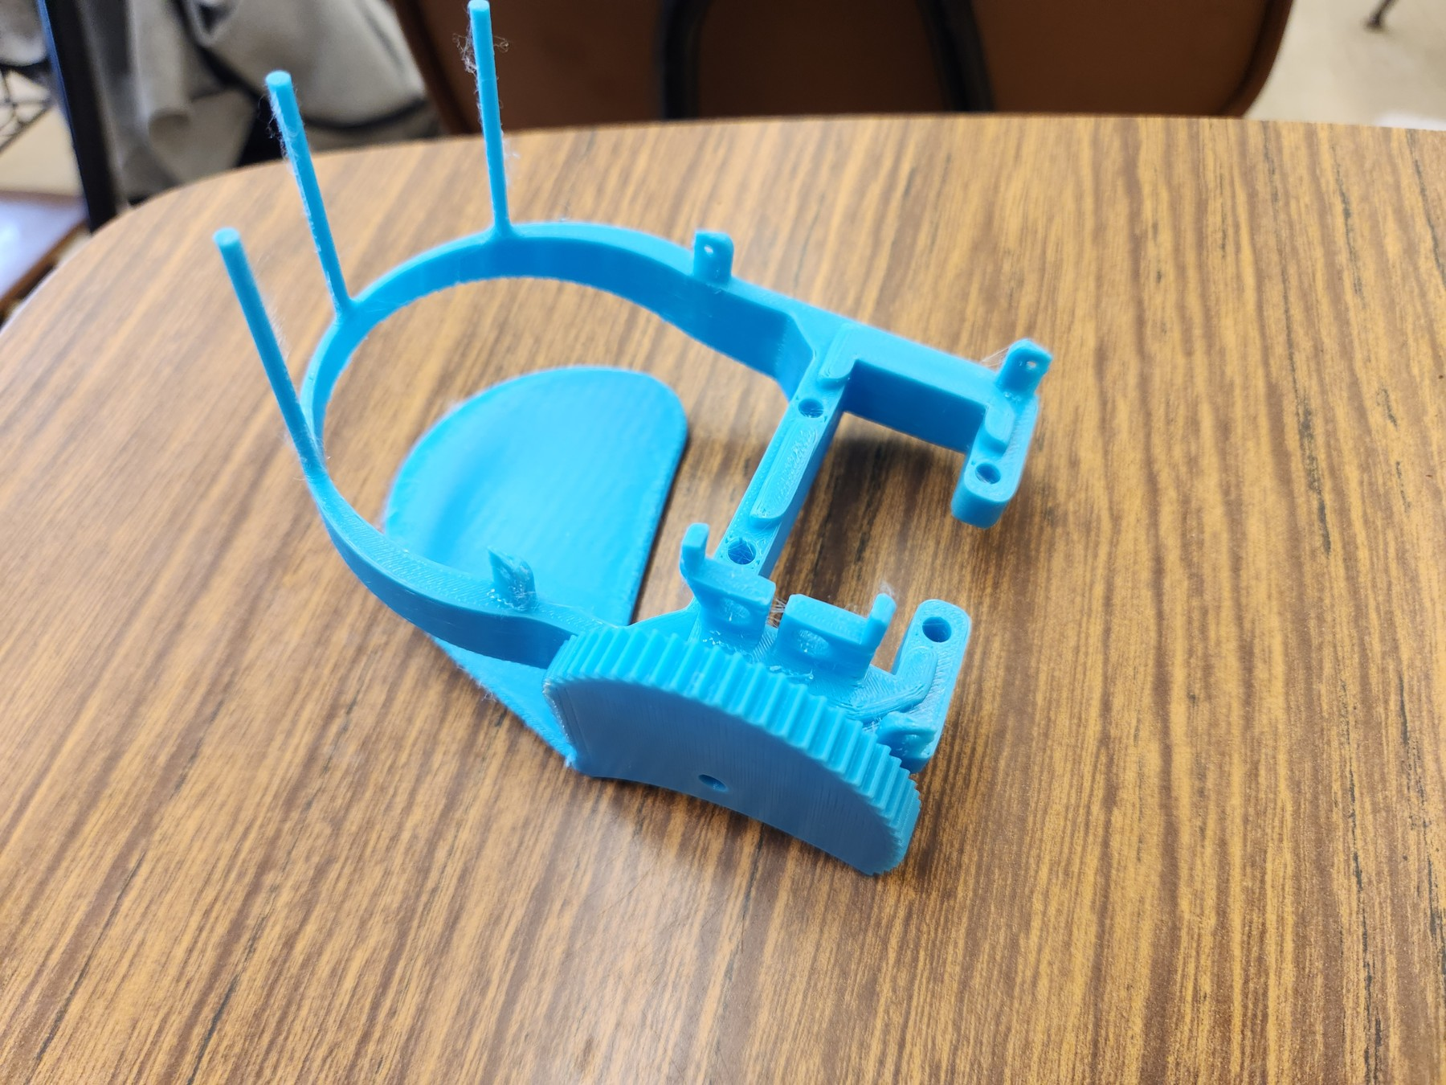
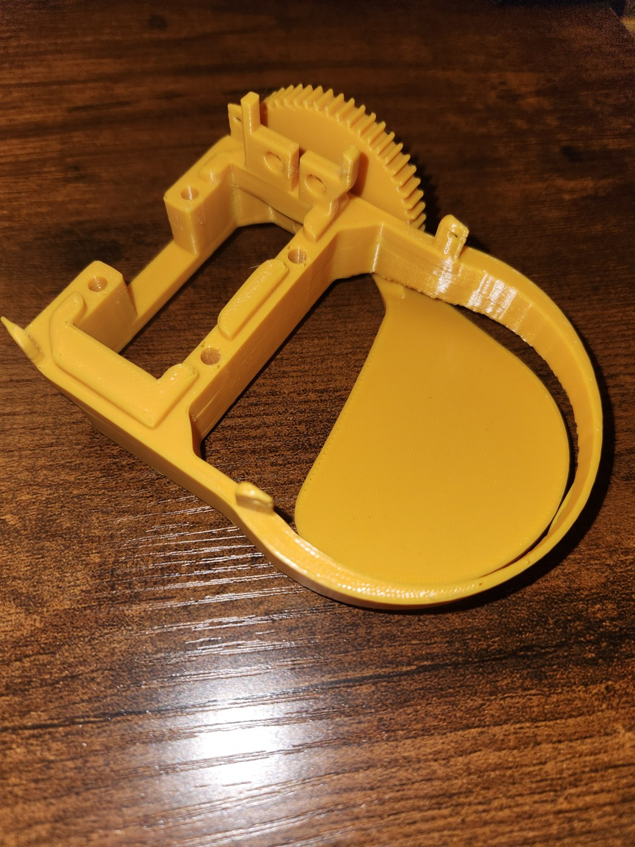
2024 / PART · R&D Mechanical Systems
Bachelor Payload Capsule
Goals
• Release a single payload from a UAV operating above 100 feet while simplifying payload-module replacement.
• Minimize weight.
Bachelor payload capsule second prototype
Achievements
• Designed single-payload body and servo-driven release flapper
• Explored snap interfaces and optional lockball guidance
• Mk2 geometry documented through CAD and prototypes
• Balcony drop testing preceded changed project direction
• No flight testing occurred before project cancellation
Bachelor payload capsule first prototype
Henry Luo | Engineering Portfolio | View project and supporting files
9
Notes:
id: bachelor-capsule
year: 2024
title: Bachelor Payload Capsule
context: PART · R&D Mechanical Systems
summary: Developed a lightweight single-payload capsule with a snap-together body and servo-driven flapper. The capsule was tested by dropping it from a tall balcony, then scrapped when the team changed its payload-capsule direction.
objective: Release a single payload from a UAV operating above 100 feet while simplifying payload-module replacement.
challenges: ['Minimize weight.', 'Reuse one lidar, one Arduino Nano, and one servo.', 'Fit printed parts on the print bed with minimal supports.']
contribution: Designed the body to retain the payload and guide the rotating flapper. An optional experimental lockball supports smoother rotation and helps prevent snap-joint separation. Files document two design iterations.
tags: ['Aerospace', 'Mechanisms', 'Prototyping']
outcome: The capsule was tested by dropping it from a tall balcony; it was not tested in flight. The design was subsequently scrapped because the team changed the direction of the payload capsule.
iterations: [{'title': 'A simpler single-payload capsule', 'before': 'The project began as a lighter alternative to a triple-payload basket.', 'after': 'The retained Mk2 design uses a snap-together body and servo-driven flapper. Only Mk2 CAD is available; the photos alone do not establish the exact Mk1-to-Mk2 geometry changes.', 'evidence': 'Project summary and retained Mk2 CAD. No unsupported Mk1 failure claim is made.'}]
documents: []
presentation_bullets: ['Designed single-payload body and servo-driven release flapper', 'Explored snap interfaces and optional lockball guidance', 'Mk2 geometry documented through CAD and prototypes', 'Balcony drop testing preceded changed project direction', 'No flight testing occurred before project cancellation']
# Bachelor Payload Capsule
## Purpose
Release a single payload from a UAV operating above 100 feet while simplifying payload-module replacement.
## Requirements and constraints
- Minimize weight.
- Reuse one lidar, one Arduino Nano, and one servo.
- Fit printed parts on the print bed with minimal supports.
## Engineering contribution
Designed the body to retain the payload and guide the rotating flapper. An optional experimental lockball supports smoother rotation and helps prevent snap-joint separation. Files document two design iterations.
## Outcome and limits
The capsule was tested by dropping it from a tall balcony; it was not tested in flight. The design was subsequently scrapped because the team changed the direction of the payload capsule.
## A simpler single-payload capsule
Before: The project began as a lighter alternative to a triple-payload basket.
After: The retained Mk2 design uses a snap-together body and servo-driven flapper. Only Mk2 CAD is available; the photos alone do not establish the exact Mk1-to-Mk2 geometry changes.
Images and demonstrations:
Bachelor payload capsule second prototype: assets/project_descriptions/2024-bachelor-payload-capsule/media/images/mk2.jpg
Bachelor payload capsule first prototype: assets/project_descriptions/2024-bachelor-payload-capsule/media/images/mk1.jpg
Exploded payload capsule CAD: assets/project_descriptions/2024-bachelor-payload-capsule/media/images/bachelor-exploded.png
Payload capsule joint detail: assets/project_descriptions/2024-bachelor-payload-capsule/media/images/joint.png

Slide 10
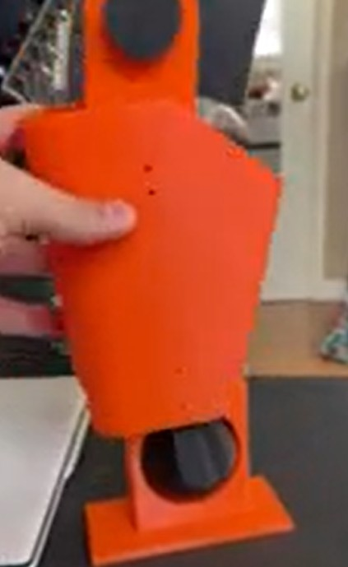
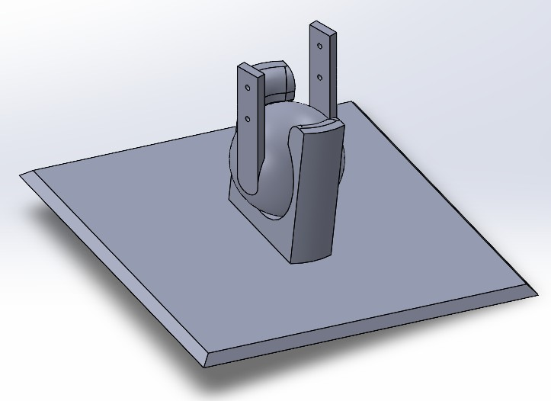
2024 / HRC · Small Leg Components
Ball Joint
Goals
• Create a ball-and-socket jig that simulates ankle rolling motion for the development of ankle controls.
• Provide ankle-like rotation.
Printed ball-and-socket prototype
Achievements
• Modeled ball, socket, and assembly in SOLIDWORKS
• Explored ankle-like rotation through ball-and-socket joint geometry
• Produced a physical prototype using 3D printing
Ball-and-socket CAD assembly
Henry Luo | Engineering Portfolio | View project and supporting files
10
Notes:
id: ball-joint
year: 2024
title: Ball Joint
context: HRC · Small Leg Components
summary: Designed a parametric, 3D-printed ball-and-socket jig to simulate ankle rolling motion for ankle-controls development. Adjustable CAD dimensions support rapid changes to the calf-mounted ball and foot-mounted socket.
objective: Create a ball-and-socket jig that simulates ankle rolling motion for the development of ankle controls.
challenges: ['Provide ankle-like rotation.', 'Use variable-based CAD for dimensional adjustments.', 'Fit printed parts on the print bed with minimal supports.', 'Keep assembly simple and retain the ball in the socket during use.']
contribution: Modeled the ball, socket, and assembly in SOLIDWORKS and produced a printed joint prototype.
tags: ['Robotics', 'Parametric CAD']
documents: []
presentation_bullets: ['Modeled ball, socket, and assembly in SOLIDWORKS', 'Explored ankle-like rotation through ball-and-socket joint geometry', 'Produced a physical prototype using 3D printing']
# Ball Joint
## Purpose
Create a ball-and-socket jig that simulates ankle rolling motion for the development of ankle controls.
## Requirements and constraints
- Provide ankle-like rotation.
- Use variable-based CAD for dimensional adjustments.
- Fit printed parts on the print bed with minimal supports.
- Keep assembly simple and retain the ball in the socket during use.
## Engineering contribution
Modeled the ball, socket, and assembly in SOLIDWORKS and produced a printed joint prototype.
## Outcome and limits
No separate quantified validation record is retained.
Images and demonstrations:
Printed ball-and-socket prototype: assets/project_descriptions/2024-ball-joint/media/images/printed-balljoint.png
Ball-and-socket CAD assembly: assets/project_descriptions/2024-ball-joint/media/images/cadballjoint.png
Calf joint CAD: assets/project_descriptions/2024-ball-joint/media/images/cadcalf.png
Ball joint motion demonstration: assets/project_descriptions/2024-ball-joint/media/videos/balljoint.mp4

Slide 11
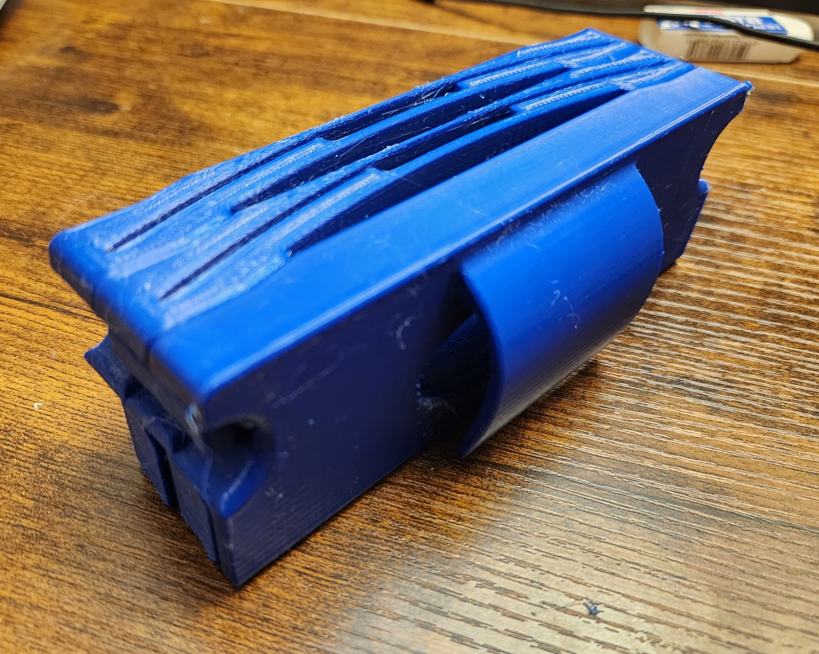
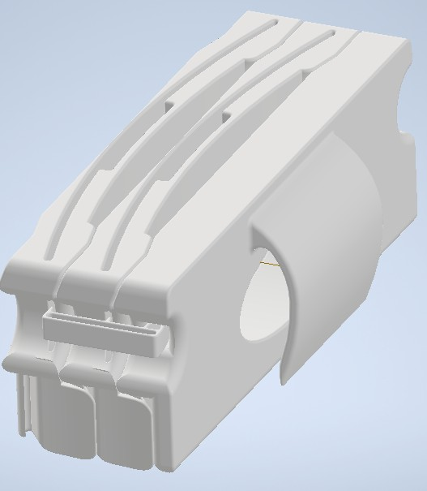
2024 / Personal project
Clip-On Sunglasses Holder
Achievements
• V1 clips slipped during aggressive door opening
• V2 bracket added a secondary tensile connection
• Revised bracket lasted nearly two service years
• Cycling was the suspected cause of brittleness
• Gradual looseness made bracket failure easily detectable
• Low consequences and replacement cost were acceptable
Clip-on sunglasses holder
V2 sunglasses-holder CAD assembly
Henry Luo | Engineering Portfolio | View project and supporting files
11
Notes:
id: sunglasses-holder
year: 2024
title: Clip-On Sunglasses Holder
context: Personal project
summary: Designed a modular, 3D-printed sunglasses holder for a car door pocket. A tension bracket improved retention after V1 clips occasionally slipped; the revised bracket lasted nearly two years in everyday use.
objective: Keep clip-on sunglasses accessible and securely stored in a car.
challenges: ['Clip onto the car door pocket.', 'Retain clip-on sunglasses.', 'Fit printed parts on the print bed with minimal supports.']
contribution: Designed the modular clip, housing, and V2 retention bracket. V1 relied on the front-most holder’s own clips to connect to upstream components. V2 added a secondary tensile load path, reducing reliance on the clips’ limited interference engagement.
tags: ['Personal Project', '3D Printing']
iterations: [{'title': 'From clip slippage to secondary tension retention', 'before': 'V1 had no bracket. The front-most holder connected to upstream components only through its own clips, which occasionally slipped when the car door opened aggressively.', 'after': 'V2 added a bracket that holds the components together primarily through tension, providing secondary retention beyond the clips’ small interference engagement.', 'evidence': 'Owner’s account of V1 behavior, V2 bracket geometry, and nearly two years of use.'}, {'title': 'Field service and an acceptable failure mode', 'before': 'Repeated impacts, temperature changes, and moisture-driven expansion exposed the bracket to continuous cycling.', 'after': 'After nearly two years, the bracket broke. Observed brittleness was attributed to environmental and impact cycling. Low consequences, long service life, obvious looseness, and very low replacement-material cost made this failure acceptable for this personal application.', 'evidence': 'Owner-reported service history and qualitative failure assessment; no formal FMEA scores or controlled aging tests are claimed.'}]
documents: []
presentation_bullets: ['V1 clips slipped during aggressive door opening', 'V2 bracket added a secondary tensile connection', 'Revised bracket lasted nearly two service years', 'Cycling was the suspected cause of brittleness', 'Gradual looseness made bracket failure easily detectable', 'Low consequences and replacement cost were acceptable']
outcome: The revised bracket lasted nearly two years before breaking in everyday use. Based on observed use and failure, I attributed increased brittleness to repeated impact, thermal, and moisture-driven expansion cycles; this assessment comes from field observations. The failure was gradual and easy to detect: the assembly became looser and the bracket came loose, without suddenly separating the mount. I considered this acceptable for this application because consequences were minor, service life was long, and replacement material cost was estimated below one cent; printing time and other costs were not included.
# Clip-On Sunglasses Holder
## Contribution
Designed the modular clip, housing, and V2 retention bracket. V1 relied on the front-most holder’s own clips to connect to upstream components. V2 added a secondary tensile load path, reducing reliance on the clips’ limited interference engagement.
## Field service and limitations
The revised bracket lasted nearly two years before breaking in everyday use. Based on observed use and failure, I attributed increased brittleness to repeated impact, thermal, and moisture-driven expansion cycles; this assessment comes from field observations. The failure was gradual and easy to detect: the assembly became looser and the bracket came loose, without suddenly separating the mount. I considered this acceptable for this application because consequences were minor, service life was long, and replacement material cost was estimated below one cent; printing time and other costs were not included.
## From clip slippage to secondary tension retention
Before: V1 had no bracket. The front-most holder connected to upstream components only through its own clips, which occasionally slipped when the car door opened aggressively.
After: V2 added a bracket that holds the components together primarily through tension, providing secondary retention beyond the clips’ small interference engagement.
## Field service and an acceptable failure mode
Before: Repeated impacts, temperature changes, and moisture-driven expansion exposed the bracket to continuous cycling.
After: After nearly two years, the bracket broke. Observed brittleness was attributed to environmental and impact cycling. Low consequences, long service life, obvious looseness, and very low replacement-material cost made this failure acceptable for this personal application.
Images and demonstrations:
Clip-on sunglasses holder: assets/project_descriptions/2024-clip-on-sunglasses-holder/media/images/v2.jpg
Holder attached to a car door pocket: assets/project_descriptions/2024-clip-on-sunglasses-holder/media/images/v2--v2-attached.jpg
Attachment clip CAD: assets/project_descriptions/2024-clip-on-sunglasses-holder/media/images/v1--clip.png
Sunglasses housing CAD: assets/project_descriptions/2024-clip-on-sunglasses-holder/media/images/v1--housing.png
V2 sunglasses-holder CAD assembly: assets/project_descriptions/2024-clip-on-sunglasses-holder/media/images/v2-assembly-cad.png
Revised V2 attachment bracket: assets/project_descriptions/2024-clip-on-sunglasses-holder/media/images/v2-bracket-cad.png

Slide 12
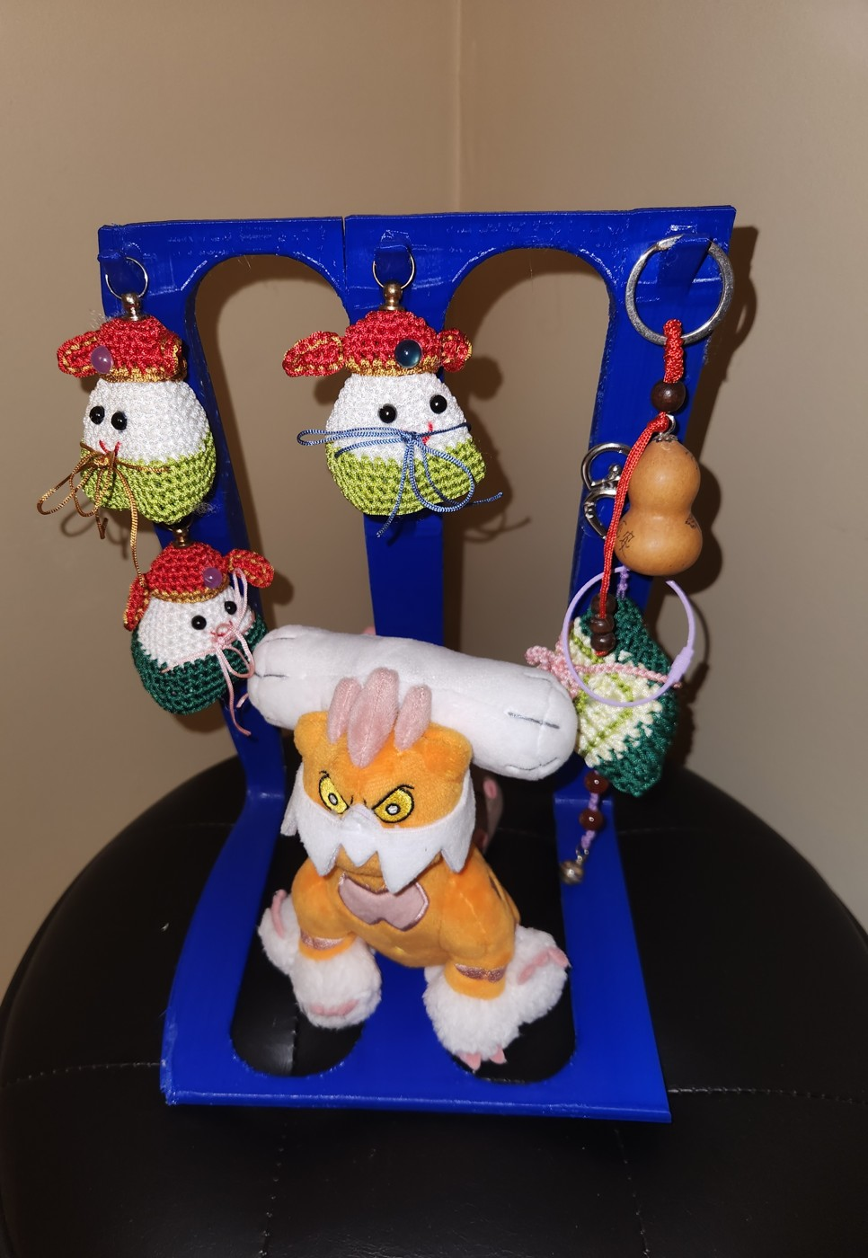
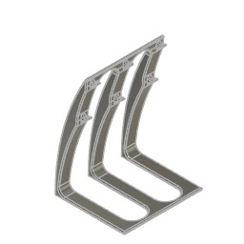
2024 / Personal project
Display Hooks
Achievements
• Designed compact freestanding hooks for displaying memorabilia
• Modeled the required hook arrangement in Fusion
• Physical photographs document the completed display structure
Freestanding memorabilia display hooks
Preview embedded in the Fusion design
Henry Luo | Engineering Portfolio | View project and supporting files
12
Notes:
id: display-hooks
year: 2024
title: Display Hooks
context: Personal project
summary: Designed a freestanding, 3D-printed display for six hanging memorabilia items, with an optional central display position. The geometry balances visual character, low material use, and fabrication with minimal supports.
objective: Display hookable memorabilia in a compact standalone structure.
challenges: ['Provide six hooks and an optional central display position.', 'Minimize material use and printing supports.', 'Fit on the print bed and maintain an intentional appearance.']
contribution: Modeled a single display structure in Fusion 360 around the required hook arrangement.
tags: ['Personal Project', '3D Printing']
documents: []
presentation_bullets: ['Designed compact freestanding hooks for displaying memorabilia', 'Modeled the required hook arrangement in Fusion', 'Physical photographs document the completed display structure']
# Display Hooks
## Purpose
Display hookable memorabilia in a compact standalone structure.
## Requirements and constraints
- Provide six hooks and an optional central display position.
- Minimize material use and printing supports.
- Fit on the print bed and maintain an intentional appearance.
## Engineering contribution
Modeled a single display structure in Fusion 360 around the required hook arrangement.
## Outcome and limits
No separate quantified validation record is retained.
Images and demonstrations:
Freestanding memorabilia display hooks: assets/project_descriptions/2024-display-hooks/media/images/display-hooks.jpg
Preview embedded in the Fusion design: assets/project_descriptions/2024-display-hooks/media/images/display-hooks-cad-preview.png

Slide 13
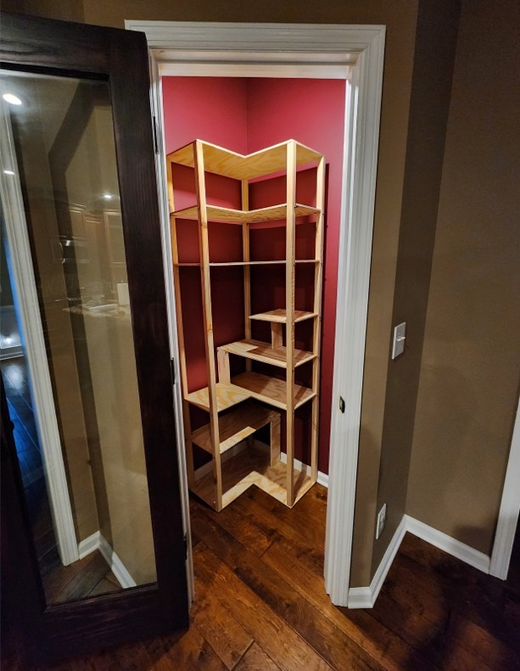
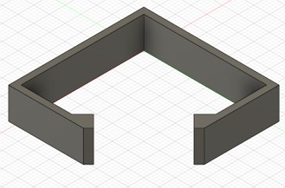
2023 / Personal project
Pine Display Shelf
Goals
• Create an attractive freestanding display shelf that fits the room and supports the intended display items.
• Use unlaminated pine plywood and account for wood damage and delamination.
Pine display shelf installed in the room
Achievements
• Planned shelf around an irregular room layout
• Modeled frame, assembly, and plywood cutting scheme
• Built using only a jigsaw and drill
• Combined shaped shelves, structural beams, and brackets
• Installed successfully for $77.58 against $100 budget
Target room CAD layout
Henry Luo | Engineering Portfolio | View project and supporting files
13
Notes:
id: shelf
year: 2023
title: Pine Display Shelf
context: Personal project
summary: Designed and built an L-shaped pine plywood display shelf for a uniquely shaped room using only a jigsaw and drill. Room-layout CAD, frame models, and cutting plans guided fabrication and installation, with material spending of $77.58 against a budget below $100.
objective: Create an attractive freestanding display shelf that fits the room and supports the intended display items.
challenges: ['Use unlaminated pine plywood and account for wood damage and delamination.', 'Fabricate with a jigsaw and drill.', 'Keep materials below $100.', 'Check room fit, installation clearance, stability, and appearance.']
contribution: Modeled the room, frame, shelf assembly, and board-cutting layout. The structure uses five frame beams, shaped shelves and supports, top/bottom sandwich plates, aluminum L-brackets, and bolts.
tags: ['Product Design', 'Woodworking']
outcome: Built and installed the shelf using a jigsaw and drill. Materials cost $77.58 against a budget below $100.
iterations: [{'title': 'From room-fit planning to the installed shelf', 'before': 'The shelf needed to fit an irregular room and be maneuvered into position using limited fabrication tools.', 'after': 'Room and frame models checked placement; a board-cutting schematic guided fabrication of the L-shaped shelf. Installation photos document the resulting build.', 'evidence': 'Project summary, planning CAD, and installed-shelf photos.'}]
documents: []
presentation_bullets: ['Planned shelf around an irregular room layout', 'Modeled frame, assembly, and plywood cutting scheme', 'Built using only a jigsaw and drill', 'Combined shaped shelves, structural beams, and brackets', 'Installed successfully for $77.58 against $100 budget']
# Pine Display Shelf
## Purpose
Create an attractive freestanding display shelf that fits the room and supports the intended display items.
## Requirements and constraints
- Use unlaminated pine plywood and account for wood damage and delamination.
- Fabricate with a jigsaw and drill.
- Keep materials below $100.
- Check room fit, installation clearance, stability, and appearance.
## Engineering contribution
Modeled the room, frame, shelf assembly, and board-cutting layout. The structure uses five frame beams, shaped shelves and supports, top/bottom sandwich plates, aluminum L-brackets, and bolts.
## Outcome and limits
Built and installed the shelf using a jigsaw and drill. Materials cost $77.58 against a budget below $100.
## From room-fit planning to the installed shelf
Before: The shelf needed to fit an irregular room and be maneuvered into position using limited fabrication tools.
After: Room and frame models checked placement; a board-cutting schematic guided fabrication of the L-shaped shelf. Installation photos document the resulting build.
Images and demonstrations:
Pine display shelf installed in the room: assets/project_descriptions/2023-pine-display-shelf/media/images/day-2-shelf-installed.jpg
Target room CAD layout: assets/project_descriptions/2023-pine-display-shelf/media/images/target-room-cad.png
Shelf frame CAD: assets/project_descriptions/2023-pine-display-shelf/media/images/frame-cad.png
Plywood cutting schematic: assets/project_descriptions/2023-pine-display-shelf/media/images/shelf-cutting-schematic.png
Complete shelf CAD assembly: assets/project_descriptions/2023-pine-display-shelf/media/images/full-shelf-cad.png

Slide 14
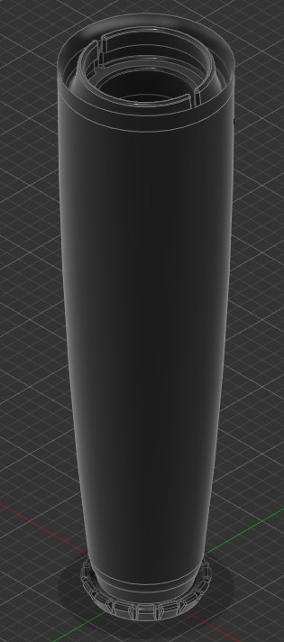
2023 / Personal project
Clothes Hanger
Achievements
• Developed modular pole sections and snap-fit connections
• Explored bases, branches, hooks, and joint covers
• Printed prototypes demonstrate the main pole concept
• Complete loaded assembly testing was not recorded
Modular pole section CAD
Henry Luo | Engineering Portfolio | View project and supporting files
14
Notes:
id: clothes-hanger
year: 2023
title: Clothes Hanger
context: Personal project
summary: Designed a modular, 3D-printed clothing tree with snap-together joints that retain each section while allowing rotation. Print-bed-sized components, branching pole sections, and joint covers support a configurable design with minimal printing supports.
objective: Explore a freestanding clothing organizer assembled from repeatable printed modules.
challenges: ['Fit components on the print bed with minimal supports.', 'Keep the modular structure stable when upright.', 'Retain assembled sections while allowing relative rotation.']
contribution: Developed male/female snap-fit proof-of-concept parts, base segments, pole sections, branches, hooks, and plugs that cover the joints.
tags: ['Personal Project', 'Modular Design']
iterations: [{'title': 'From snap-fit tests to modular parts', 'before': 'The initial proof-of-concept models isolate male/female hook and base snap connections.', 'after': 'The later part set applies those connections to bases, poles, branches, and hooks, with plugs covering the joints. A complete loaded assembly test is not recorded.', 'evidence': 'Project summary: proof-of-concept and component sections.'}]
documents: []
presentation_bullets: ['Developed modular pole sections and snap-fit connections', 'Explored bases, branches, hooks, and joint covers', 'Printed prototypes demonstrate the main pole concept', 'Complete loaded assembly testing was not recorded']
# Clothes Hanger
## Purpose
Explore a freestanding clothing organizer assembled from repeatable printed modules.
## Requirements and constraints
- Fit components on the print bed with minimal supports.
- Keep the modular structure stable when upright.
- Retain assembled sections while allowing relative rotation.
## Engineering contribution
Developed male/female snap-fit proof-of-concept parts, base segments, pole sections, branches, hooks, and plugs that cover the joints.
## Outcome and limits
No separate quantified validation record is retained.
## From snap-fit tests to modular parts
Before: The initial proof-of-concept models isolate male/female hook and base snap connections.
After: The later part set applies those connections to bases, poles, branches, and hooks, with plugs covering the joints. A complete loaded assembly test is not recorded.
Images and demonstrations:
Printed clothing-tree section prototypes: assets/project_descriptions/2023-clothes-hanger/media/images/midsects.jpg
Modular pole section CAD: assets/project_descriptions/2023-clothes-hanger/media/images/pole-midsects.png

Slide 15
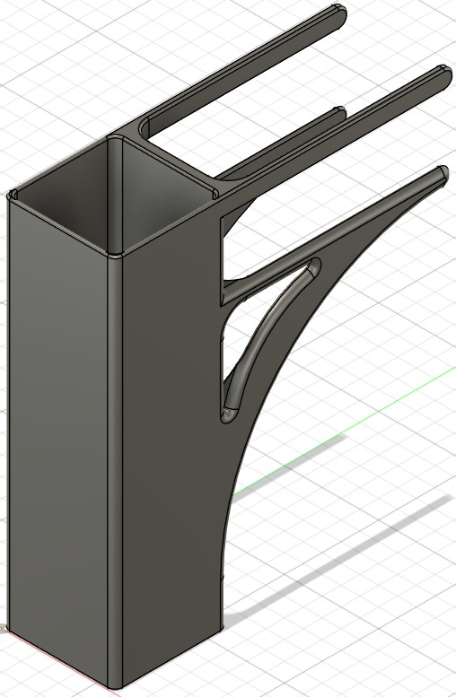
2023 / Personal project
Desk Pencil Holder
Achievements
• Designed compact storage for frequently used pencils
• Modeled desk-edge attachment geometry in Fusion 360
• CAD image shows holder and attachment interface
Desk-edge pencil holder design
Henry Luo | Engineering Portfolio | View project and supporting files
15
Notes:
id: pencil-holder
year: 2023
title: Desk Pencil Holder
context: Personal project
summary: Designed a 3D-printed pencil holder that hangs from a desk edge to keep writing utensils accessible while freeing desktop space. The compact geometry was developed around print-bed limits and minimal support material.
objective: Store writing utensils at the edge of a desk.
challenges: ['Attach to the edge of a desk or table.', 'Fit on the print bed with minimal supports.']
contribution: Modeled a compact holder with desk-edge attachment geometry in Fusion 360.
tags: ['Personal Project', '3D Printing']
documents: []
presentation_bullets: ['Designed compact storage for frequently used pencils', 'Modeled desk-edge attachment geometry in Fusion 360', 'CAD image shows holder and attachment interface']
# Desk Pencil Holder
## Purpose
Store writing utensils at the edge of a desk.
## Requirements and constraints
- Attach to the edge of a desk or table.
- Fit on the print bed with minimal supports.
## Engineering contribution
Modeled a compact holder with desk-edge attachment geometry in Fusion 360.
## Outcome and limits
No separate quantified validation record is retained.
Images and demonstrations:
Desk-edge pencil holder design: assets/project_descriptions/2023-desk-pencil-holder/media/images/pencil-holder.png

