Slide 1
Project: IEEE P802.15 Working Group for Wireless Personal Area Networks (WPANs)
Submission Title: Solution to TG 4e Frame Exhaustion Issue – Frame Type Extensibility Scheme
Date Submitted: 9 Dezember 2009
Source: Michael Bahr (Siemens AG, Corporate Technology)
Address: Otto-Hahn-Ring 6, 80200 München, Germany
Voice:[…], FAX: […], E-Mail: bahr et siemens dod com
Re: Informal request for an extensibility scheme for frame types
Abstract: This submission provides a proposed solution to the envisaged exhaustion of IEEE 802.15.4 frame types with the current ideas proposed in TG 4e.
Purpose: IEEE 802.15.4e to consider the concept, that is proposed in this document, as solution to the frame type exhaustion problem in TG 4e and as the frame type extensibility scheme.
Notice: This document has been prepared to assist the IEEE P802.15. It is offered as a basis for discussion and is not binding on the contributing individual(s) or organization(s). The material in this document is subject to change in form and content after further study. The contributor(s) reserve(s) the right to add, amend or withdraw material contained herein.
Release: The contributor acknowledges and accepts that this contribution becomes the property of IEEE and may be made publicly available by P802.15.

Slide 2
Solution to TG 4e Frame Exhaustion Issue
Frame Type Extensibility Scheme
Michael Bahr
Siemens AG, Corporate Technology

Slide 3
Overview – Current Ideas
Frame Types
b000 – Beacon
b001 – Data
b010 – Acknowledgement
b011 – MAC Command
b100 – 1 octet MAC Header (Low Latency Networks)
b101 – CSL Wakeup
b110 – CSL Secure ACK
b111 – RFID Blink

Slide 4
Overview – Current Ideas
Frame Version
EGTS Beacon (frame type b000)
PA Secure ACK/NACK (frame type b001)
Others
CSL sync bit in frames (frame types 0x000-0x011)
Link status report command (frame type b100)

Slide 5
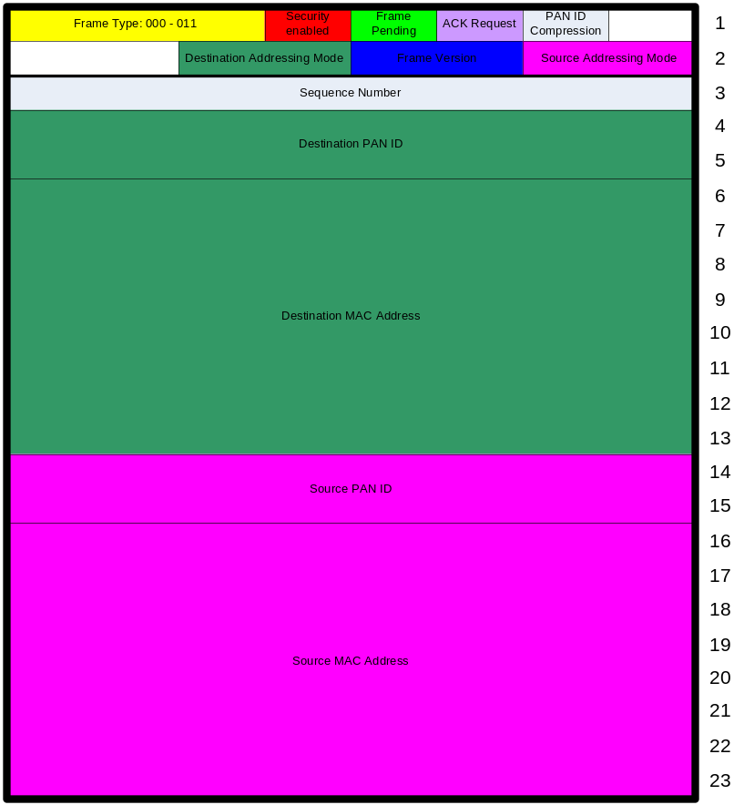
IEEE 802.15.4-2006
beacon
data
acknowledgement
MAC command

Slide 6
1-octet MAC Header – Low Latency Networks
LL beacon
LL command
LL ACK
LL data

Slide 7
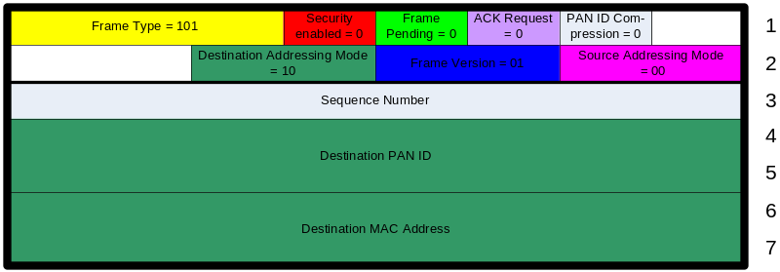
CSL Wakeup
special meaning of frame: CSL Wakeup
IEEE 802.15.4-2006 frame control

Slide 8
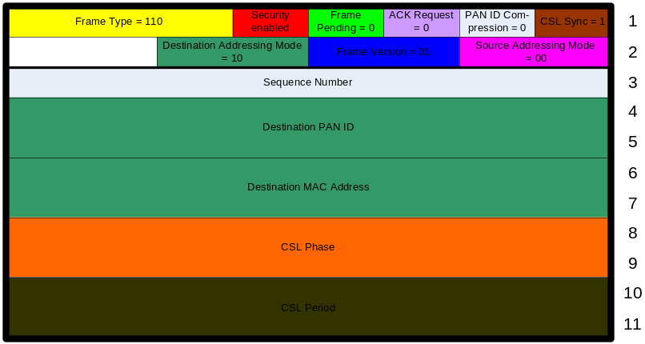
Secure ACK
IEEE 802.15.4-2006 acknowledgment frame extended with CLS phase and CSL period

Slide 9
RFID Blinks
Four blink frames are required
(A)
Frame Control
Sequence
Number
PAN
ID (D)
Source 64-bit address
Variable
payload
FCS
(B)
Frame Control
Sequence
Number
Source 64-bit address
Variable
payload
FCS
(C)
Frame Control
Sequence
Number
PAN
ID (D)
Variable
payload
FCS
* reordered
Sequence Number
Destination PAN ID
Source 64-bit address
according to IEEE 802.15.4-2006
(D)
Frame Control
Sequence
Number
Variable
payload
FCS

Slide 10
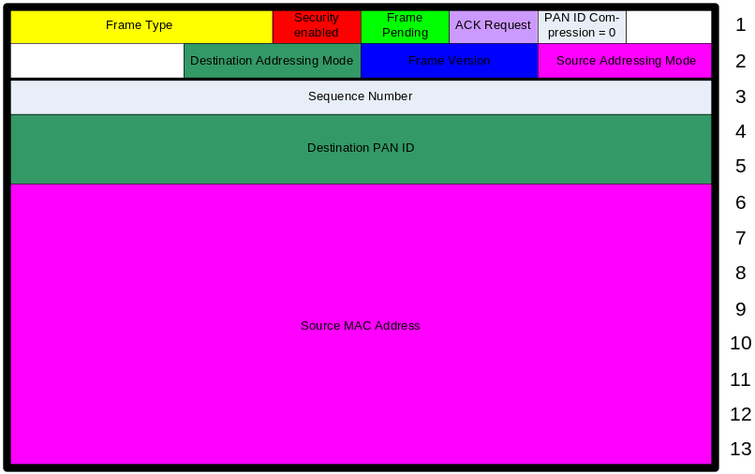
RFID Blink
Special meaning of frame: Blink
different addressing scheme (only source address)

Slide 11
Summary – Current Ideas
2 complete sets of frame types
  beacon, data, ack, command
  IEEE 802.15.4-2006 (000-011)
  low latency networks (100)
3 frame types with special meaning
  CSL Wakeup (101)
  Blink (111)
  Secure ACK (110)
3 additions based on new frame version
  EGTS Beacon
  PA Secure ACK/NACK
  CSL Sync bit

Slide 12
Extensibility Proposal
represent CSL Wakeup and Blink as LLNW command frame
represent CSL Secure ACK as LLNW ACK
increase frame version for EGTS-Beacon and CSL Sync bit
use Link Status Report command in MAC command frames
frame types 101, 110, and 111 are reserved for future extensions
if desired, define 111 as extensibility frame with 8 new sub frame types (reserved bits 7-9)

Slide 13
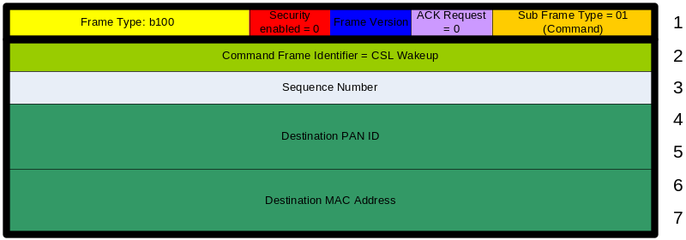
CSL Wakeup LL Command
CSL Wakeup Frame: 7 octets
CSL Wakeup Command: 7 octets
easy processing since many fields correspond to IEEE 802.15.4-2006 frame format

Slide 14
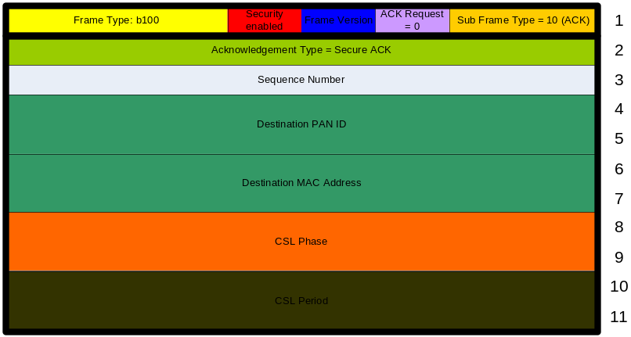
CSL Secure LL ACK
CSL Secure ACK Frame:
11 octets
Secure LL ACK:
11 octets
Sync bit always 1
easy processing since many fields correspond to IEEE 802.15.4-2006 frame format

Slide 15
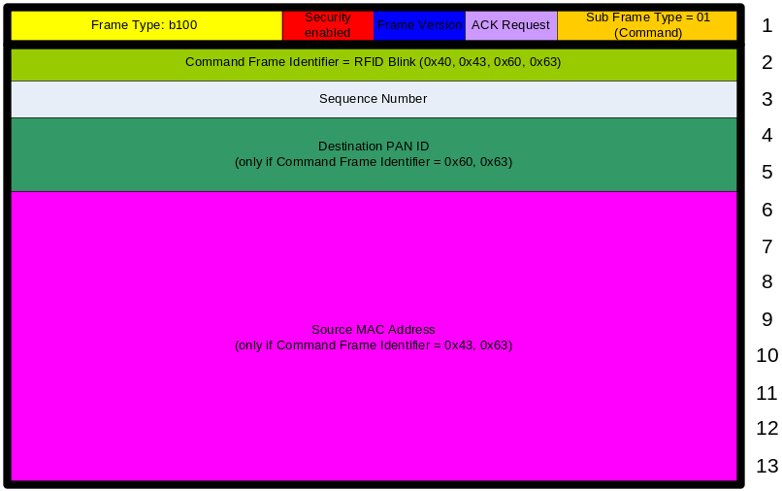
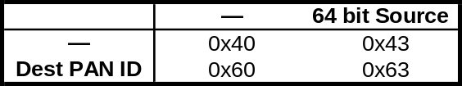
RFID Blink LL Commands
RFID Blink Frame: 13 octets
RFID Blink LL Command:
13 octets
4 RFID Blink LL commands
  each command identifier indicates a specific combination of Destination PAN ID and Source MAC address (64 bit)
  bit pattern encoded in command identifier
  bits correspond to Destination/ Source addressing mode of IEEE 802.15.4-2006 Frame Control
easy processing since many fields correspond to IEEE 802.15.4-2006 frame format
Blink Command Frame Identifier

Slide 16
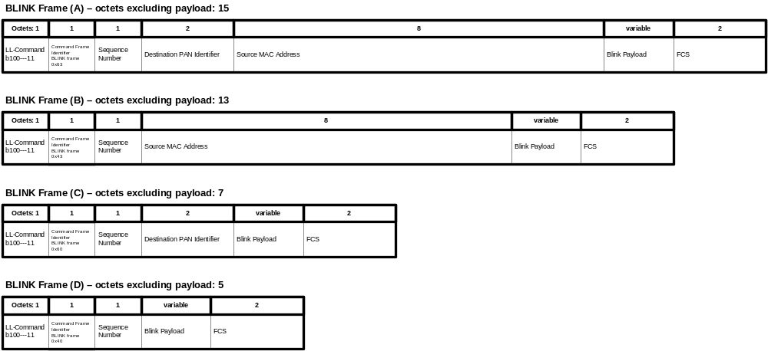
Blink Frames as LL-Command

Slide 17
EGTS Beacon
clause 7.2.6.2.2 (09/604r3)
define one of the reserved bits in Superframe Specification field or GTS Specification subfield in MAC Payload of Beacon as EGTS bit
  EGTS bit = 0
  same as IEEE 802.15.4-2006 beacon frame
  EGTS bit = 1
  MAC payload of beacon frame is extended by Superframe Specification field, Channel Hopping Specification field, Time Synchronization Specification field, and Beacon Bitmap field
because previously reserved EGTS bit will be ignored by IEEE 802.15.4-2006 devices, they cannot discard extended frames based on EGTS bit = 1
need to introduce frame version of 2 ☹ for beacon frames

Slide 18
PA Secure ACK/NACK
clause 7.2.4 (09/604r3)
remove requirement for at least one address for frames of type b001 (7.2.2.2.1 (802.15.4-2006))
restricted to maxPAenabled = TRUE
reception procedures should be okay
→ no need for increment of frame version

Slide 19
CSL Sync Bit
clause 7.3.14.2 (09/604r3)
define reserved bit 8 in Frame Control field as CSL Sync bit
  CSL Sync bit = 0
  same as IEEE 802.15.4-2006 beacon/ data/ ack/ command frame
  CSL Sync bit = 1
  MAC header of beacon/ data/ ack/ command frame is extended by CSL Phase field and CSL Period field
because reserved bit 8 will be ignored by IEEE 802.15.4-2006 devices, they cannot discard extended frames based on bit 8 = 1
need to introduce frame version of 2 ☹ for beacon/ data/ ack/ command frames

Slide 20
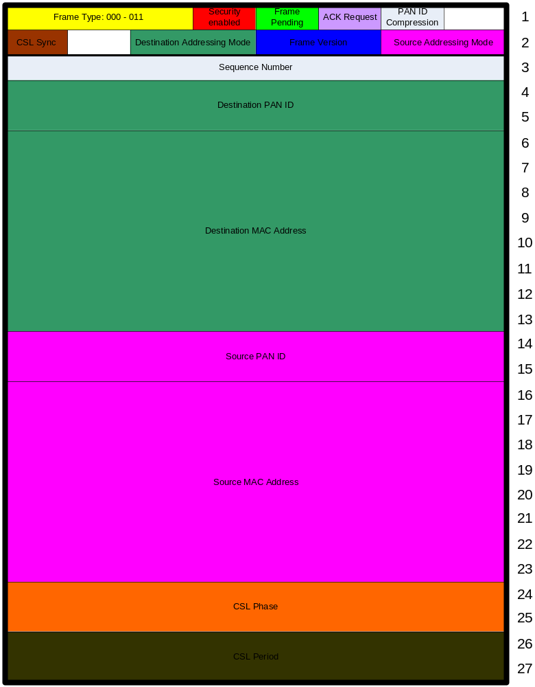
IEEE 802.15.4 frame
beacon
data
acknowledgement
MAC command

Slide 21
Link Status Report Command
clause 7.3.12.19 (09/604r3)
seems to be a „spelling mistake“
use Link Status Report command in IEEE 802.15.4-2006 MAC command frame (frame type b011)

Slide 22
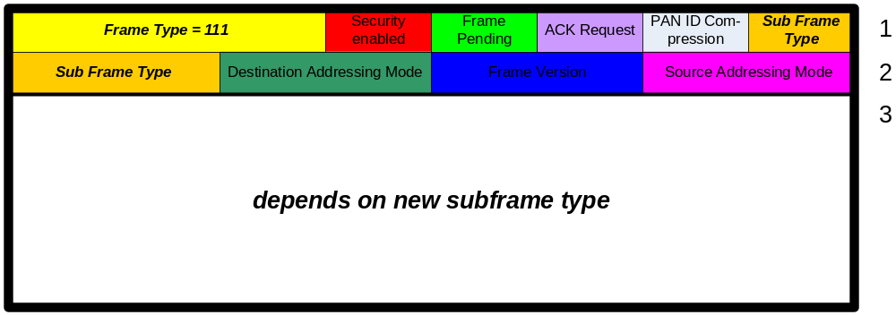
Extensibility Frame Type (if desired)
define Frame Type 111 as extensibility
if Frame Type = 111, redefine reserved bits 7-9 as Sub Frame Type
→ 8 more frame types
  one may be designed as next extensibility frame type
  extensibility frame types follow IEEE 802.15.4-2006 frame control field, but some fields might be ignored or overridden depending on sub frame type

Slide 23
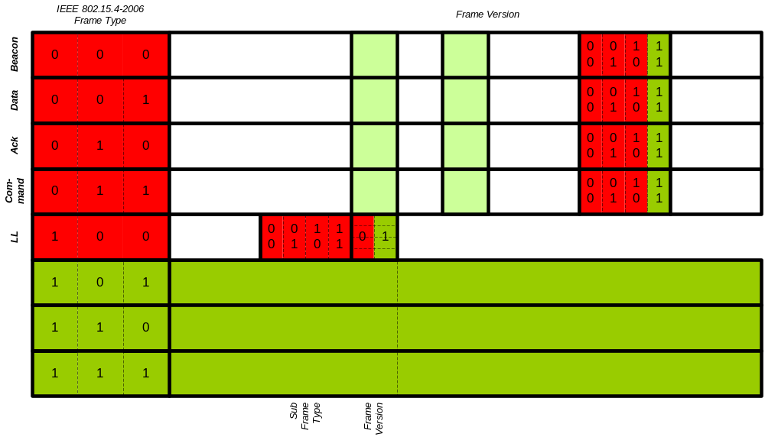
Extensibility Map
∞ * 3 with frame types
8 with frame version
4 * 4 with reserved bits
→ almost unlimited extensibility

Slide 24
Conclusion
2 complete sets of frame types
  beacon, data, ack, command
  IEEE 802.15.4-2006 (000-011)
  low latency networks (100)
5 new low latency command frames
  CSL Wakeup
  Blink (4 command frames)
1 new low latency ACK frame
  Secure ACK
increase frame version for EGTS-Beacon and CSL Sync bit
  Can this be avoided?
3 reserved frame types (101-111) for future extensions
→ almost unlimited extensibility
Does TG 4e need to care about an extensibiltiy scheme with such a representation?

