Slide 1
Project: IEEE P802.15 Working Group for Wireless Personal Area Networks (WPANs)
Submission Title: Solution to TG 4e Frame Exhaustion Issue – Frame Type Extensibility Scheme
Date Submitted: 30 November 2009
Source: Michael Bahr (Siemens AG, Corporate Technology)
Address: Otto-Hahn-Ring 6, 80200 München, Germany
Voice:[…], FAX: […], E-Mail: bahr et siemens dod com
Re: Informal request for an extensibility scheme for frame types
Abstract: This submission provides a proposed solution to the envisaged exhaustion of IEEE 802.15.4 frame types with the current ideas proposed in TG 4e.
Purpose: IEEE 802.15.4e to consider the concept, that is proposed in this document, as solution to the frame type exhaustion problem in TG 4e and as the frame type extensibility scheme.
Notice: This document has been prepared to assist the IEEE P802.15. It is offered as a basis for discussion and is not binding on the contributing individual(s) or organization(s). The material in this document is subject to change in form and content after further study. The contributor(s) reserve(s) the right to add, amend or withdraw material contained herein.
Release: The contributor acknowledges and accepts that this contribution becomes the property of IEEE and may be made publicly available by P802.15.

Slide 2
Solution to TG 4e Frame Exhaustion Issue
Frame Type Extensibility Scheme
Michael Bahr
Siemens AG, Corporate Technology

Slide 3
Overview – Current Ideas
b000 – Beacon
b001 – Command
b010 – ACK
b011 – Data
b100 – 1 octet MHR (Low Latency Networks)
b101 – CSL Wakeup
b110 – Secure ACK
b111 – RFID Blink

Slide 4
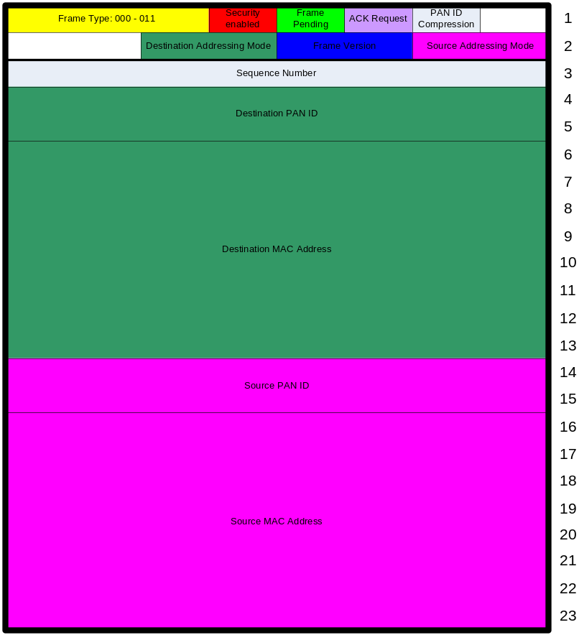
IEEE 802.15.4-2006
beacon
command
ACK
data

Slide 5
1 octet MHR – Low Latency Networks
LL beacon
LL command
LL ACK
LL data

Slide 6
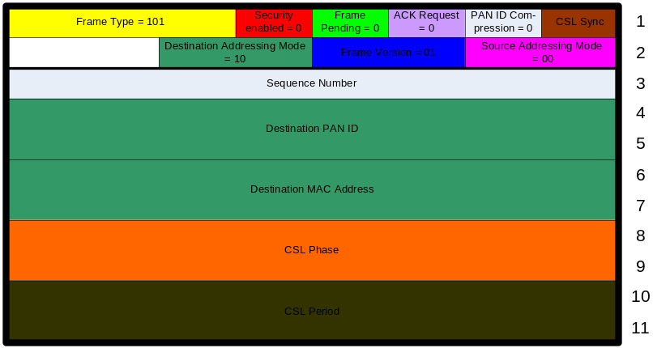
CSL Wakeup
special meaning of frame: CSL Wakeup
IEEE 802.15.4-2006 frame control
CSL sync bit
MHR may include CLS phase and CSL period

Slide 7

Secure ACK
IEEE 802.15.4-2006 acknowledgment frame extended with CLS phase and CSL period

Slide 8
RFID Blinks
Four blink frames are required
(A)
Frame Control
Sequence
Number
PAN
ID (D)
Source 64-bit address
Variable
payload
FCS
(B)
Frame Control
Sequence
Number
Source 64-bit address
Variable
payload
FCS
(C)
Frame Control
Sequence
Number
PAN
ID (D)
Variable
payload
FCS
* reordered
Sequence Number
Source 64-bit address
Destination PAN ID
according to IEEE 802.15.4-2006
(D)
Frame Control
Sequence
Number
Variable
payload
FCS

Slide 9
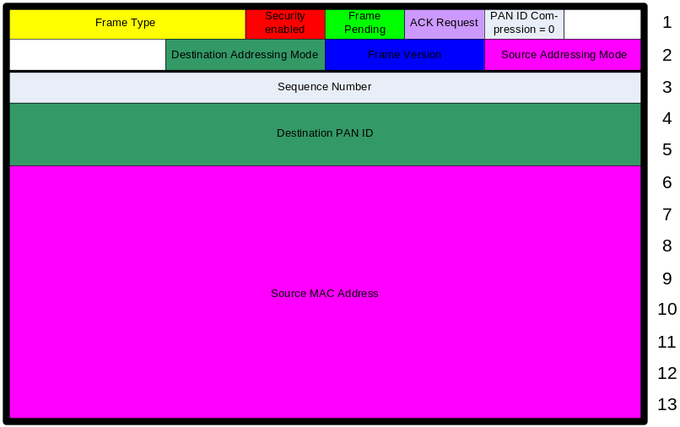
RFID Blink
Special meaning of frame: Blink
different addressing scheme (only source address)

Slide 10
Summary
2 complete sets of frame types
  beacon, command, ack, data
  IEEE 802.15.4-2006 (000-011)
  low latency networks (100)
3 frame types with special meaning
  CSL Wakeup (101)
  Blink (111)
  Secure ACK (110)

Slide 11
Extensibility Proposal
represent CSL Wakeup and Blink as LLNW command frame
represent Secure ACK as LLNW ACK
define 111 as extensibility frame with 8 new sub frame types (reserved bits 7-9)
do not increase frame version

Slide 12
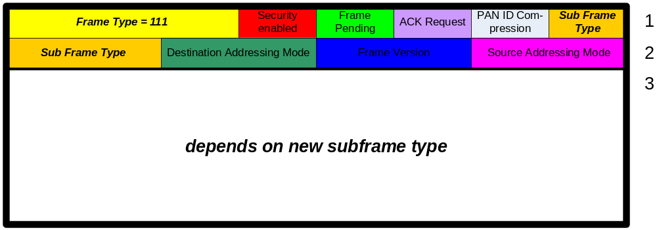
Extensibility Frame Type
define Frame Type 111 as extensibility
if Frame Type = 111, redefine reserved bits 7-9 as Sub Frame Type
→ 8 more frame types
  one may be designed as next extensibility frame type
  extensibility frame types follow IEEE 802.15.4-2006 frame control field, but some fields might be ignored or overridden depending on sub frame type

Slide 13
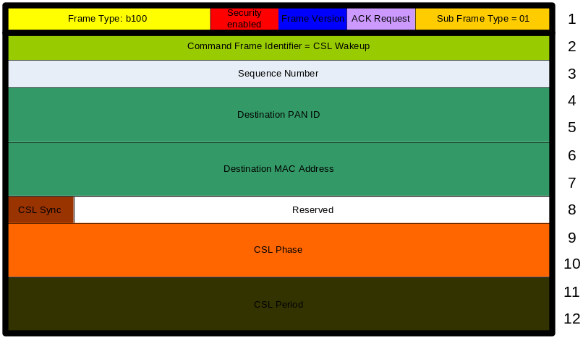
CSL Wakeup LL Command
CSL Wakeup Frame:
11 octets
CSL Wakeup Command:
12 octets
alternatives for additional Flags field (1 octet):
  2 command frame identifiers
  implicit length of command frame derived from Frame Length in PHY header
  undefined indicator for CSL Phase/ CSL Period
easy processing since many fields correspond to IEEE 802.15.4-2006 frame format

Slide 14
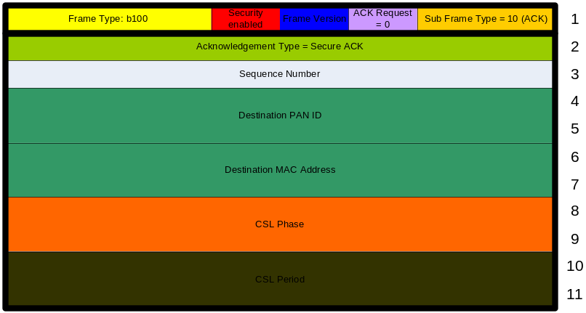
Secure LL ACK
Secure ACK Frame:
11 octets
Secure LL ACK:
11 octets
Sync bit always 1
easy processing since many fields correspond to IEEE 802.15.4-2006 frame format

Slide 15
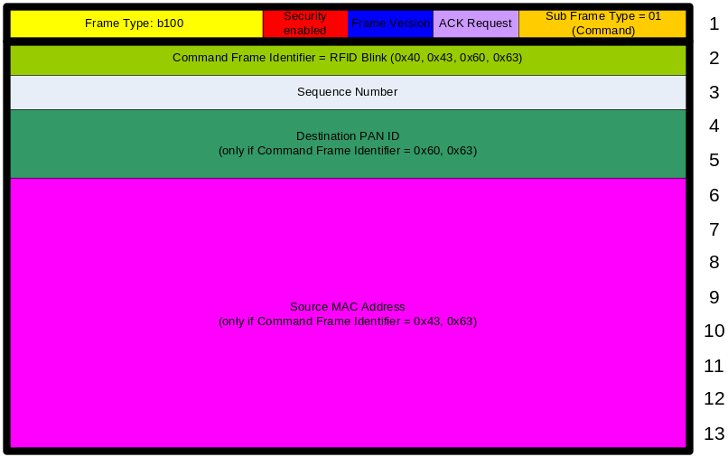
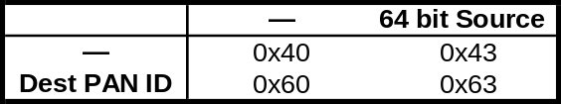
RFID Blink LL Commands
RFID Blink Frame: 13 octets
RFID Blink LL Command:
13 octets
4 RFID Blink LL commands
  each command identifier indicates a specific combination of Destination PAN ID and Source MAC address (64 bit)
  bit pattern encoded in command identifier
  bits correspond to Destination/ Source addressing mode of IEEE 802.15.4-2006 Frame Control
easy processing since many fields correspond to IEEE 802.15.4-2006 frame format
Blink Command Frame Identifier

Slide 16
Conclusion
2 complete sets of frame types
  beacon, command, ack, data
  IEEE 802.15.4-2006 (000-011)
  low latency networks (100)
5 new low latency command frames
  CSL Wakeup
  Blink (4 command frames)
1 new low latency ACK frame
  Secure ACK
3 reserved frame types (101-111)
Does TG 4e need to care about an extensibiltiy scheme?

