Slide 1
TRANSACTION INTELLIGENCE
PORTFOLIO ANALYTICS
Customer shopping behaviour
A transactional study of 3,900 retail purchases across 50 markets
Dataset analysis covering categories, loyalty segments, discount sensitivity and fulfillment channels
Notes:
Introduce the presentation: an empirical look at 3,900 customer transactions evaluating revenue drivers, customer segmentation, discount elasticity, and channel dynamics.

Slide 2

3,900 purchases reveal a loyal base with room to convert more buyers
Dataset scope
Average purchase
3,900
$59.76
Purchases across 25 products, 4 categories, 50 locations and 4 seasons.
CORE OPPORTUNITY
Turn repeat behaviour into subscriptions and protect margin on discount-led demand.
02
Notes:
Highlight the broad coverage of the dataset: 3,900 purchases representing nationwide distribution across all seasons. Emphasize that the average order holds steady at $59.76.

Slide 3



The analysis combines clean data, SQL questions and a decision dashboard
Clean and standardize
Use SQL
Bring the findings into a Power BI dashboard
the transaction data; impute 37 missing review ratings by product-category median.
to compare revenue, ratings, shipping, subscriptions, discounts, segments and age groups.
for interactive slicing by subscription, gender, category and shipping type.
03
Notes:
Walk through the three-stage methodology: standardizing raw transactions with median category imputation, extracting insights with SQL queries, and deploying the Power BI dashboard for real-time slicing.

Slide 4
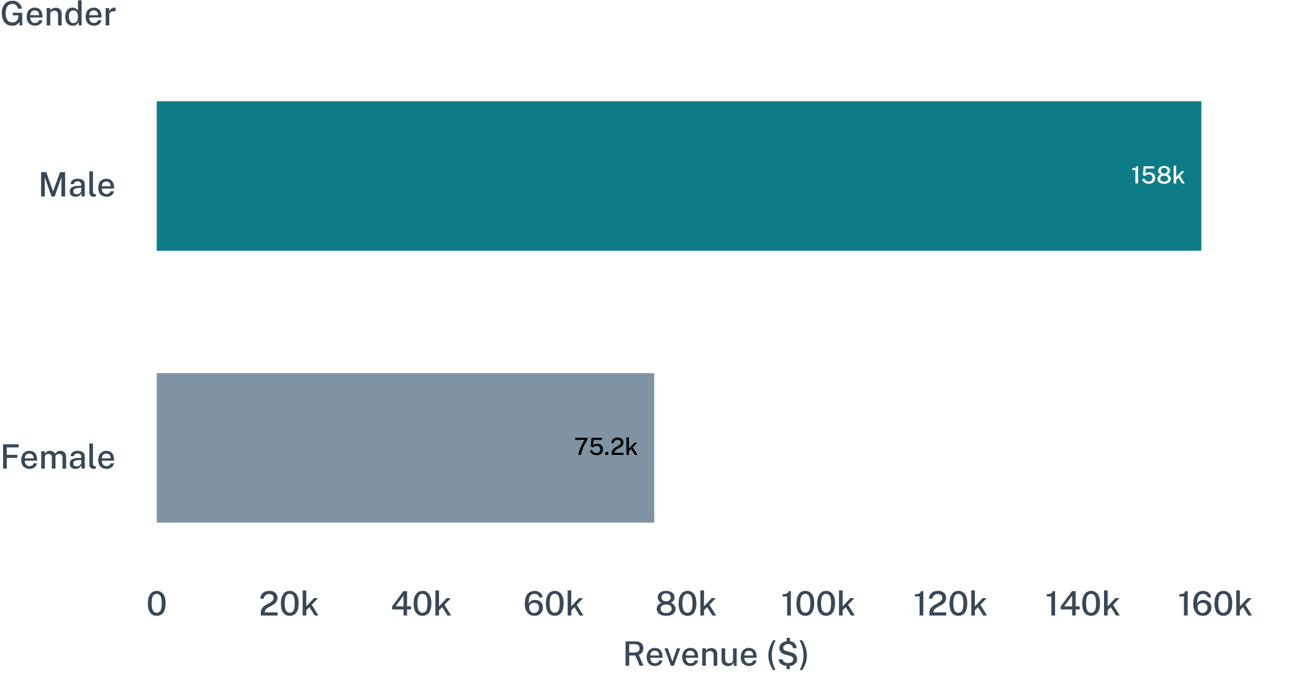
Revenue is concentrated in male customers, but the gap is a targeting signal
Male revenue share
Female revenue share
67.7%
32.3%
$157,890 total generated
$75,191 total generated
Build a gender-aware acquisition and merchandising plan without treating the current mix as a ceiling.
Male customers generate $157,890 vs. $75,191 from female buyers across identical product categories.
04
Notes:
Male revenue accounts for more than two-thirds of the current total. Rather than accepting this as an immutable constraint, use it to craft dedicated acquisition and tailored merchandising for female demographics.

Slide 5
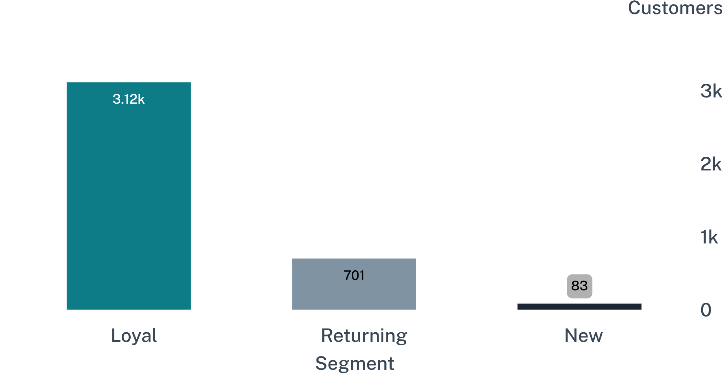
Loyalty is the biggest growth lever: 80% of customers are already loyal
Loyal cohort share
Conversion bridge
79.9%
701 returning
Prime candidates for loyalty enrollment
3,116 accounts in regular rotation
Reward repeat buyers and create a clear bridge from returning to loyal status to maximize lifetime value.
Loyal buyers dominate the pool (3,116), with 701 returning and a narrow inflow of 83 new buyers.
05
Notes:
Eighty percent of buyers already demonstrate high loyalty with over 3,100 members. The immediate commercial priority is transitioning the 701 returning customers into the top tier.

Slide 6
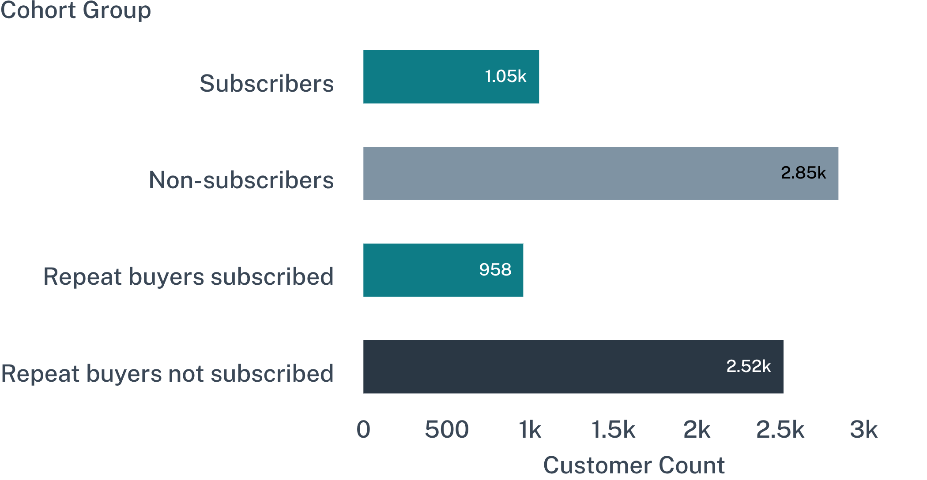
Subscriptions are under-penetrated even among repeat buyers
Subscribers revenue
$62,645 (1,053 buyers)
Average basket: $59.49
Non-subscribers revenue
$170,436 (2,847 buyers)
Average basket: $59.87
Subscription penetration lags repeat transaction volume; with near-identical basket values, structured perks can unlock recurring revenue.
2,518 frequent buyers (5+ orders) remain unsubscribed despite identical spend profiles.
06
Notes:
Over 2,500 customers with five or more purchases do not subscribe. Basket size is virtually identical ($59.49 vs $59.87), proving subscribers do not require steep discounts to buy.

Slide 7
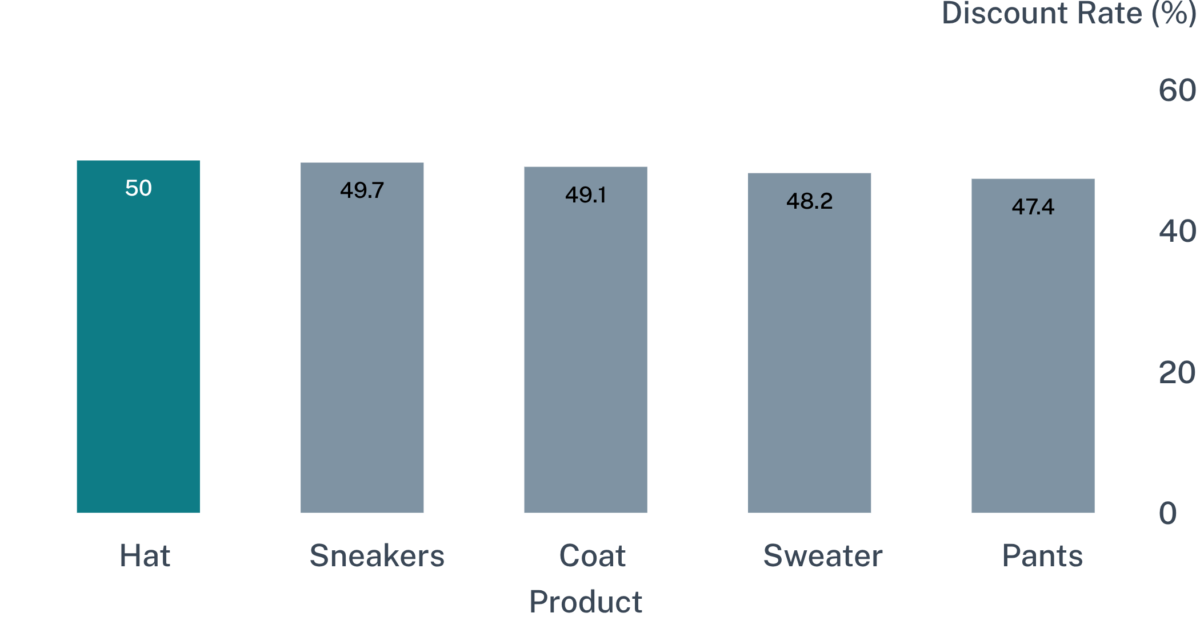
Discounts drive demand for a specific product set
Commercial question
Action
Test targeted offers and track margin, conversion and repeat purchase together.
Which products need discount support, and which are training customers to wait?
Hat 50.0%, Sneakers 49.7%, Coat 49.1%, Sweater 48.2%, Pants 47.4%.
07
Notes:
Nearly half of all sales in top apparel and footwear categories are discounted. We need to distinguish true promotion sensitivity from self-inflicted margin loss where buyers anticipate sales.

Slide 8
Top-rated products cluster around practical accessories and footwear
TOP FIVE BY AVERAGE RATING
BEST-SELLING LEADERS BY CATEGORY
PRODUCT | AVERAGE RATING
Gloves | 3.86
Sandals | 3.84
Boots | 3.82
Hat | 3.80
Skirt | 3.78
CATEGORY | LEADER
Accessories | Jewelry
Clothing | Blouse
Footwear | Sandals
Outerwear | Jacket
Use high-rated products as campaign anchors, then cross-sell into category leaders.
08
Notes:
Use high-rated products as campaign anchors, then cross-sell into category leaders.

Slide 9
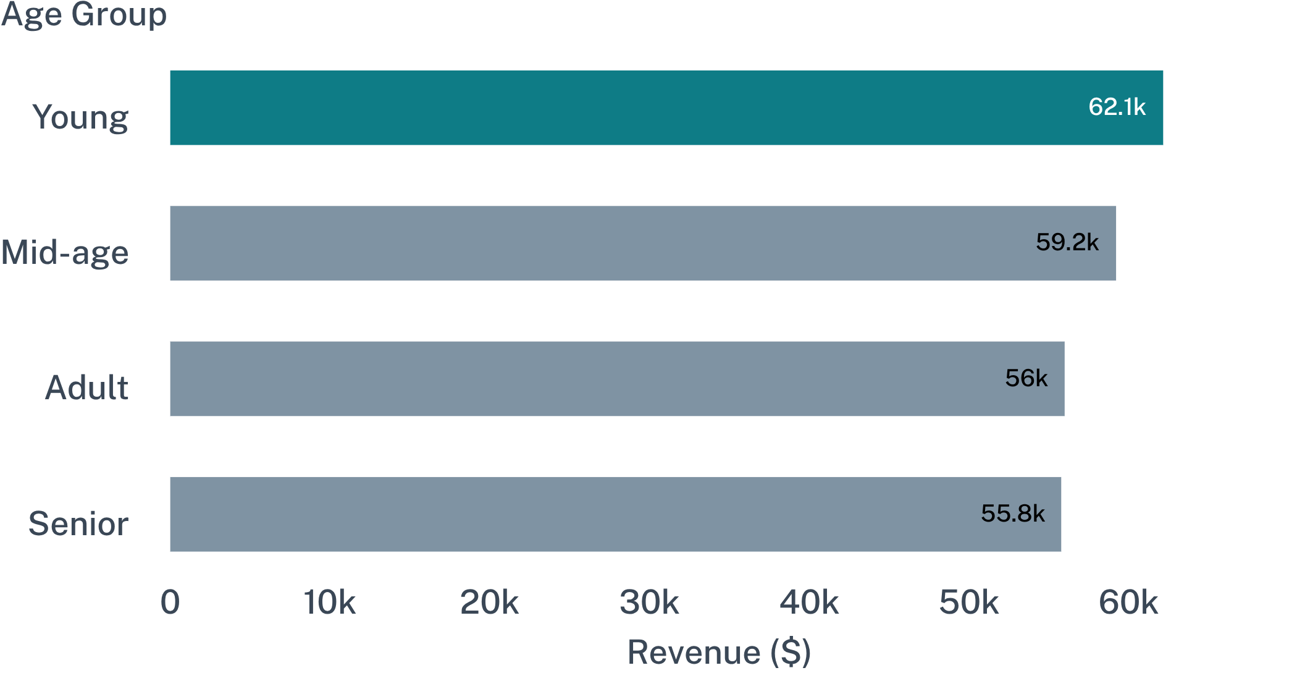
Young customers lead revenue, but the four age groups are close enough to segment by message
Young
Mid-age
$62,143
$59,197
Adult
Senior
$55,978
$55,763
Total revenue spans a tight band from $55,763 (Senior) to $62,143 (Young).
09

Slide 10
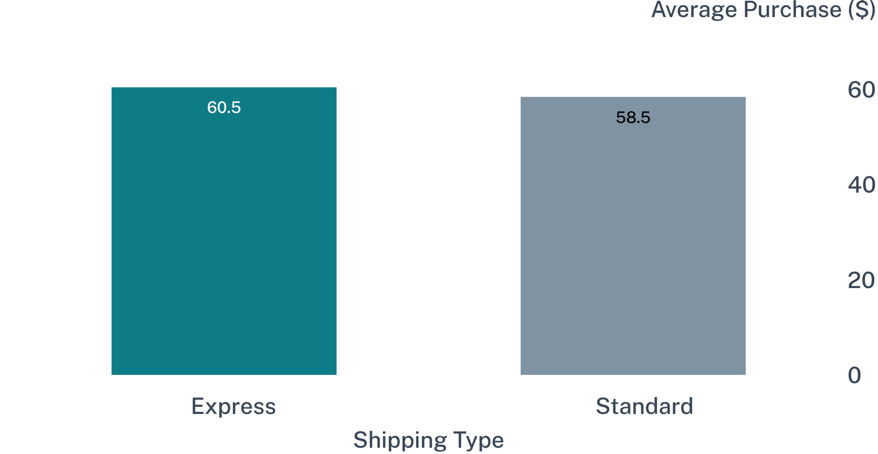
Express shipping correlates with a slightly higher basket
Basket premium
Strategic read
+$2.02
Speed serves as a modest premium indicator, but margin net of fulfillment expense must be verified before subsidizing expedited delivery tiers.
Higher order value on Express orders
Express basket averages $60.48 vs. $58.46 for Standard fulfillment (+3.5% lift).
10
Notes:
Express fulfillment yields a modest $2.02 lift in basket size. While positive, the incremental revenue must be weighed against carrier surcharges before offering expedited shipping as a conversion promotion.

