Slide 1

CS-111
<Module No- 6>
Lab7
NITK SURATHKAL
INBASEKARAN.P
201EC226
Mentor: Mrs Marwa Mohiddin

Slide 2
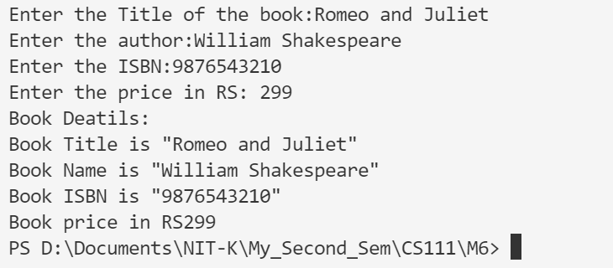
// Lab 7 Questin 1
// Inbasekaran.P 201EC226
/*Program to input and display book information ( Title of the book,Author , ISBN,Price)*/
#include<stdio.h>
#include<stdlib.h>
struct books{
char title[30],author[30],isbn[10];
int price;
};
void input_details(struct books *st){
printf("Enter the Title of the book:");
gets(st->title);
printf("Enter the author:");
gets(st->author);
printf("Enter the ISBN:");
gets(st->isbn);
printf("Enter the price in RS: ");
scanf("%d",&st->price);
}
void print_details(struct books st){
printf("Book Deatils:\n");
printf("Book Title is \"%s\" \n",st.title);
printf("Book Name is \"%s\" \n",st.author);
printf("Book ISBN is \"%s\" \n",st.isbn);
printf("Book price in RS%d \n",st.price);
}
int main(){
system("clear");
struct books st;
input_details(&st);
print_details(st);
return 0;
}
OUTPUT

Slide 3
// Lab 7 Questin 2
// Inbasekaran.P 201EC226
/*
Program to accept 5 people’s name, address and telephone number and to search
for the information of a particular person.
i. Based on name
ii. Based on telephone number
*/
// For printf() and scanf()
#include <stdio.h>
// Including stdlib for system("clear") to clear the screen in the terminal.
#include<stdlib.h>
#include<string.h>
struct person {
char name[50];
char address[50];
char number[16];
};
struct person input(){
struct person s;
printf("Enter information:\n");
printf("Enter name: ");
gets(s.name);
printf("Enter address: ");
gets(s.address);
printf("Enter number along with code: ");
gets(s.number);
return s;
}
void display(struct person s){
printf("Displaying Information:\n");
printf("Name: ");
printf("%s\n", s.name);
printf("Address: %s\n", s.address);
printf("Phone number: %s\n", s.number);
}
struct person* find_number(char number [], struct person* data, int n){
for (int i = 0; i < n; i++){
if(!strcmp(number,data->number)){
return data;
}
else{
data ++;
}
}
printf("Item not found !!!\n");
return NULL;
}
PTO

Slide 4
struct person* find_name(char name [], struct person* data, int n){
for (int i = 0; i < n; i++){
if(!strcmp(name,data->name)){
return data;
}
else{
data ++;
}
}
printf("Item not found !!!\n");
return NULL;
}
struct person* find(struct person* data, int n){
printf("Find\n");
printf("1)Based on name\n");
printf("2)Based on telephone number\n");
int choice;
scanf("%d",&choice);
if(choice == 1){
printf("Enter name: ");
char name[50];
scanf("%c");
gets(name);
return find_name(name,data,n);
}else if(choice == 2){
printf("Enter telephone number: ");
char number[16];
scanf("%c");
gets(number);
printf("%s", number);
return find_number(number,data,n);
}else{
printf("Invalid Choice\n");
}
return NULL;
}
int main() {
system("clear");
struct person s[5];
for(int i=0; i<5;++i){
s[i] = input();
display(s[i]);
}
struct person* item = find(s,5);
display(*item);
return 0;
}
PTO

Slide 5
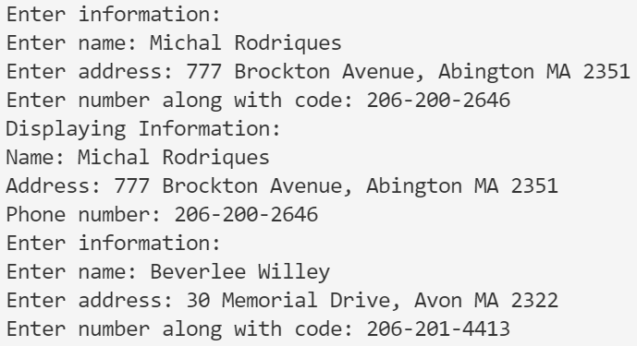
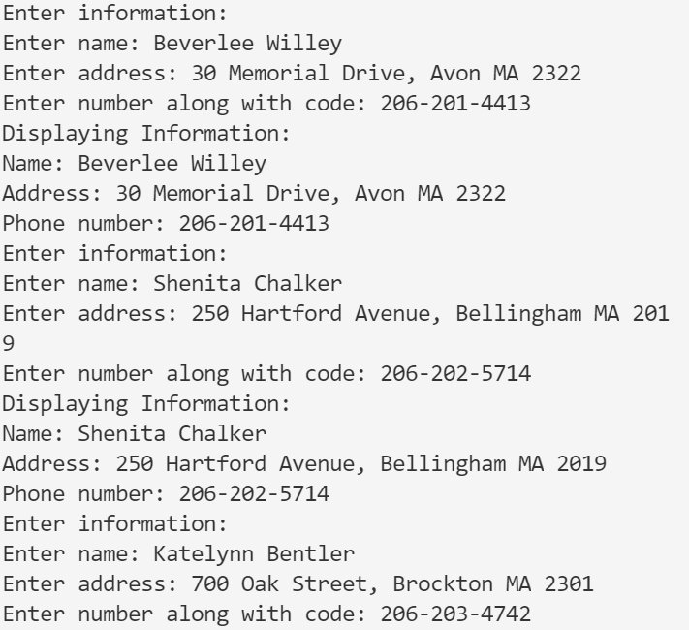
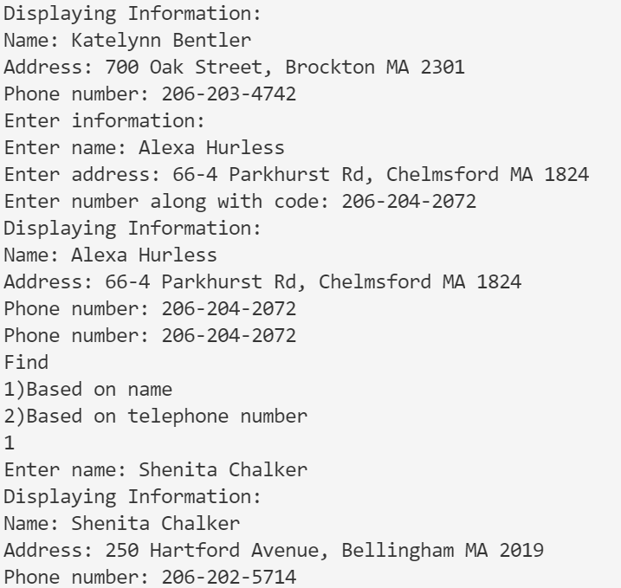
OUTPUT

Slide 6
// Lab 7 Questin 5
// Inbasekaran.P 201EC226
/*Write a menu driven program for the following
i. Add two distances (in inch-feet) using structures
ii. Add two complex numbers by passing structure to a function
iii. Calculate the difference between two time periods using structures.*/
// For printf() and scanf()
#include <stdio.h>
// Including stdlib for system("clear") to clear the screen in the terminal.
#include <stdlib.h>
struct Distance {
int feet;
float inch;
};
struct Distance input_dist(struct Distance d){
printf("Enter the distance\n");
printf("Enter feet: ");
scanf("%d", &d.feet);
printf("Enter inch: ");
scanf("%f", &d.inch);
return d;
}
struct Distance add_dist(struct Distance d1, struct Distance d2){
struct Distance result;
// adding distances
result.feet = d1.feet + d2.feet;
result.inch = d1.inch + d2.inch;
// convert inches to feet if greater than 12
while (result.inch >= 12.0) {
result.inch = result.inch - 12.0;
++result.feet;
}
printf("\nSum of distances = %d\'-%.1f\"", result.feet, result.inch);
return result;
}
PTO

Slide 7
struct complex{
float real;
float imaginary;
};
struct complex input_cnum(struct complex cnum){
printf("Enter real and imaginary part of the complex number:\n");
scanf("%f%f", &cnum.real, &cnum.imaginary);
return cnum;
}
struct complex add_cnum(struct complex cnum1, struct complex cnum2){
struct complex sum;
sum.real = cnum1.real + cnum2.real;
sum.imaginary = cnum1.imaginary + cnum2.imaginary;
printf("SUM = %0.2f + i %0.2f", sum.real, sum.imaginary);
}
struct TIME {
int seconds;
int minutes;
int hours;
};
struct TIME input_time(struct TIME time){
printf("Enter the time. \n");
printf("Enter hours, minutes and seconds: ");
scanf("%d %d %d", &time.hours,&time.minutes,&time.seconds);
return time;
}
struct TIME differenceBetweenTimePeriod(struct TIME start, struct TIME stop) {
struct TIME diff;
while (stop.seconds > start.seconds){
--start.minutes;
start.seconds += 60;
}
diff.seconds = start.seconds - stop.seconds;
while (stop.minutes > start.minutes){
--start.hours;
start.minutes += 60;
}
diff.minutes = start.minutes - stop.minutes;
diff.hours = start.hours - stop.hours;
printf("\nTime Difference: %d:%d:%d - ",start.hours,start.minutes,start.seconds);
printf("%d:%d:%d ", stop.hours,stop.minutes,stop.seconds);
printf("= %d:%d:%d\n", diff.hours,diff.minutes,diff.seconds);
return diff;
}
PTO

Slide 8
int menue(){
printf("Enter Your choice\n");
printf("1. Add two distances (in inch-feet) using structures\n");
printf("2. Add two complex numbers by passing structure to a function\n");
printf("3. Calculate the difference between two time periods using structures\n");
int choice;
scanf("%d",&choice);
return choice;
}
void switch_case(int choice){
switch (choice) {
case 1: {
struct Distance d1;
printf("Distance 1\n");
d1 = input_dist(d1);
printf("Distance 2\n");
struct Distance d2;
d2 = input_dist(d2);
add_dist(d1,d2);
break;
}
case 2: {
struct complex c1;
printf("Complex number 1\n");
c1 = input_cnum(c1);
printf("Complex number 2\n");
struct complex c2;
c2 = input_cnum(c2);
add_cnum(c1,c2);
break;
}
case 3: {
struct TIME start;
printf("Start Time\n");
start = input_time(start);
struct TIME end;
printf("End Time\n");
end = input_time(end);
differenceBetweenTimePeriod(start,end);
break;
}
default:
printf("wrong Input\n");
}
}
int main(){
switch_case(menue());
return 0;
}
PTO

Slide 9
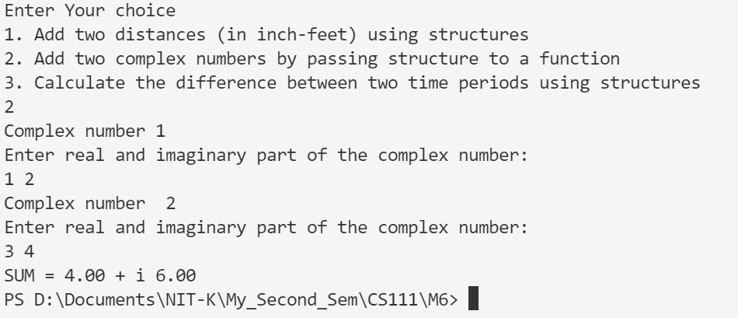
OUTPUT

Slide 10
// Lab 7 Questin 6
// Inbasekaran.P 201EC226
/* Write a C program to compare structure and union variables */
#include <stdio.h>
#include <string.h>
#include <stdlib.h>
struct my_struct{
int int_data;
float float_data;
char name[20];
};
union my_union{
int int_data;
float float_data;
char name[20];
};
int main(){
system("clear");
struct my_struct s = {1,3.14,"my_struct"};
union my_union u={2,4.96,"my_union"};
printf("Structure data:\nint_data: %d\n"
"float_data: %.2f\nname: %s\n",
s.int_data, s.float_data, s.name);
printf("\nunion data:\nint_data: %d\n"
"float_data: %.2f\nname: %s\n",
u.int_data, u.float_data, u.name);
printf("\nsizeof structure : %d\n", sizeof(s));
printf("sizeof union : %d\n\n\n", sizeof(u));
strcpy(u.name, "New name");
printf("Structure data:\nint_data: %d\n"
"float_data: %.2f\nname: %s\n",
s.int_data, s.float_data, s.name);
printf("\nunion data:\nint_data: %d\n"
"float_data: %.2f\nname: %s\n",
u.int_data, u.float_data, u.name);
return 0 ;
}
PTO

Slide 11
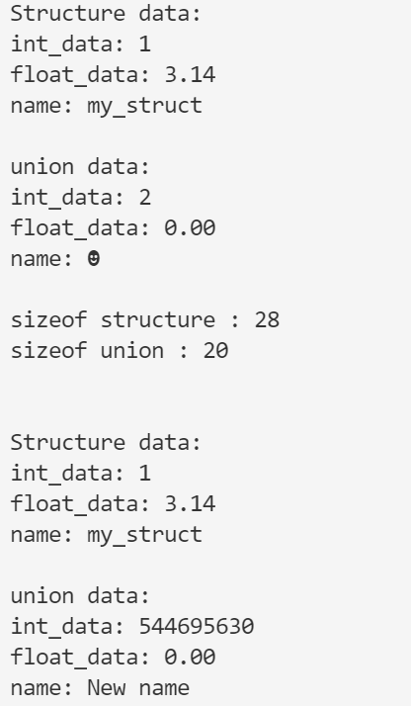
OUTPUT

