Slide 1

CS-111
<Module No- 7>
NITK SURATHKAL
INBASEKARAN.P
201EC226
Mentor: Mrs Marwa Mohiddin

Slide 2
// Lab 7 Questin 1
// Inbasekaran.P 201EC226
/*Program to count frequency of every character present in a line of text*/
// For printf() and scanf()
#include <stdio.h>
// Including stdlib for system("clear") to clear the screen in the terminal.
#include <stdlib.h>
#include <string.h>
// Size of the string
#define SIZE 100
#define COUNT_SIZE 128
int *countChar(char *string)
{
int *count = (int *)malloc((COUNT_SIZE) * sizeof(int));
if (count == NULL)
{
printf("Error!!! memory not allocated.");
exit(0);
}
memset(count, 0, COUNT_SIZE * sizeof(int));
while (*string)
{
count[*string]++;
string++;
}
return count;
}
void displayCount(int *count)
{
printf("Char : Count\n");
for (size_t i = 0; i < COUNT_SIZE; i++)
{
if(*(count + i))
printf("%c : %d\n", i, *(count + i));
}
}

Slide 3
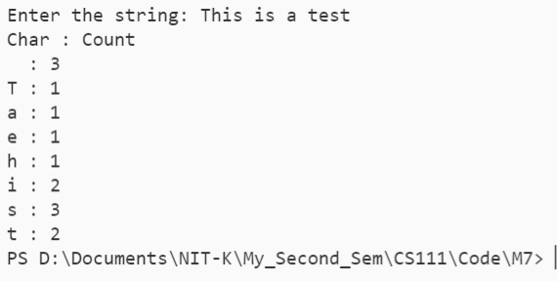
void inputStr(char *string)
{
printf("Enter the string: ");
fflush(stdin);
gets(string);
fflush(stdin);
}
int main()
{
// To clear the console.
system("clear");
char string[SIZE] = {'\0'};
// input the string
inputStr(string);
int *count = countChar(string);
displayCount(count);
free(count);
return 0;
}
OUTPUT

Slide 4
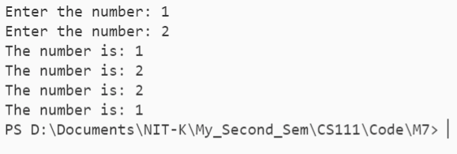
// Lab 7 Questin 2
// Inbasekaran.P 201EC226
/*Program to swap two numbers*/
// For printf() and scanf()
#include <stdio.h>
// Including stdlib for system("clear") to clear the screen in the terminal.
#include <stdlib.h>
void swap(int *a, int *b)
{
int temp = *a;
*a = *b;
*b = temp;
return;
}
int input()
{
int n;
printf("Enter the number: ");
scanf("%d", &n);
return n;
}
void dispaly(int a)
{
printf("The number is: %d\n", a);
}
int main()
{
// To clear the console.
system("clear");
int a = input();
int b = input();
dispaly(a);
dispaly(b);
swap(&a, &b);
dispaly(a);
dispaly(b);
return 0;
}
OUTPUT

Slide 5
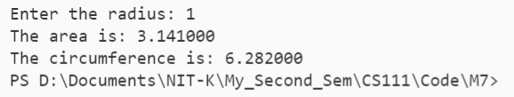
// Lab 7 Questin 3
// Inbasekaran.P 201EC226
/*Program to find area and circumference of a circle*/
// For printf() and scanf()
#include <stdio.h>
// Including stdlib for system("clear") to clear the screen in the terminal.
#include <stdlib.h>
// Size of the string
#define PI 3.141
int input()
{
int n;
printf("Enter the radius: ");
scanf("%d", &n);
return n;
}
double area(int *radius)
{
return PI * (*radius) * (*radius);
}
double circumference(int *radius)
{
return 2 * PI * (*radius);
}
int main()
{
// To clear the console.
system("clear");
int r = input();
printf("The area is: %lf\n", area(&r));
printf("The circumference is: %lf\n", circumference(&r));
return 0;
}
OUTPUT

Slide 6
// Lab 6 Questin 4
// Inbasekaran.P 201EC226
/*
Write functions for the following string operations.
a) Concatenation. b) Comparison. c) Length d) Copy e) Reverse.
*/
// For printf() and scanf()
#include <stdio.h>
// Including stdlib for system("clear") to clear the screen in the terminal.
#include <stdlib.h>
#include <string.h>
// Size of the string
#define SIZE 100
int length(char *string);
char *concatenate(char *string1, char *string2);
int comparison(char *string1, char *string2);
char *copy(char *string);
char *reverse(char *string);
void swap(char *a, char *b);
void switch_case(int choice);
int menu();
void inputStr(char *string);
void display(char *string);
int main()
{
// To clear the console.
system("clear");
switch_case(menu());
return 0;
}
int menu()
{
printf("Enter Your choice\n");
printf("1. Concatenation\n");
printf("2. Comparison\n");
printf("3. Length\n");
printf("4. Copy\n");
printf("5. Reverse\n");
int choice;
scanf("%d", &choice);
return choice;
}
PTO

Slide 7
void display(char *string)
{
int i = 0;
while (string[i])
{
printf("%c", string[i++]);
}
printf("\n");
}
void inputStr(char *string)
{
printf("Enter the string: ");
fflush(stdin);
gets(string);
fflush(stdin);
}
void switch_case(int choice)
{
switch (choice)
{
case 1:
{
char string1[SIZE] = {'\0'};
// input the string
inputStr(string1);
char string2[SIZE] = {'\0'};
// input the string
inputStr(string2);
char *strCat = concatenate(string1, string2);
display(strCat);
break;
}
case 2:
{
char string1[SIZE] = {'\0'};
// input the string
inputStr(string1);
char string2[SIZE] = {'\0'};
// input the string
inputStr(string2);
int n = comparison(string1, string2);
if (n == 1)
printf("%s is larger\n", string1);
else if (n == -1)
printf("%s is larger\n", string2);
else
printf("Same Strings\n");
break;
}
PTO

Slide 8
case 3:
{
char string1[SIZE] = {'\0'};
// input the string
inputStr(string1);
int len = length(string1);
printf("The length of the string is %d", len);
break;
}
case 4:
{
char string1[SIZE] = {'\0'};
// input the string
inputStr(string1);
char *string2 = copy(string1);
printf("The new copy of the string:");
display(string2);
break;
}
case 5:
{
char string1[SIZE] = {'\0'};
// input the string
inputStr(string1);
char *string2 = reverse(string1);
printf("The reverse of the string:");
display(string2);
break;
}
default:
printf("wrong Input\n");
}
}
int length(char *string)
{
int n = 0;
while (string[++n])
;
return n;
}
PTO

Slide 9
char *concatenate(char *string1, char *string2)
{
int n1 = length(string1);
int n2 = length(string2);
int n = n1 + n1;
char *string = (char *)malloc(n * sizeof(char) + 1);
if (string == NULL)
{
printf("Error!!! memory not allocated.");
exit(0);
}
memset(string, 0, n * sizeof(char) + 1);
int i = 0;
for (; i < n1; ++i)
{
string[i] = string1[i];
}
for (int j = 0; j < n2; ++i, ++j)
{
string[i] = string2[j];
}
return string;
}
int comparison(char *string1, char *string2)
{
int i = 0;
while (string1[i++] && string2[i++])
;
if (string1[i])
return 1;
else if (string2[i])
return -1;
else
return 0;
}
char *copy(char *string)
{
int n = length(string);
char *stringC = (char *)malloc(n * sizeof(char) + 1);
if (string == NULL)
{
printf("Error!!! memory not allocated.");
exit(0);
}
memset(stringC, 0, n * sizeof(char) + 1);
for (size_t i = 0; i < n; i++)
{
stringC[i] = string[i];
}
return stringC;
}
PTO

Slide 10
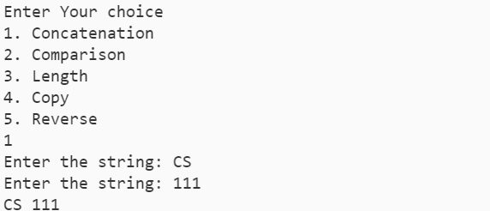




void swap(char *a, char *b)
{
char temp = *a;
*a = *b;
*b = temp;
return;
}
char *reverse(char *string)
{
int i = 0;
int j = length(string) - 1;
while (j > i)
{
swap(&string[i++], &string[j--]);
}
return string;
}
OUTPUT

Slide 11
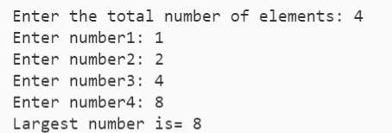
// Lab 5 Questin 5
// Inbasekaran.P 201EC226
/*Write a program to display the greatest of N numbers –use malloc() function*/
// For printf() and scanf()
#include <stdio.h>
// Including stdlib for system("clear") to clear the screen in the terminal.
#include <stdlib.h>
#include<limits.h>
int main()
{
// To clear the console.
system("clear");
int n;
printf("Enter the total number of elements: ");
scanf("%d", &n);
int *data = (int *)malloc(n * sizeof(int));
if (data == NULL)
{
printf("Error!!! memory not allocated.");
exit(0);
}
for (int i = 0; i < n; ++i)
{
printf("Enter number%d: ", i + 1);
scanf("%d", (data + i));
}
int max = INT_MIN;
for (int i = 1; i < n; ++i)
{
if (max < *(data + i))
{
max = *(data + i);
}
}
printf("Largest number is= %d", max);
free(data);
return 0;
}
OUTPUT

Slide 12
// Lab 7 Questin 6
// Inbasekaran.P 201EC226
/*Write a program to arrange N names in alphabetical order using
dynamic memory allocation*/
// For printf() and scanf()
#include <stdio.h>
// Including stdlib for system("clear") to clear the screen in the terminal.
#include <stdlib.h>
#include <string.h>
// Size of the string
#define SIZE 100
char *inputName()
{
printf("Enter the number of characters in the name: ");
int n = 0;
scanf("%d", &n);
char *string = (char *)malloc(n * sizeof(char) + 1);
if (string == NULL)
{
printf("Error!!! memory not allocated.");
exit(0);
}
memset(string, 0, n * sizeof(char) + 1);
fflush(stdin);
printf("Enter the name: ");
for (size_t i = 0; i < n; i++)
{
scanf("%c", &string[i]);
}
fflush(stdin);
return string;
}
PTO

Slide 13
char **nameList()
{
printf("Enter the number of students: ");
int n = 0;
scanf("%d", &n);
char **list = (char **)malloc(n * sizeof(char *) + 1);
if (*list == NULL)
{
printf("Error!!! memory not allocated.");
exit(0);
}
for (size_t i = 0; i < n; i++)
{
list[i] = inputName();
}
list[n] = NULL;
return list;
}
void displayList(char **list)
{
printf("Name list: \n");
int i = 0;
while (list[i])
{
printf("%s\n", list[i++]);
}
}
void swap(char **name1Add, char **name2Add)
{
char *temp = *name1Add;
*name1Add = *name2Add;
*name2Add = temp;
return;
}
PTO

Slide 14
int len(char **list)
{
int i = 0;
while (list[i])
{
i++;
}
return i;
}
void sortList(char **list)
{
int n = len(list);
for (int i = 0; i < n - 1; i++)
{
for (int j = 0; j < n - i - 1; j++)
{
if (list[j][0] > list[j + 1][0])
{
swap(&list[j], &list[j + 1]);
}
else if (list[j][0] == list[j + 1][0])
{
int k = 1;
while (list[j][k] == list[j + 1][k] && (list[j][k] != '\0' && list[j + 1][k] != '\0'))
{
k++;
}
if (list[j][k] > list[j + 1][k])
{
swap(&list[j], &list[j + 1]);
}
}
}
}
}
int main()
{
char **list = nameList();
sortList(list);
displayList(list);
return 0;
}
PTO

Slide 15
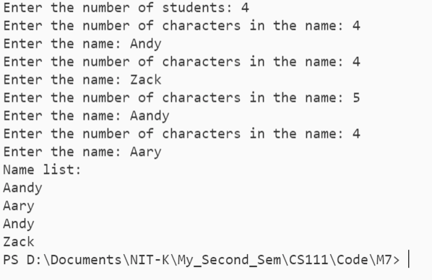
OUTPUT

