Slide 1

CS-111
<Module No- 4>
Lab3
NITK SURATHKAL
INBASEKARAN.P
201EC226
Mentor: Mrs Marwa Mohiddin

Slide 2
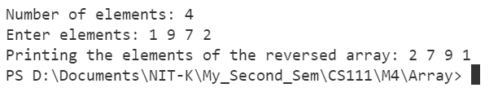
// Lab 4.1 Questin 1
// Inbasekaran.P 201EC226
/*To read an array of N elements and reverse it.*/
// For printf() and scanf()
#include <stdio.h>
// Including stdlib for system("clear") to clear the screen in the terminal.
#include <stdlib.h>
int main()
{
// To clear the console.
system("clear");
printf("Number of elements: ");
int size = 10;
scanf("%d",&size);
int arr[size];
printf("Enter elements: ");
for (int i = 0; i < size; i++)
{
scanf("%d",&arr[i]);
}
int rev_arr[size];
for (int i = 0; i < size; i++)
{
rev_arr[i] = arr[size - i - 1];
}
printf("Printing the elements of the reversed array: ");
for (int i = 0; i < size; i++)
{
printf("%d ", rev_arr[i]);
}
printf("\n");
return 0;
}
OUTPUT

Slide 3
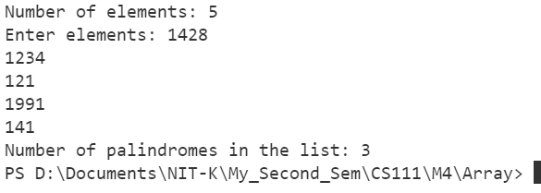
// Lab 4.1 Questin 2
// Inbasekaran.P 201EC226
/*Program to count the number of palindromes in a given list of n numbers*/
// For printf() and scanf()
#include <stdio.h>
// Including stdlib for system("clear") to clear the screen in the terminal.
#include <stdlib.h>
int main()
{
// To clear the console.
system("clear");
int arr[100],size;
int count =0;
printf("Number of elements: ");
scanf("%d",&size);
printf("Enter elements: ");
for(int i=0;i<size;i++)
scanf("%d",&arr[i]);
for(int i=0;i<size;i++)
{
int rev = 0;
int num = arr[i];
while(num)
{
int last = num%10;
rev = 10*rev + last;
num /= 10;
}
if(rev == arr[i])
count++;
}
printf("Number of palindromes in the list: %d",count);
return 0;
}
OUTPUT

Slide 4
// Lab 4.1 Questin 7
// Inbasekaran.P 201EC226
/*To add and multiply two matrices.*/
// For printf() and scanf()
#include <stdio.h>
// Including stdlib for system("clear") to clear the screen in the terminal.
#include <stdlib.h>
#define SIZE 10
int main()
{
// To clear the console.
system("clear");
printf("Enter the order[n x m] of the first matrix: ");
int n1 ,m1;
scanf("%d %d", &n1, &m1);
printf("Enter the order[n x m] of the second matrix: ");
int n2 ,m2;
scanf("%d %d", &n2, &m2);
int mat1[SIZE][SIZE] = {0};
int mat2[SIZE][SIZE] = {0};
int add_matrix[SIZE][SIZE] = {0};
int mul_matrix[SIZE][SIZE] = {0};
printf("Enter the elements of first matrix: \n");
for(int i = 0; i < n1; ++i)
{
for(int j = 0; j< m1; ++j)
{
scanf("%d",&mat1[i][j]);
}
}
printf("Enter the elements of second matrix: \n");
for(int i = 0; i < n2; ++i)
{
for(int j = 0; j< m2; ++j)
{
scanf("%d",&mat2[i][j]);
}
}
PTO

Slide 5
if(n1 == n2 && m2==m1)
{
for(int i = 0; i < n1; ++i)
{
for(int j = 0; j< m1; ++j)
{
add_matrix[i][j] = mat1[i][j]+mat2[i][j];
}
}
printf("The elements of the addition matrix: \n");
for(int i = 0; i < n1; ++i)
{
for(int j = 0; j< m1; ++j)
{
printf("%d ",add_matrix[i][j]);
}
printf("\n");
}
}
else
printf("!!! The order of the matrix is different.Matrix addition is not possible\n");
if(m1 == n2)
{
for(int i = 0; i < n1; ++i)
{
for(int j = 0; j< m2; ++j)
{
for (int k = 0; k < m1; k++)
{
mul_matrix[i][j] += (mat1[i][k] * mat2[k][j]);
}
}
}
PTO

Slide 6
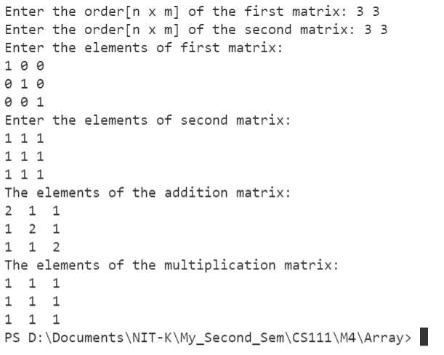
printf("The elements of the multiplication matrix: \n");
for(int i = 0; i < n1; ++i)
{
for(int j = 0; j< m2; ++j)
{
printf("%d ",mul_matrix[i][j]);
}
printf("\n");
}
}
else
printf("!!! Matrix multiplication is not possible\n");
return 0;
}
OUTPUT

Slide 7
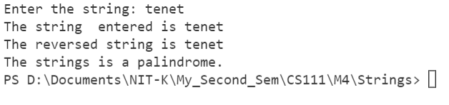
// Lab 4.2 Questin 2
// Inbasekaran.P 201EC226
/*To reverse a string and check whether the string is palindrome or not*/
// For printf() and scanf()
#include <stdio.h>
// Including stdlib for system("clear") to clear the screen in the terminal.
#include <stdlib.h>
// Size of the string
# define SIZE 100
int main()
{
// To clear the console.
system("clear");
char string[SIZE] = {'\0'};
// Input the string
printf("Enter the string: ");
scanf("%[^\n]s",string);
int i = 0;
while(string[i++]);
i--;
char rev_string[SIZE] = {'\0'};
for(int j = 0; j < i; ++j)
rev_string[j] = string[i-j-1];
printf("The string entered is %s\n", string);
printf("The reversed string is %s\n", rev_string);
for(int j = 0; j < i; ++j)
{
if(rev_string[j] != string[j])
{
printf("The string is NOT a palindrome.\n");
return 0;
}
}
printf("The strings is a palindrome.\n");
return 0;
}
OUTPUT

Slide 8
// Lab 4.2 Questin 3
// Inbasekaran.P 201EC226
/*To delete extra blank spaces in a string*/
// For printf() and scanf()
#include <stdio.h>
// Including stdlib for system("clear") to clear the screen in the terminal.
#include <stdlib.h>
// Size of the string
# define SIZE 100
int main()
{
// To clear the console.
system("clear");
char string[SIZE] = {'\0'};
// input the string
printf("Enter the string: ");
scanf("%[^\n]s",string);
for (int i = 0; string[i] != '\0'; i++)
{
if(string[i] == ' '&& string[i + 1] == ' ')
{
for (int j = i + 1; string[j] != '\0' ;j++)
{
string[j] = string[j+1];
}
i--;
}
}
printf("The string withour extra blank spaces is: %s\n", string);
return 0;
}
OUTPUT

Slide 9
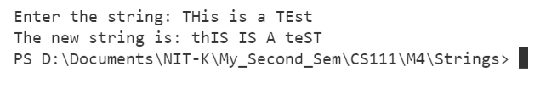
// Lab 4.2 Questin 4
// Inbasekaran.P 201EC226
/*Program to replace lowercase characters by uppercase & vice-versa*/
// For printf() and scanf()
#include <stdio.h>
// Including stdlib for system("clear") to clear the screen in the terminal.
#include <stdlib.h>
// Size of the string
# define SIZE 100
int main()
{
// To clear the console.
system("clear");
char string[SIZE] = {'\0'};
// input the string
printf("Enter the string: ");
scanf("%[^\n]s",string);
for (int i = 0; string[i] != '\0'; i++)
{
if(string[i] >= 'a' && string[i] <= 'z')
{
string[i] = string[i] - 'a' + 'A';
}
else if (string[i] >= 'A' && string[i] <= 'Z')
{
string[i] = string[i] - 'A' + 'a';
}
}
printf("The new string is: %s\n", string);
return 0;
}
OUTPUT

