Slide 1

CS-111
<Module No- 2>
Lab2
NITK SURATHKAL
INBASEKARAN.P
201EC226
Mentor: Mrs Marwa Mohiddin

Slide 2
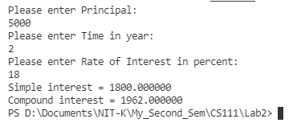
// Lab 2 Questin 1
// Inbasekaran.P 201EC226
/*To find Simple and Compound Interest*/
// For printf() and scnaf()
#include<stdio.h>
// Including stdlib for system("clear") to clear the screen in the terminal.
#include<stdlib.h>
// for pow() and sqrt()
#include<math.h>
int main()
{
// To clear the console.
system("clear");
double p;
// Input principal,time and rate of interest.
printf("Please enter Principal:\n");
scanf("%lf",&p);
double t;
printf("Please enter Time in year:\n");
scanf("%lf",&t);
double r;
printf("Please enter Rate of Interest in percent:\n");
scanf("%lf",&r);
// simple intrest calculation.
double si=(p*t*r)/100;
// Print the simple intrest
printf("Simple interest = %lf\n",si);
// Compound intrest calculation.
double amount=p*pow((1 +r/100),t);
double ci=amount-p;
// Print compound intrest
printf("Compound interest = %lf\n",ci);
return 0;
}
OUTPUT

Slide 3

// Lab 2 Questin 2
// Inbasekaran.P 201EC226
/*To read the radius of a circle and find its Area and Perimeter.*/
// Including standard input and output for printing the variables.
#include <stdio.h>
// Including stdlib for system("clear") to clear the screen in the terminal.
#include<stdlib.h>
int main()
{
// To clear the console.
system("clear");
// Making Pi as a constant
const float PI = 3.1415;
float r;
// Input
printf("Enter the radius: \n");
scanf("%f",&r);
// Area of circle
float area = PI*r*r;
// Perimeter of circle
float perimeter = 2*PI*r;
// Print area.
printf("%f\n", area);
// Print perimeter.
printf("%f\n", perimeter);
return 0;
}
OUTPUT

Slide 4

// Lab 2 Questin 3
// Inbasekaran.P 201EC226
/*
3. To read the temperature in Fahrenheit and convert it to degree
centigrade.
*/
// Including standard input and output for printing the variables.
#include <stdio.h>
// Including stdlib for system("clear") to clear the screen in the
terminal.
#include<stdlib.h>
int main()
{
// To clear the console.
system("clear");
// Declaring variables
float Fahrenheit, Celsius;
// Input
printf("Enter the temperature is Fahrenheit: \n");
scanf("%f",&Fahrenheit);
// Calculating celsius from Fahrenheit
Celsius = ((Fahrenheit-32)*5)/9;
// Print the temperature in celsius
printf("Temperature in Celsius is : %f",Celsius);
return 0;
}
OUTPUT

Slide 5
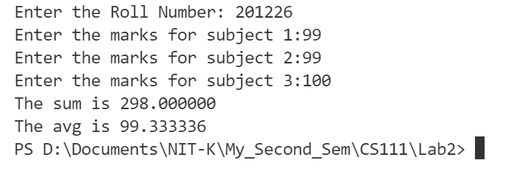
// Lab 2 Questin 4
// Inbasekaran.P 201EC226
/*4. Program to accept student roll no, marks in 3 subjects and calculate total,
average of marks and print them with appropriate messages.*/
// Including standard input and output for printing the variables.
#include <stdio.h>
// Including stdlib for system("clear") to clear the screen in the terminal.
#include<stdlib.h>
int main()
{
// To clear the console.
system("clear");
// Declaring variables
int rollno;
// Input Roll Number
printf("Enter the Roll Number: ");
scanf("%d",&rollno);
// Input Marks
float m1,m2,m3;
printf("Enter the marks for subject 1:");
scanf("%f",&m1);
printf("Enter the marks for subject 2:");
scanf("%f",&m2);
printf("Enter the marks for subject 3:");
scanf("%f",&m3);
// Calculating sum
float sum = m1 + m2 + m3;
// Print sum
printf("The sum is %f\n",sum);
// Print average
printf("The avg is %f\n",sum/3);
return 0;
}
OUTPUT

Slide 6

// Lab 2 Questin 5
// Inbasekaran.P 201EC226
/*5. An Employee's Basic Pay (BP) is to be read through keyboard. DA is 40% of
BP, HRA is 20% of BP, calculate the Gross Pay (GP) GP is computed as BP+DA+HRA.*/
// For printf() and scnaf()
#include<stdio.h>
// Including stdlib for system("clear") to clear the screen in the terminal.
#include<stdlib.h>
int main()
{
// To clear the console.
system("clear");
// Declaring Variables
double BP;
double DA,HRA,GP;
//Input
printf("Enter Employee's Basic Pay:\n");
scanf("%lf",&BP);
// Calculating Gross product
DA = 0.4 * BP;
HRA = 0.2 * BP;
GP = BP + DA + HRA;
//Print Gross Product.
printf("Gross Product %lf",GP);
return 0;
}
OUTPUT

Slide 7
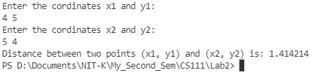
// Lab 2 Questin 6
// Inbasekaran.P 201EC226
/*6. Program to find distance between two points (x1, y1)
and (x2, y2) in a Cartesian plane.*/
// For printf() and scnaf()
#include<stdio.h>
// Including stdlib for system("clear") to clear the screen in the terminal.
#include<stdlib.h>
// for pow() and sqrt()
#include<math.h>
int main()
{
// To clear the console.
system("clear");
// Declaring variables
double x1,x2,y1,y2;
double dis;
//Input
printf("Enter the cordinates x1 and y1:\n");
scanf("%lf %lf",&x1,&y1);
printf("Enter the cordinates x2 and y2:\n");
scanf("%lf %lf",&x2,&y2);
//Distance formulae
dis = sqrt(pow((x1-x2),2) + pow((y1-y2),2));
//Output
printf("Distance between two points (x1, y1) and (x2, y2) is: %lf \n",dis);
return 0;
}
OUTPUT

Slide 8
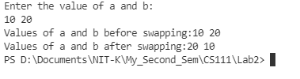
// Lab 2 Questin 7
// Inbasekaran.P 201EC226
/*7. Program to swap two numbers using temporary variable.
Also print the original and exchanged values.*/
// For printf() and scnaf()
#include<stdio.h>
// Including stdlib for system("clear") to clear the screen in the terminal.
#include<stdlib.h>
int main()
{
// To clear the console.
system("clear");
// Declaring variables
int a,b,temp;
//Input
printf("Enter the value of a and b:\n");
scanf("%d %d",&a,&b);
// Print the values of a and b before swapping
printf("Values of a and b before swapping:%d %d \n",a,b);
//Swap using temp
temp = a;
a = b;
b = temp;
// Print the values of a and b after swapping
printf("Values of a and b after swapping:%d %d \n",a,b);
return 0;
}
OUTPUT

