Slide 1

CS-111
<Module No- 2>
Lab2
NITK SURATHKAL
INBASEKARAN.P
201EC226
Mentor: Mrs Marwa Mohiddin

Slide 2
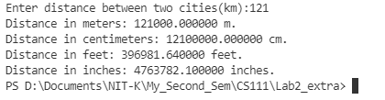
// Lab 2 Questin 1
// Inbasekaran.P 201EC226
/*1. The distance between two cities (in km.) is input through the keyboard.
Write a program to convert and print this distance in meters, feet,
inches and centimeters. */
// For printf() and scnaf()
#include<stdio.h>
// Including stdlib for system("clear") to clear the screen in the terminal.
#include<stdlib.h>
int main()
{
// To clear the console.
system("clear");
//Declaring variables
double dist;
// Input
printf("Enter distance between two cities(km):");
scanf("%lf",&dist);
// 1 km = 1000 m
printf("Distance in meters: %lf m.\n",1000*dist);
// 1 km = 1000*100 cm
printf("Distance in centimeters: %lf cm.\n",1000*100*dist);
// 1 km = 3280.84 feet
printf("Distance in feet: %lf feet.\n",3280.84*dist);
// 1 km = 39370.1 inches
printf("Distance in inches: %lf inches.\n",39370.1*dist);
return 0;
}
OUTPUT

Slide 3
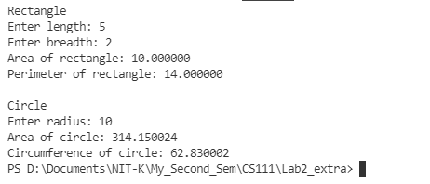
// Lab 2 Questin 2
// Inbasekaran.P 201EC226
/* The length & breadth of a rectangle and radius of a circle are input through
the keyboard.Write a program to calculate the area & perimeter of the rectangle,
and the area & circumference of the circle.*/
// Including standard input and output for printing the variables.
#include <stdio.h>
// Including stdlib for system("clear") to clear the screen in the terminal.
#include<stdlib.h>
int main()
{
// To clear the console.
system("clear");
// Rectangle
// Input
const float PI = 3.1415;
float l,b;
printf("Rectangle\n");
printf("Enter length: ");
scanf("%f",&l);
printf("Enter breadth: ");
scanf("%f",&b);
// area of rectangle = l*b
printf("Area of rectangle: %f\n",l*b);
// perimeter = 2*(l+b)
printf("Perimeter of rectangle: %f\n\n",2*(l+b));
// Circle
// Input
float r;
printf("Circle\n");
printf("Enter radius: ");
scanf("%f",&r);
// Area = PI*r*r
printf("Area of circle: %f\n",PI*r*r);
// Circumference of circle = 2*PI*r
printf("Circumference of circle: %f\n",2*PI*r);
return 0;
}
OUTPUT

Slide 4

// Lab 2 Questin 3
// Inbasekaran.P 201EC226
/* If a five-digit number is input through the keyboard,
write a program to calculate the sum of its digits.*/
// Including standard input and output for printing the variables.
#include <stdio.h>
// Including stdlib for system("clear") to clear the screen in the terminal.
#include<stdlib.h>
int main()
{
// To clear the console.
system("clear");
// input number
int num;
printf("Enter ther five digit number: ");
scanf("%d",&num);
// initializing sum to 0
int sum = 0;
// Adding the last digit of num to sum
sum += num%10;
// Removes the last digit of num
num /= 10;
// Repeating the above steps for 4 more times
sum += num%10;
num /= 10;
sum += num%10;
num /= 10;
sum += num%10;
num /= 10;
sum += num%10;
// Output
printf("Sum of it's digits: %d \n",sum);
return 0;
}
OUTPUT

Slide 5

// Lab 2 Questin 4
// Inbasekaran.P 201EC226
/*If a five-digit number is input through the keyboard,
write a program to reverse the number*/
// Including standard input and output for printing the variables.
#include <stdio.h>
// Including stdlib for system("clear") to clear the screen in the terminal.
#include<stdlib.h>
int main()
{
// To clear the console.
system("clear");
// input number
int num;
printf("Enter ther five digit number: ");
scanf("%d",&num);
int rev_num = 0;
rev_num *= 10;
// Adding last digit of num to rev_num
rev_num += num%10;
// Removing the last digit
num /= 10;
// Repeating the same step for fore more times
rev_num *= 10;
// Adding last digit of num to rev_num
rev_num += num%10;
// Removing the last digit
num /= 10;rev_num *= 10;
// Adding last digit of num to rev_num
rev_num += num%10;
// Removing the last digit
num /= 10;rev_num *= 10;
// Adding last digit of num to rev_num
rev_num += num%10;
// Removing the last digit
num /= 10;rev_num *= 10;
// Adding last digit of num to rev_num
rev_num += num%10;
printf("Reverse of the number: %d",rev_num);
return 0;
}
OUTPUT

Slide 6

// Lab 2 Questin 5
// Inbasekaran.P 201EC226
/* If the total selling price of 15 items and the total profit earned on
them is input through the keyboard, write a program to find the cost price of one item.*/
// For printf() and scnaf()
#include<stdio.h>
// Including stdlib for system("clear") to clear the screen in the terminal.
#include<stdlib.h>
int main()
{
// To clear the console.
system("clear");
// Declaring variables
float SP,P;
// input
printf("Enter Selling Price:");
scanf("%f",&SP);
printf("Enter Profit:");
scanf("%f",&P);
// CP = SP - P
printf("Cost Price of each item is: %f\n",(SP-P)/15);
return 0;
}
OUTPUT

Slide 7
// Lab 2 Questin 6
// Inbasekaran.P 201EC226
/* Write a program to compute the values of square-roots
and squares of the numbers 0 to 100 in steps 10*/
// For printf() and scnaf()
#include<stdio.h>
// Including stdlib for system("clear") to clear the screen in the terminal.
#include<stdlib.h>
// for pow() and sqrt()
#include<math.h>
int main()
{
// To clear the console.
system("clear");
// print square-root and squares
int i = 0;
printf("The square-root of %3d is %7.4lf\n",i,sqrt(i));
printf("The square of %3d is %5d\n",i,(int)pow(i,2));
i += 10;
printf("The square-root of %3d is %7.4lf\n",i,sqrt(i));
printf("The square of %3d is %5d\n",i,(int)pow(i,2));
i += 10;
printf("The square-root of %3d is %7.4lf\n",i,sqrt(i));
printf("The square of %3d is %5d\n",i,(int)pow(i,2));
i += 10;
printf("The square-root of %3d is %7.4lf\n",i,sqrt(i));
printf("The square of %3d is %5d\n",i,(int)pow(i,2));
i += 10;
printf("The square-root of %3d is %7.4lf\n",i,sqrt(i));
printf("The square of %3d is %5d\n",i,(int)pow(i,2));
i += 10;
printf("The square-root of %3d is %7.4lf\n",i,sqrt(i));
printf("The square of %3d is %5d\n",i,(int)pow(i,2));
i += 10;
printf("The square-root of %3d is %7.4lf\n",i,sqrt(i));
printf("The square of %3d is %5d\n",i,(int)pow(i,2));
i += 10;
printf("The square-root of %3d is %7.4lf\n",i,sqrt(i));
printf("The square of %3d is %5d\n",i,(int)pow(i,2));
i += 10;
PTO

Slide 8
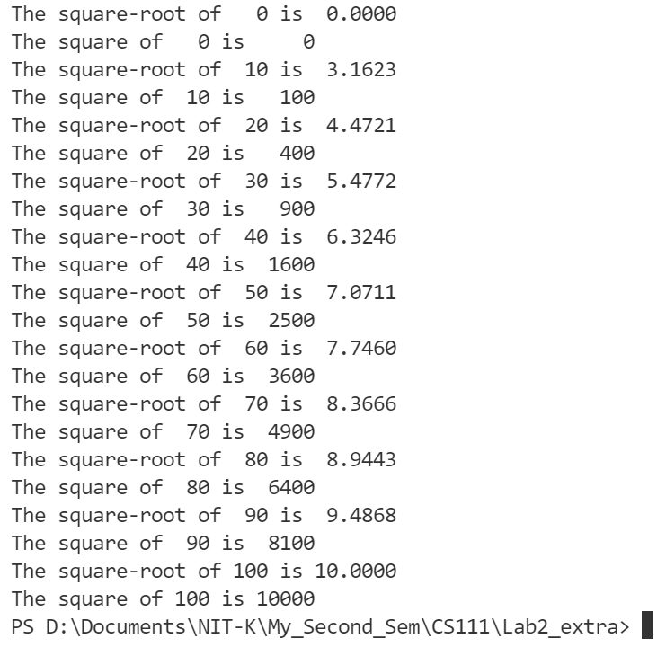
printf("The square-root of %3d is %7.4lf\n",i,sqrt(i));
printf("The square of %3d is %5d\n",i,(int)pow(i,2));
i += 10;
printf("The square-root of %3d is %7.4lf\n",i,sqrt(i));
printf("The square of %3d is %5d\n",i,(int)pow(i,2));
i += 10;
printf("The square-root of %3d is %7.4lf\n",i,sqrt(i));
printf("The square of %3d is %5d\n",i,(int)pow(i,2));
i += 10;
return 0;
}
OUTPUT

