Slide 1
CUDA MODE:
Lecture 1
Mark Saroufim

Slide 2
Logistics
Hosts: Andreas Köpf, Thomas Viehmann, Mark Saroufim
1 per 2 week on a CUDA topic: textbook chapter, pair programming session or project
Target audience is torch programmers tired of CUDA tutorial hell
Textbook: Programming Massively Parallel Processors
Additional resources here in resource-stream
All communication will happen on our Discord
Sessions will be recorded on https://www.youtube.com/@CUDAMODE

Slide 3

Goal of Lecture 1
Integrate a CUDA kernel inside a pytorch program
Learn how to profile it
Most of the code is here https://github.com/msaroufim/cudamodelecture1
I believe thing I see

Slide 4
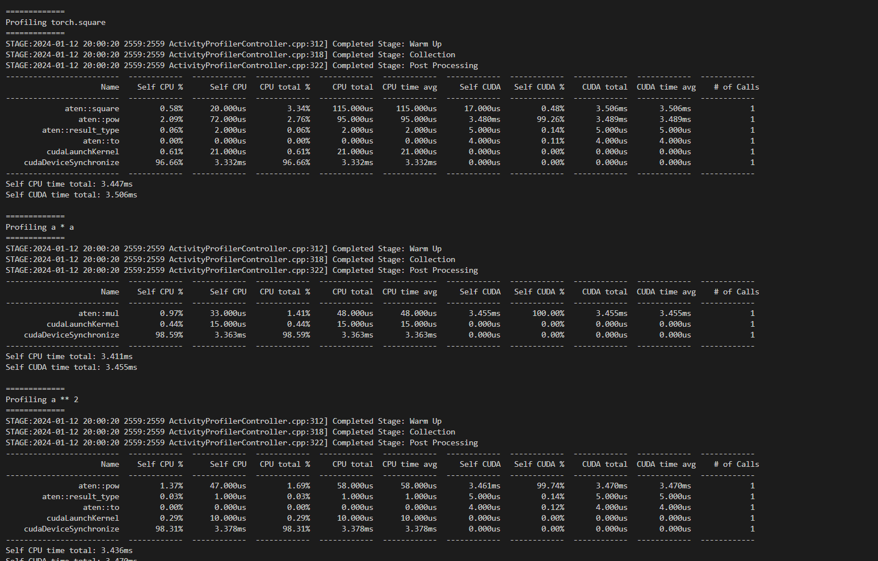
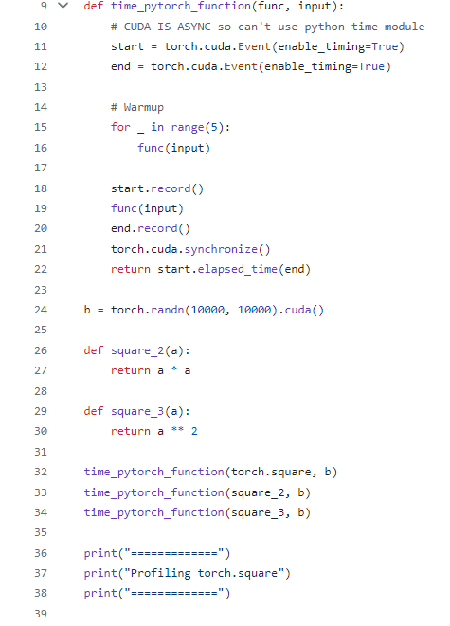
Start with something simple
https://github.com/msaroufim/cudamodelecture1/blob/main/pytorch_square.py

Slide 5
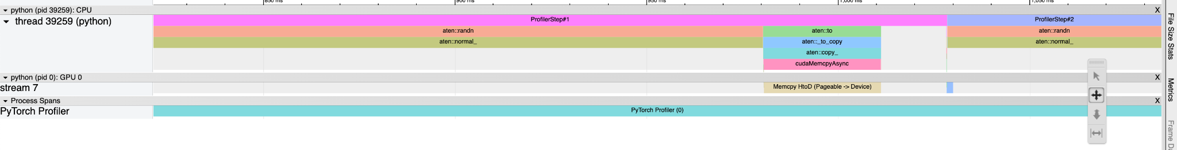
PyTorch profiler
Memcpy HtoD (Pageable -> Device)
Host to device copy
Pageable memory is on host but can be copied freely in out of RAM
https://github.com/msaroufim/cudamodelecture1/blob/main/pt_profiler.py

Slide 6
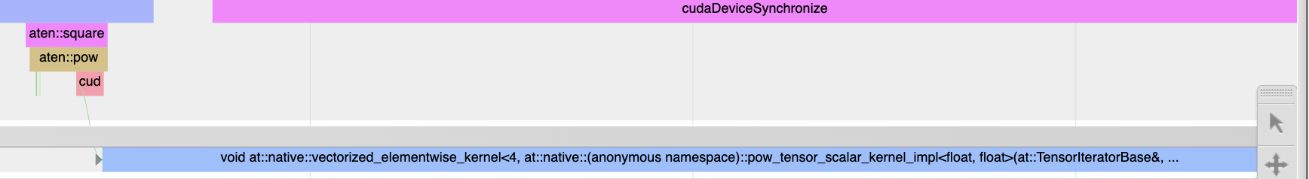
What can we learn?
Aten::square is a call to aten:pow
A cuda kernel gets launched called native_vectorized_elementwise_kernel<4, ..>
4 is the number of blocks
https://github.com/pytorch/pytorch/blob/main/caffe2/utils/math/elementwise.cu

Slide 7
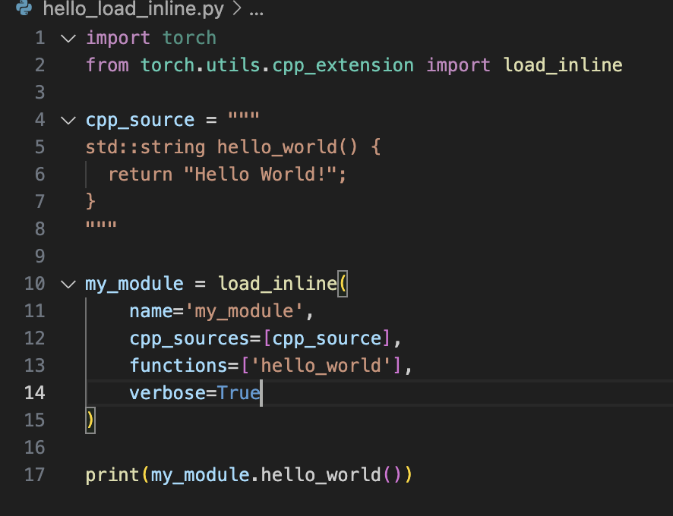
Custom cpp extensions
https://github.com/msaroufim/cudamodelecture1/tree/main/tmp

Slide 8
Codegen
#include <torch/extension.h>
std::string hello_world() {
return "Hello World!";
}
PYBIND11_MODULE(TORCH_EXTENSION_NAME, m) {
m.def("hello_world", torch::wrap_pybind_function(hello_world), "hello_world");
}

Slide 9
How to run a CUDA kernel from pytorch
https://github.com/msaroufim/cudamodelecture1/blob/main/load_inline.py

Slide 10
numba
https://gist.github.com/msaroufim/6673c9e5c0c3d58740472601eac6d4df

Slide 11
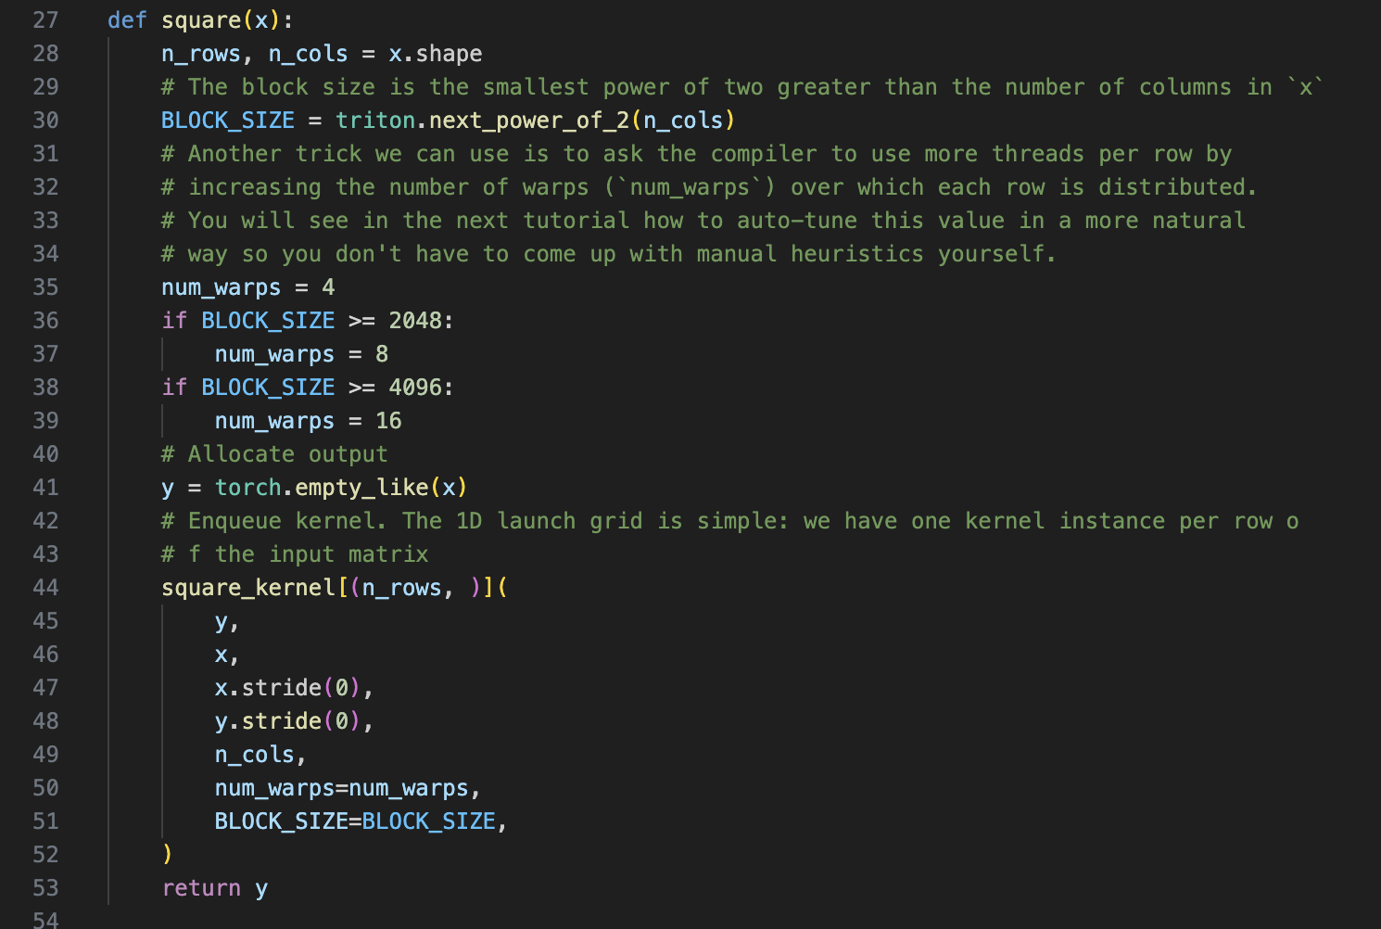
Integrate a triton kernel

Slide 12
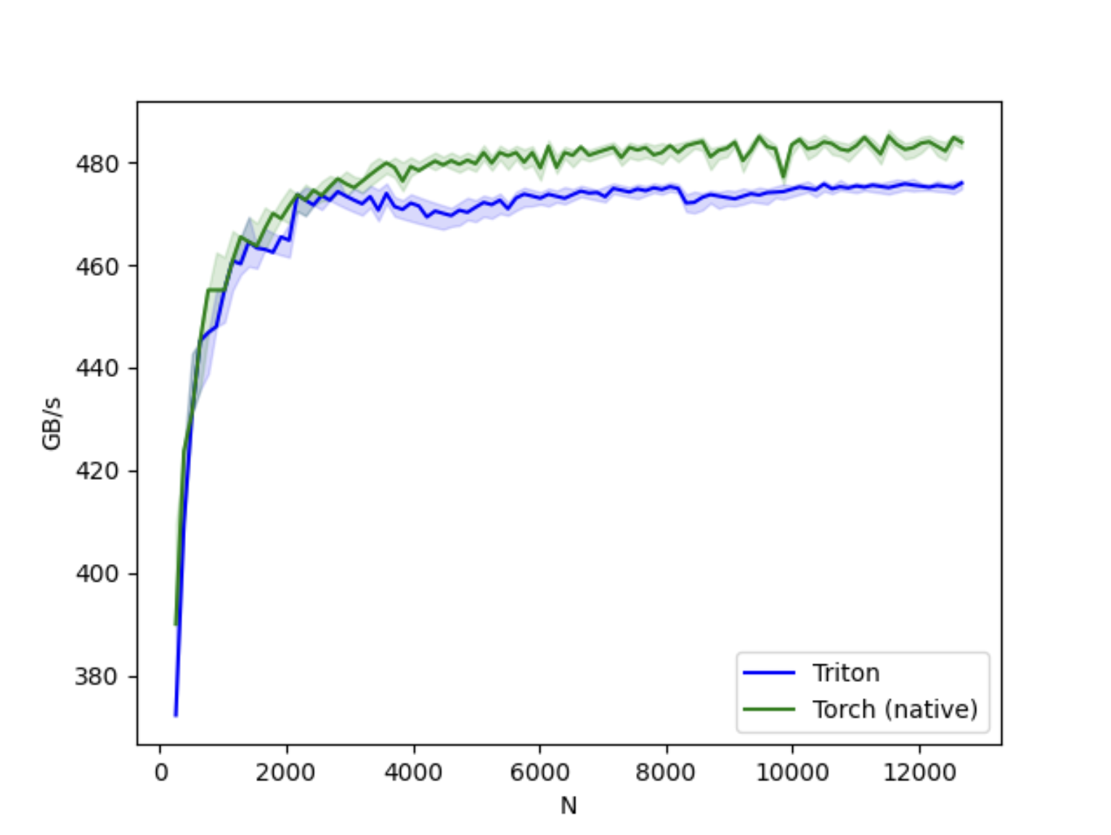
Triton kernel on A10G
https://gist.github.com/msaroufim/8649307ecdbb9309ced2d5106073bc0c

Slide 13
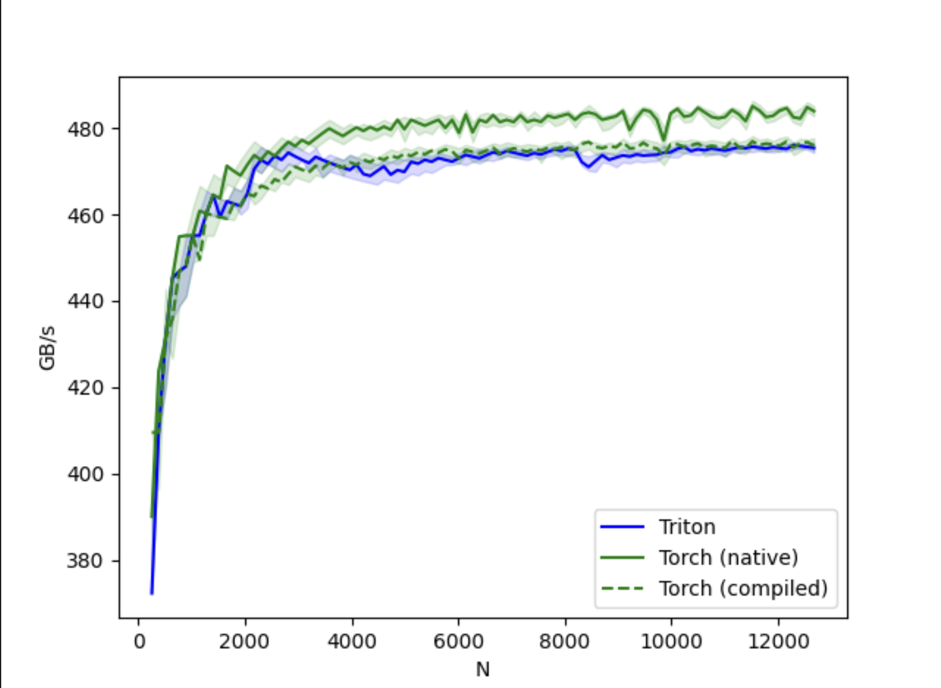
torch.compile

Slide 14
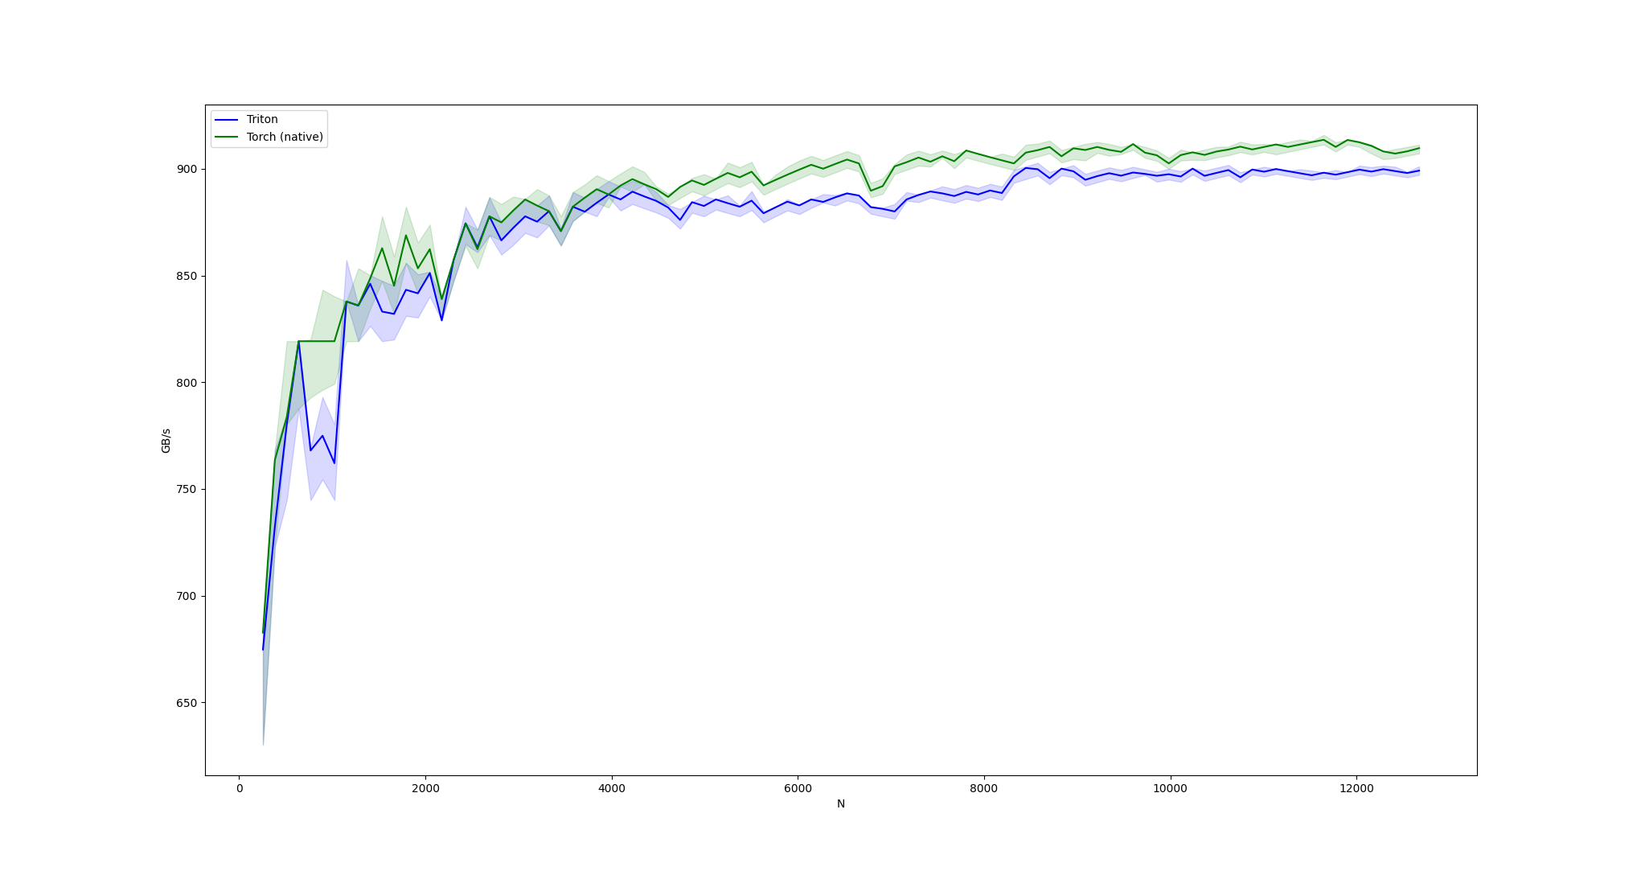
Results on 4090

Slide 15
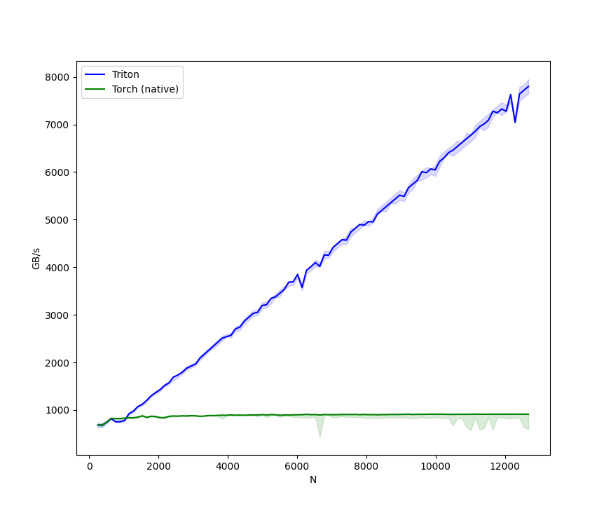
After fixing the block size to 1024

Slide 16
Triton has a debugger now
triton.jit(interpret=True)
Almost everything is a WrappedTensor so inspect variables with var_name.tensor
https://gist.github.com/msaroufim/f849df30687708782e0269c4b42264b1

Slide 17
Look at PTX
https://github.com/msaroufim/cudamodelecture1/blob/main/square_kernel.ptx
8 registers with a self multiplication for input
8 registers for output
.loc 1 19 26
mul.f32 %f9, %f1, %f1;
mul.f32 %f10, %f2, %f2;
mul.f32 %f11, %f3, %f3;
mul.f32 %f12, %f4, %f4;
mul.f32 %f13, %f5, %f5;
mul.f32 %f14, %f6, %f6;
mul.f32 %f15, %f7, %f7;
mul.f32 %f16, %f8, %f8;

Slide 18
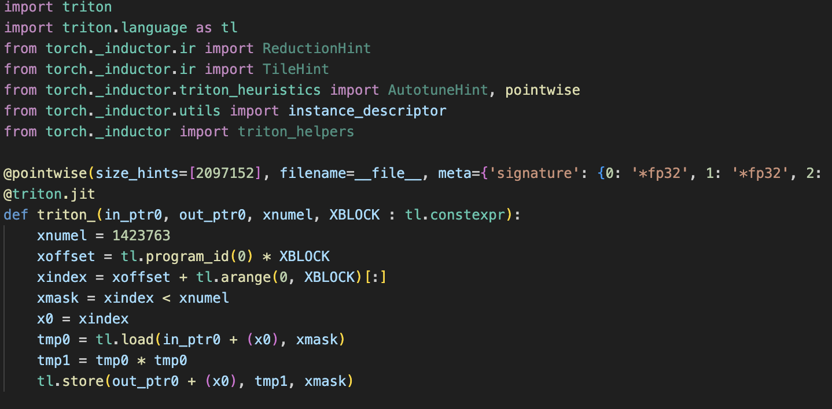
Cheat: Generate a triton kernel
TORCH_LOGS="output_code" python compile_square.py
torch.compile(torch.square))

Slide 19
ncu profiler
ncu python train.py
ncu --set full -o output $(which python) train.py
https://github.com/msaroufim/cudamodelecture1/blob/main/ncu_logs
Contains actionable hints like
OPT This kernel grid is too small to fill the available resources on this device, resulting in only 0.4 full waves across all SMs. Look at Launch Statistics for more details.

Slide 20
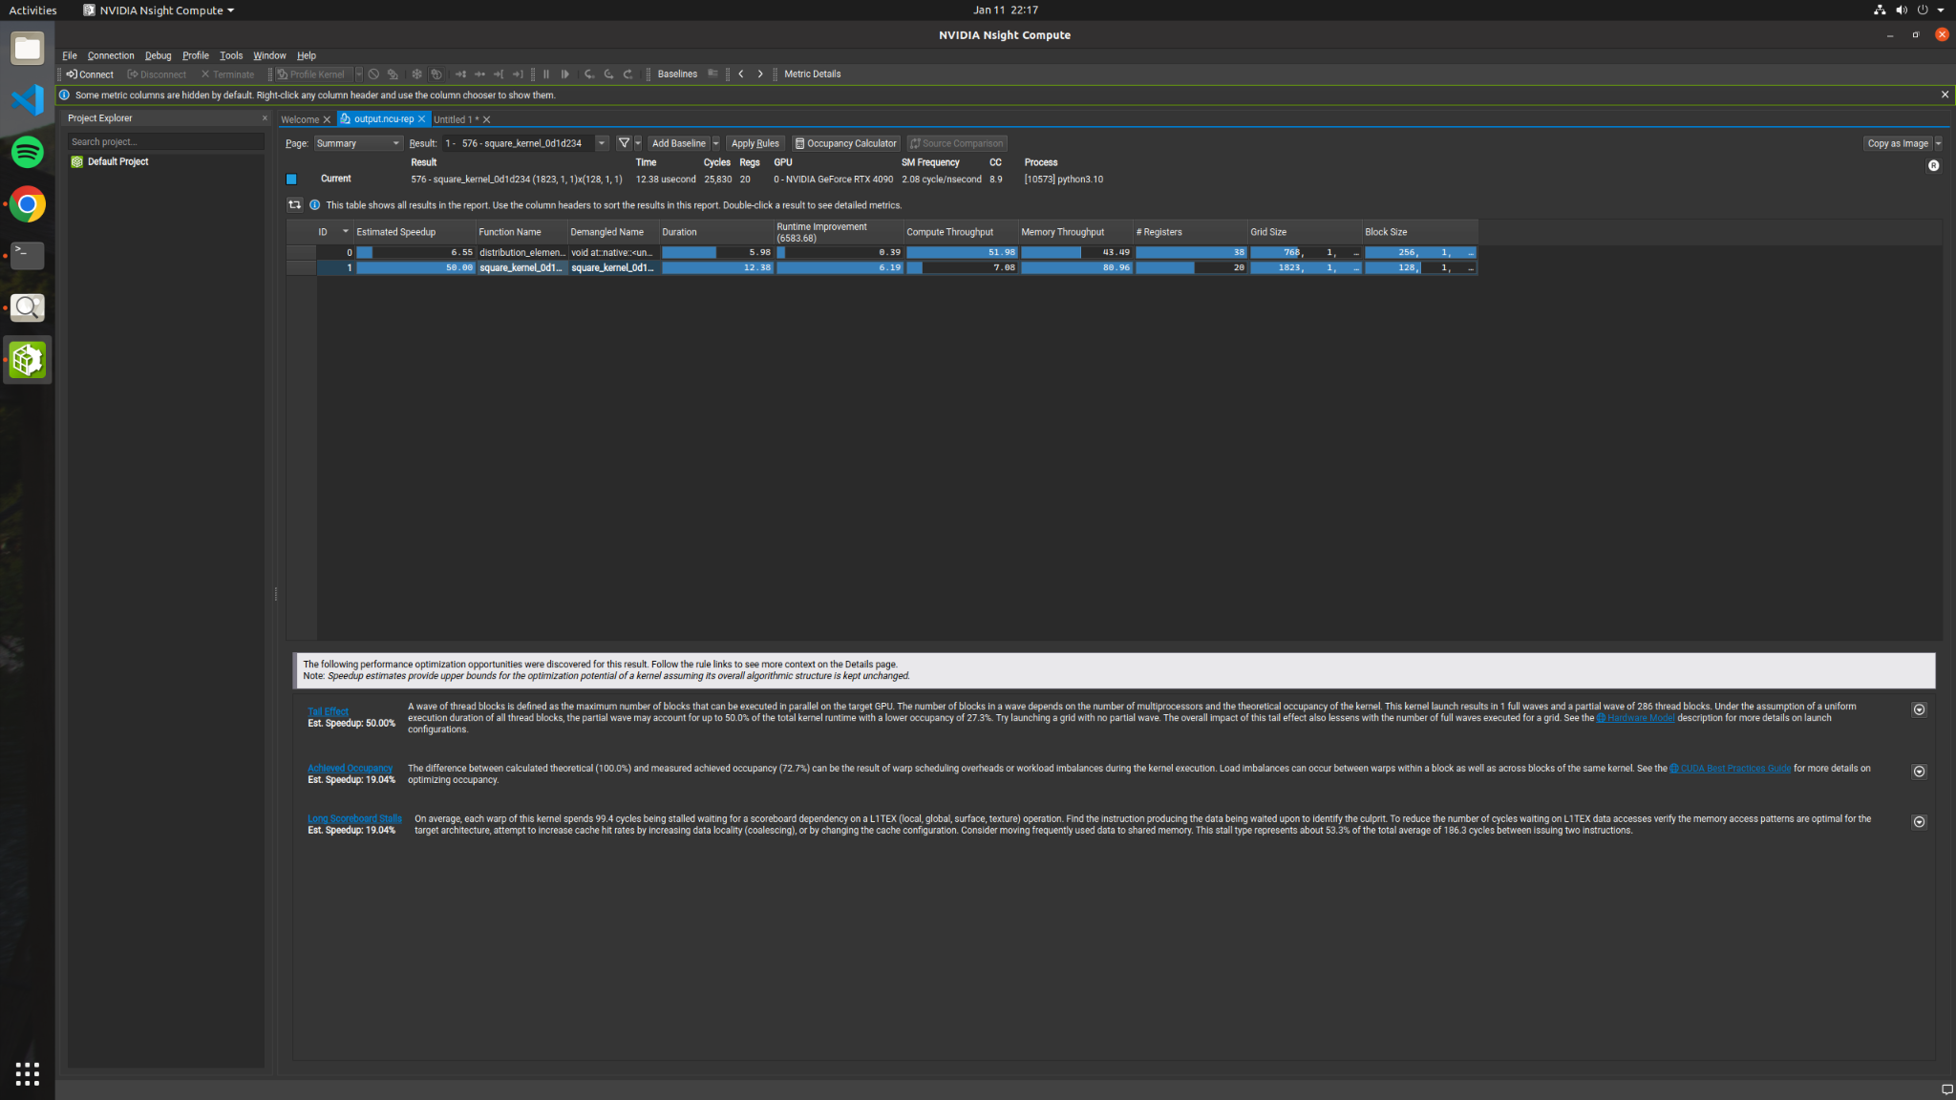

Slide 21
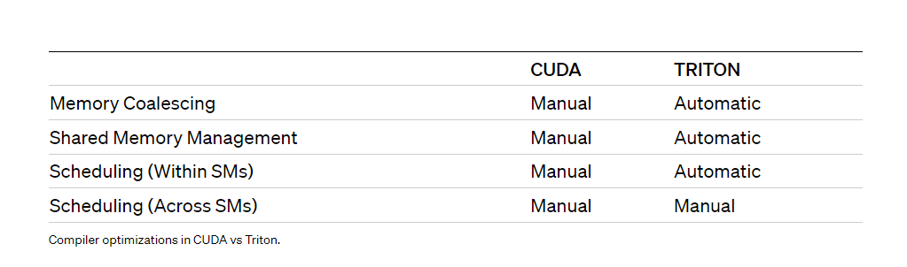
Zoom in
Tail effect + Achieved occupancy 70%: Try padding (We can control)
Long scoreboard stalls: coalesce, use shared memory (Controlled by Triton :( )

Slide 22
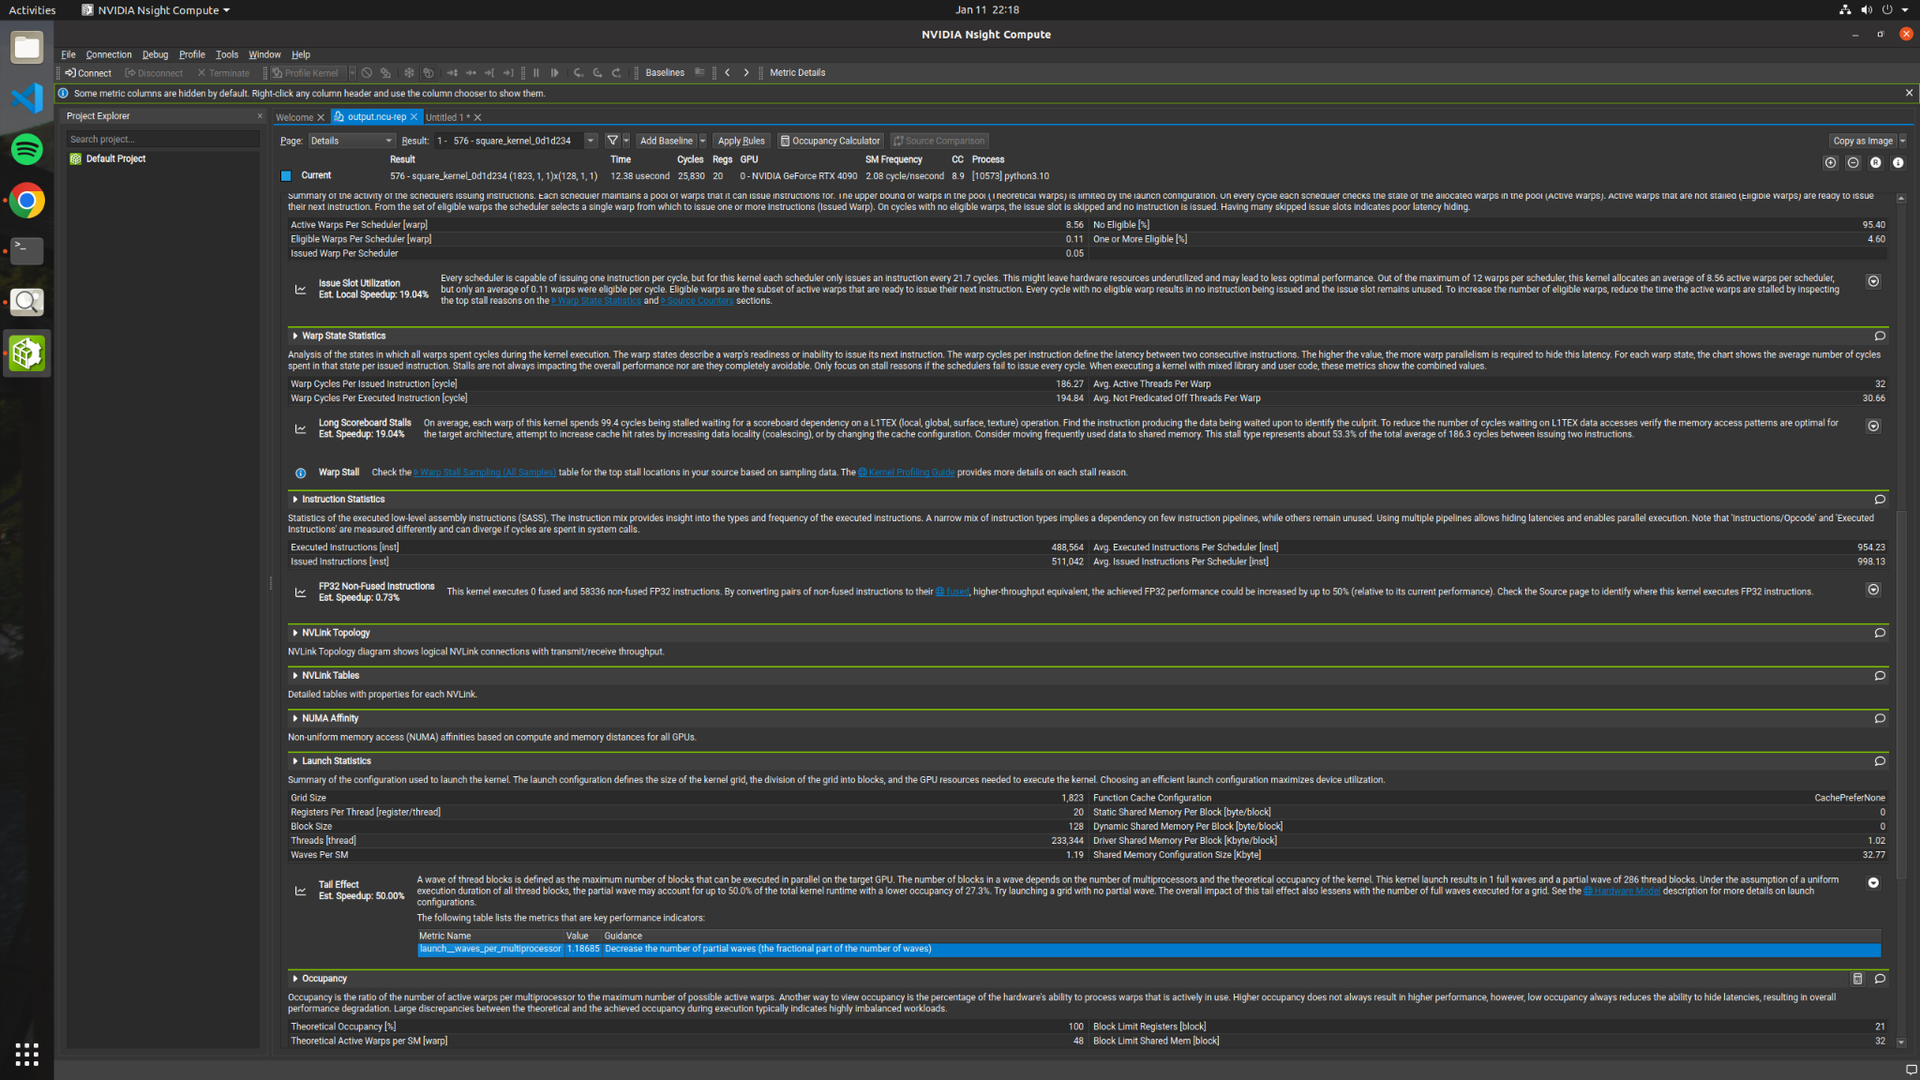

Slide 23
