Slide 1
Flutter
An installation guide

Slide 2
What is Flutter
Flutter is an open-source UI software development kit created by Google. It is used to develop cross platform applications for Android, iOS, Linux, Mac, Windows, Google Fuchsia, and the web from a single codebase. The first version of Flutter was known as codename "Sky" and ran on the Android operating system.

Slide 3
Language
Dart
Dart is a programming language designed for client development, such as for the web and mobile apps. It is developed by Google and can also be used to build server and desktop applications. Dart is an object-oriented, class-based, garbage-collected language with C-style syntax.

Slide 4
Why Flutter
Nowadays, most of the companies are enthusiastic about flutter. It is mainly because one can develop applications for Android, iOS, Windows, Mac, Linux, and web from a single codebase. Despite fast development and flexible UI, many developers still want to hold on to the React Native.

Slide 5
Installation
Go to -> https://flutter.dev/docs/get-started/install
Select OS of the machine you are currently working on

Slide 6
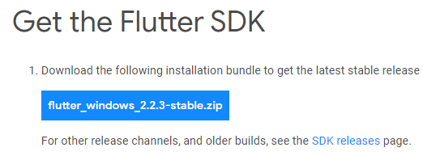
Download Flutter SDK
Click on the flutter_windows_stable.zip
Your download will start

Slide 7
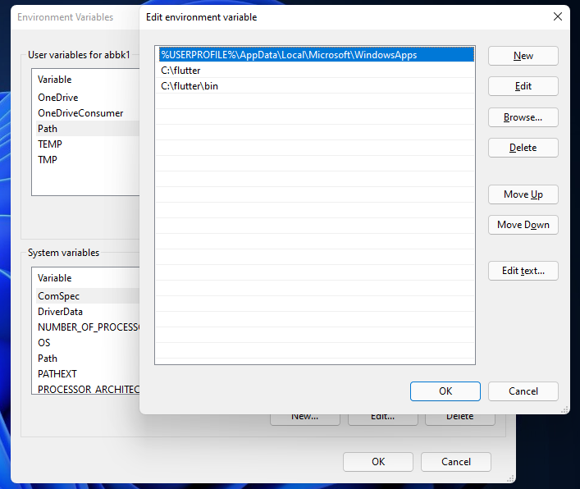
Environment Variable
From the Start search bar, enter ‘env’ and select Edit environment variables for your account.
Under User variables check if there is an entry called Path:
If the entry exists, append the full path to flutter\bin using ; as a separator from existing values.
If the entry doesn’t exist, create a new user variable named Path with the full path to flutter\bin as its value.

Slide 8
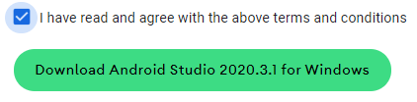
Installation of Android Studio
Go to -> https://developer.android.com/studio
Click Download Android Studio
Check I have read and agree with the above terms and conditions
Click Download android studio for windows

Slide 9
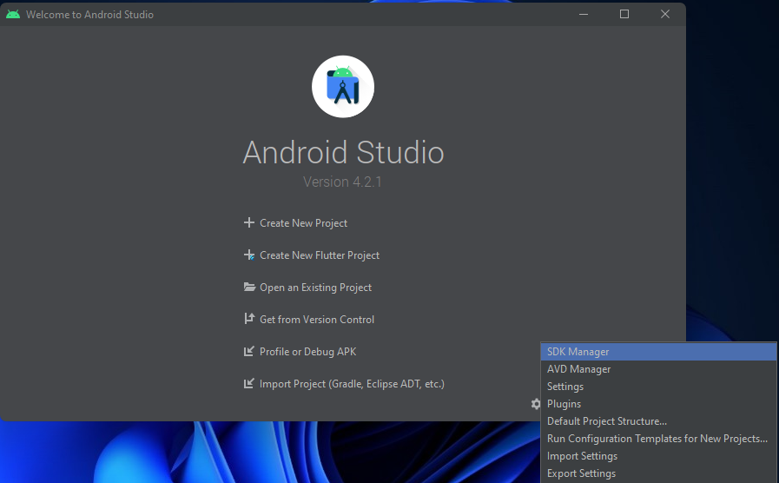
Flutter Configuration in Android Studio
On the bottom right click Configure then Plugins

Slide 10
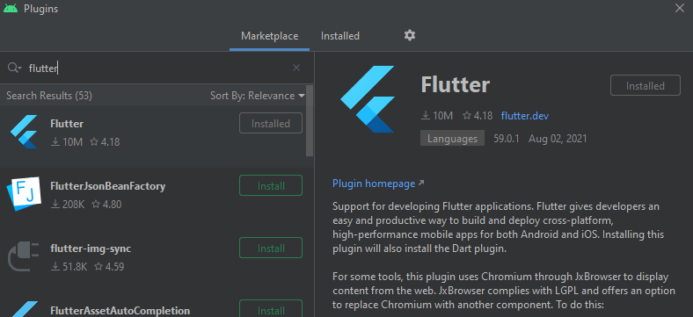
Flutter Configuration in Android Studio
Search for flutter
Click install
Then it will prompt to install dart with it
Click OK
Now restart Android Studio

Slide 11
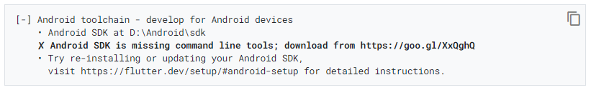
Flutter Doctor
Open Cmd
Type Flutter doctor
Press Enter
You’ll see some errors they will be resolved in next few steps

Slide 12
Issues with Flutter Doctor
Android licenses
To resolve open CMD, run
The issue will be resolved
flutter doctor --android-licenses

Slide 13
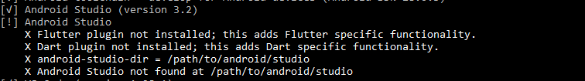
Issues with Flutter Doctor
Android Studio not found
If Flutter cannot locate it, run
flutter config --android-studio-dir <directory>
to set the directory that Android Studio is installed to.

Slide 14
Android Virtual Device
To setup the android virtual device download Genymotion
Go to -> https://www.genymotion.com/

Slide 15
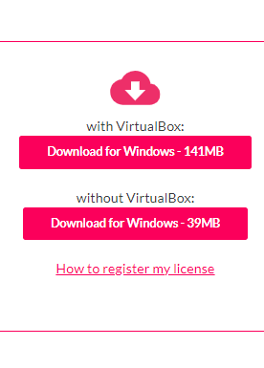
Genymotion
Download with virtual Box

Slide 16
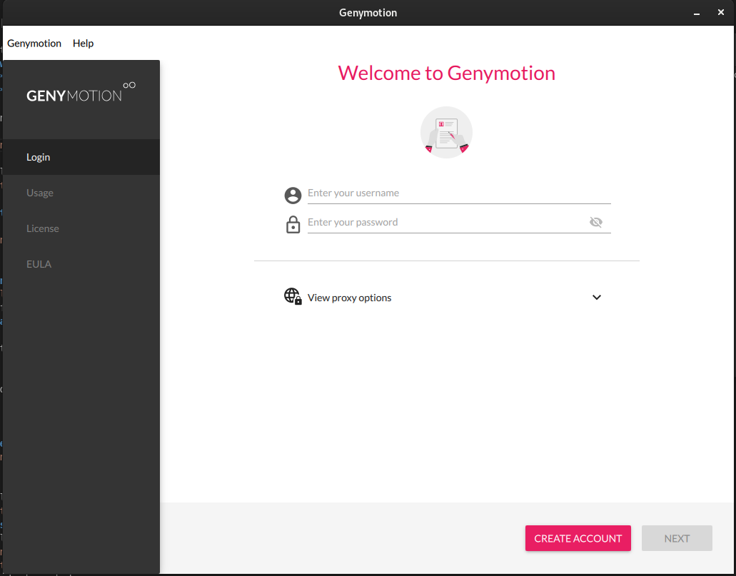
Create account
After following the installation steps Create Account
Login using that account

Slide 17
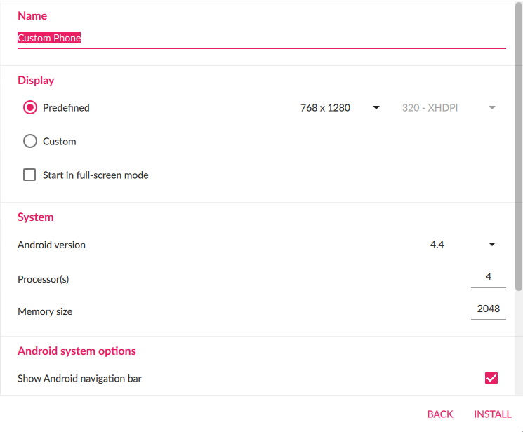
Create device
From the top right corner Click Add Device
After that choose the desired device and select install

Slide 18
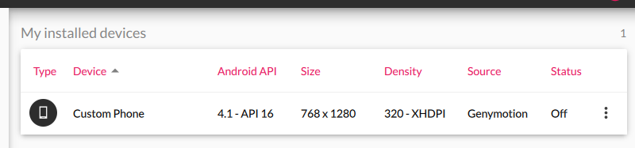
Start device
Once the device installation is completed, you’ll see the device in the main screen
Click on the 3 dots and select start

Slide 19
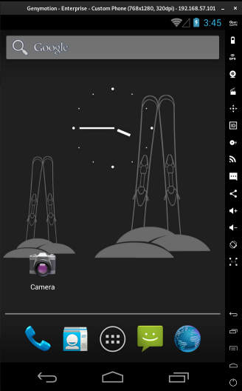
Your Android Virtual Device is successfully created

Slide 20
Physical Device
To Connect a physical device with Android Studio
Connect the mobile using a cable
Go to About phone
Tap build number multiple times until you see “You are now a developer”
Go to developer options and enable USB debugging.
Your mobile is now connected

Slide 21
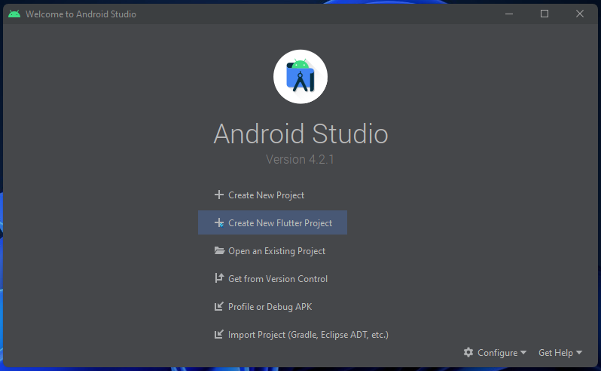
Create first Application
Open Android Stuidio
Click Create a new Flutter project

Slide 22
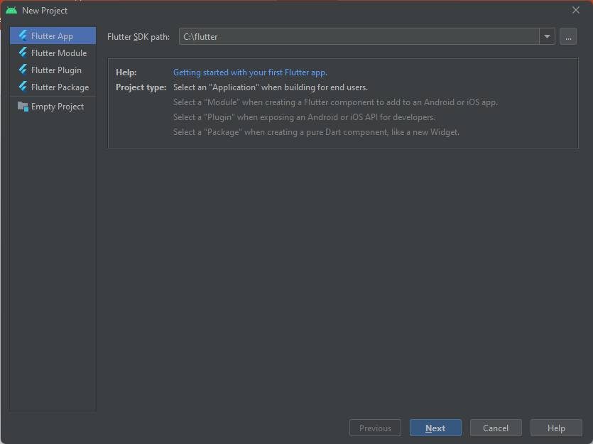
SDK Path
Give path to Flutter SDK
Click Next

Slide 23
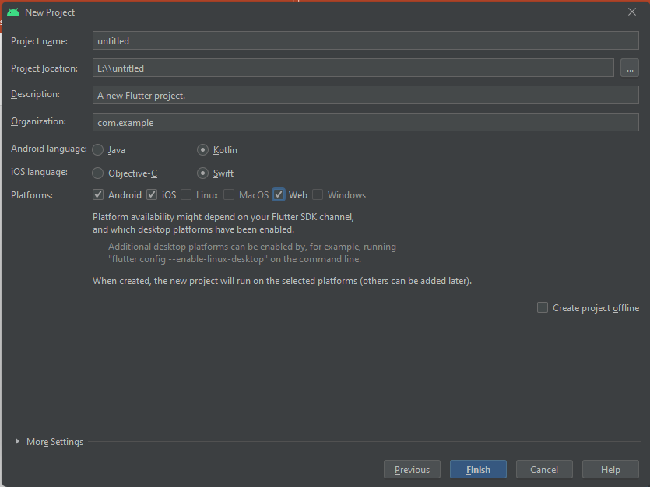
Project Setting
Setup the project according to needs
Click Finish
And your first App is created

Slide 24
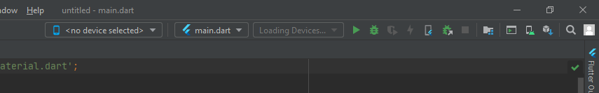
Run App
To run the app on AVD
Start Genymotion
You will see the Device name in the Android Studio Window
Just hit the Start Button

Slide 25
Run App
To run the app on Physical Device
Connect mobile to PC and perform the above mentioned steps (if not)
You will see the Device name in the Android Studio Window
Just hit the Start Button

Slide 26
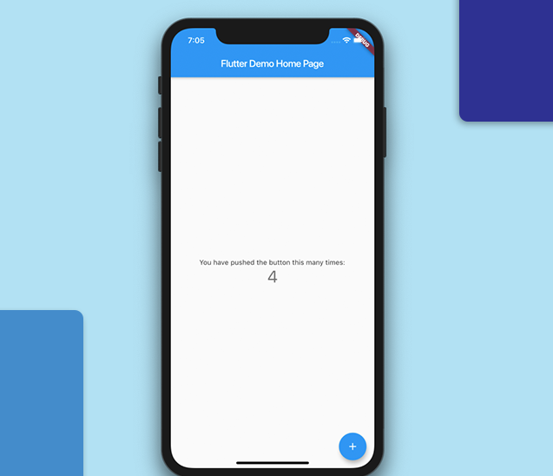
Your first App
This will create an app of Counter
You can now start coding

Slide 27
THE END ☺

