Slide 1
AI Study Buddy
AI Powered Learning Platform with
Complete DevOps & Cloud Integration
Presented By: Rahul Tyagi
Reg. No: 12319156
Subject Code: INT377
Faculty Mentor: Ms. Arshiya
Technology Stack: Python · Streamlit · Docker · Jenkins · Terraform · Kubernetes · AWS · Prometheus · Grafana

Slide 2
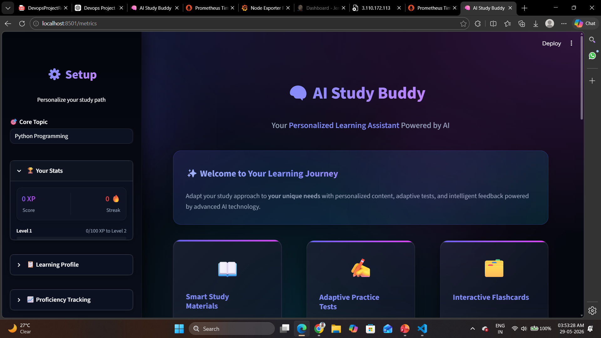
Introduction to AI Study Buddy
What is AI Study Buddy?
An intelligent educational assistant platform that helps students interact with AI for learning support, doubt solving, and academic guidance.
📷
Streamlit Dashboard
Main Objectives
Key Features
Create an AI-powered study platform
Implement professional DevOps workflow
Automate deployment process
Monitor performance in real time
Deploy scalable infrastructure on AWS
AI chatbot integration
Streamlit-based UI
Cloud deployment
Containerized architecture
Monitoring dashboards
CI/CD automation
📷
AI Chatbot Interface
AI Study Buddy | Rahul Tyagi | 2 / 15

Slide 3
Challenges in Traditional Systems
❌ Problems Faced
Need for DevOps
✅ Our Solution
Manual deployment processes
Difficult application scaling
No automated monitoring
High downtime during updates
Environment inconsistency
Dependency conflicts
Traditional deployment methods are slow and error-prone. Modern apps require automation, scalability, reliability, and continuous monitoring.
Docker for containerization
Jenkins for CI/CD
Terraform for infrastructure automation
Kubernetes for orchestration
Prometheus & Grafana for monitoring
AI Study Buddy | Rahul Tyagi | 3 / 15

Slide 4
Tools & Technologies Used
Category | Tools Used
Frontend | Streamlit
Backend | Python
AI Integration | Gemini API
Version Control | Git & GitHub
Containerization | Docker
Multi-Container Mgmt | Docker Compose
CI/CD | Jenkins
Infrastructure as Code | Terraform
Cloud Platform | AWS EC2
Orchestration | Kubernetes
Monitoring | Prometheus & Grafana
GitHub
Source code management
Docker
Application containerization
Jenkins
Automation pipeline
Terraform
AWS infrastructure automation
Kubernetes
Container orchestration
Prometheus
Metrics collection
Grafana
Visualization dashboards
AI Study Buddy | Rahul Tyagi | 4 / 15

Slide 5
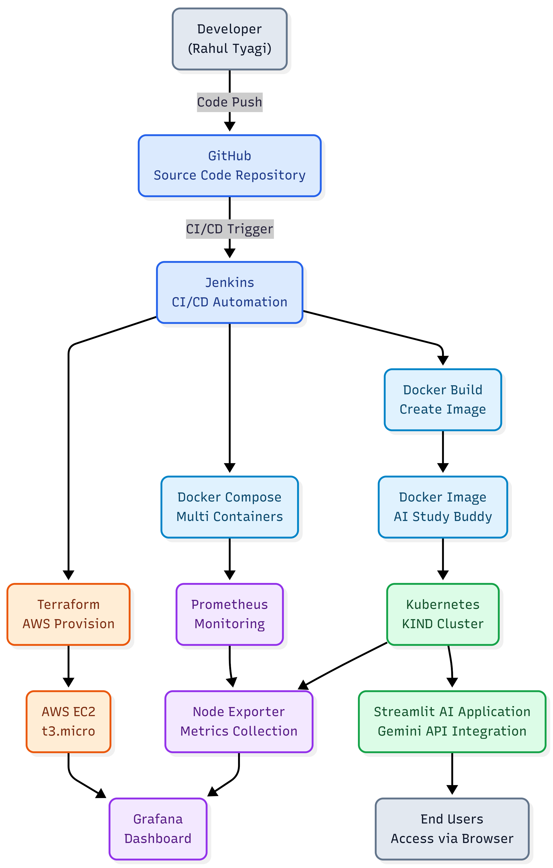
Complete Project Architecture
1
Developer pushes code to GitHub
5
Terraform provisions AWS resources
2
Jenkins pipeline triggers automatically
6
Kubernetes manages containers
3
Docker image gets built
7
Prometheus collects metrics
4
Containers are deployed
8
Grafana displays dashboards
Infrastructure: AWS EC2 Ubuntu · 20 GB EBS · Dockerized Services · Kubernetes Cluster · Monitoring Stack
AI Study Buddy | Rahul Tyagi | 5 / 15

Slide 6
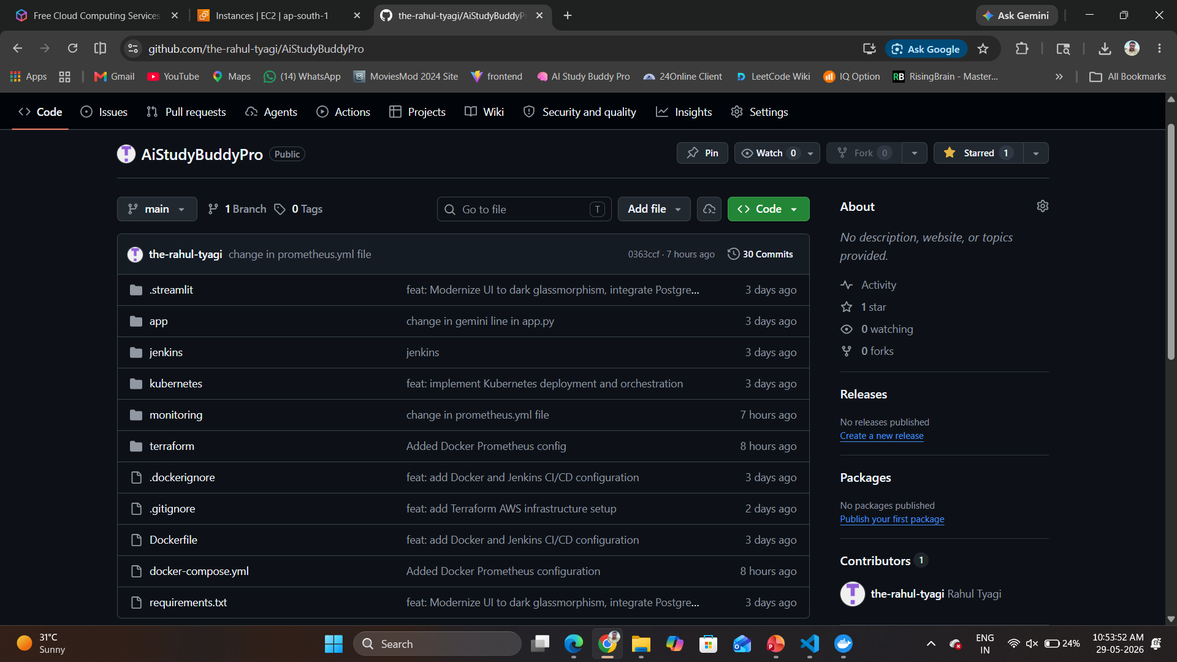
Version Control & Repository Management
Git Workflow Used
Benefits
Code development in VS Code
Git commit for version tracking
GitHub repository hosting
Branch-based workflow
Version tracking
Team collaboration
Backup & recovery
CI/CD integration
Commands Used
git init
git add .
git commit -m "Initial Commit"
git push origin main
git clone <repo-url>
AI Study Buddy | Rahul Tyagi | 6 / 15

Slide 7
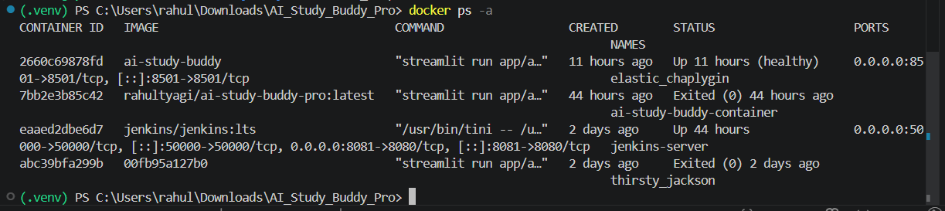
Application Containerization
Why Docker?
Docker packages the application and its dependencies together for portability and consistency across environments.
Docker Components
Ports Used
Dockerfile
Docker Images
Docker Containers
Docker Compose
Service | Port
Streamlit App | 8501
Grafana | 3000
Prometheus | 9090
Jenkins | 8081
Docker Commands Used
docker build -t ai-study-buddy .
docker run -d -p 8501:8501 ai-study-buddy
docker ps
docker images
AI Study Buddy | Rahul Tyagi | 7 / 15

Slide 8
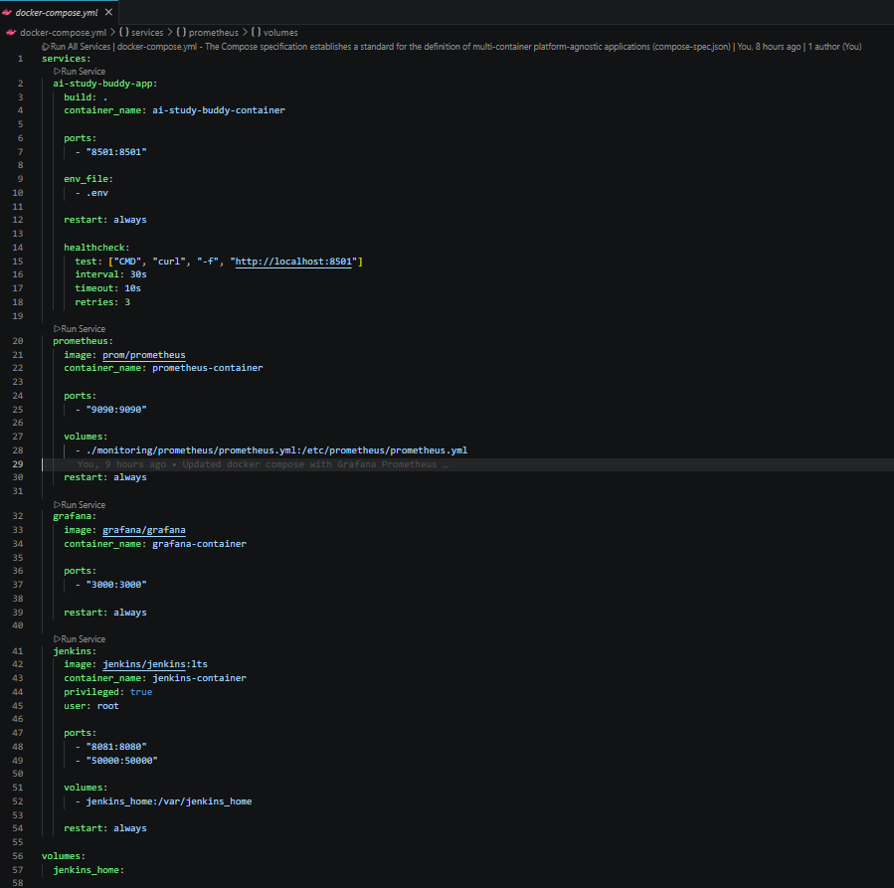
Multi-Container Deployment
Services Configured
Compose Benefits
AI Application
Prometheus
Grafana
Jenkins
Easy multi-container deployment
Simplified networking
Single command deployment
Commands Used
Challenges & Solutions
docker compose up -d
docker compose down
docker compose logs
Port conflicts → Updated compose config
No space on device → Expanded EBS volume
Container conflicts → Removed orphan containers
AI Study Buddy | Rahul Tyagi | 8 / 15

Slide 9
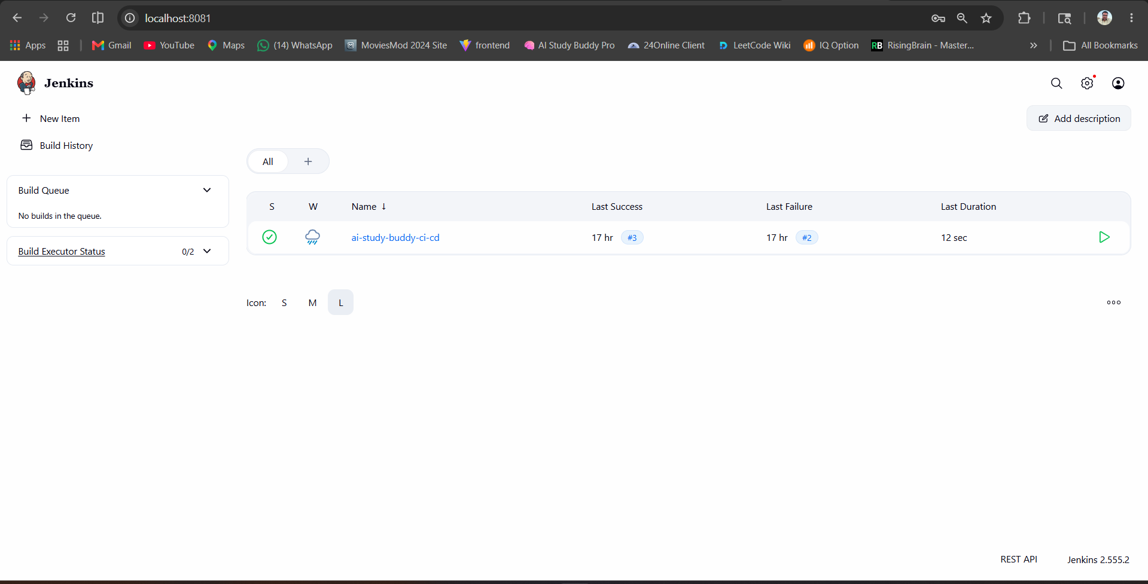
Continuous Integration & Continuous Deployment
Pipeline Stages
Jenkins Plugins
1. Source Code Fetch
Docker Plugin
Git Plugin
Pipeline Plugin
Blue Ocean Plugin
2. Docker Build
3. Image Deployment
Benefits
4. Container Verification
Automated deployment
Faster delivery
Reduced manual errors
Continuous integration
5. Monitoring Integration
docker run -d -p 8081:8080 jenkins/jenkins:lts
AI Study Buddy | Rahul Tyagi | 9 / 15

Slide 10
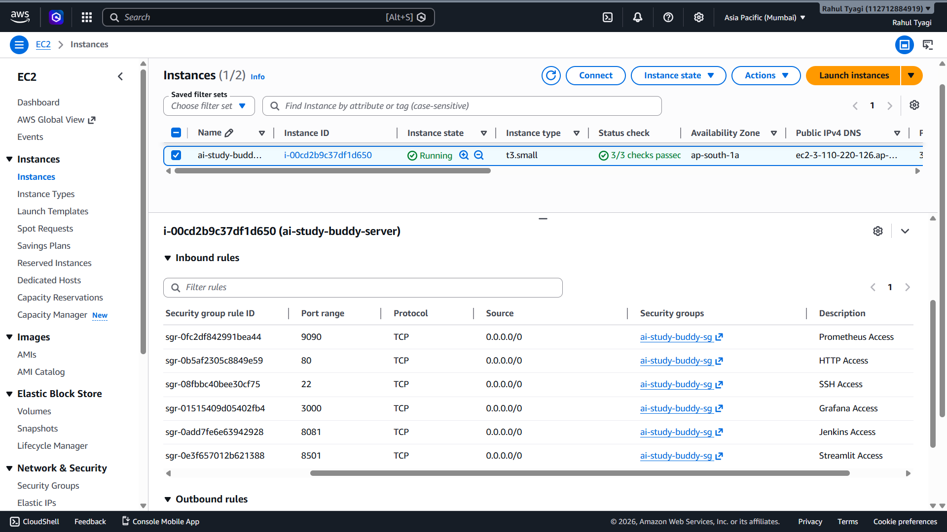
Cloud Infrastructure Setup
AWS Services Used
Security Group Ports
EC2 Instance
EBS Volume
Security Groups
Port | Service
22 | SSH
8501 | Streamlit
3000 | Grafana
9090 | Prometheus
8081 | Jenkins
EC2 Configuration
Configuration | Value
Instance Type | t3.small
OS | Ubuntu 24.04
Storage | 20 GB
Region | ap-south-1
AI Study Buddy | Rahul Tyagi | 10 / 15

Slide 11
Infrastructure as Code
Why Terraform? — Terraform automates cloud infrastructure provisioning, making it version-controlled, repeatable, and reusable.
Workflow
Commands Used
1. Write .tf configuration
2. Initialize Terraform
3. Validate configuration
4. Apply infrastructure
terraform init
terraform validate
terraform plan
terraform apply
Benefits: Automated provisioning · Reusable infrastructure · Version-controlled infrastructure
AI Study Buddy | Rahul Tyagi | 11 / 15

Slide 12
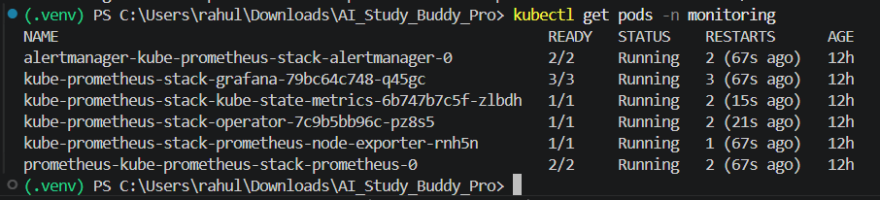
Container Orchestration
Kubernetes Setup
K8s Features
Component | Count
Cluster | 1
Master Node | 1
Worker Node | 1
Pods | 2–3
Pod management
Scaling capability
Self-healing containers
Load balancing
Commands Used
kubectl get pods
kubectl get nodes
kubectl apply -f deployment.yml
AI Study Buddy | Rahul Tyagi | 12 / 15

Slide 13
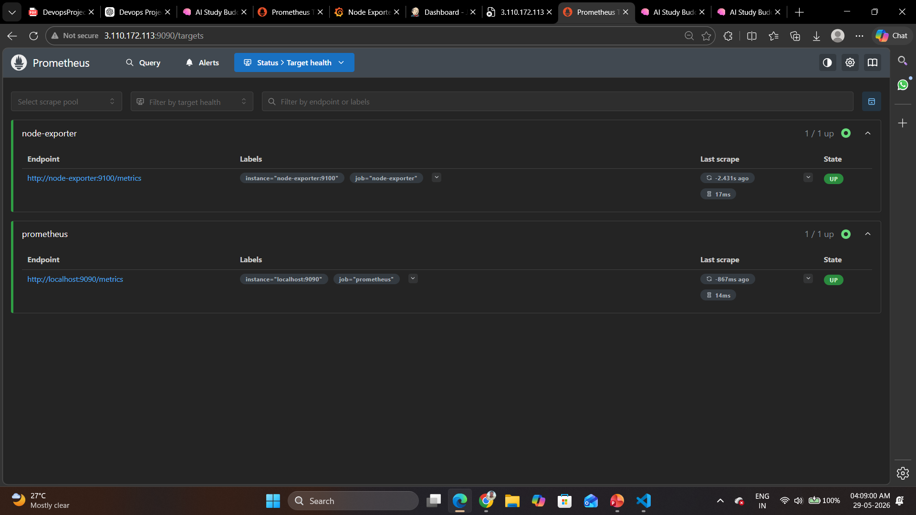
Real-Time Monitoring
Prometheus
Grafana
Collects system metrics
Monitors containers
Tracks CPU and memory usage
Dashboard visualization
Real-time analytics
Performance monitoring
URLs Used
Tool | URL
Grafana | http://IP:3000
Prometheus | http://IP:9090
AI Study Buddy | Rahul Tyagi | 13 / 15

Slide 14
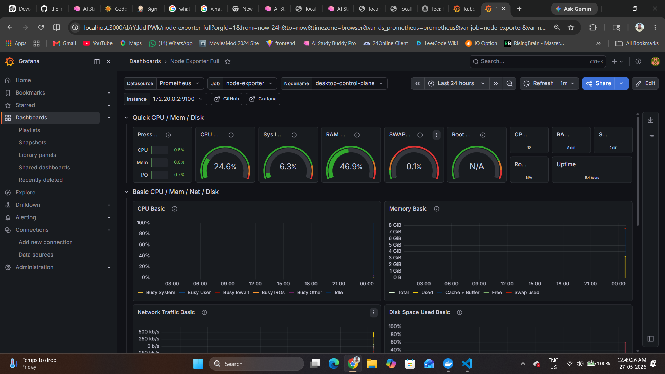

Slide 15
Problems Faced During Development
Challenge | Solution
Docker permission denied | Added user to docker group
Port conflicts | Updated compose configuration
No space left on device | Increased EBS volume
Jenkins container exit | Restarted container
Security group issue | Opened required ports
Container conflicts | Removed orphan containers
Key Learning: Real-world DevOps requires troubleshooting, debugging, and infrastructure optimization.
AI Study Buddy | Rahul Tyagi | 14 / 15

Slide 16
Project Outcome
Achievements
Skills Gained
Deployed AI platform on AWS
Full DevOps lifecycle
Automated deployment pipeline
Real-time monitoring enabled
Learned industry-level workflow
Docker
Kubernetes
Terraform
Jenkins
AWS Cloud
Monitoring & Observability
Future Enhancements
HTTPS domain integration
Auto scaling
Database integration
Multi-node Kubernetes cluster
Load balancer implementation
AI Study Buddy | Rahul Tyagi | 15 / 15

