Slide 1
Detection of plant leaf diseases using image segmentation and soft computing techniques
Darekar Akshay Yuvraj
1911MT05 M.tech Mechatronics

Slide 2
Why detect Plant Leaf Diseases?
Automatic detection reduces large work of monitoring
Helps in early stage of infection
Database from previous infection helps for analysis on infection history

Slide 3
Process overview
Image Acquisition
Image smoothing
Contrast Enhancement
Calculate Co-occurrence matrices of HSI
Obtain important segments
Segment using Genetic Algorithm
Calculate texture features
Classify using KNN & SVM
Analyse the results

Slide 4
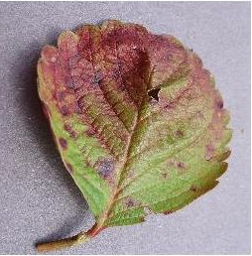
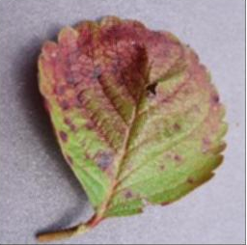
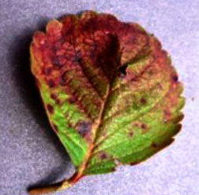
Image smoothening and Enhancement
The image is smoothed using mean filter 3x3
The contrast is enhanced using histogram equalisation
Original
Smoothed
Enhanced

Slide 5
Segment Using Genetic Algorithm.
Overview of genetic algorithm
Initialise no of clusters
Initialise population. Each chromosome in population is set of cluster centres.
Replace the cluster centres with centroid of each cluster for each chromosome.
Select best chromosomes using fitness function and Roulette wheel selection
Cross-over by interchanging the co-ordinates
Mutate the chromosome.
Add the chromosome in population and repeat for number of iterations

Slide 6
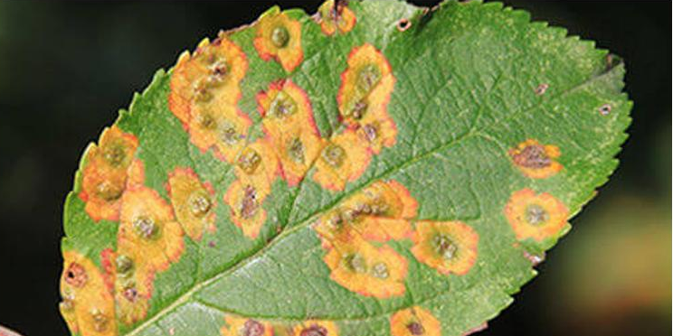
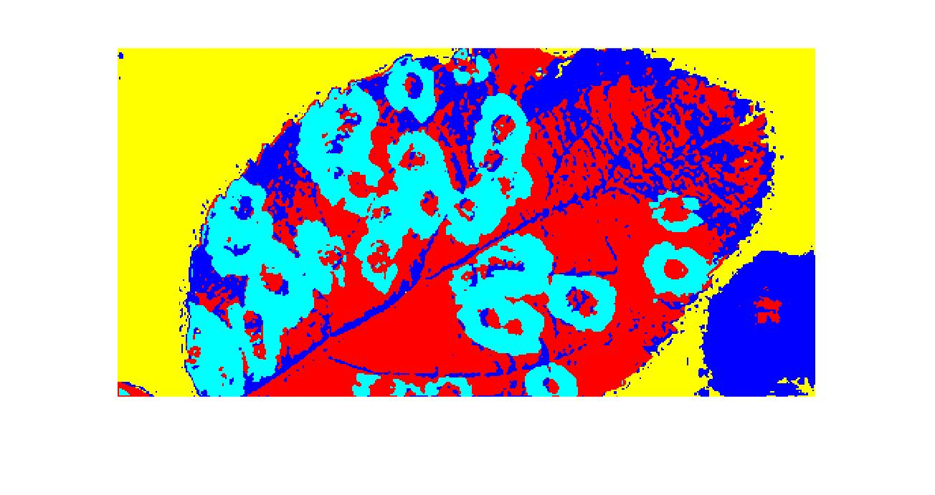
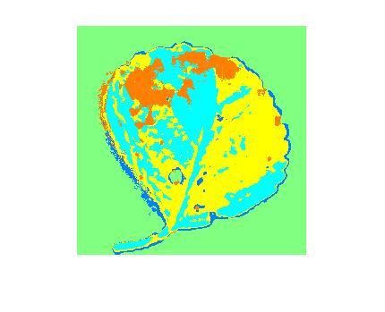
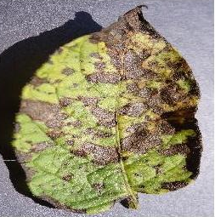
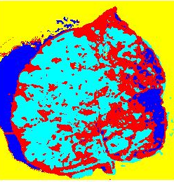
Segment using genetic Algorithm

Slide 7
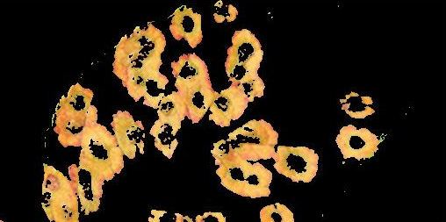
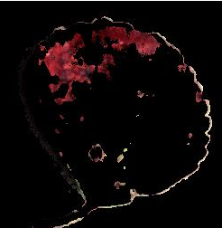
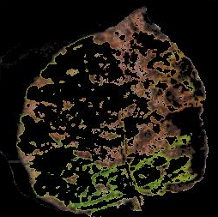
Obtain Useful segments
Based on segmented image, background cluster is masked
And Green clusters are also masked

Slide 8
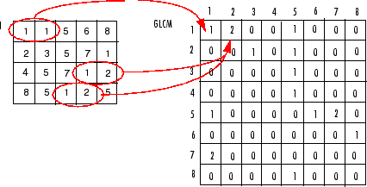
Calculate Co-occurrence Matrix
Convert the useful segments to HSV
Get co-occurrence matrix for each H, S and V matrix
Source – mathworks.com

Slide 9
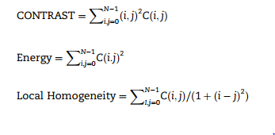

Get texture features from GLCM
Get features like contrast, local homogeneity, Energy and Entropy.
4 features per matrix. Hence total 4x3 = 12 features
Source : Paper

Slide 10
Classification Using KNN and SVM
After getting the features. The data is stored in a CSV or any file format.
This data is used for classification of new images.
KNN or K-Nearest neighbour or Minimum distance classifier.
In the above method, the distance between the concerned point and all points is considered. The point is labelled with the label to which it is most nearest.
In SVM or Support Vector Machine , Hyper planes are found in such a way that they separate different classes. These depend on type of kernel Eg) Radial kernel.

Slide 11
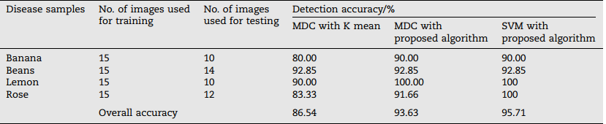
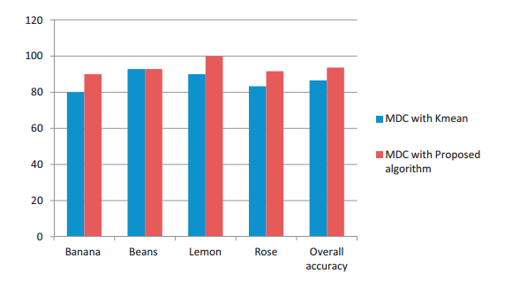
Results of Paper

Slide 12
Results of my project
I took the plant leaf dataset from https://www.kaggle.com/vipoooool/new-plant-diseases-dataset
Two plants were considered Potato and Strawberry
From Potato two classes Healthy and Early blight disease
From Strawberry two classes Healthy and Leaf scorch disease

Slide 13
Contd : Results of my Project
Disease Samples | No of training images | No of testing images | Detection accuracy %
 |  |  | MDC with K-means | MDC with proposed algorithm | SVM with K-means | SVM with proposed algorithm.
Potato | 1021 | 941 | 79.70 | 79.71 | 74.17 | 77.22
Strawberry | 1377 | 900 | 80.88 | 84.11 | 81.556 | 86.22
Overall Accuracy |  |  | 80.29 | 81.91 | 77.863 | 81.72

Slide 14
Thank you

