Slide 1


Housing and Neighborhood Development
Alan Joles, Director
Office of Community Planning and Development
Minneapolis HUD Field Office

Slide 2



HUD Strategic Goals
Increase homeownership opportunities
Promote decent affordable housing
Strengthen communities
Ensure equal opportunity in housing
Embrace high standards of ethics, management, and accountability
Promote participation of faith-based and community organizations

Slide 3
Housing Development in Minnesota
Minnesota used approximately 48% of its CDBG funds for Housing related activities over the past 30 years.
The average percentage of CDBG funds used for housing related activities nationwide was approximately 28%.

Slide 4
Housing Development in Minnesota
Historically, Minnesota CPD Grantees have focused on the needs of their communities.
Urban Renewal, Neighborhood Development Programs or Model Cities.

Slide 5
Housing Development in Minnesota
In the sixties and early seventies, Minnesota was a major user of the 312 loan program and the Code Enforcement program.
We were also an early pioneer in the use of urban homesteading and the old $1 home purchase program.
CDBG really didn’t change the development priorities for our communities, only the source of funding.

Slide 6
Housing Development in Minnesota
The primary emphasis continued to be neighborhood stabilization and revitalization.
HOME allowed further targeting.
In the seventies, Minnesota developed a regional fair share allocation process that allowed us to spread affordable housing resources throughout the metropolitan area.

Slide 7
Housing Development in Minnesota
The advent of Urban Counties provided us a vehicle to provide targeted resources to suburban and developing areas that were used for income targeted affordable housing programs.
UDAG funds were used as seed funds to create the Family Housing Fund of the Twin Cities.

Slide 8
Housing Development in Minnesota
Initial focus of the Family Housing Fund’s was facilitating the development of affordable housing in the central core cities.
In 2003 alone, the Family Housing Fund, together with its partners, helped produce or preserve over 2,100 affordable housing units.
The mission was expanded with the advent of the Holman Consent Decree.

Slide 9
Housing Development in Minnesota
Arnie Carlson, Governor of Minnesota in the late 90s was the first to link the provision of affordable housing as an economic development tool.
In 1993, the Interagency Stabilization Group (ISG) was formed.
ISG works to preserve housing by providing funds to pay for building repairs and to restore the finacial stability of affordable housing developments.
.

Slide 10
Housing Development in Minnesota
CDBG funds were one sources of funds used for building repairs.
In the first 5 years, from 1993-1998, ISG provided stabilization assistance to 52 rental developments with 3,324 units of affordable housing in Minneapolis and St. Paul.
The ability to create mixed-income/mixed use deals has allowed us to leverage discreet amounts of CDBG funds and create significant numbers of new housing units.

Slide 11
Housing Development in Minnesota
As an example of partnerships developed in Minnesota, the members of the ISG include:
Family Housing Fund
Local Initiatives Support Corporation
The McKnight Foundation
Minneapolis Community Dev. Agency
Minnesota Housing Finance Agency
St. Paul Dept. of Planning and Economic Development
U.S Dept. of HUD.

Slide 12
Direct Homeownership Assistance Activities
Subsidize interest rate and mortgage principal amounts
Finance the cost of acquiring property already occupied by the household
Pay all or part of the premium (on behalf of the purchaser for the mortgage insurance
Pay any or all of the reasonable closing costs
Pay up to 50% of the down payment costs.I

Slide 13
Indirect Homeowner Assistance Activities
Homeownership assistance activities may also be eligible under the categories of Public Services or Special Activities by CBDOs.
Public Service activities must comply with the public service cap requirement.

Slide 14
Compliance with National Objective Requirement
Use of funds under this category is specifically limited to assisting LMI households – 24CFR570.201(n)

Slide 15
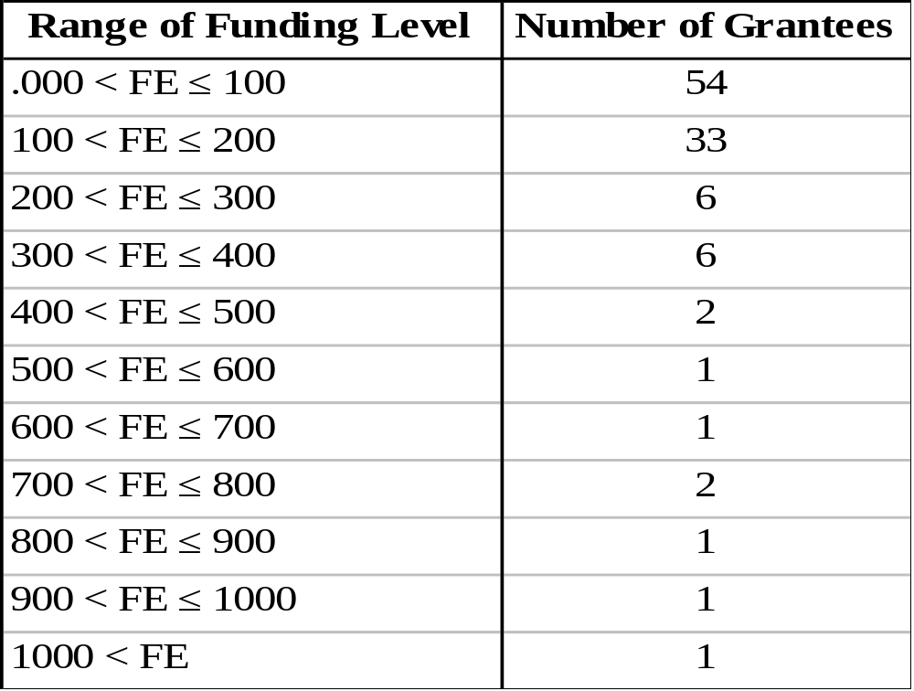
Funds Expended (FE) During the Life of the Activity ($1000)
(Matrix Code 13, 2003)

Slide 16
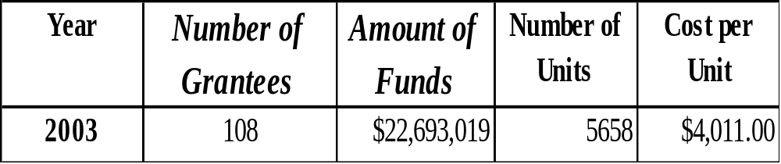
Total Amount of Funds Expended on Direct Homeownership Activities

Slide 17
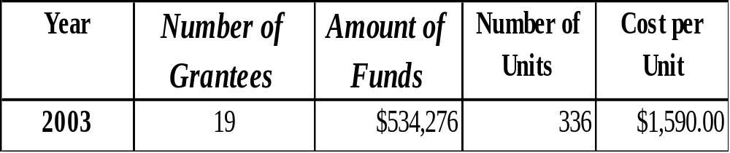
Total Amount of Funds Expended on Indirect Homeownership Activities
Notes:
As shown in Table 1, a majority of grantees spent less than or about $200,000 on activities (Matrix Code 13)
that were completed in 2003. For activities classified under 05R, spending levels were below $100,000.
Tables 1, 2 and 3 are based on valid data only. Big cities such as Los Angeles (CA), New York City (NY), Atlanta (GA), and Houston, (TX) did not report any activities completed during FY 2003.

Slide 18
Direct Homeownership Activities
Big Users: Funds Expended > $400,000
Denver, CO
Matrix Code 13, FY 2003
$642,645 (153 units): $4200 per unit
Harris County, TX
Matrix Code 13, FY 2003
$2,814,851 (91 units): $30932 per unit
Lake County, IN
Matrix Code 13, FY 2003
$501,785 (33 units): $15206 per unit

Slide 19
Direct Homeownership Activities
Memphis, TN
Matrix Code, FY 2003
$815, 093 (272 units): $2997 per unit
New Castle County, DE
Matrix Code 13, FY 2003
$792,802 (160 units): $4955 per unit
Oxnard, CA
Matrix Code 13, FY 2003
$471,000 (22 units): $21409 per unit

Slide 20
Direct Homeownership Activities
Philadelphia, PA
Matrix Code 13, FY 2003
$441,885 (448 units): $986 per unit
St. Louis, MO
Matrix Code 13, FY 2003
$1,748,327 (215 units): $8132 per unit
New Castle County, DE
Matrix Code 13, FY 2002
$782,647 (197 units): $3973 per unit
Winston-Salem Consortium, NC
Matrix Code 13, FY 2002
$800,362 (12 units): $66697 per unit

Slide 21
Indirect Homeownership Activities
Biggest User, FY 2003
Denver, CO
$424,999.60 (1121 beneficiaries)
$397 per beneficiary
Biggest User, FY 2002
Patterson, NJ
$354,880 (20 beneficiaries)
$17744 per beneficiary

