Slide 1

IILM UNIVERSITY, GREATER NOIDA
School of Computer Science and Engineering
Internship Presentation
Ethical Hacking
AICTE – EduSkills Virtual Internship Program
Student Name
Amanul Haque
Enrollment Number
[Enter Enrollment Number]
Program & Semester
B.Tech CSE (Cyber Security) — 7th Semester
Organization
EduSkills Academy (AICTE National Internship Portal)

Slide 2
OVERVIEW
What We'll Cover
01
Introduction
02
Organization Profile
Overview of the internship and the domain of ethical hacking
About EduSkills Academy and the AICTE National Internship Portal
03
Problem Statement & Objectives
04
Scope, Tools & Technologies
The security challenge addressed and internship goals
Boundaries of the work and the toolkit used
05
Methodology
06
System Architecture
Week-wise structure of the 8-week program
The penetration-testing workflow followed
07
Outcomes & Certification
Key learnings and proof of completion
Ethical Hacking — AICTE-EduSkills Virtual Internship
2

Slide 3
CHAPTER 4.1
Introduction
8
Weeks of structured learning
This report documents work completed during the 8-week AICTE – EduSkills Virtual Internship Program in Ethical Hacking, from June to August 2026.
Ethical hacking is the authorized probing of systems and networks to uncover security weaknesses before malicious actors can exploit them — a discipline growing more critical as cyberattacks increase in frequency and sophistication.
8
Curriculum modules completed
1
Capstone project delivered
Ethical Hacking — AICTE-EduSkills Virtual Internship
3

Slide 4
CHAPTER 4.2
Organization Profile
EduSkills Academy
Delivery Mode
An ISO 9001:2015 & ISO 20000-1:2018 certified skilling organization working under the theme "Nation Building Through Skills."
Virtual, self-paced
Duration
8 Weeks (June – Aug 2026)
AICTE National Internship Portal
EduSkills partners with AICTE to deliver structured virtual internships to engineering students nationwide across cybersecurity, cloud, and emerging-tech domains.
Domain
Ethical Hacking
Certification
AICTE-backed Internship Credential
Ethical Hacking — AICTE-EduSkills Virtual Internship
4

Slide 5
CHAPTER 4.3 – 4.4
Problem Statement & Objectives
Key Objectives
Problem Statement
1
Understand the purpose, legality & scope of ethical hacking
Organizations face growing risk from unpatched vulnerabilities, weak network configurations, social engineering, and poorly tested web applications — many undetected until exploited. This internship addressed how to identify and responsibly assess such risks using standard ethical hacking methodologies.
2
Learn core cybersecurity principles & threat types
3
Identify social engineering attacks (phishing, impersonation)
4
Study malware types, behaviour and impact
5
Gain hands-on familiarity with Kali Linux tools
6
Perform basic vulnerability assessment & pen testing
Ethical Hacking — AICTE-EduSkills Virtual Internship
5

Slide 6
CHAPTER 4.5 – 4.6
Scope, Tools & Technologies
Scope
Limited to a controlled, educational lab environment using Kali Linux on sample web applications — covering reconnaissance through basic penetration testing, in line with responsible and ethical practice (no live third-party systems tested).
Kali Linux
Nmap
Burp Suite / OWASP tools
Core operating system for security testing
Network reconnaissance & scanning
Web vulnerability assessment
TCP/IP, DNS, HTTP(S)
Linux CLI & scripting
Social Engineering & Malware concepts
Networking fundamentals
Command-line operations
Threat awareness
Ethical Hacking — AICTE-EduSkills Virtual Internship
6

Slide 7
CHAPTER 4.8
Methodology — Week-wise Structure
Intro to Ethical Hacking
Social Engineering
Networking Essentials
Web App Vulnerability Assessment
1
2
3
4
5
6
7
8
Fundamentals of Security
Malware & Types
Intro to Kali Linux
Penetration Testing + Capstone
Each week combined self-paced modules with a weekly assessment; select weeks required project documentation. The program closed with a Final Assessment Test and Capstone Project.
Ethical Hacking — AICTE-EduSkills Virtual Internship
7

Slide 8
CHAPTER 4.7
System Architecture — Testing Workflow
01
02
03
04
05
Reconnaissance
Scanning
Vulnerability Assessment
Controlled Exploitation
Reporting
→
→
→
→
Gather information about the target web application
Identify open ports, services & technologies in use
Map the app against common vulnerability classes
Verify identified vulnerabilities in a lab setting
Document findings and recommended remediations
This five-phase workflow mirrors the standard process used in professional penetration-testing engagements.
Ethical Hacking — AICTE-EduSkills Virtual Internship
8

Slide 9
CHAPTER 4.9
Expected Outcomes & Key Learnings
✓
Working understanding of ethical hacking principles & professional conduct
✓
Ability to identify common web-application vulnerability categories
✓
Practical familiarity with Kali Linux and core security-testing tools
✓
Stronger grasp of networking fundamentals as they relate to security
✓
Ability to recognize and respond to social engineering attempts
✓
A completed capstone project applying vulnerability assessment skills
Ethical Hacking — AICTE-EduSkills Virtual Internship
9

Slide 10
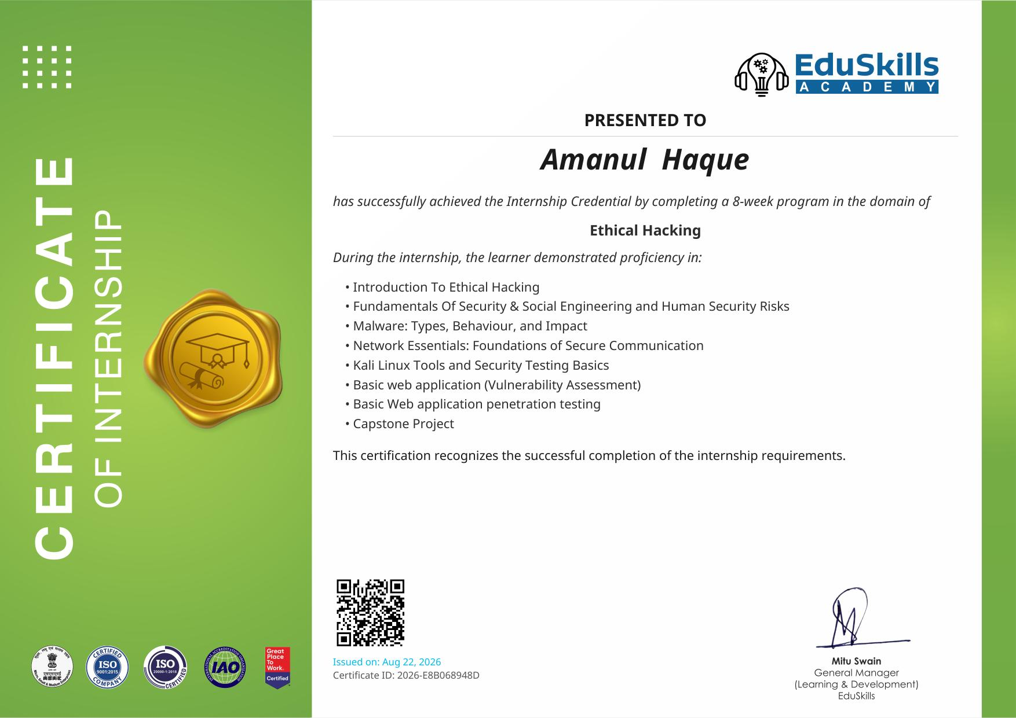
CHAPTER 4.10
Proof of Completion
Ethical Hacking — AICTE-EduSkills Virtual Internship
10

Slide 11
Thank You
Questions & Discussion
Amanul Haque | B.Tech CSE (Cyber Security) | IILM University, Greater Noida

