Slide 1

USDT Transaction Explorer: Software Requirements Specification
This presentation outlines the software requirements for the USDT Transaction Explorer, a system designed to analyze and visualize USDT (Tether) transaction data. It helps businesses retrieve wallet transaction data, visualize transaction flows, and provide AI-based safety analysis before engaging in transactions.
The system can be hosted on AWS along with utilization of LinodeGPU for enhanced performance.

Slide 2

Purpose and Scope of the USDT Transaction Explorer
Purpose
Scope
Define system requirements to help users evaluate and analyze USDT wallet transaction history. Provides transaction trees and safety assessments to guide business decisions.
Retrieve transaction data for ERC20 and TRC20 wallets via blockchain explorers
Visualize wallet transactions through transaction trees
AI-based safety analysis of wallet transaction history
The project is designed for seamless deployment on AWS instances, enabling scalable, global accessibility.
Exclusions
No financial audits or deep wallet verification; only assesses transaction patterns and safety based on historical behavior.

Slide 3
Key Definitions, Acronyms, and References
Definitions & Acronyms
References
USDT: Tether stable coin pegged to USD
AWS Documentation
ERC20: Ethereum token standard
Etherscan API Documentation
TRC20: TRON token standard
Tronscan API Documentation
AWS: Amazon Web Services cloud platform
LinodeGPU: GPU instances for ML tasks
API: Application Programming Interface
AI: Artificial Intelligence

Slide 4
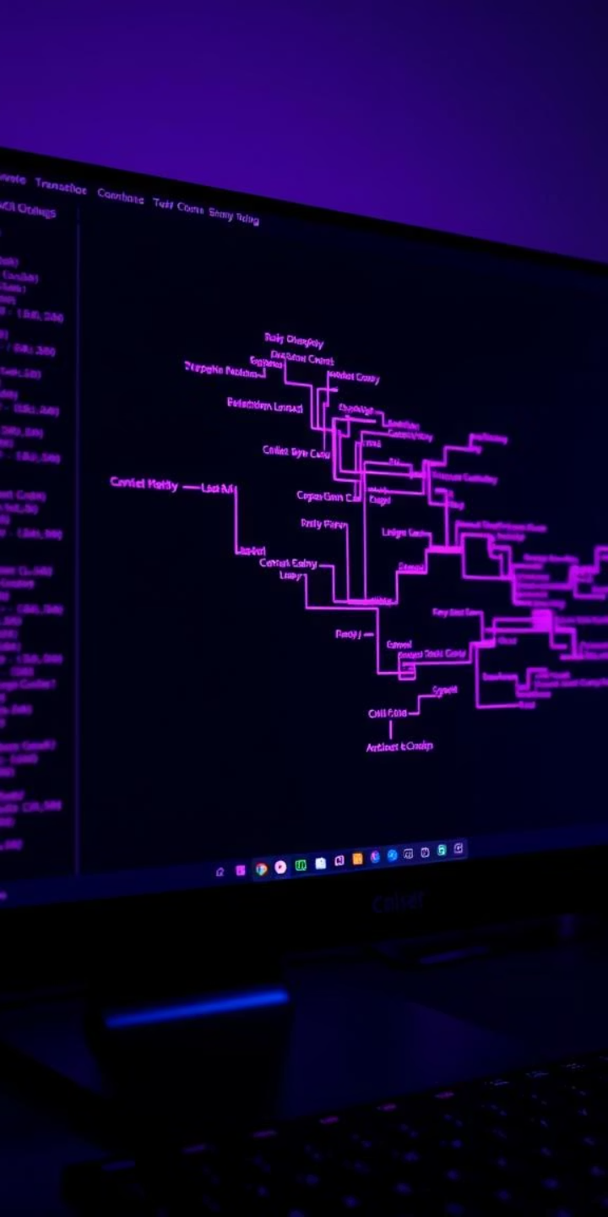



General Description and Product Perspective
Integration
Visualization
Connects with Tronscan and Etherscan APIs to fetch USDT wallet transaction data.
Processes data into transaction trees showing wallet-to-wallet USDT transfers.
AI Analysis
Uses Google Generative AI to evaluate transaction patterns and provide safety recommendations.

Slide 5
Product Functions and User Characteristics
Product Functions
User Characteristics
Retrieve transactions from Ethereum and TRON blockchains
Targeted at businesses and analysts with basic blockchain and cryptocurrency knowledge who need to assess wallet safety before transactions.
Generate visual transaction trees
AI-driven safety analysis of wallets
Web interface for wallet input and results display

Slide 6

General Constraints and Assumptions
Constraints
Must handle multiple concurrent users
API rate limits from Etherscan and Tronscan must be managed
Performance optimized using LinodeGPU for AI processing
Assumptions
Stable access to Etherscan and Tronscan APIs
Transaction trees can’t show patterns of money laundering and other illicit activities
Consistent AI model performance based on historical data

Slide 7
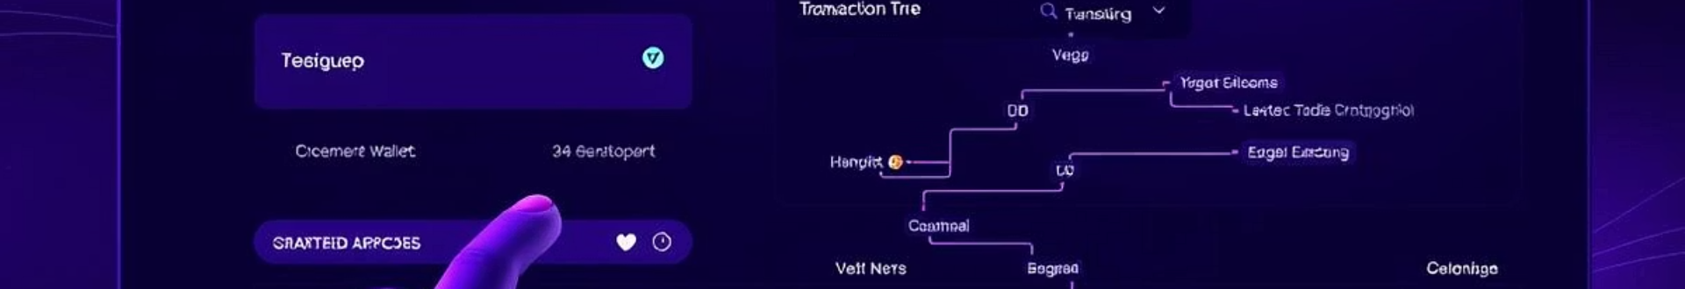



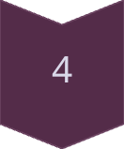
External Interface Requirements
User Interfaces
Web interface for inputting wallet addresses and viewing transaction trees and AI safety assessments.
Hardware Interfaces
Optimized for seamless deployment on AWS, ensuring scalable performance and potential global accessibility.
Software Interfaces
Etherscan for ERC20 wallet data
Tronscan for TRC20 wallet data
Google Generative AI for safety analysis
Communications Interfaces
All communications use HTTPS for secure data transfer between system components and external APIs.

Slide 8
Functional Requirements: Transaction Tree and AI Analysis
Transaction Tree Generation
AI-Based Wallet Analysis
Input: Wallet address (ERC20 or TRC20)
Input: Transaction tree data
Process: Query blockchain APIs to fetch transaction data
Process: Google Generative AI analyzes transaction patterns
Output: Visual transaction tree of wallet-to-wallet USDT transfers
Output: Textual safety assessment for business engagement
Error Handling: Return error if address invalid or API fails
Error Handling: AI reports failure if analysis cannot be completed

Slide 9
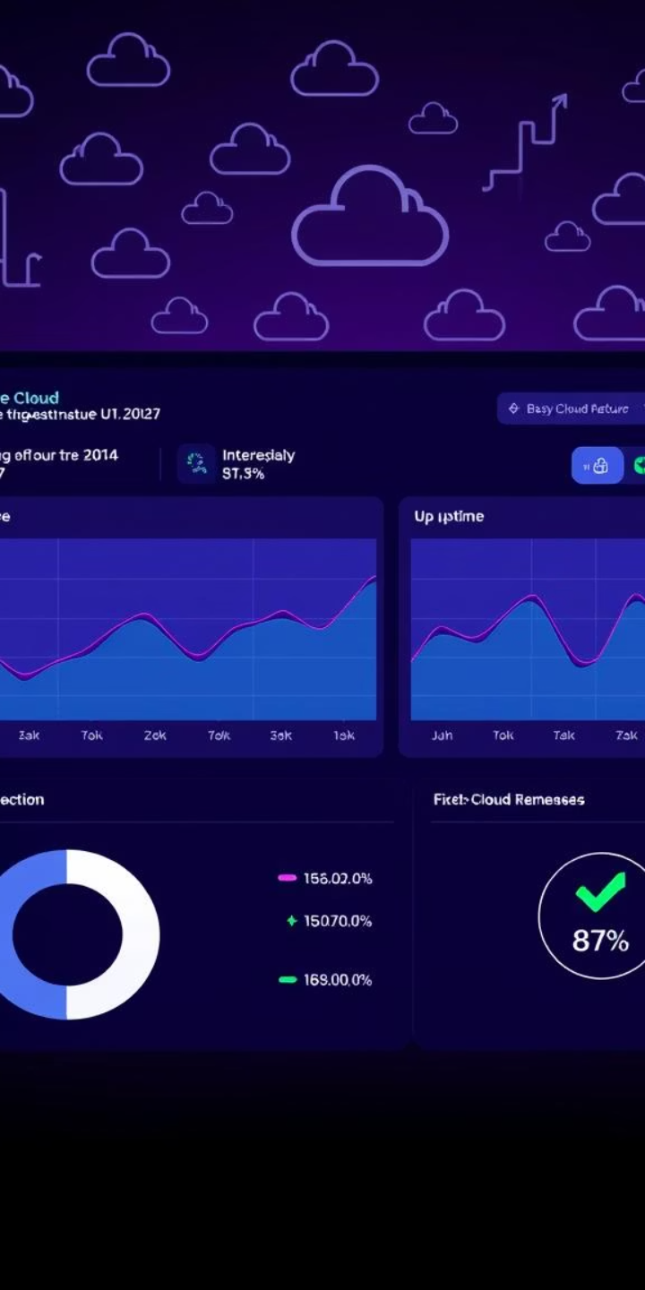



Non-Functional Requirements: Performance, Reliability, and Security
Performance
Reliability & Availability
Process up to 5 wallet queries per second with efficient data retrieval and AI processing.
Maintains 99.9% uptime when hosted on AWS with auto-scaling to handle dynamic workloads.
Security
Use HTTPS for all external and internal communications to ensure data security.

Slide 10
Maintainability, Portability, and Design Constraints
Maintainability
Portability
Design Constraints
Modular system architecture with version-controlled code deployed via CI/CD pipelines for easy maintenance.
System designed to be portable across AWS regions for geographic redundancy and reliability.
API rate limits require rate-limiting mechanisms to avoid bans

