Slide 1

IEEE S&P 2024 · COLUMBIA UNIVERSITY
SmartInv
Multimodal Smart Contract
Invariant Inference
A* PAPER EVALUATION
Mid-semester project review
Rishi · 2024ucp1566
SMARTINV · MID-SEMESTER REVIEW
01 / 13

Slide 2
THE $3.8B CRISIS
Why one tiny bug can move billions
$3.8B
A smart contract is like a vending machine: insert value, rules run, output appears. But once deployed, the machine is public, automatic—and painfully hard to rewind.
stolen in 2022
VALUE IN
CODE DECIDES
VALUE OUT
NO UNDO
SMARTINV · MID-SEMESTER REVIEW
02 / 13

Slide 3
THE CORE PROBLEM
Same codebase. Two very different enemies.
IMPLEMENTATION BUG
FUNCTIONAL LOGIC FLAW
The machine is built wrong
The machine follows the wrong rule
Overflow, reentrancy, access control. Think: a loose wire or jammed coin slot. Static analyzers are good here.
The code runs exactly as written—but violates business intent. Think: dispensing two products for one payment.
SMARTINV · MID-SEMESTER REVIEW
03 / 13

Slide 4

CASE STUDY · VISOR FINANCE
$8.2M vanished through a rule nobody checked
The attacker supplied fake deposit data. The contract accepted it because a crucial relationship was never enforced. Syntax scanners saw valid code; the business rule was missing.
TRADITIONAL TOOLS: PASSED
Valid syntax ≠ valid intent
SMARTINV · MID-SEMESTER REVIEW
04 / 13

Slide 5
THE GOLDEN RULE
An invariant is a promise that must always stay true.
01
02
03
Elevator
Bank account
Token vault
Doors stay closed while moving.
Balance never drops below allowed limits.
Shares always match the assets inside.
SMARTINV · MID-SEMESTER REVIEW
05 / 13

Slide 6
SMARTINV ARCHITECTURE
AI guesses the rule. Math checks the homework.
MULTIMODAL INPUT
AI CANDIDATES
FORMAL PROOF
code · specs · traces
plausible invariants
keep only what holds
SMARTINV · MID-SEMESTER REVIEW
06 / 13

Slide 7
KEY INNOVATION 1 · MULTIMODAL
One contract. Three ways to understand it.
SOLIDITY CODE
What the machine literally does
THE WHOLE
PICTURE
ON-CHAIN TRACES
What it actually did in the wild
NATURAL LANGUAGE
What humans say it should do
SMARTINV · MID-SEMESTER REVIEW
07 / 13

Slide 8
KEY INNOVATION 2 · TIER OF THOUGHT
Six small reasoning steps beat one giant guess.
1
READ
CONTEXT
3
FIND
RELATIONS
5
VERIFY
LOGIC
2
MAP
ENTITIES
4
PROPOSE
RULES
6
PROVE OR
REJECT
Structure is the guardrail against hallucination.
SMARTINV · MID-SEMESTER REVIEW
08 / 13

Slide 9
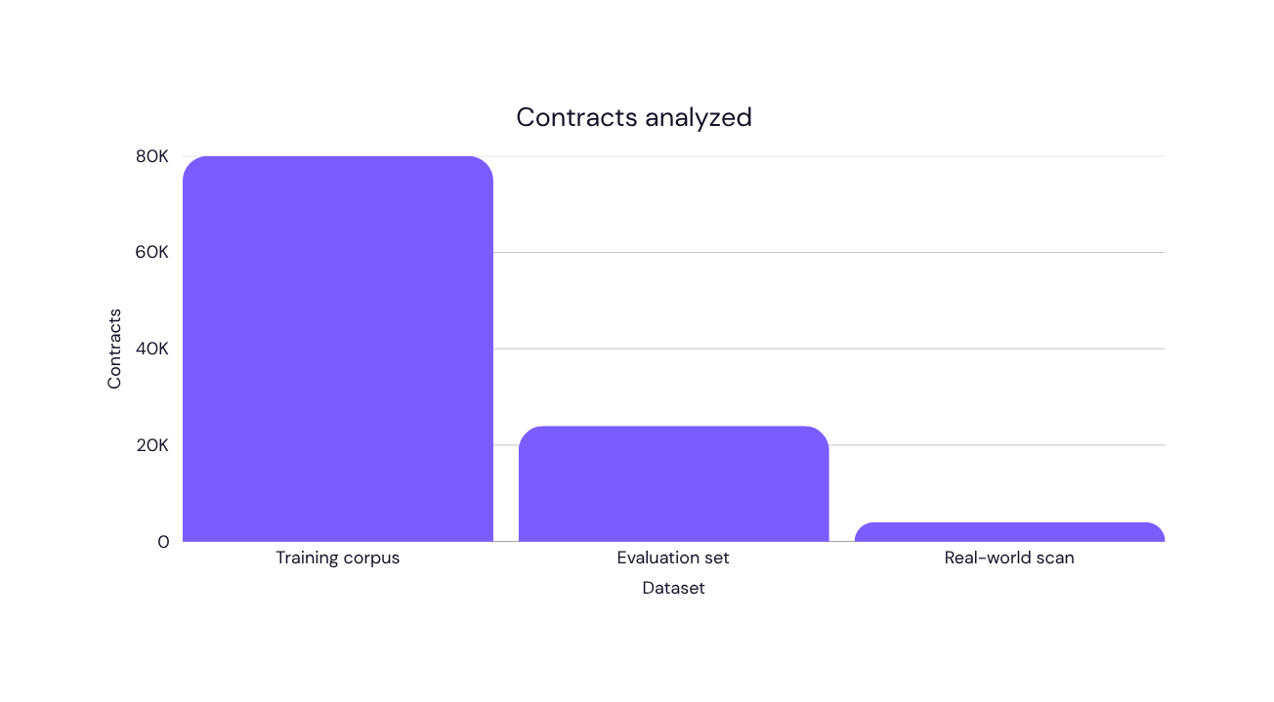
EXPERIMENTAL BENCHMARKS
Tested at ecosystem scale—not on toy examples.
80,000+
real Ethereum contracts formed the learning base.
Scale matters: rare logic patterns only appear when the dataset is broad.
SMARTINV · MID-SEMESTER REVIEW
09 / 13

Slide 10

REAL-WORLD IMPACT · MAINNET
119 bugs nobody knew existed.
119
ZERO-DAYS
Fresh mainnet findings turn SmartInv from a clever paper into a practical security system.
SMARTINV · MID-SEMESTER REVIEW
10 / 13

Slide 11
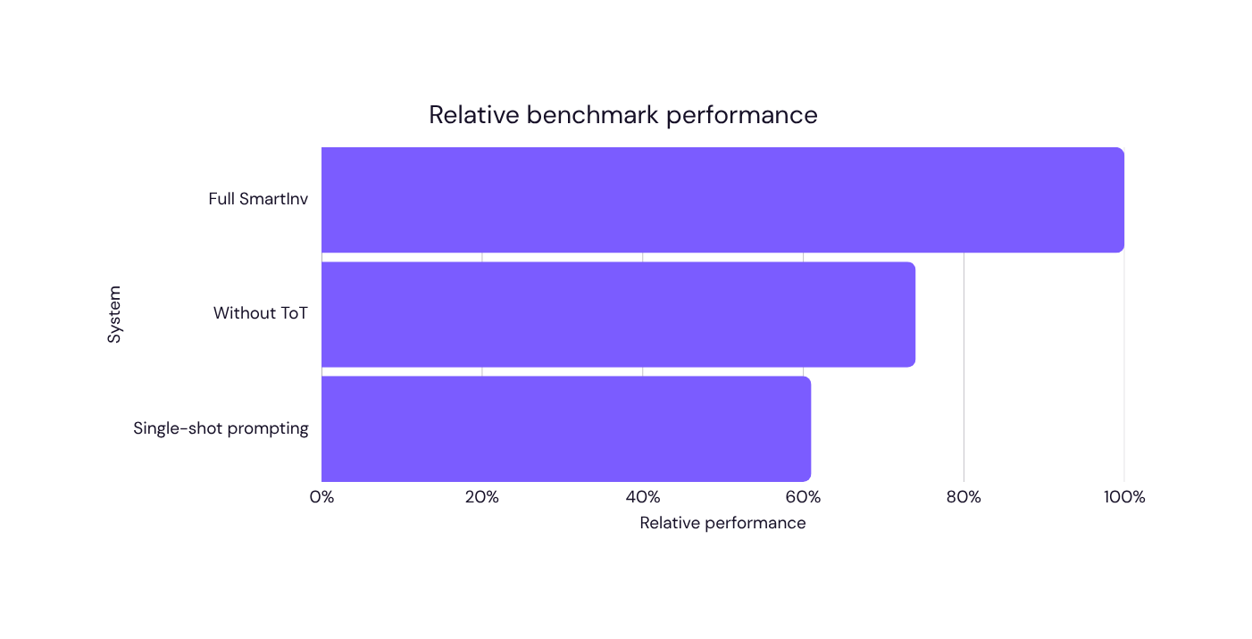
ABLATION STUDY
Remove Tier of Thought—and the system loses its edge.
ToT is the hero
It converts fuzzy model intuition into a repeatable checklist—raising precision and making errors easier to inspect.
SMARTINV · MID-SEMESTER REVIEW
11 / 13

Slide 12
MID-SEMESTER PRACTICAL MILESTONES
From paper to a working local pipeline.
01
ENVIRONMENT
02
BUG FIXES
Reproduced the stack locally on Windows.
Patched path, dependency and shell issues.
03
DATASET
04
PIPELINE
Generated contract samples and metadata.
Validated end-to-end inference stages.
SMARTINV · MID-SEMESTER REVIEW
12 / 13

Slide 13

CONCLUSION · VIVA DEFENSE
SmartInv sees
what syntax misses.
Multimodal context finds the intent. Tier of Thought structures the reasoning. Formal verification keeps every claim honest.
AI INTUITION × MATHEMATICAL PROOF
Questions? Let’s stress-test the idea.
SMARTINV · MID-SEMESTER REVIEW
13 / 13

