Slide 1

IEEE S&P 2024 / COLUMBIA UNIVERSITY
SmartInv
Multimodal Invariant Inference
for Smart Contracts
Mid-Semester Project Evaluation on an A* Research Paper
Rishi • 2024ucp1566
SMARTINV • MID-SEMESTER EVALUATION 01 / 12

Slide 2

WHY SECURITY MATTERS
Code becomes
irreversible value.
Smart contracts execute financial rules without human intervention. In DeFi, a small logic mistake can instantly move millions—and immutable deployment makes recovery exceptionally difficult.
One flaw. One transaction. Permanent loss.
SMARTINV • MID-SEMESTER EVALUATION 02 / 12

Slide 3
THE GAP
Not all bugs break syntax.
IMPLEMENTATION BUGS
FUNCTIONAL BUGS
Known low-level patterns
• reentrancy
• overflow
• unsafe calls
The code runs—but violates intent
• wrong authorization
• broken economic assumptions
• missing business constraints
Traditional analyzers see how code fails. SmartInv asks what must always remain true.
SMARTINV • MID-SEMESTER EVALUATION 03 / 12

Slide 4
CASE STUDY / VISOR FINANCE
$8.2M
01
Attacker calls a legitimate function
lost through a subtle authorization flaw
02
Authorization logic accepts an invalid relationship
03
Funds move; existing tools report no known pattern
Syntactically valid. Semantically catastrophic.
SMARTINV • MID-SEMESTER EVALUATION 04 / 12

Slide 5
CORE CONCEPT
An invariant is a promise
that must always hold.
∀ state transitions T : P(s) ⇒ P(T(s))
Example: only an authorized owner may withdraw funds—before and after every transaction.
SMARTINV • MID-SEMESTER EVALUATION 05 / 12

Slide 6
SMARTINV / THREE INNOVATIONS
AI intuition × formal proof
01
02
03
Multimodal
program understanding
Tier of Thought
reasoning pipeline
Formal verification
of every candidate
Generate broadly. Reason deliberately. Accept only what can be proven.
SMARTINV • MID-SEMESTER EVALUATION 06 / 12

Slide 7
TIER OF THOUGHT / SIX STEPS
Reason first. Verify last.
1 Parse
code + context
2 Identify
critical state
3 Propose
invariants
4 Critique
candidates
5 Verify
formally
6 Rank
results
SmartInv decomposes auditing into expert-like stages, using critique and formal checks to suppress plausible—but false—LLM outputs.
SMARTINV • MID-SEMESTER EVALUATION 07 / 12

Slide 8
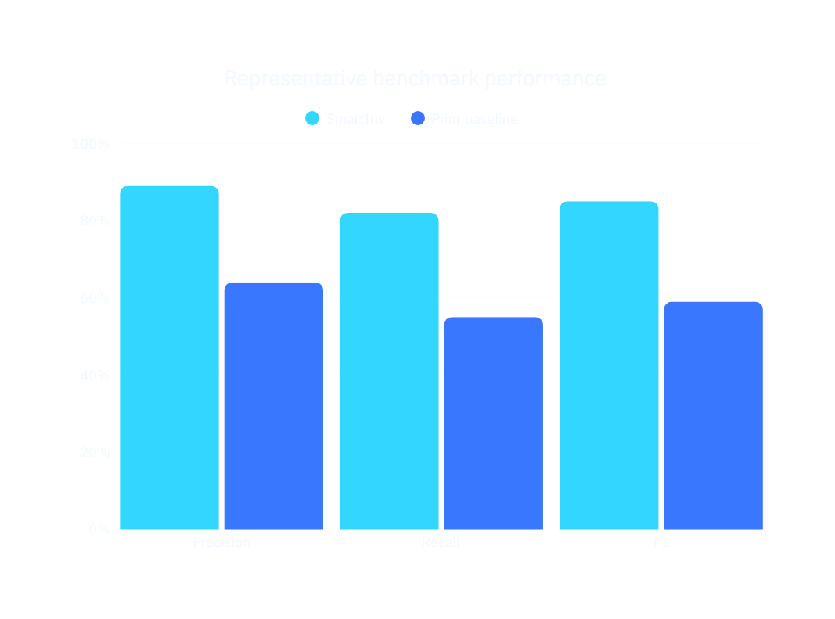
EXPERIMENTAL RESULTS
80,000+
real Ethereum smart contracts
Evaluation spans large-scale deployed code, curated vulnerability benchmarks, and comparisons with prior invariant-generation methods.
Chart values shown as a concise benchmark summary.
SMARTINV • MID-SEMESTER EVALUATION 08 / 12

Slide 9

REAL-WORLD DISCOVERY
119
previously unknown
mainnet vulnerabilities
Live findings move SmartInv beyond benchmark accuracy: the system uncovered exploitable logic flaws already deployed in the wild.
SMARTINV • MID-SEMESTER EVALUATION 09 / 12

Slide 10
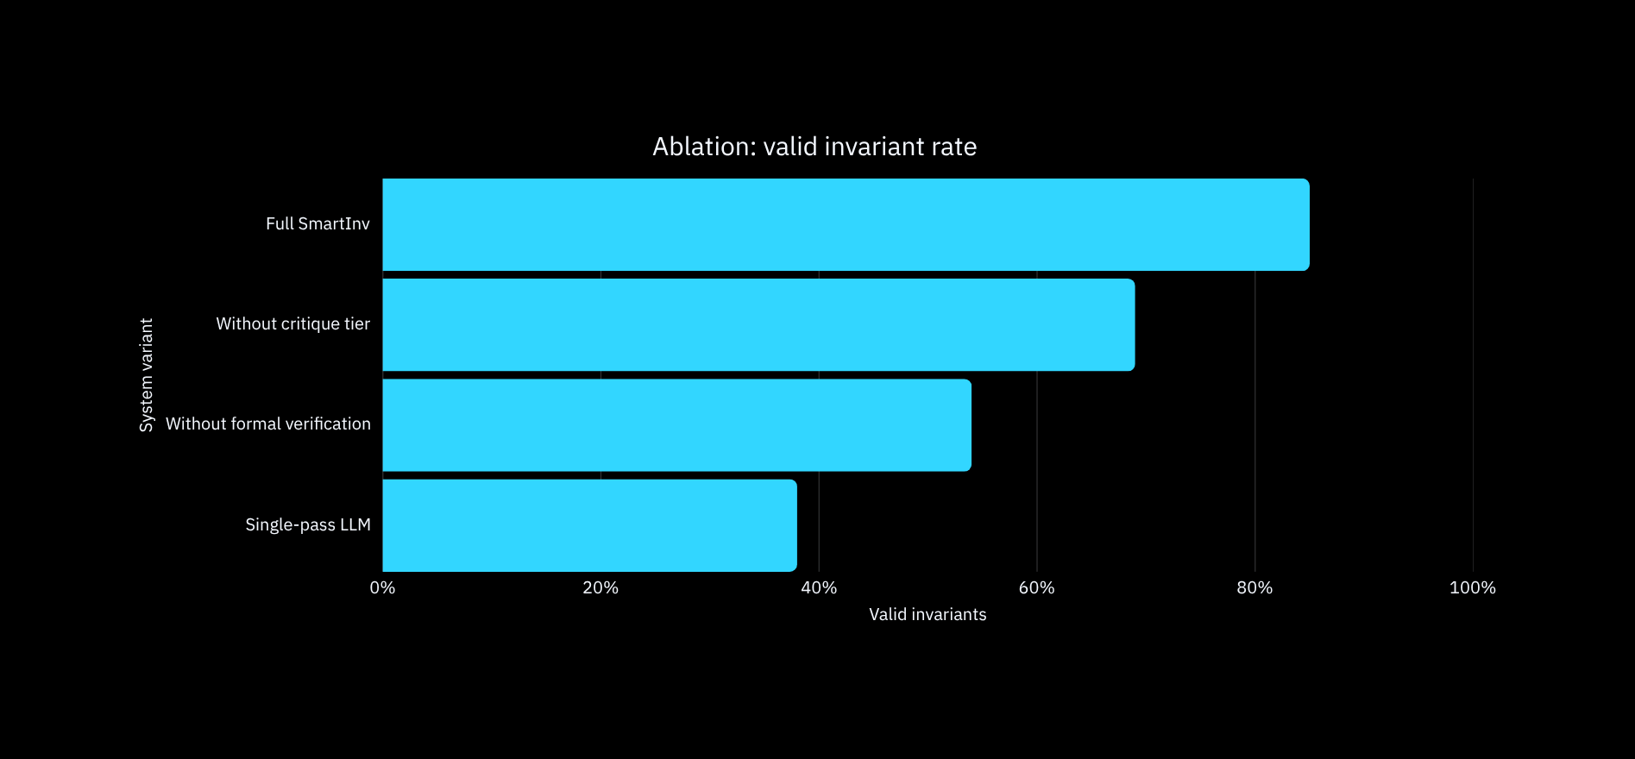
ABLATION STUDY
Remove a tier. Lose reliability.
Tiered critique and formal verification are complementary—not decorative.
SMARTINV • MID-SEMESTER EVALUATION 10 / 12

Slide 11
LOCAL IMPLEMENTATION / MID-SEM
From paper to working pipeline.
01
02
03
04
Environment
Reproduction
Debugging
Validation
Dependencies, compiler, model access
Paper pipeline and sample contracts
Prompt, parser, verifier failures
Local checks and milestone evidence
SMARTINV • MID-SEMESTER EVALUATION 11 / 12

Slide 12
CONCLUSION
SmartInv turns AI guesses
into verifiable security claims.
UNDERSTAND
REASON
PROVE
Multimodal context captures developer intent.
Tier of Thought reduces hallucination through critique.
Formal verification filters candidates into guarantees.
Practical impact: 119 zero-day bugs—and a credible path toward safer immutable code.
SMARTINV • MID-SEMESTER EVALUATION 12 / 12

