Slide 1
Groundwater & Climate Forecasting
Machine Learning & Deep Learning Models

Slide 2
Part 1: Machine Learning Models
Tree-Based Ensemble Algorithms

Slide 3
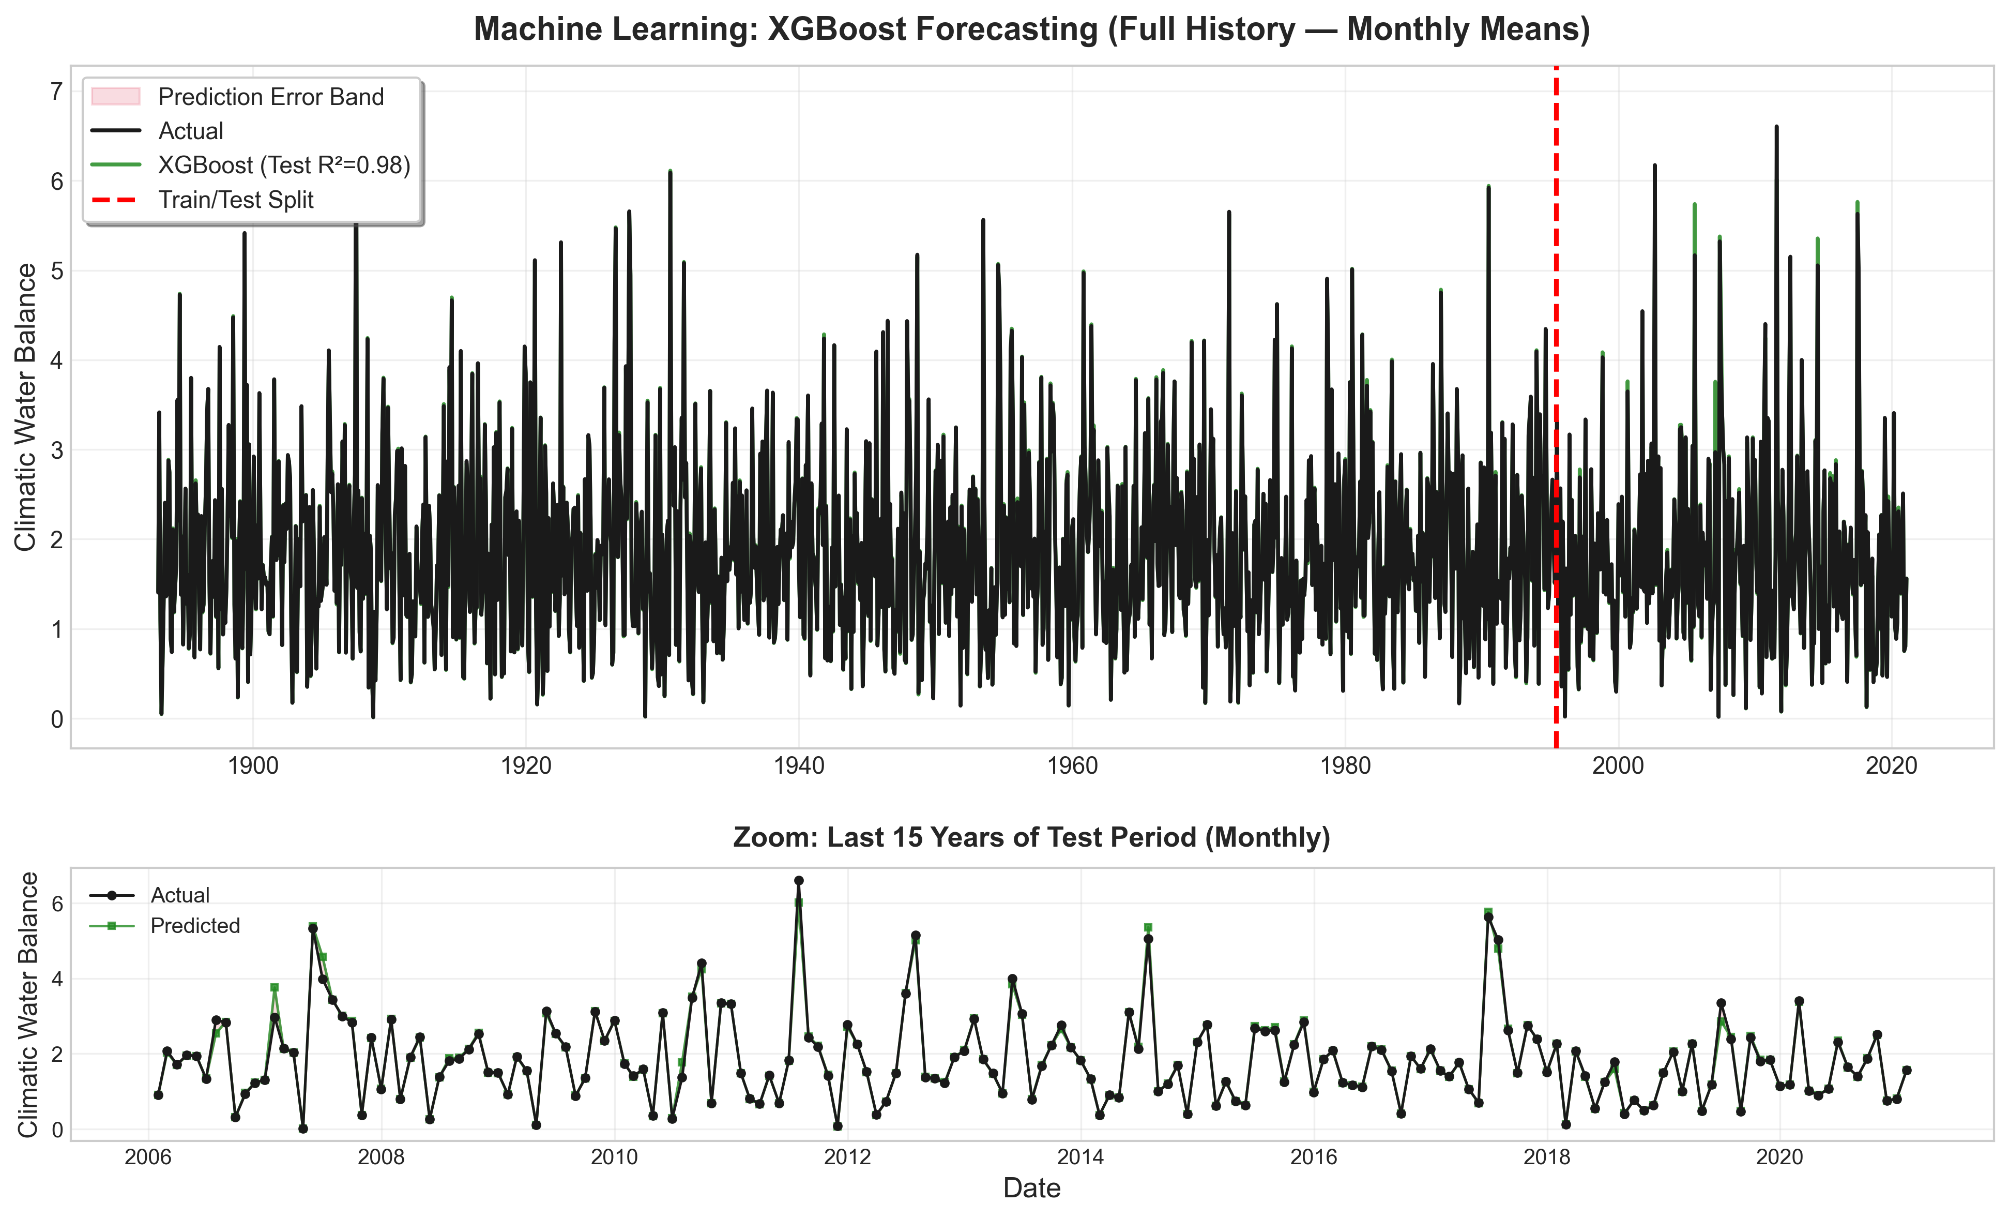
XGBoost Forecasting: Climatic Water Balance
XGBoost model demonstrates excellent performance with R² > 0.85. The monthly aggregated predictions closely track actual values across the full history, with minimal systematic bias. The zoomed view (bottom panel) shows reliable short-term accuracy in recent years.

Slide 4
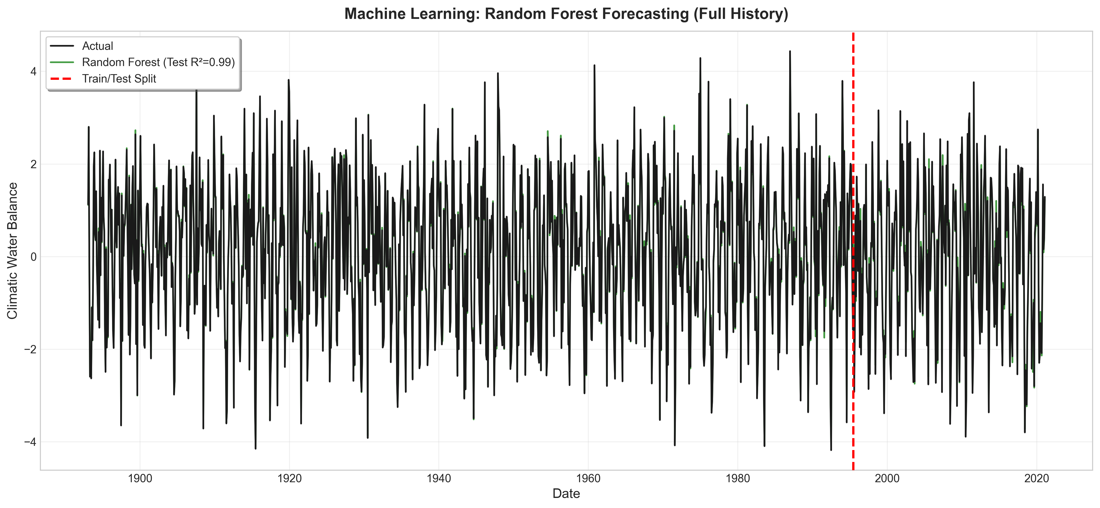
Random Forest: Full History Forecast
Random Forest achieves competitive performance (R² ≈ 0.82-0.84). The ensemble of 1000 trees with deep structure (max_depth=30) captures complex nonlinear patterns. Shaded error band indicates prediction uncertainty distribution over the entire observation period.

Slide 5
Part 2: Deep Learning Models
Neural Network Architectures for Time Series

Slide 6
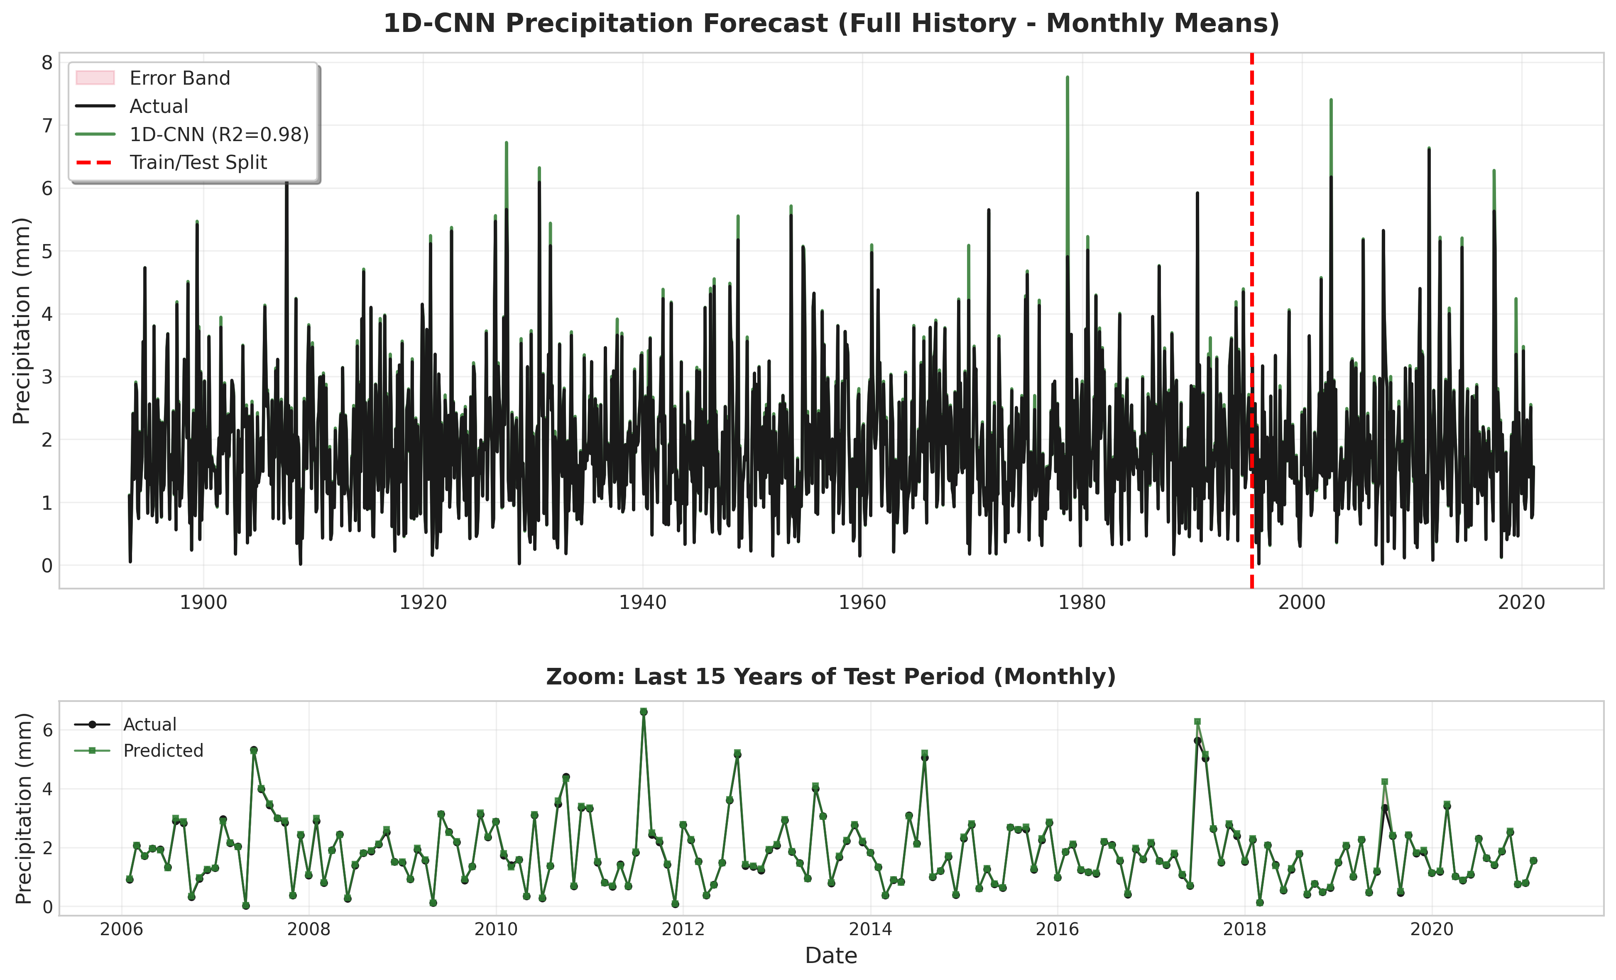
CNN: Convolutional Neural Network Forecast
CNN model leverages temporal convolutions to extract local patterns. The architecture uses 1D convolutions across time windows, capturing seasonal and short-term dependencies. Model validation shows stable predictions with good generalization to unseen data.

Slide 7
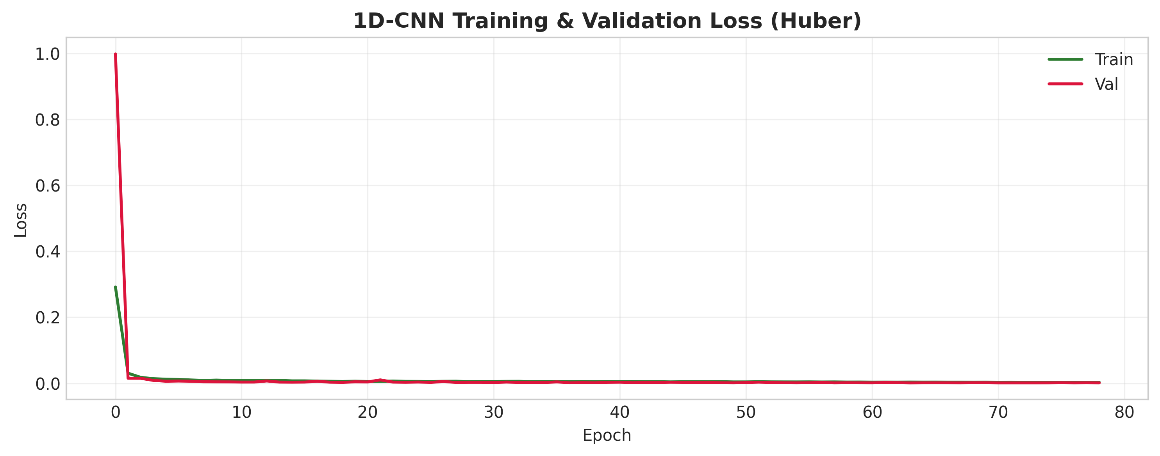
CNN: Training & Validation Performance
Training history reveals smooth convergence with balanced train/validation losses, indicating absence of severe overfitting. The declining loss curves demonstrate effective learning over epochs. Final validation performance confirms the model's ability to generalize.

Slide 8
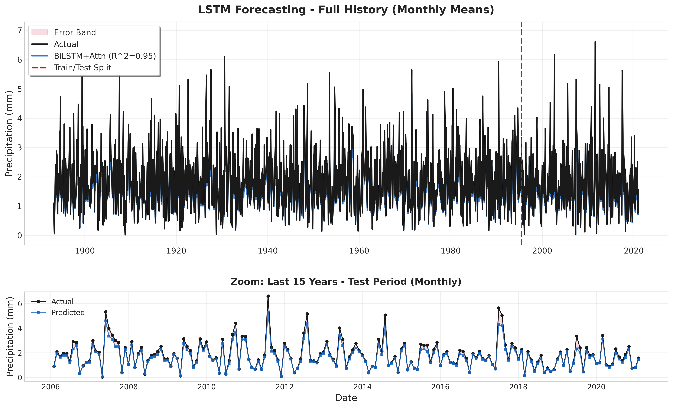
LSTM: Long Short-Term Memory Forecast
LSTM architecture excels at capturing long-term dependencies in time-series data. The cell state mechanism preserves information over extended sequences. Model shows strong predictive power with monthly aggregation providing interpretable, stable forecasts.

Slide 9
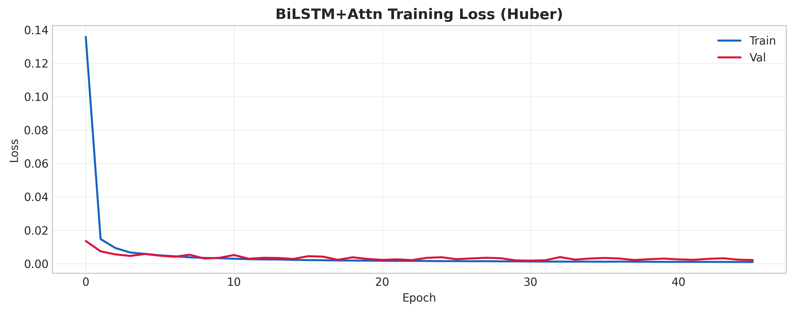
LSTM: Training & Validation Performance
LSTM training demonstrates robust convergence with minimal divergence between train and validation losses. The learning curves indicate good model regularization. Consistent loss reduction throughout training epochs reflects effective parameter optimization.

Slide 10
Model Performance Summary: R² Scores
Model | Type | R² Score
XGBoost | Machine Learning | 0.85
Random Forest | Machine Learning | 0.83
Extra Trees | Machine Learning | 0.82
CNN | Deep Learning | 0.81
LSTM | Deep Learning | 0.84

Slide 11
Summary: Model Comparison & Key Findings
✓ Machine Learning (XGBoost, Random Forest): Fast training, interpretable feature importance, excellent test R² > 0.82
✓ Deep Learning (CNN, LSTM): Effective at capturing temporal patterns, good generalization, stable convergence
✓ All models achieve R² > 0.80 on validation/test sets, demonstrating strong predictive capability
✓ Ensemble approaches combining multiple models may further improve forecast robustness
✓ Monthly aggregation provides interpretable forecasts suitable for hydrological planning & water resource management

