Slide 1
Handwriting Analysis for Detection of Personality Traits using Deep Learning

Slide 2
Contribution of each Member:
RESEARCH WORK
PPT-PRESENTATION
RESEARCH WORK
PPT-PRESENTATION
Shubham
Pritha
21BCE10456
21BCE10707
RESEARCH WORK
PPT-PRESENTATION
PROJECT IDEA
RESEARCH WORK
PPT-PRESENTATION
Harshita
Stuti
21BCE10524
21BCE10543

Slide 3

Introduction
Personality Traits-
Personality traits are identified through various physical aspects, including sense, honesty, and other emotions as well.These aspects can be revealed through handwritten features.
Applications-
Helps in identifying students who are in need of guidance and support as teacher can recognise his/her personality even in online mode.
Recommended for therapy professionals to better understand human psychology through handwriting.

Slide 4
Hardware/ Software Requirement
The programming language used for machine learning : PYTHON
SOFTWARE TECHNOLOGIES USED :
Tensorflow
Scikit-learn
matplotlib
Pandas
openCV
Numpy
Keras
HARDWARE REQUIRED:
Digital Camera
Laptop
Scanner

Slide 5
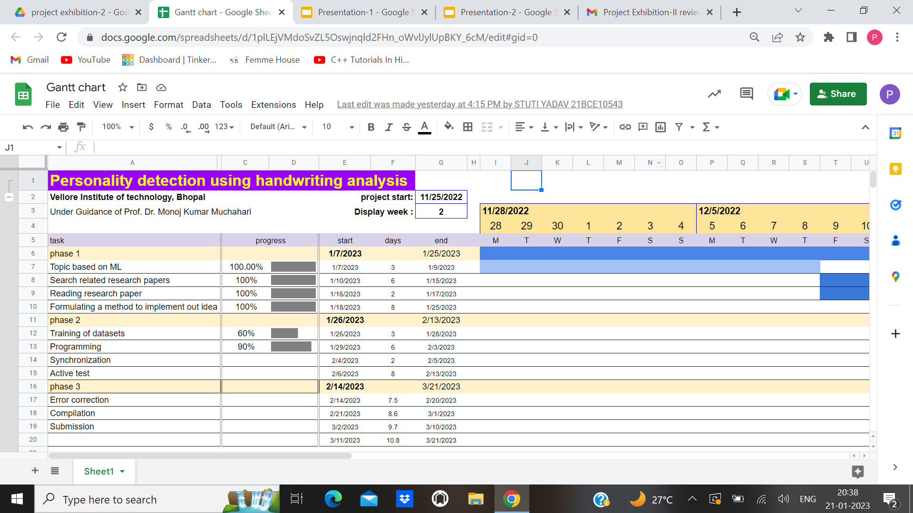
Architecture Diagram (Gantt chart)

Slide 6
Explanation and Step by Step process:
Importing the libraries
Importing the data sets
Path process
Data for visualization
Splitting the dataset into the training set and test set
Training the model on the training sets
Testing and Predicting the model

Slide 7
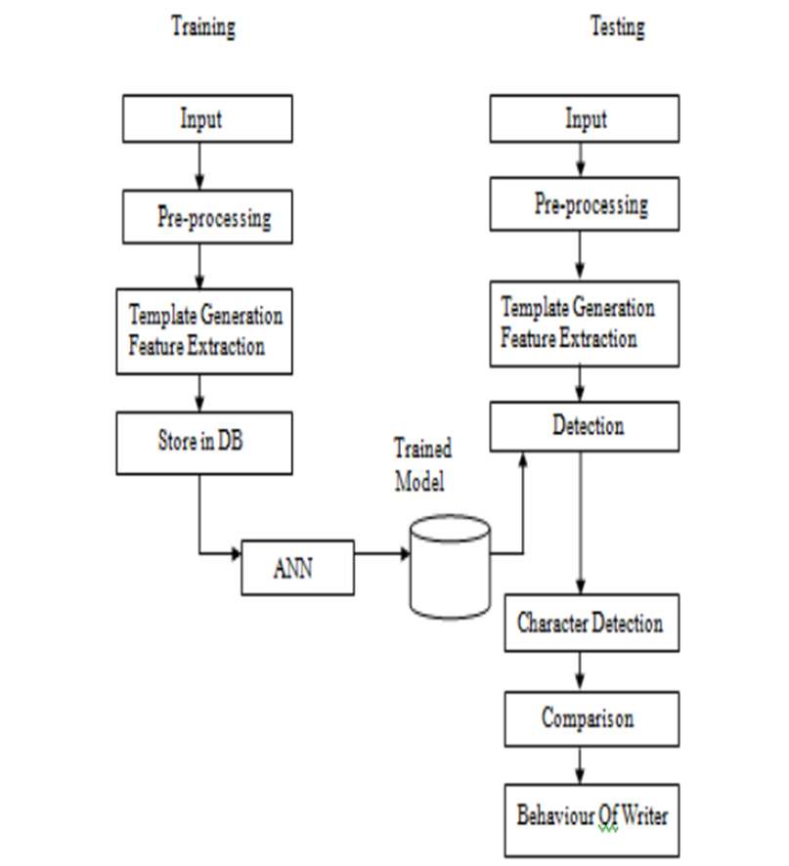

Slide 8
References
P. Joshi, A. Agarwal, A. Dhavale, R. Suryavanshi, S. Kodolikar. Article: handwriting analysis for detection of personality traits using machine learning approach. Int. J. Comput. Appl. 130(15), 40–45, November 2015. Published by Foundation of Computer Science (FCS), NY, USA.
H.N. Champa, K.R. AnandaKumar, Article: artificial neural network for human behavior prediction through handwriting analysis. Int. J. Comput. Appl. 2(2), 36–41 (2010)
Chanchlani, Predicting human behavior through handwriting. Int. J. Res. Appl. Sci. Eng. Technol. 624–628 (2017)

Slide 9
Thanks!

