Slide 1
An Introduction to Scientific Writing
Research Software Engineering Management and Communication
Marc Schmidt
schmidt@se-rwth.de
Software Engineering
RWTH Aachen
Notes:
Herzlich Willkommen zu meinem FoWo-Vortrag zu dem Stand meiner Promotion im Bereich RSE

Slide 2
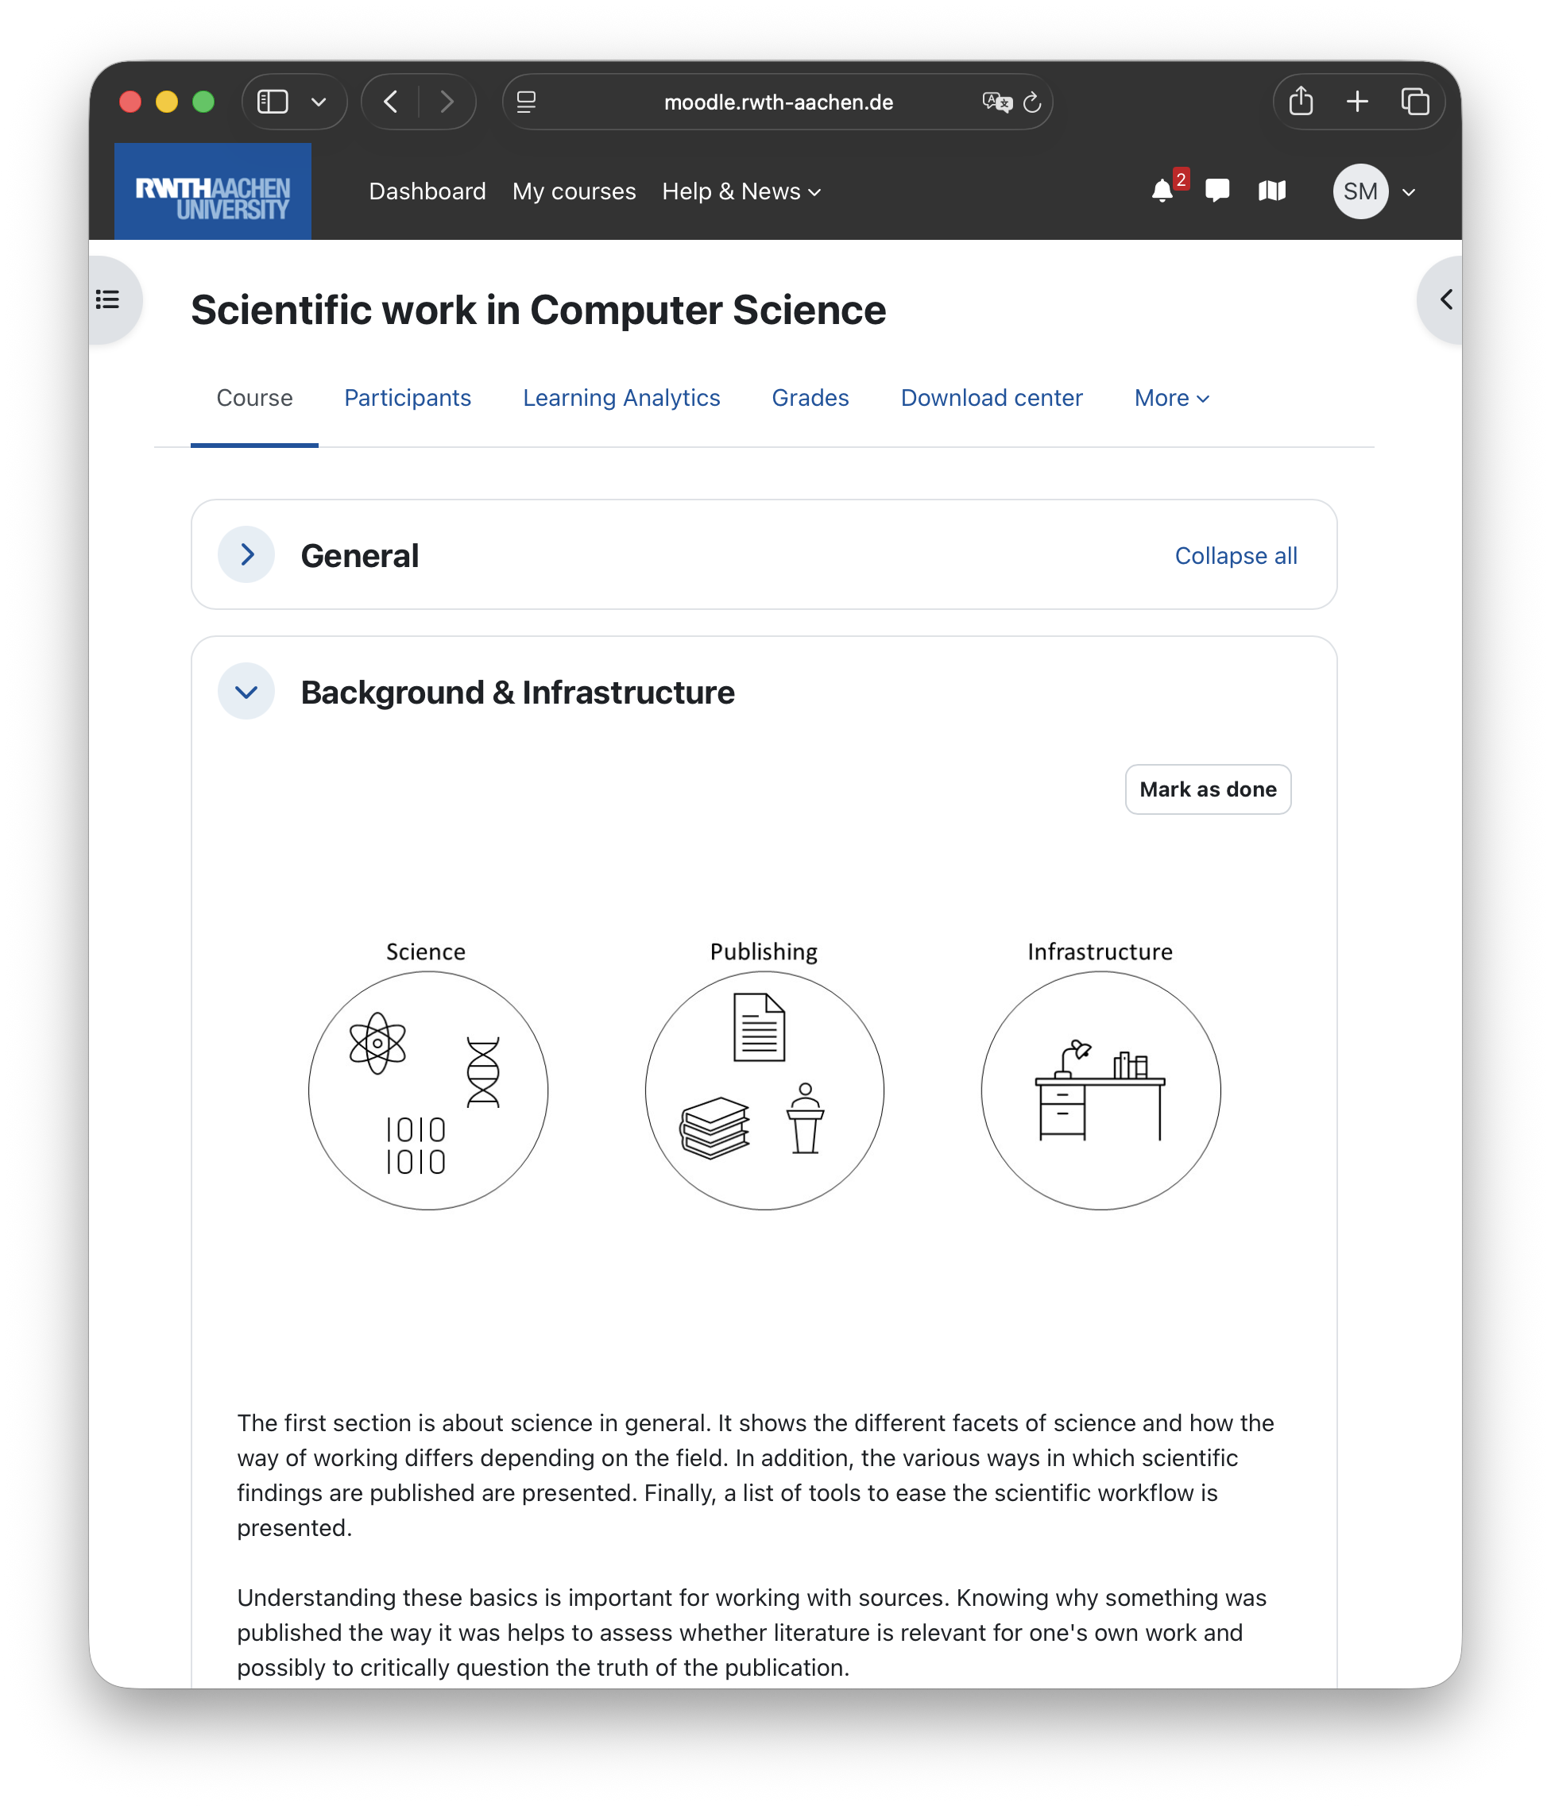
Workshop Content
Problem / Question
Based on the RWTH course „Scientific work in Computer Science“
Literature
Research
Research Contribution
Evaluation
Publication & Presentation

Slide 3
Key Characteristics of Scientific Papers
Scope
Provides new knowledge
Contributes to the current state of research
Focuses on a small, clearly defined area
Usually presented at conferences
Follows the journals or seminars formalities
Page Limits
Ensure efficiency
Ensure concise and precise formulations
We exclude the bibliography
Appendix
Not affected by page limits
Space for bulky transcripts, source code, experimental data…
we mark seminar
specifics orange

Slide 4
Useful Tools
Literature Management
Zotero organizes and tracks literature
Add notes and relevance
Avoid duplicates
Translation Tools
Look up technical terms
Use context-aware translations
Dict.cc, Linguee, DeepL
Visualization
Improves understanding
Important for papers & presentations
Sketches: Draw.io, Lucidchart, Mermaid
We require PowerPoint for final graphics
Literature Review
Writing
Presenting
Literature Access
VPN: remote access to licensed literature
Web of Science
Writing Tools
MS Word
LaTeX for scientific papers
Better for formulas, references
Writing Assistants
Enable the editor spellchecker
Grammarly checks spelling, grammar, tone
Use LLMs carefully

Slide 5
LLM Usage Guidelines
Based on principles of good scientific practice
Allowed but must be transparent and properly disclosed
Researchers remain fully responsible for content and integrity
Only natural persons can be listed as authors
No plagiarism or IP violations permitted
AI use prohibited in peer review due to confidentiality
Source: DFG guidelines on generative AI

Slide 6
(Idealized) Writing Procedure
Peer Review
„Finished“ Research
Structure the overall paper
Structure the sections
Write the sections
Final Touches

Slide 7
Paper Structure & Narrative Logic
Structure
Prerequisites finished research / content
Organize logically, not chronologically
Adapt the structure to the content
Sections
Abstract
Introduction
Background
Related Work
Main Contribution
Future Work
Conclusion
The Common Thread
Paper ≠ chronological story
Comparison to novel (1)
Object of study = protagonist
Background / Related Work = setting
Problem / research gap = tension
Approach & results = climax
Implications = resolution
Maintain clarity, don‘t leave out missing parts
PRISMA
Reporting guideline for systematic reviews & meta-analyses
Improves transparency and completeness
provide
meaningful
titles
Anna Clemens: https://www.socialsciencespace.com/2018/06/how-to-tell-a-story-in-your-research-paper/

Slide 8
Paper Structure
Abstract
Introduction
Goal: Readers can quickly assess whether the paper is relevant
What's the topic?
What has been done?
What are the results?
50 – 200 words
See abstract manual
Goal: Readers can decide whether to keep reading
What is the context of this work?
What is the motivation?
Why is this topic interesting?
What are the results?
How is the paper structured? (only for longer papers)
Detail topic, problem, motivation, context, approach and results

Slide 9
Paper Structure
Background
Related Work
Goal:
Readers can follow all content
Readers can understand the paper
Provide necessary prior knowledge
Assume basic domain knowledge
We assume basic knowledge in RSE
Start from reader’s initial level
Goal:
Readers can understand existing state of research
Readers can compare approaches with your contribution
Present key work of other researchers
Identify gaps and limitations
Enable comparison with own work
Improvements or extensions
New use cases
Advantages over prior work
No fixed length
Based on relevant literature
Focus on important contributions

Slide 10
Paper Structure: Main Contribution
Structure by Argumentation Chain
Concept
Concept of your own approach.
Realization
Practical implementation
Evaluation
Evaluation of the approach
Methods
Methodical approach
Results
Results without interpretation
Discussion
Interpretation and discussion of the results
Limitations of the results or approach
Other Structures
Structure by specificity:
general overview → detailed steps
useful for different stages
Structure by research questions:
stepwise answering of main and sub-questions
useful for common thread
Structure by examples:
start with example
formal explanation follows
Structure by complexity:
start with simple case
include increasing complexity
you may deviate in the seminar report

Slide 11
Paper Structure
Future Work
Conclusion
Goal: Derive future research directions
Identify
open problems
remaining tasks, e.g., evaluations
Limitations
Propose possible improvements
Goal: Summarize core content and key points
Recap main results and how they were obtained
State key takeaway of the paper
Link results back to research question
Clarify extent of question being answered

Slide 12
Language
General
Convey knowledge results- and not process-oriented
Justify everything to make results comprehensible
Adjectives
Stylistic Devices
Used sparingly for precise descriptions
Avoid unncessary or decorative or judgmental
Used only to enhance comprehension
No devices that leave room for interpretation, e.g., metaphors or rhetorical questions
Compared to older approaches, out method was able to achieve better results in the experiments
Finding a correct path in the graph is NP-hard. The cause of this XY.
Our approach delivers incredible results in the experiments
Finding a correct path in the graph is like looking for a needle in a haystack.

Slide 13
Language
Choice of Words
Active vs. Passive
Express precisely, rationally and objectively
Keep sentences short
Avoid vague formulations
Mark personal opinions
Predominantly write in active voice
Actor becomes clear
Often easier to understand
Our method achieved higher accuracy than previous approaches in the experiments.
The preprocessor converts the source code in the first step.
Our amazing method delivers incredible results and outperforms all others.
In the first step, the source code is converted.

Slide 14
Overcoming Writer‘s Block
Definition
Possible Solutions
Temporary inability to write despite intention
Difficulty starting or continuing text
Lack of ideas or suitable wording
Planning
Use a clear writing plan based on paper structure
Set realistic goals
Split large chapters over several days
Schedule time for proofreading and revisions
Incremental Writing
Write reasoning first as bullet points
Turn bullet points into first draft
Improve formulations
Start with easy or motivating chapters
Writing flow improves after starting

Slide 15
Citing Properly
Cite all non-original content
Reasons:
avoid plagiarism
avoid violating intellectual property
separate own from prior work
provide credibility and background access
Two components of citation:
in-text citation after quote/ paraphrase
bibliography to clearly identify sources
Format depends on citation style (provided by template)

Slide 16
Citing Properly
Direct Citation
Indirect Citation
Word-for-word quotation in quotation marks
Source given immediately after quote
Single word omissions marked with [..]
Several omitted words marked with [...]
Additions marked with [addition]
Use rarely in computer science
Content rewritten in own words
Must not stay close to original wording
Simple reordering ≠ indirect citation
Entire paragraph quoted: reference after period
Only last sentenced quoted: reference before period
"[The] method shows a [...] reduction in the error sum of squares of 5%." [1]
Property XY can reduce the error sum of squares by 5%. [1]
Original: "Our method shows a significant reduction in the error sum of squares of 5%. This is mainly due to property XY."

Slide 17
Citing Properly
Sources vs. Footnotes
Et al.
Source
Information directly used in your work
Integrated into your argument or text
Must be cited in-text
Footnote
Additional or explanatory information
Not directly used in main argument
Provides background or clarification
Not part of core evidence
Exception
Citation styles like Chicago use footnotes for sources
Many publications have multiple authors
“et al.” = “and others” (Latin: et alii)
Used to shorten author lists in text
Usually applied from 3+ authors (style-dependent)
Always plural → “et al. describe” (not “describes”)
Only used in in-text citations
All authors listed in bibliography

Slide 18
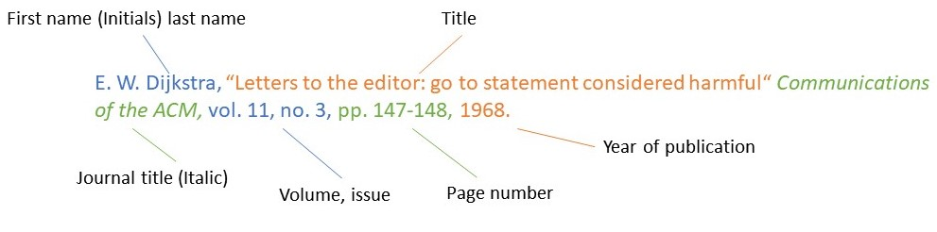
Citing Properly
Citation Styles
Specified by the template
Citing Websites
Include author, title, and publication date (if available)
Add URL and access/visit date
Access date required due to possible changes
Use organization/company as author if no person listed
Use HTML page title if no title is given
IEEE

Slide 19
Further Advice
Use of Visualizations
Text Formatting
Always describe visualizations in the text
Avoid standalone graphics without context
Guide reader through what is shown
Visualization supports the text, not vice versa
Number all figures consistently
Refer to figures by number, e.g., Fig. 1
Bold only for headings
Italics for:
new technical terms
foreign words
formulas / mathematical symbols
book titles (style-dependent)
Achieve emphasis by rephrasing sentences not bold or italics
Figure 2 shows the flowchart of the analysis XY. Data is extracted from systems A, B and C.
The mean squared error describes…
The visualization below shows a flowchart of the analysis.
Bronze is an alloy of two elements.

Slide 20
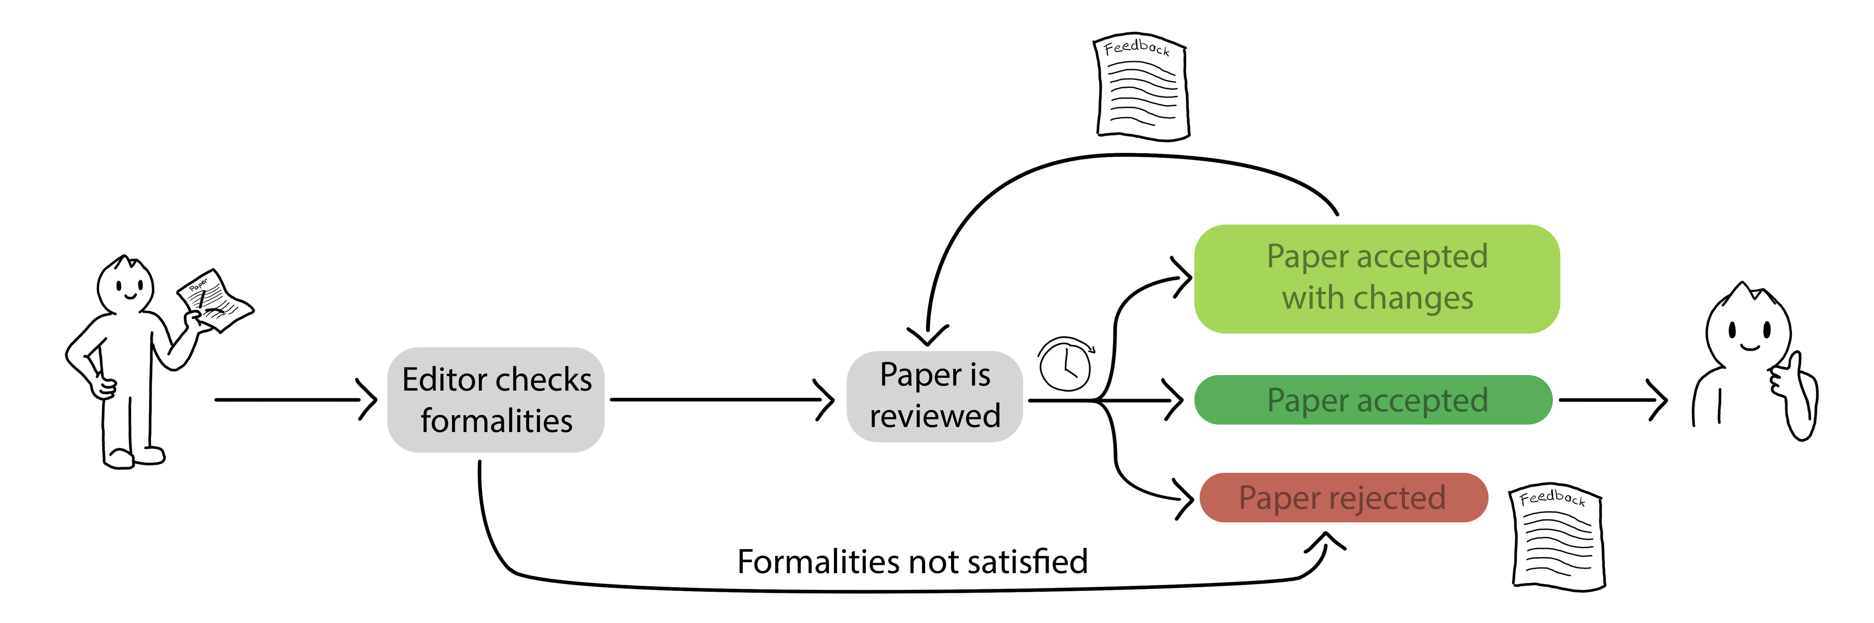
Peer Review
Peer review = scientific quality assurance
Paper evaluated by expert reviewers (peers)
Decision: acceptance or rejection
Based on defined review criteria
Low acceptance rates (≈10–60%)
Ensures journal quality
Provides valuable feedback
Revisions and resubmission often possible
Single-blind or
Double-blind
Template, header, length

Slide 21
Peer Review
Incorporate Feedback
Provide Feedback
Take breaks to evaluate feedback objectively
Criticism must be reviewed point by point
Not all reviewer suggestions must be accepted
Justify decisions when rejecting feedback
Peer review quality depends on reviewers
Evaluate papers carefully and objectively
Ensure scientific quality assurance
Provide constructive feedback to authors
Be specific (clearly describe issues)
Be direct (clear, concise wording)
Stay objective (critique arguments, not authors)
Use positive phrasing (focus on improvements)
Consider author perspective
Use the template
Critique aims to improve the paper, not discourage

Slide 22
Conclusion
Introduction to scientific writing
Key characteristics of scientific papers
Useful tools for different phases
Writing procedure
Paper Structure
Language
Writer‘s Block
Citing Properly
Peer Review

