Slide 1


From Zero to Binder!
The Turing Way
making Reproducible Data Science “too easy not to do”
Shamelessly copied from Tim Head’s amazing Zero-to-Binder workshops here: bit.ly/zero-to-binder and bit.ly/zero-to-binder-rise
Visit the Turing Way repo here: github.com/alan-turing-institute/the-turing-way

Slide 2
Running Code is More Complicated than Displaying Code
GitHub is a great service for sharing code
But the contents of a GitHub repository are static
How could you run a GitHub repository without installing complicated requirements? Or even in your browser?
To run code, you need:
Hardware on which to run the code
Software, including:
The code itself
The programming language (e.g. python, R)
Relevant packages (e.g. pandas, matplotlib, tidyverse, ggplot)

Slide 3
What Binder provides
Binder is a service that provides your code, the hardware, and the software
You can create a link to a live, interactive version of your code
An example binder link:
https://mybinder.org/v2/gh/trekhleb/homemade-machine-learning/master?filepath=notebooks%2Fanomaly_detection%2Fanomaly_detection_gaussian_demo.ipynb
From this repo: github.com/trekhleb/homemade-machine-learning
The Binder link has a similar structure the GitHub repo link!
The “filepath” argument opens a specific notebook in the repo!

Slide 4
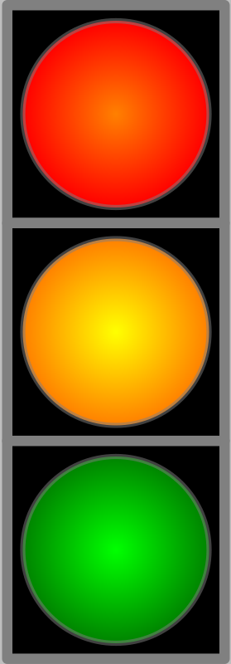

Creating a repo to Binderize
TO DO:
Create a new repo on GitHub called “my-first-binder”
Don’t forget to initialise with a README!!
Create a file called hello.py via the web interface with print(“Hello from Binder!”) on the first line and commit this straight to master
Bad practice but we’re not collaborating right now
“Binderize” → creating the instructions that Binder can understand to create the environment your code needs
This Photo by Unknown Author is licensed under CC BY-SA

Slide 5
Launch your first Repo!
TO DO:
Go to https://mybinder.org
Type the URL of your repo into the “GitHub repo or URL” box
Should look like: https://github.com/your-username/my-first-binder
As you type, the webpage generates a link in the “Copy the URL below…” box
Should look like: https://mybinder.org/v2/gh/your-username/my-first-binder/master
Copy it, open a new browser tab and visit that URL
You will see a “spinner” as binder launches the repo
Background Box!
While you wait, BinderHub is:
Fetching your repo from GitHub
Analysing the contents
Creating a Docker image
Launching that image in the Cloud
Connecting you to it via your browser

Slide 6
Run hello.py
If everything ran smoothly, you’ll see a Jupyter Notebook interface.
TO DO:
In the top right corner click “New” → “Terminal”
In the new tab with the terminal, type python hello.py and press return

Slide 7
Pinning Dependencies
It was easy to get started, but our environment is barebones – let’s add a dependency!
TO DO:
In your repo, create a file called requirements.txt
Add a line that says: numpy==1.14.5
Check for typos!
Visit https://mybinder.org/v2/gh/your-username/my-first-binder/master again in a new tab
This time, click on “Build Logs” in the big, horizontal, grey bar. This will let you watch the progress of your build. It’s useful when your build fails or something you think should be installed is missing.
Background Box!
This time, BinderHub will read requirements.txt and install version 1.14.5 of the numpy package

Slide 8
Check the Environment
TO DO:
In the top right corner of the Jupyter Notebook window, click “New” → “Python 3” to open a new Notebook
Type the following into a new cell:
Run the cell to see the version number and a random number printed out
Press either SHIFT+RETURN or the “Run” button in the Menu bar
import numpy
print(numpy.__version__)
numpy.random.randn()
← 2 underscores either side! “_”

Slide 9

Sharing your Work
Binder is all about sharing your work easily and there are two ways to do it:
Share the https://mybinder.org/v2/gh/your-username/my-first-binder/master URL directly
Visit https://mybinder.org, type in the URL of your repo, and copy the Markdown or Restructured Text snippet into your README. This snippet will render a badge that people can click.
TO DO:
Add the Markdown snippet from https://mybinder.org to the README.md file in your repo
The grey bar with a badge in it unfolds the snippets. Click the clipboard next to the box marked with an “m” to automatically copy the Markdown snippet.
Click the badge to make sure it works!

Slide 10
Beyond Notebooks…
JupyterLab is installed into your containerized repo by default.
You can access it by changing the URL you visit to:
https://mybinder.org/v2/gh/your-username/my-first-binder/master?urlpath=lab
Here you can access:
Notebooks
IPython consoles
Terminals
A text editor
If you use R, you can also open RStudio using ?urlpath=rstudio

