Slide 1


From Zero to Binder!
The Turing Way
making Reproducible Data Science “too easy not to do”
Shamelessly copied from Tim Head’s amazing Zero-to-Binder workshops here: bit.ly/zero-to-binder and bit.ly/zero-to-binder-rise
Visit the Turing Way repo here: github.com/alan-turing-institute/the-turing-way

Slide 2
Running Code is More Complicated than Displaying Code
GitHub is a great service for sharing code
But the contents of a GitHub repository are static
How could you run a GitHub repository without installing complicated requirements? Or even in your browser?
To run code, you need:
Hardware on which to run the code
Software, including:
The code itself
The programming language (e.g. python, R)
Relevant packages (e.g. pandas, matplotlib, tidyverse, ggplot)

Slide 3
What Binder provides
Binder is a service that provides your code, the hardware, and the software
You can create a link to a live, interactive version of your code
An example binder link:
https://mybinder.org/v2/gh/trekhleb/homemade-machine-learning/master?filepath=notebooks%2Fanomaly_detection%2Fanomaly_detection_gaussian_demo.ipynb
From this repo: github.com/trekhleb/homemade-machine-learning
The Binder link has a similar structure the GitHub repo link!
The “filepath” argument opens a specific notebook in the repo!

Slide 4
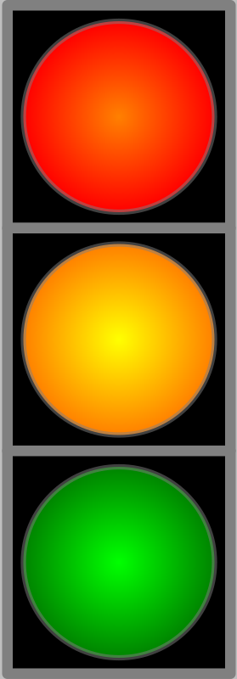

Creating a repo to Binderize
TO DO:
Create a new repo on GitHub called “my-first-binder”
Don’t forget to initialise with a README!!
Create a file called hello.py via the web interface with print(“Hello from Binder!”) on the first line and commit this straight to master
Bad practice but we’re not collaborating
“Binderize” → creating the instructions that Binder can understand to creating the environment your code needs
This Photo by Unknown Author is licensed under CC BY-SA

Slide 5
Launch your first Repo!
TO DO:
Go to https://mybinder.org
Type the URL of your repo into the “GitHub repo or URL” box
Should look like: https://github.com/your-username/my-first-binder
As you type, the webpage generates a link in the “Copy the URL below…” box
Should look like: https://mybinder.org/v2/gh/your-username/my-first-binder/master
Copy it, open a new browser tab and visit that URL
You will see a “spinner” as binder launches the repo
Background Box!
While you wait, BinderHub is:
Fetching your repo from GitHub
Analysing the contents
Creating a Docker image
Launching that image in the Cloud
Connecting you to it via your browser

