Slide 1
Change Name Pronunciation
Team – “The Whack Hack”
Hackathon - 2022

Slide 2
Contents
User Story
Design Approach
Tool Features (Demo)
Demo Video
Playback Book
Automated Test Suite & Coverage Report
Future
“The Whack Hack” - Team

Slide 3
User Story
Business Need
Employees and contingent workers come from an amazing diversity of backgrounds, and the variety of names withing the company is profound. Often, employees find themselves struggling with the pronunciation of names. What can we do to make it easier for employees to pronounce others’ names as the would like them to be pronounced, and for employees to let others know how they would like their names pronounced?
Challenge Scope
Tool will deliver a solution for phonetic pronunciation of names. The successful solution will enable Company’s employees to understand the pronunciation of people’s names in two ways:
Standard Pronunciation: Standard aural pronunciation.
Non-Standard Pronunciation: Override standard pronunciation and provide “custom”.

Slide 4
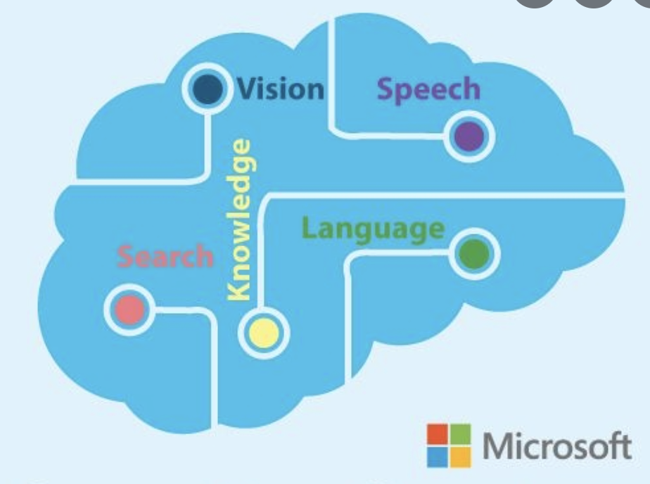



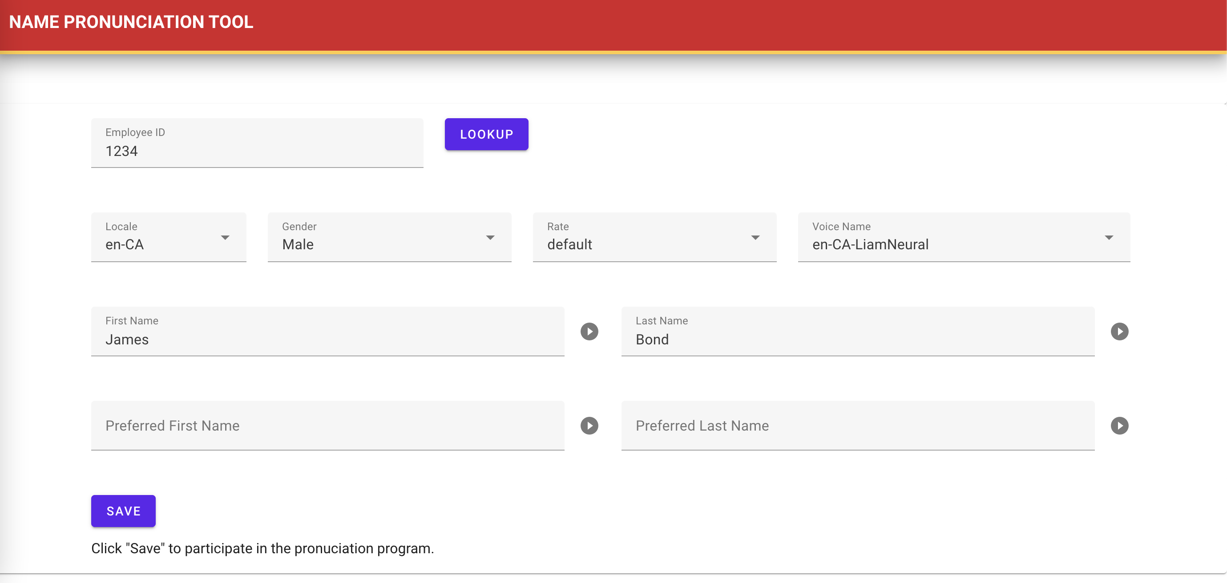
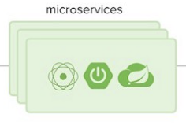




Design Approach
Block Diagram
Azure Speech Services (Azure Cognitive Services)
User
Azure App Service Configuration
UI – Interface
(Azure Static App Services)
MicroServices
(Azure App Services)

Slide 5
Design Approach (CONT.)
CODE (GIT REPOS)
UI STATIC CONTENT: [https://github.com/the-whack-hack-hackathon/name-pronunciation-static]
API SERVICE: [https://github.com/the-whack-hack-hackathon/name-pronunciation-tool]
TECHNOLOGY STACK
VUE JS
SPRINGBOOT MICROSERVICE (JAVA)
AZURE CLOUD – “SPEECH SERVICE (AZURE CONGNITIVE SERVICES)
YugabyetDB

Slide 6
Tool Features (Demo)
Standard Pronunciation for First Name and Last Name
Non-Standard Pronunciation (text-based phonetics) for First Name and Last Name
Employee ID Lookup
Pronunciation based on selected LOCALE
Pronunciation based on Gender (Male or Female)
Pronunciation based on Gender (Male or Female)
Pronunciation playback speed rate
Azure Neural based Voice Integration
Save preferred Pronunciation by Employee/User

Slide 7
Demo video
Click on Below URL
[ CLICK HERE TO PLAY IN BROWSER ]

Slide 8
Playback book
Deployment
Pre-Requisites
Azure Setup:
Azure Account Setup
Azure Resource Group Setup
Azure Network policy
Azure Access setup
Azure Cognitive Services Setup with Azure Resource Group
Azure API Authentication Service provider Secret
Azure API Subscription Key
YugabyteDB Setup
Credentials
Schema [ https://github.com/the-whack-hack-hackathon/name-pronunciation-tool/blob/main/create.sql ]
2 Azure App Services
Create 1 Azure App Services to provision as a “static” content web service
Create 1 Azure App Service to provision “SpringBoot” embedded tomcat-based service deployment
2 Git projects
”Static” Content project: Make “git workflow” module with a target server having details from above “static” content based Azure App Service and to be deployed “on-commit” from “main” branch of git project.
SpringBoot Service project: Make “git workflow” module with a target server having details from above “SpringBoot” content based Azure App Service and to be deployed “on-commit” from “main” branch of git project.
Externalize following Sustentive details in “App Service” Configuration of “SpringBoot” deployed Azure App Service
Azure Authentication Service Provider Secret (“MICROSOFT_PROVIDER_AUTHENTICATION_SECRET”)
Subscription Key (“SUBSCRIPTION_KEY”)
YugabyteDB Username (“YUGA_USERNAME”)
YugabyteDB Password (“YUGA_PASSWORD”)

Slide 9
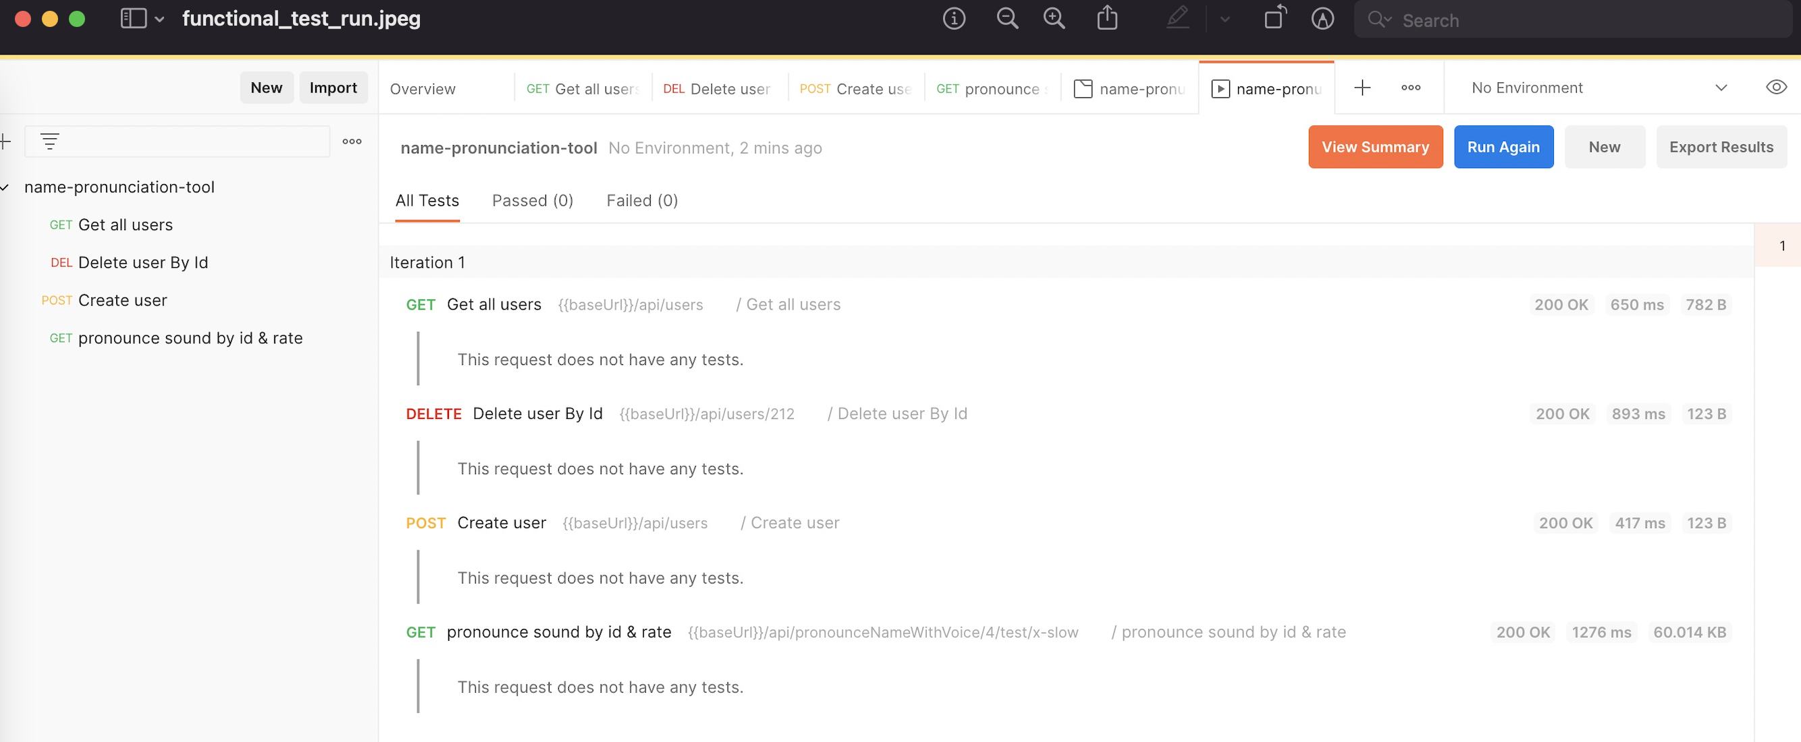
Automated Test Suite & coverage report
Postman Client Test Script: [ https://github.com/the-whack-hack-hackathon/name-pronunciation-tool/tree/main/documents/postman ]
Screenshot (Test Run)

Slide 10
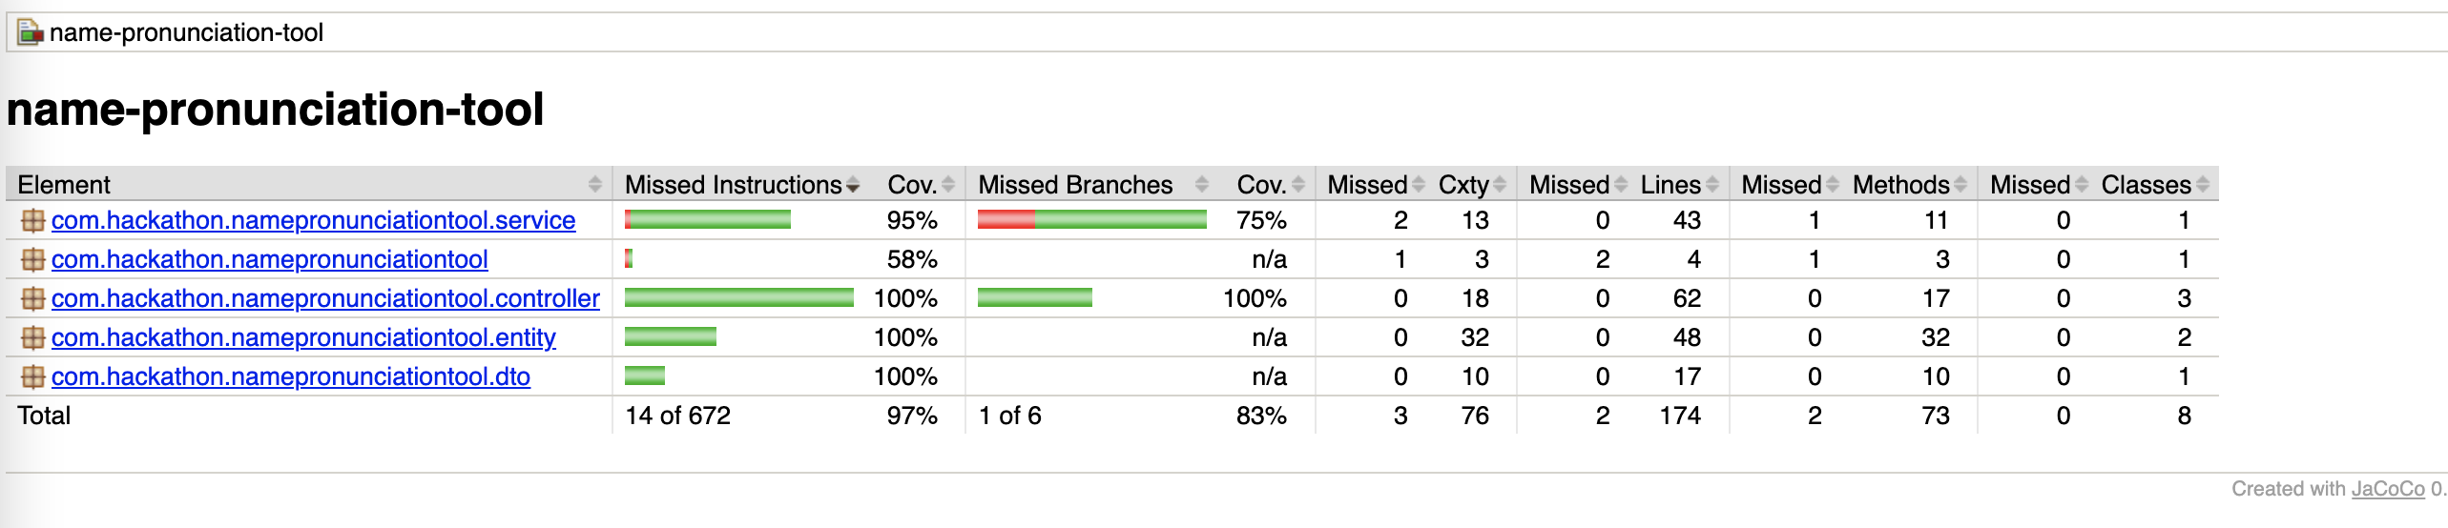
Automated Test Suite & coverage report (ConT.)
JACOCO Coverage Report
Report location: [ https://github.com/the-whack-hack-hackathon/name-pronunciation-tool/blob/main/documents/test-reports/jacoco/ ]
Screenshot

Slide 11
Future
Refactor
AD Service – RBAC Management
Key Management & Vault Service
Azure Resource Manager – Cloud infrastructure resources in a code.

Slide 12
The wHack hack - team
Srikanth B.
William C.
Laxma reddy E.
Bhasker M.
Durgaswamy S.
Abhay S.
Ashutosh B.

Slide 13
Thank You

