Slide 1
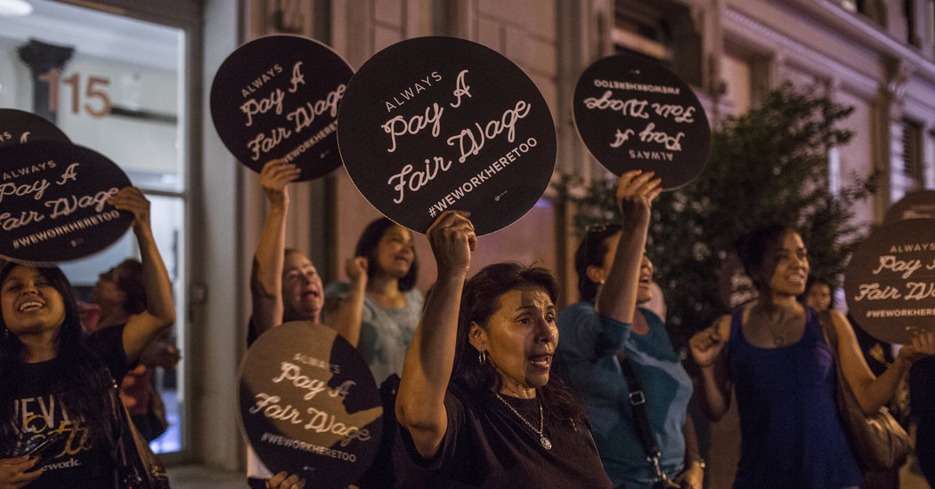
At WeWork, an Idealistic Start-Up Clashes With Its Cleaners
Xinghai Zhang

Slide 2
When the New York City cleaners — who made about $10 an hour and received no benefits or paid time off — tried to unionize in June, CBM terminated its contract with WeWork and eliminated the jobs.

Slide 3
WeWork decided to hire its own in-house cleaning staff but will not hire all the former CBM workers, leaving about 100 people jobless.

Slide 4
The cleaners said they had worn WeWork T-shirts, gotten to know the company’s staff and customers, and believed WeWork had a responsibility to them.

Slide 5
Neumann explained that WeWork was now hiring its own cleaners, paying them $15 to $18 an hour, and offering health care along with equity in the company.

Slide 6
“When I asked WeWork for more money, they told me to talk to CBM,” he said.

Slide 7
“When I asked CBM for more money, CBM said WeWork had to approve the raise.

Slide 8
But for now, a company like WeWork has no obligations to look out for the employees of a contractor like CBM.

Slide 9
When they began organizing this summer, CBM asked WeWork to change its contract in order to pay the cleaners higher wages and allow them to join a union — though a union of CBM’s choosing.

Slide 10
” CBM terminated its contract with WeWork.

Slide 11
WeWork said that it asked CBM to waive that restriction, but that CBM initially declined.

Slide 12
The local Service Employees International Union chapter, which has been working with the former WeWork cleaners, contends that WeWork intentionally avoided hiring former CBM workers so it could prevent pro-union cleaners from joining the company and trying to organize.

Slide 13
More than 500 WeWork members signed a petition demanding that the company hire the former CBM cleaners as community service associates.

Slide 14
The End
Thank You

