Slide 1
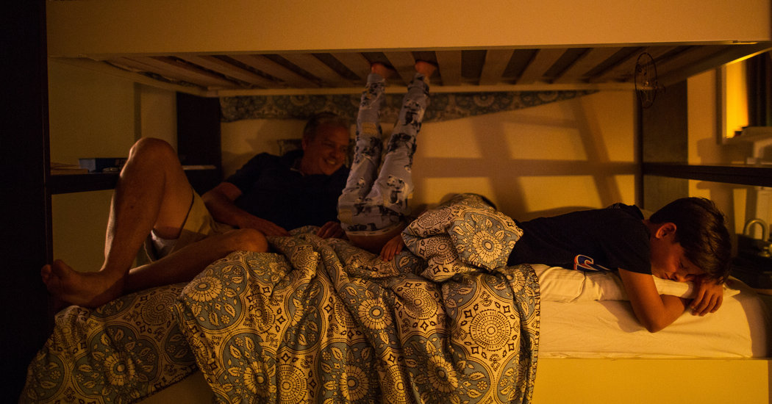
High-Tech Lights to Help Baby Sleep, or Students Stay Alert
Xinghai Zhang

Slide 2
But it is part of a technological revolution coming to homes, offices, hotels and schools through lighting designed to undo the ill effects of artificial light — both overhead and on screen — and help regulate sleep, alertness and even people’s moods.

Slide 3
The Lighting Science Group makes Sleepy Baby and is among the companies that are most devoted to the growing market for lighting to enhance rest or alertness, with bulbs like Good Night, and Awake and Alert.

Slide 4
“With these kinds of bulbs that are coming to the market, you can suddenly now put better lighting controls systems, very affordable, into the hands of everyone,” said Beatrice Witzgall, an architect and lighting designer who founded LumiFi.

Slide 5
The End
Thank You

