Slide 1
Tesseract OCR API Server
Using Python Flask

Slide 2


Assignment Overview
Objective
Develop a server using Python to run Tesseract OCR version 5.
Complete the APIs
APIs to Develop
get-text: Extracts the entire text from an image
get-bboxes: Extracts bounding boxes for types like ‘word’, ‘line’, ’paragraph’, ‘block’, or ‘page’.

Slide 3

Code Architecture
Flask Web Framework
Main Components
API Endpoints
Flask is a lightweight Python web framework that supports rapid development by offering tools, templates, and an easy-to-use routing system.
Image Decoding: `decode_base64_image()`
Text Extraction: `image_to_text()`
Bounding Box Extraction: `image_to_bboxes()`
API Endpoints:
`/api/get-text`
`/api/get-bboxes`

Slide 4
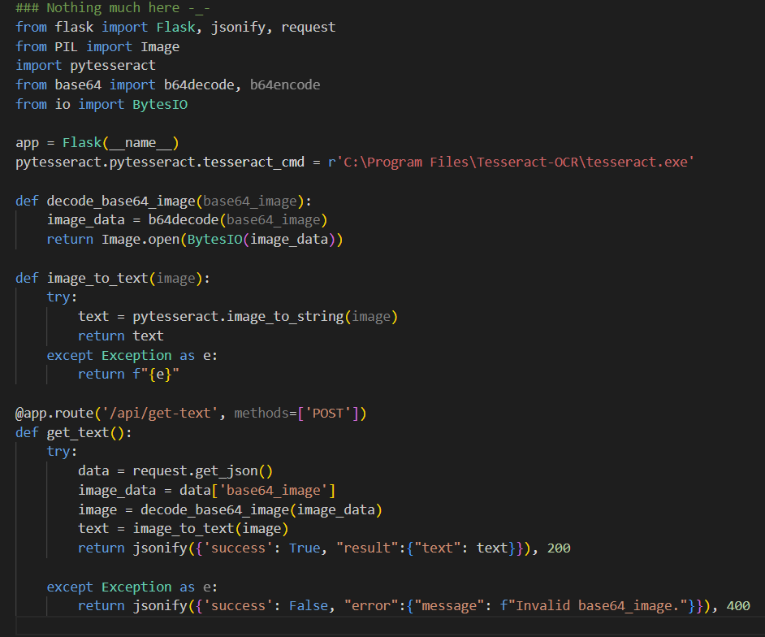
Describing tesseract.py

Slide 5
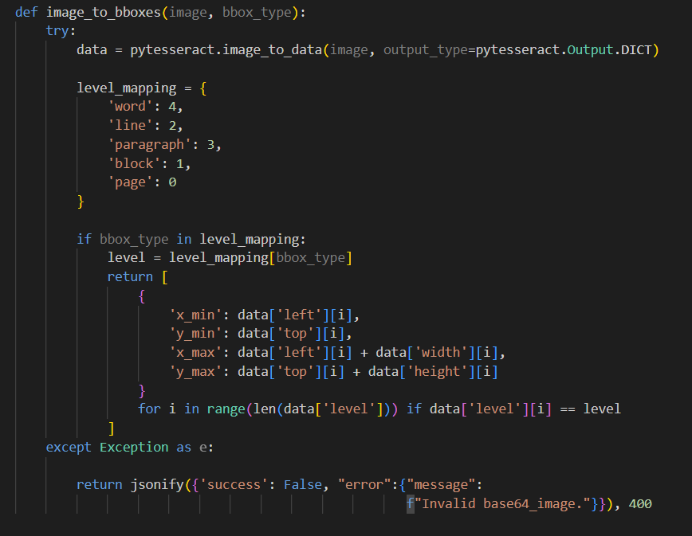
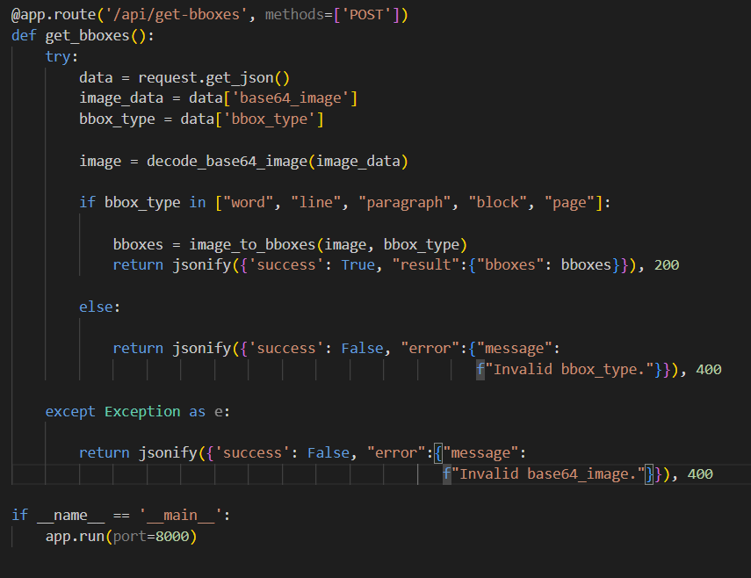

Slide 6
Testing APIs
1
2
3
Clone the Repository
Start the Flask Server
API Calling
Clone the repository from
https://github.com/the-y9/tesseract-ocr-api/blob/main/tesseract.py
The server will start by running the file `tesseract.py`.
Open the browser and call the APIs with request structure described

Slide 7
Additional Notes
Verify Tesseract OCR is correctly installed on your system
Be sure that the dependencies are installed correctly
Update the path in the code as necessary

Slide 8
Thank you.

